Slide 1


COMPUTER SCIENCE
S E D G E W I C K / W A Y N E
PA R T I : P R O G R A M M I N G I N JAVA
_{C}omputer
5. Functions and Libraries
_{S}cience
An Interdisciplinary Approach
2.1–2.2
R O B E R T S E D G E W I C K
KEVIN W A YNE
http:// introcs.cs.princeton.edu

Slide 2

COMPUTER SCIENCE
S E D G E W I C K / W A Y N E
PA R T I : P R O G R A M M I N G I N JAVA
Functions and Libraries
Basic concepts
Case study: Digital audio
Application: Gaussian distribution
Modular programming and libraries
CS.5.A.Functions.Basics

Slide 3

Context: basic building blocks for programming
any program you might want to write
objects
functions and libraries
functions and libraries
graphics, sound, and image I/O
arrays
This lecture:
Reuse code to build big programs from small pieces
conditionals and loops
conditionals and loops
Math
text I/O
primitive data types
assignment statements

Slide 4

Functions, libraries, and modules
Modular programming
Organize programs as independent modules that do a job together.
Why? Easier to share and reuse code to build bigger programs.
Facts of life
Support of modular programming has been a holy grail for decades.
Ideas can conflict and get highly technical in the real world.
Def. A library is a set of functions.
Def. A module is a .java file.
for purposes of this lecture
for purposes of this course
For now. Libraries and modules are the same thing: .java files containing sets of functions.
Later. Modules implement data types (stay tuned).

Slide 5



Functions (static methods)
Java function ("aka static method")
Takes zero or more input arguments.
Returns zero or one output value.
May cause side effects (e.g., output to standard draw).
input x
Java functions are more general than mathematical functions
side effects
function f
Applications
Scientists use mathematical functions to calculate formulas.
Programmers use functions to build modular programs.
You use functions for both.
output f (x)
Examples seen so far
Built-in functions: Math.random(), Math.abs(), Integer.parseInt().
Our I/O libraries: StdIn.readInt(), StdDraw.line(), StdAudio.play().
User-defined functions: main().

Slide 6

Anatomy of a Java static method
To implement a function (static method)
Create a name.
Declare type and name of argument(s).
Specify type for return value.
Implement body of method.
Finish with return statement.
return type
argument declarations
method name
the method’s signature
public static double sqrt(double c, double eps)
{
if (c < 0) return Double.NaN; double t = c;
while (Math.abs(t - c/t) > eps * t) t = (c/t + t) / 2.0;
body of sqrt()
return statement
return t;
}

Slide 7

Anatomy of a Java library
A library is a set of functions.
public class Newton
{
library/module name
public static double sqrt(double c, double eps)
{
if (c < 0) return Double.NaN; double t = c;
while (Math.abs(t - c/t) > eps * t)
Note: We are using our sqrt() from Lecture 2 here to illustrate the basics with a familiar function.
sqrt() method
t = (c/t + t) / 2.0; return t;
}
Our focus is on control flow here. See Lecture 2 for technical details.
module named
Newton.java
public static void main(String[] args)
{
double[] a = new double[args.length]; for (int i = 0; i < args.length; i++)
a[i] = Double.parseDouble(args[i]);
for (int i = 0; i < a.length; i++) StdOut.println(sqrt(a[i], 1e-3));
}
You can use Math.sqrt().
main() method
}
Key point. Functions provide a new way to control the flow of execution.

Slide 8




Scope
Def. The scope of a variable is the code that can refer to it by name.
public class Newton
{
public static double sqrt(double c, double eps)
{
scope of c and eps
if (c < 0) return Double.NaN;
scope of t
double t = c;
while (Math.abs(t - c/t) t = (c/t + t) / 2.0;
return t;
In a Java library, a variable’s scope is the code following its declaration, in the same block.
> eps * t)
cannot refer to
a or i in this code
}
public static void main(String[] args)
{
scope of a
double[] a = new double[args.length]; for (int i = 0; i < args.length; i++)
a[i] = Double.parseDouble(args[i]);
two different variables named i each with scope limited to a single for loop
for (int i = 0; i < a.length; i++)
StdOut.println(sqrt(a[i], 1e-3));
}
cannot refer to
c, eps, or t in this code
}
Best practice. Declare variables so as to limit their scope.

Slide 9

Flow of control
public class Newton
{
public static double sqrt(double c, double eps)
{
if (c < 0) return Double.NaN; double t = c;
while (Math.abs(t - c/t) > eps * t) t = (c/t + t) / 2.0;
return t;
}
public static void main(String[] args)
{
double[] a = new double[args.length]; for (int i = 0; i < args.length; i++)
a[i] = Double.parseDouble(args[i]); for (int i = 0; i < a.length; i++)
{
double x = sqrt(a[i], 1e-3); StdOut.println(x);
}
}
}
Summary of flow control for a function call
Control transfers to the function code.
Argument variables are declared and initialized with the given values.
Function code is executed.
Control transfers back to the calling code (with return value assigned in place of the function name in the calling code).
“pass by value”
(other methods used in other systems)
Note. OS calls main() on java command

Slide 10


Function call flow of control trace
public class Newton
{
public static double sqrt(double c, double eps)
{
if (c < 0) return Double.NaN; double t = c;
while (Math.abs(t - c/t) > eps * t) t = (c/t + t) / 2.0;
return t;
}
public static void main(String[] args)
{
double[] a = new double[args.length];
t
c
c
t
3.0
3.0
2.0 2.0
1.5
1.417
1.414
2.0
1.75
c t
1.0 1.0
1.732
i
a[i]
x
i
a[i]
0
1.0
1.000
for (int i = 0; i < args.length; i++)
a[i] = Double.parseDouble(args[i]);
0
1.0
1
2.0
1.414
for (int i = 0; i < a.length; i++)
1
2.0
2
3.0
1.732
{
2
3.0
double x = sqrt(a[i], 1e-3);
3
StdOut.println(x);
}
% java Newton 1 2 3
}
1.000
1.414
1.732
}

Slide 11

Pop quiz 1a on functions
Q. What happens when you compile and run the following code?
public class PQfunctions1a
{
public static int cube(int i)
{
int j = i * i * i; return j;
}
public static void main(String[] args)
{
int N = Integer.parseInt(args[0]); for (int i = 1; i <= N; i++)
StdOut.println(i + " " + cube(i));
}
}

Slide 12

Pop quiz 1a on functions
Q. What happens when you compile and run the following code?
public class PQfunctions1a
{
public static int cube(int i)
{
int j = i * i * i; return j;
}
public static void main(String[] args)
{
int N = Integer.parseInt(args[0]); for (int i = 1; i <= N; i++)
StdOut.println(i + " " + cube(i));
}
}
A. Takes N from the command line, then prints cubes of integers from 1 to N
% javac PQfunctions1a.java
% java PQfunctions1a 6
1 1
2 8
3 27
4 64
5 125
6 216

Slide 13

Pop quiz 1b on functions
Q. What happens when you compile and run the following code?
public class PQfunctions1b
{
public static int cube(int i)
{
}
public static void main(String[] args)
{
int N = Integer.parseInt(args[0]); for (int i = 1; i <= N; i++)
StdOut.println(i + " " + cube(i));
}
}
int i = i * i * i;
return i;

Slide 14

Pop quiz 1b on functions
Q. What happens when you compile and run the following code?
public class PQfunctions1b
{
public static int cube( int i )
{
int i = i * i * i; return i;
}
public static void main(String[] args)
{
int N = Integer.parseInt(args[0]); for (int i = 1; i <= N; i++)
StdOut.println(i + " " + cube(i));
}
}
A. Won't compile. Argument variable i is declared and initialized for function block, so the name cannot be reused.
% javac PQfunctions1b.java
PQfunctions1b.java:5: i is already defined in cube(int) int i = i * i * i;
^
1 error

Slide 15

Pop quiz 1c on functions
Q. What happens when you compile and run the following code?
public class PQfunctions1c
{
public static int cube(int i)
{
}
public static void main(String[] args)
{
int N = Integer.parseInt(args[0]); for (int i = 1; i <= N; i++)
StdOut.println(i + " " + cube(i));
}
}
i = i * i * i;

Slide 16

Pop quiz 1c on functions
Q. What happens when you compile and run the following code?
public class PQ6_1c
{
public static int cube(int i)
{
}
public static void main(String[] args)
{
int N = Integer.parseInt(args[0]); for (int i = 1; i <= N; i++)
StdOut.println(i + " " + cube(i));
}
}
A. Won't compile. Need return statement.
i = i * i * i;
% javac PQfunctions1c.java PQfunctions1c.java:6: missing return statement
}
^
1 error

Slide 17
Pop quiz 1d on functions
Q. What happens when you compile and run the following code?
public class PQfunctions1d
{
public static int cube(int i)
{
}
public static void main(String[] args)
{
int N = Integer.parseInt(args[0]); for (int i = 1; i <= N; i++)
StdOut.println(i + " " + cube(i));
}
}
i = i * i * i;
return i;

Slide 18

Pop quiz 1d on functions
Q. What happens when you compile and run the following code?
public class PQfunctions1d
{
public static int cube(int i)
{
i = i * i * i; return i;
}
public static void main(String[] args)
{
int N = Integer.parseInt(args[0]); for (int i = 1; i <= N; i++)
StdOut.println(i + " " + cube(i));
}
}
A. Works. The i in cube() is
Declared and initialized as an argument.
Different from the i in main().
BUT changing values of function arguments is sufficiently confusing to be deemed bad style for this course.
% % | javac PQfunctions1d.java java PQfunctions1d 6
1 | 1
2 | 8
3 | 27
4 | 64
5 | 125
6 | 216

Slide 19
Pop quiz 1e on functions
Q. What happens when you compile and run the following code?
public class PQfunctions1e
{
public static int cube(int i)
{
}
public static void main(String[] args)
{
int N = Integer.parseInt(args[0]); for (int i = 1; i <= N; i++)
StdOut.println(i + " " + cube(i));
}
}
return i * i * i;

Slide 20

Pop quiz 1e on functions
Q. What happens when you compile and run the following code?
public class PQfunctions1e
{
public static int cube(int i)
{
return i * i * i;
}
public static void main(String[] args)
{
int N = Integer.parseInt(args[0]); for (int i = 1; i <= N; i++)
StdOut.println(i + " " + cube(i));
}
}
A. Works fine. Preferred (compact) code.
% javac PQfunctions1e.java
% java PQfunctions1e 6
1 1
2 8
3 27
4 64
5 125
6 216

Slide 21
COMPUTER SCIENCE
S E D G E W I C K / W A Y N E
PA R T I : P R O G R A M M I N G I N JAVA
Image sources
http://upload.wikimedia.org/wikipedia/commons/b/ba/Working_Together_Teamwork_Puzzle_Concept.jpg http://pixabay.com/en/ball-puzzle-pieces-of-the-puzzle-72374/ http://upload.wikimedia.org/wikipedia/commons/e/ef/Ben_Jigsaw_Puzzle_Puzzle_Puzzle.png http://en.wikipedia.org/wiki/Function_(mathematics)#mediaviewer/File:Function_machine2.svg
CS.5.A.Functions.Basics

Slide 22
COMPUTER SCIENCE
S E D G E W I C K / W A Y N E
PA R T I : P R O G R A M M I N G I N JAVA
Functions and Libraries
Basic concepts
Case study: Digital audio
Application: Gaussian distribution
Modular programming
CS.5.B.Functions.Audio

Slide 23
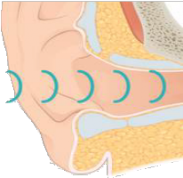




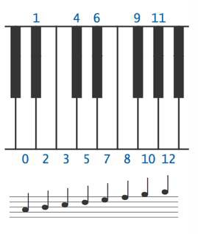
Crash course in sound
Sound is the perception of the vibration of molecules.
A musical tone is a steady periodic sound.
A pure tone is a sinusoidal waveform.
Western musical scale Concert A is 440 Hz. 12 notes, logarithmic scale. | pitch |  | i | frequency (440*2^{i/12}) |  | sinusodial waveform
 | A |  | 0 | 440
 | A♯ / B♭ |  | 1 | 466.16
 | B |  | 2 | 493.88
 | C |  | 3 | 523.25
 | C♯ / D♭ |  | 4 | 554.37
 | D |  | 5 | 587.33
 | D♯ / E♭ |  | 6 | 622.25
 | E |  | 7 | 659.26
 | F |  | 8 | 698.46
 | F♯ / G♭ |  | 9 | 739.99
 | G |  | 10 | 783.99
 | G♯ / A♭ |  | 11 | 830.61
 | A |  | 12 | 880

Slide 24
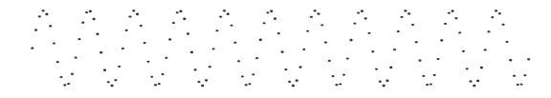
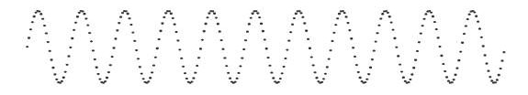
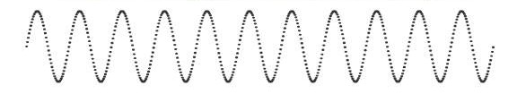
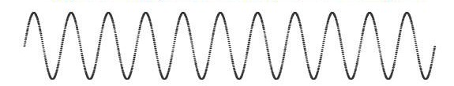
Digital audio
To represent a wave, sample at regular intervals and save the values in an array.
same as when plotting a function (previous lecture)
samples/sec
samples
sampled waveform
1/40 second of concert A
5,512
137
11,025
275
22,050
551
1102
CD standard
44,100
Bottom line. You can write programs to manipulate sound (arrays of double values).

Slide 25

StdAudio library
Developed for this course, also broadly useful
Play a sound wave (array of double values) on your computer’s audio output.
Convert to and from standard .wav file format.
Computer
_{S}cience
An Interdisciplinary Approach
R O B E R T S E D G E W I C K
KEVIN W A YNE
public class StdAudio
void play(String file) | play the given .wav file
void play(double[] a) | play the given sound wave
void play(double x) | play the sample for 1/44100 second
void save(String file, double[] a) | save to a .wav file
double[] read(String file) | read from a .wav file
API
Enables you to hear the results of your programs that manipulate sound.
25

Slide 26












“Hello, World” for StdAudio
public class PlayThatNote
{
pitch
2πi · hz
44100
public static double[] tone(double hz, double duration)
{
int N = (int) (44100 * duration); double[] a = new double[N+1];
for (int i = 0; i <= N; i++)
a[i] = Math.sin(2 * Math.PI * i * hz / 44100); return a;
}
public static void main(String[] args)
{
double hz = Double.parseDouble(args[0]); double duration = Double.parseDouble(args[1]); double[] a = tone(hz, duration); StdAudio.play(a);
}
sin
i
% java PlayThatNote 440.0 3.0
% java PlayThatNote 880.0 3.0
% java PlayThatNote 220.0 3.0
}
% java PlayThatNote 494.0 3.0

Slide 27






Play that tune
Read a list of tones and durations from standard input to play a tune.
public class PlayThatTune
{
public static void main(String[] args)
{
% more < elise.txt
7 .125
6 .125
7 .125
6 .125
7 .125
2 .125
5 .125
3 .125
0 .25
...
control tempo from command line
double tempo = Double.parseDouble(args[0]); while (!StdIn.isEmpty())
{
int pitch = StdIn.readInt();
double duration = StdIn.readDouble() * tempo; double hz = 440 * Math.pow(2, pitch / 12.0); double[] a = PlayThatNote.tone(hz, duration); StdAudio.play(a);
}
StdAudio.close();
A B C D E F G A
% java PlayThatTune 2.0 < elise.txt
7 6 7 6 7 2 5 3 0
}
}
% java PlayThatTune 1.0 < elise.txt

Slide 28
Pop quiz 2 on functions
Q. What sound does the following program produce?
public class PQfunctions2
{
public static void main(String[] args)
{
int N = (int) (44100 * 11); double[] a = new double[N+1]; for (int i = 0; i <= N; i++)
a[i] = Math.random(); StdAudio.play(a);
}
}

Slide 29

Pop quiz 2 on functions
Q. What sound does the following program produce?
public class PQfunctions2
{
public static void main(String[] args)
{
int N = (int) (44100 * 11.0); double[] a = new double[N+1]; for (int i = 0; i <= N; i++)
a[i] = Math.random(); StdAudio.play(a);
}
}
A. 11 seconds of pure noise.
% java PQfunctions2.java

Slide 30

Play that chord
Produce chords by averaging waveforms.
a
a[i]
public static double[] avg(double[] a, double[] b)
{
double[] c = new double[a.length]; for (int i = 0; i < a.length; i++)
c[i] = a[i]/2.0 + b[i]/2.0; return c;
}
b[i]
b
c
a[i]/2.0 + b[i]/2.0
all values stay between 0 and 1
i

Slide 31


Play that chord implementation
public class PlayThatChord
{
public static double[] avg(double[] a, double[] b)
{ /* See previous slide. */ }
public static double[] chord(int pitch1, int pitch2, double d)
{
double hz1 = 440.0 * Math.pow(2, pitch1 / 12.0); double hz2 = 440.0 * Math.pow(2, pitch2 / 12.0); double[] a = PlayThatNote.tone(hz1, d);
double[] b = PlayThatNote.tone(hz2, d); return avg(a, b);
}
A B C D E F G A
public static void main(String[] args)
{
% java PlayThatChord 0 3 5.0
int pitch1 = Integer.parseInt(args[0]); int pitch2 = Integer.parseInt(args[1]);
double duration = Double.parseDouble(args[2]);
double[] a = chord(pitch1, pitch2, duration); StdAudio.play(a);
% java PlayThatChord 0 12 5.0
}
}

Slide 32





Play that tune (deluxe version)
Add harmonics to PlayThatTune to produce a more realistic sound.
Function to add harmonics to a tone
half frequency
lo
public static double[] note(int pitch, double duration)
{
double hz = 440.0 * Math.pow(2, pitch / 12.0); double[] a = tone(1.0 * hz, duration); double[] hi = tone(2.0 * hz, duration); double[] lo = tone(0.5 * hz, duration); double[] harmonic = sum(hi, lo);
return avg(a, harmonic);
}
double frequency
hi
both harmonics
harmonic
pure pitch
a
result
% java PlayThatTune 1.5 < elise.txt
Program 2.1.4 in text (with tempo added)
avg(a, harmonic)

Slide 33
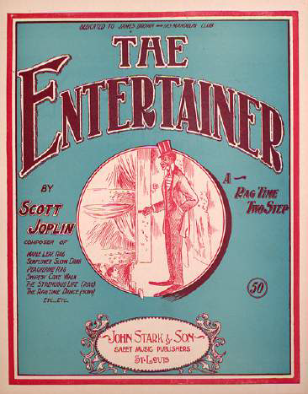
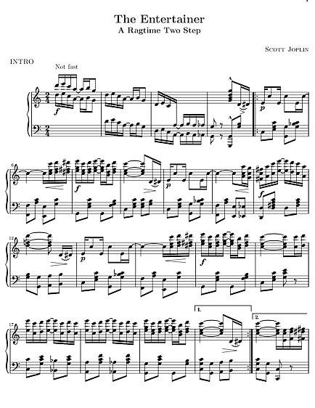
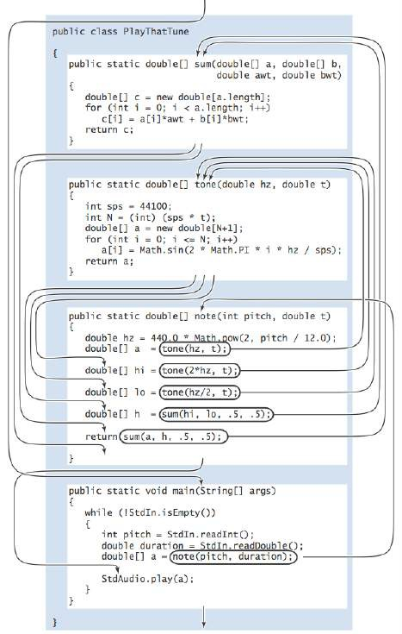

Digital audio (summary)
avg
% java PlayThatTune 1.5 < entertainer.txt
Bottom line. You can write programs to manipulate sound.
This lecture: Case study of the utility of functions. Upcoming assignment: Fun with musical tones.

Slide 34
COMPUTER SCIENCE
S E D G E W I C K / W A Y N E
PA R T I : P R O G R A M M I N G I N JAVA
Image sources
http://commons.wikimedia.org/wiki/File:1405_Sound_Waves_and_the_Ear.jpg http://en.wikipedia.org/wiki/The_Entertainer_(rag)#mediaviewer/File:EntertainerJoplinCover.JPEG http://cantorion.org/music/497/The-Entertainer-Original-version
CS.5.B.Functions.Audio

Slide 35
COMPUTER SCIENCE
S E D G E W I C K / W A Y N E
PA R T I : P R O G R A M M I N G I N JAVA
Functions and Libraries
Basic concepts
Case study: Digital audio
Application: Gaussian distribution
Modular programming
CS.5.C.Functions.Gaussian

Slide 36
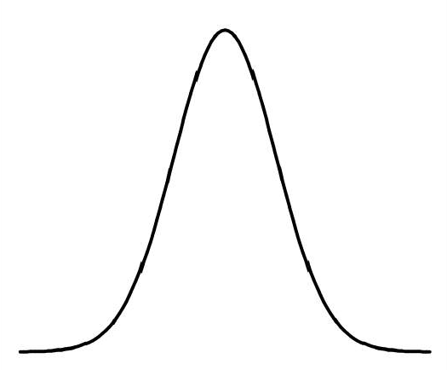
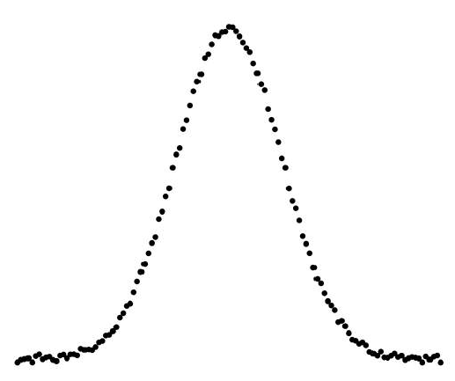
Gaussian distribution
Gaussian distribution.
A mathematical model used successfully for centuries.
"Bell curve" fits experimental observations in many contexts.
Gaussian probability density function (pdf) Example: SAT scores in 20xx (verbal + math)
0.4
1
.0191
cp(x)=
_{e}-x² /2
1
2 2
^{j}2r
cp(x, µ, a) = ✓ e
-(x-µ) /(2(j )
0.3
.0143
a 2
=
1 x
µ
a
cp
a
0.2
.0095
0.1
mean (μ): 0
stddev (σ): 1
.0047
mean (μ): 1019
stddev (σ): 209
0
0
−4 −3 −2 −1 0
1
2
3
4
601
1019
1437

Slide 37
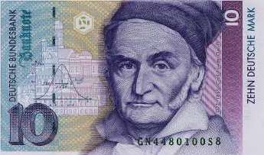
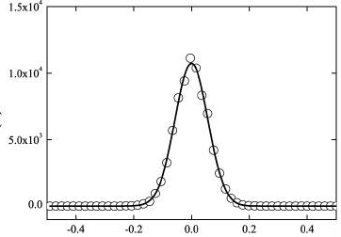
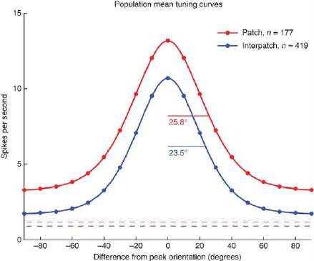
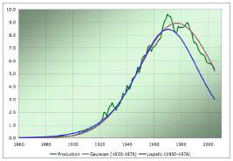
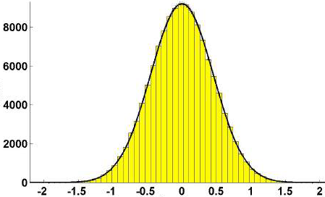
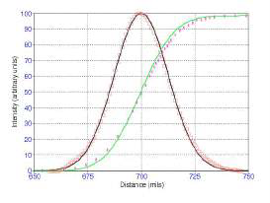
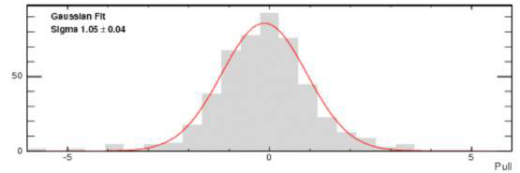
Gaussian distribution in the wild
German money
Polystyrene particles in glycerol
Cytochrome oxidase patches
in macaque primary visual cortex
Predicted US oil production
Calibration of optical tweezers
Laser beam propagation
Polarized W bosons from top-quark decay

Slide 38


Defining a library of functions
Q. Is the Gaussian pdf Φ implemented in Java's Math library?
A. No.
Q. Why not?
A. Maybe because it is so easy for you to do it yourself.
public class Gaussian
{
public static double pdf(double x)
call a function in another module
1
_{e}-
x² /2
{
cp(x)=
;2rc
return Math.exp(-x*x / 2) / Math.sqrt(2 * Math.PI);
}
public static double pdf(double x, double mu, double sigma)
module named
Gaussian.java
x µ
{
¢(x, µ, er)= ¢
return pdf((x - mu) / sigma) / sigma;
er
er
}
functions with different signatures are different (even if names match)
// Stay tuned for more functions.
}
Functions and libraries provide an easy way for any user to extend the Java system.

Slide 39
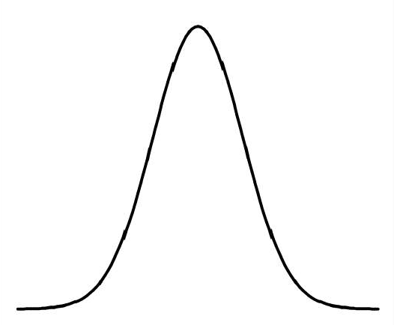
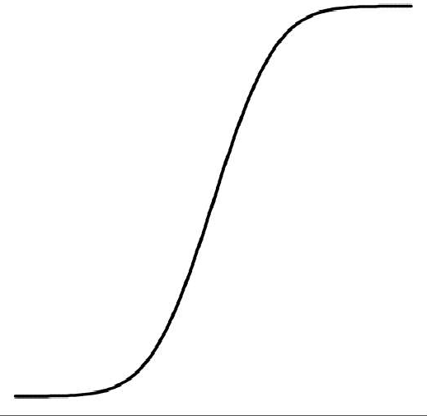
Gaussian cumulative distribution function
Q. What percentage of the total is less than or equal to z?
Q. (equivalent). What is the area under the curve to the left of z?
A. Gaussian cumulative distribution function.
(_, µ, er)=
_ µ
er
Gaussian probability density function (pdf)
Gaussian cumulative distribution function (cdf)
0.4
1
1.0
cp(x)=
_{e}-x² /2
^{j}2r
0.3
0.75
0.2
0.5
-
1 _{r}
(r)= :
--: /:
0.1
0.25
L K-
-oo
0
0
−4 −3 −2 −1 0
1
2
3
4
−4 −3 −2 −1 0
1
2
3
4
z
z
39

Slide 40
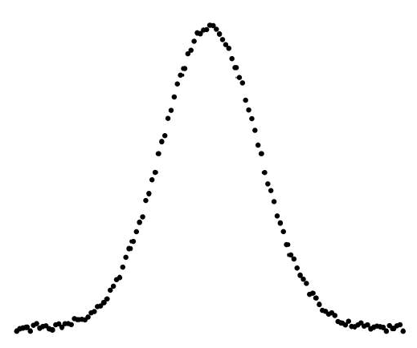
Typical application: SAT scores
Q. In 20xx NCAA required at least 820 for Division I athletes. What fraction of test takers did not qualify??
A. About 17%, since Φ(820, 1019, 209) = 0.17050966869132111...
.0191
1.0
.0143
0.75
.0095
0.5
.0047
0.25
0
0
601
1019
1437
601
1019
1437
820
820
40

Slide 41

Gaussian CDF implementation
Q. No closed form for Gaussian CDF Φ. How to implement?
_{z}
_{z z}3 _{z}5 _{z}7
⁺ 3 ⁺ 3 · 5 ⁺ 3 · 5 · 7 ^{+ .. .}
A. Use Taylor series. (z) ¢(x)dx = ₂ + ¢(z)
-oo
public static double cdf(double z)
{
if (z < -8.0) return 0.0;
if (z > 8.0) return 1.0; double sum = 0.0, term = z;
for (int i = 3; sum + term != sum; i += 2)
{
sum = sum + term;
term = term * z * z / i;
}
return 0.5 + sum * pdf(z); accurate to 15 places
}
public static double cdf(double z, double mu, double sigma)
{ return cdf((z - mu) / sigma); }
Bottom line. 1,000 years of mathematical formulas at your fingertips.

Slide 42


Summary: a library for Gaussian distribution functions
Best practice
Test all code at least once in main().
Also have it do something useful.
public class Gaussian
{
public static double pdf(double x)
{ return Math.exp(-x*x / 2) / Math.sqrt(2 * Math.PI); }
public static double pdf(double x, double mu, double sigma)
{ return pdf((x - mu) / sigma) / sigma; }
public static double cdf(double z)
{
if (z < -8.0) return 0.0;
if (z > 8.0) return 1.0; double sum = 0.0, term = z;
for (int i = 3; sum + term != sum; i += 2)
{
sum = sum + term;
term = term * z * z / i;
}
return 0.5 + sum * pdf(z);
}
public static double cdf(double z, double mu, double sigma)
{ return cdf((z - mu) / sigma); }
}
Q. What fraction of SAT test takers did not qualify for NCAA participation in 20xx?
% java Gaussian 820 1019 209
0.17050966869132111
Fun fact
We use cdf() to evaluate randomness in submitted programs.
public static void main(String[] args)
{
double z = Double.parseDouble(args[0]); double mu = Double.parseDouble(args[1]); double sigma = Double.parseDouble(args[2]); StdOut.println(cdf(z, mu, sigma));
}
Bottom line
YOU can build a layer of abstraction to use in any future program.

Slide 43


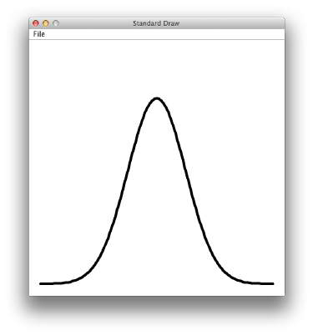

Using a library
To use these methods in another program
Put a copy of Gaussian.java in your working directory.
Learn to use your OS "classpath" mechanism if you find yourself with too many copies.
Call Gaussian.pdf() or Gaussian.cdf() from any other module in that directory.
Example. Draw a plot of cp(x, o, 1) in (−4, 4)
public class GaussianPlot
{
public static void main(String[] args)
{
int N = Integer.parseInt(args[0]); StdDraw.setXscale(-4.0, +4.0);
StdDraw.setYscale(0, .5); StdDraw.setPenRadius(0.01); double[] x = new double[N+1]; double[] y = new double[N+1]; for (int i = 0; i <= N; i++)
{
x[i] = -4.0 + 8.0 * i / N;
}
for (int i = 0; i < N; i++) StdDraw.line(x[i], y[i], x[i+1], y[i+1]);
}
}
% java GaussianPlot 200
y[i] = Gaussian.pdf(x[i]);
Libraries of functions provide an easy way for any user (you) to extend the Java system.

Slide 44
COMPUTER SCIENCE
S E D G E W I C K / W A Y N E
PA R T I : P R O G R A M M I N G I N JAVA
Image sources
http://www.intechopen.com/books/rheology-new-concepts-applications-and-methods/ a-practical-review-of-microrheological-techniques
http://tweezpal.natan.si http://www.albartlett.org/articles/art2000jan.html http://laser.physics.sunysb.edu/~vwang/beam-propagation/ http://www.nature.com/neuro/journal/v14/n12/full/nn.2958.html http://www-cdf.fnal.gov/physics/new/top/2012/WHel9ifb/
http://en.wikipedia.org/wiki/Deutsche_Mark#mediaviewer/File:DEU-10m-anv.jpg
CS.5.C.Functions.Gaussian

Slide 45
COMPUTER SCIENCE
S E D G E W I C K / W A Y N E
PA R T I : P R O G R A M M I N G I N JAVA
Functions and Libraries
Basic concepts
Case study: Digital audio
Application: Gaussian distribution
Modular programming
CS.5.D.Functions.Modular

Slide 46


Fundamental abstractions for modular programming
Client
API
Implementation
Client
Module that calls a library's methods.
Applications programming interface (API) Defines signatures, describes methods.
Implementation Module containing library's Java code.
public class Gaussian
{
public static double pdf(double x)
{
double val = Math.exp(-x*x / 2); val /= Math.sqrt(2 * Math.PI); return val
}
...
}
public class Gaussian
double pdf(double x) | Gaussian probability density function
double cdf(double x) | Gaussian cumulative distribution function
public class GaussianPlot
{
...
...
}
y[i] = Gaussian.pdf(x[i]);

Slide 47
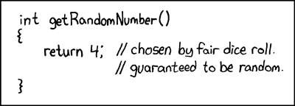
Example: StdRandom library
Developed for this course, but broadly useful
Implement methods for generating random numbers of various types.
Available for download at booksite (and included in introcs software).
Computer
_{S}cience
An Interdisciplinary Approach
R O B E R T S E D G E W I C K
KEVIN W A YNE
public class StdRandom
int uniform(int N) | integer between 0 and N-1
double uniform(double lo, double hi) | real between lo and hi
booean bernoulli(double p) | true with probability p
double gaussian() | normal with mean 0, stddev 1
double gaussian(double m, double s) | normal with mean m, stddev s
int discrete(double[] a) | i with probability a[i]
void shuffle(double[] a) | randomly shuffle the array a[]
API
First step in developing a library: Articulate the API!

Slide 48


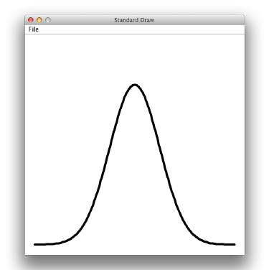
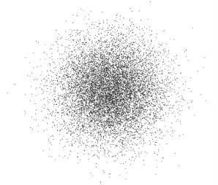

StdRandom details
Implementation
public class StdRandom
{
public static double uniform(double a, double b)
{ return a + Math.random() * (b-a); }
public static int uniform(int N)
{ return (int) (Math.random() * N); }
public static boolean bernoulli(double p)
{ return Math.random() < p; }
public static double gaussian()
/* see Exercise 1.2.27 */
public static double gaussian(double m, double s)
{ return mean + (stddev * gaussian()); }
...
}
Typical client
public class RandomPoints
{
public static void main(String[] args)
{
int N = Integer.parseInt(args[0]); for (int i = 0; i < N; i++)
{
double x = StdRandom.gaussian(0.5, 0.2); double y = StdRandom.gaussian(0.5, 0.2); StdDraw.point(x, y);
}
}
}
You could implement many of these methods, but now you don't have to!
% java RandomPoints 10000

Slide 49



Best practices
Small modules
Separate and classify small tasks.
Implement a layer of abstraction.
public class StdRandom
{
...
public static void main(String[] args)
{
int N = Integer.parseInt(args[0]); for (int i = 0; i < N; i++) {
StdOut.printf(" %2d " , uniform(100));
StdOut.printf("%8.5f ", uniform(10.0, 99.0)); StdOut.printf("%5b " , bernoulli(.5)); StdOut.printf("%7.5f ", gaussian(9.0, .2)); StdOut.println();
}
}
Independent development
Code client before coding implementation.
Anticipate needs of future clients.
}
% java StdRandom 5
61 | 21.76541 | true | 9.30910
57 | 43.64327 | false | 9.42369
31 | 30.86201 | true | 9.06366
92 | 39.59314 | true | 9.00896
36 | 28.27256 | false | 8.66800
Test clients
Include main() test client in each module.
run all code at least once!
Do more extensive testing in a separate module.

Slide 50
Example: StdStats library
Developed for this course, but broadly useful ^{and} on Implement methods for computing statistics on arrays of real numbers. Available for download at booksite (and included in introcs software).
API | public class StdStats
 | double max(double[] a) | largest value
 | double min(double[] a) | smallest value
 | double mean(double[] a) | average
 | double var(double[] a) | sample variance
 | double stddev(double[] a) | sample standard deviation
 | double median(double[] a) | plot points at (i, a[i])
 | void plotPoints(double[] a) | plot points at (i, a[i])
 | void plotLines(double[] a) | plot lines connecting points at (i, a[i])
 | void plotBars(double[] a) | plot bars to points at (i, a[i])
plotting StdDraw
Computer
_{S}cience
An Interdisciplinary Approach
R O B E R T S E D G E W I C K
KEVIN W A YNE
Easy to implement, but easier to use!
one reason to develop a library: clarify client code

Slide 51

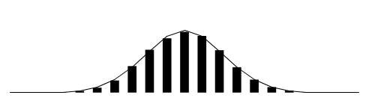
Example of modular programming: StdStats, StdRandom, and Gaussian client
Experiment
Flip N coins.
How many heads?
Prediction: Expect N/2.
Prediction (more detailed)
Run experiment trials times.
How many heads?
public static int binomial(int N)
{
int heads = 0;
for (int j = 0; j < N; j++)
if (StdRandom.bernoulli(0.5)) heads++;
return heads;
}
Goal. Write a program to validate predictions.
51

Slide 52


Example of modular programming: Bernoulli trials
public class Bernoulli
{
public static int binomial(int N)
// See previous slide.
public static void main(String[] args)
{
}
}
Bernoulli simulation
Get command-line arguments (trials experiments of N flips).
Run experiments. Keep track of frequency of occurrence of each return value.
Normalize to between 0 and 1. Plot histogram.
Plot theoretical curve.
int N = Integer.parseInt(args[0]);
int trials = Integer.parseInt(args[1]);
int[] freq = new int[N+1];
for (int t = 0; t < trials; t++) freq[binomial(N)]++;
double[] normalized = new double[N+1]; for (int i = 0; i <= N; i++)
normalized[i] = (double) freq[i] / trials; StdStats.plotBars(normalized);
double mean = N / 2.0;
double stddev = Math.sqrt(N) / 2.0; double[] phi = new double[N+1]; for (int i = 0; i <= N; i++)
phi[i] = Gaussian.pdf(i, mean, stddev); StdStats.plotLines(phi);
% java Bernoulli 20 10000
theory
experiments
52

Slide 53


Modular programming
enables development of complicated programs via simple independent modules.
see previous lecture
IFS
Bernoulli
parseInt()
parseInt()
readDouble1D() readDouble2D()
Integer
plotBars() plotLines()
uniform()
discrete()
pdf()
StdArrayIO
point()
sqrt()
StdStats
Gaussian
readDouble() readInt()
setPenRadius() setXscale() line()
StdRandom
exp()
sqrt() PI
StdIn
random()
StdDraw
Math
Advantages. Code is easier to understand, debug, maintain, improve, and reuse.

Slide 54

Why modular programming?
Modular programming enables
Independent development of small programs.
Every programmer to develop and share layers of abstraction.
Self-documenting code.
Fundamental characteristics
Separation of client from implementation benefits all future clients.
Contract between implementation and clients (API) benefits all past clients.
Challenges
How to break task into independent modules?
How to specify API?
Client
API
Implementation

Slide 55
COMPUTER SCIENCE
S E D G E W I C K / W A Y N E
PA R T I : P R O G R A M M I N G I N JAVA
Image sources
http://xkcd.com/221/ http://upload.wikimedia.org/wikipedia/commons/b/ba/Working_Together_Teamwork_Puzzle_Concept.jpg http://upload.wikimedia.org/wikipedia/commons/e/ef/Ben_Jigsaw_Puzzle_Puzzle_Puzzle.png
CS.5.D.Functions.Modular

Slide 56
COMPUTER SCIENCE
S E D G E W I C K / W A Y N E
PA R T I : P R O G R A M M I N G I N JAVA
_{C}omputer
5. Functions and Libraries
_{S}cience
An Interdisciplinary Approach
2.1–2.2
R O B E R T S E D G E W I C K
KEVIN W A YNE
http:// introcs.cs.princeton.edu

