Slide 1
Unit 1: Primitive Types Basic Java Syntax
Adapted from:
1) Building Java Programs: A Back to Basics Approach
by Stuart Reges and Marty Stepp
2) Runestone CSAwesome Curriculum
This work is licensed under the
Creative Commons Attribution-NonCommercial-ShareAlike 4.0 International License.
https://longbaonguyen.github.io

Slide 2
Java
What do Minecraft, Android phones, and Netflix have in common? They’re all programmed in Java!
Many of the apps you use in an Android phone or tablet are also written in Java. Netflix uses Java for some of its software too. Java is used worldwide to create software that we all use.

Slide 3

Java
Java is a programming language, which means that we can use Java to tell a computer what to do.
Computers don’t actually speak Java so we have to compile (translate) Java source files (they end in .java) into class files (they end in .class).
The source file is something humans can read and edit, and the class file is code that a computer can understand and can run.

Slide 4
Java Terminology
All Java code are organized into units called classes.
class:
(a) A module or program that can contain executable code.
(b) A description of a type of objects. (Animal class, Human class, Employee class, Car class)
statement: An executable piece of code that represents a complete command to the computer.
  every basic Java statement ends with a semicolon ;
method: A named sequence of statements that can be executed together to perform a particular action or computation.

Slide 5
Structure of a Java program
class: a program
public class name {
public static void main(String[] args) {
statement;
statement;
...
statement;
}
}
Every executable Java program consists of a class, called the driver class,
  that contains a method named main,
    that contains the statements (commands) to be executed.
method: a named group
of statements
statement: a command to be executed

Slide 6
Program Template
Here's a simple program that prints out a message on the screen. Code highlighted in red should be in every program!
public class Main{
public static void main(String[] args){
System.out.println("Hello, World!");
}
}
Output:
Hello, World!

Slide 7

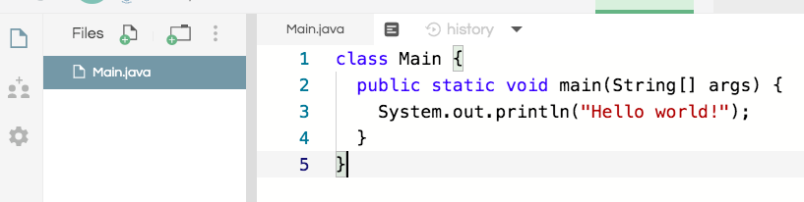
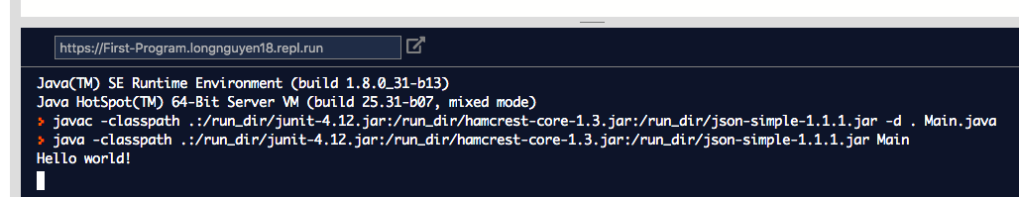
First Program: repl.it
We will use repl.it, an online integrated development environment(IDE), for the first part of this course to write all of our code.
Click on “run” to compile and run your code!
console: Text box into which
the program's output is printed.

Slide 8
File naming
The name of the class has to match up with the name of the file.
For example, the class below is called Main therefore the name of the file is Main.java. On replit, the main class must be called Main.java.(in other IDEs, you can pick any name.)

Slide 9
Printing
Two ways to print a line of output on the console: System.out.println() and System.out.print().
System.out.println() is just the way that you ask Java to print out the value of something followed by a new line (ln).
System.out.print() without the ln will print out something without advancing to the next new line.

Slide 10
System.out.println
public class Welcome{
public static void main(String[] args){
System.out.println("Hi there!");
System.out.println(”Welcome to APCS A!");
}
}
Output:
Hi There!
Welcome to APCS A!
The “System” in System.out.println() must be capitalized. And the command line must end with a semicolon (;).

Slide 11
System.out.print
public class SecondClass{
public static void main(String[] args){
System.out.print("Hi there!");
System.out.println(”Welcome to APCS A!");
System.out.print(”We will learn Java!");
}
}
Output:
Hi There!Welcome to APCS A!
We will learn Java!
Do you see why there are two lines of output as above?

Slide 12
Find the errors.
pooblic class Errors
public static void main(String args){
System.out.print("Good morning! ")
system.out.print("Good afternoon!);
System.Print "And good evening!";
}
See next slide for all of the corrections.

Slide 13
Corrected!
public class Errors {
public static void main(String[] args){
System.out.print("Good morning! ");
System.out.print("Good afternoon!”);
System.out.print("And good evening!”);
}
}

Slide 14
Strings
string: A sequence of characters to be printed.
  Starts and ends with a " quote " character.
    The quotes do not appear in the output.
  Examples:
  "hello"
  "This is a string. It's very long!"
Restrictions:
  May not span multiple lines.
  "This is not
  a legal String."
  May not contain a " character.
  "This is not a "legal" String either."
A string enclosed in quotes is called a string literal.

Slide 15
Comments
comment: A note written in source code by the programmer to describe or clarify the code.
  Comments are not executed when your program runs.
Syntax:
// comment text, on one line
or,
/* comment text; may span multiple lines */
Examples:
  // This is a one-line comment.
  /* This is a very long
  multi-line
  comment. */

Slide 16
Using comments
Where to place comments:
  at the top of each file (a "comment header")
  at the start of every method (seen later)
  to explain complex pieces of code
Comments are useful for:
  Understanding larger, more complex programs.
  Multiple programmers working together, who must understand each other's code.

Slide 17
Comments example
/* Suzy Student, CS 101, Fall 2019
This program prints lyrics about ... something. */
public class BaWitDaBa {
public static void main(String[] args) {
// first verse
System.out.println("Bawitdaba");
System.out.println("da bang a dang diggy diggy");
System.out.println();
// second verse
System.out.println("diggy said the boogy");
System.out.println("said up jump the boogy");
}
}

Slide 18
Indent Nicely!
public class Welcome{ public static void main(String[]
args){ System.out.println("Hi there!”
);System.out.println(”Welcome to APCS A!");}}
The code above will compile and run correctly. Java ignore whitespaces.
But it is very hard to read, please make an effort to indent nicely!
public class Welcome{
public static void main(String[] args){
System.out.println("Hi there!");
System.out.println(”Welcome to APCS A!");
}
}

Slide 19
Unit 1: Primitive Types Variables and Datatypes
Adapted from:
1) Building Java Programs: A Back to Basics Approach
by Stuart Reges and Marty Stepp
2) Runestone CSAwesome Curriculum
This work is licensed under the
Creative Commons Attribution-NonCommercial-ShareAlike 4.0 International License.
https://longbaonguyen.github.io

Slide 20
Data Types
A type is a set of values (e.g. integers, floats, etc..) and a set of operations (e.g. +, -, *, /, etc..) on them.
Data types can be categorized as either primitive or reference.
The primitive data types used in this course define the set of operations for numbers and Boolean(true or false) values.
Reference variables or object variables hold a reference(or address) to an object of a class(more on this in a future lecture).
Notes:
a variable is also like the MS / MR buttons on a calculator
variables must be declared before they are used, just like methods

Slide 21
Primitive types
The primitive types on the Advanced Placement Computer Science A exam are:
int - which store integers (whole numbers like 3, -76, 20393)
double - which store floating point numbers (decimal numbers like 6.3, -0.9, and 60293.93032)
boolean - which store Boolean values (either true or false).
Notes:
a variable is also like the MS / MR buttons on a calculator
variables must be declared before they are used, just like methods

Slide 22
Receipt example
What's bad about the following code?
  public class Receipt {
  public static void main(String[] args) {
  // Calculate total owed, assuming 8% tax / 15% tip
  System.out.println("Subtotal:");
  System.out.println(38 + 40 + 30);
  System.out.println("Tax:");
  System.out.println((38 + 40 + 30) * .08);
  System.out.println("Tip:");
  System.out.println((38 + 40 + 30) * .15);
  System.out.println("Total:");
  System.out.println(38 + 40 + 30 +
  (38 + 40 + 30) * .08 +
  (38 + 40 + 30) * .15);
  }
  }
  The subtotal expression (38 + 40 + 30) is repeated
  So many println statements
  We will use variables to solve the above problems.

Slide 23

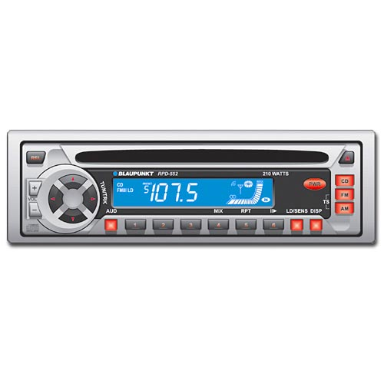
Variables
variable: A piece of the computer's memory that is given a name and type, and can store a value.
  Like preset stations on a car stereo, or cell phone speed dial:
  Steps for using a variable:
    Declare it - state its name and type
    Initialize it - store a value into it
    Use it - print it or use it as part of an expression
Notes:
a variable is also like the MS / MR buttons on a calculator
variables must be declared before they are used, just like methods

Slide 24
Declaration
variable declaration: Sets aside memory for storing a value.
  Variables must be declared before they can be used.
Syntax:
  type name;
    The name is an identifier.
  int x;
  double myGPA;
x
myGPA

Slide 25
Assignment
assignment: Stores a value into a variable.
  The value can be an expression; the variable stores its result.
Syntax:
  name = expression;
  int x;
  x = 3;
  double myGPA;
  myGPA = 1.0 + 2.25;
x | 3
myGPA | 3.25

Slide 26
Using variables
Once given a value, a variable can be used in expressions:
  int x;
  x = 3;
  System.out.println("x is " + x); // x is 3
  System.out.println(5 * x - 1); // 14
You can assign a value more than once:
  int x;
  x = 3;
  System.out.println(x + " here"); // 3 here
  x = 4 + 7;
  System.out.println("now x is " + x); // now x is 11
string concatenation:
string + number = concatenated string
(more on this later)
x | 3
x | 11

Slide 27
Declaration/initialization
A variable can be declared/initialized in one statement.
Syntax:
  type name = value;
  double myGPA = 3.95;
  int x = (12 - 3) * 2;
myGPA | 3.95
x | 18

Slide 28
Assignment and algebra
Assignment uses = , but it is not an algebraic equation.
  = means, "store the value at right in variable at left"
    The right side expression is evaluated first,
    and then its result is stored in the variable at left.
What happens here?
  int x = 3;
  x = x + 2; // no solutions
  // mathematically
  // not an equation!
x | 3
x | 5
Notes:
x = x + 2; increases the value stored in variable x by two.

Slide 29
Multiple Variables
Multiple variables of the same type can be declared and initialized at the same time.
Syntax:
  type name1, name 2, name3;
  int x, y, z; // declare three integers.
  type name1 = value1, name2 = value2, name3 = value3;
  int a = 1, b = 2, c = 3; // declare and initialize // three integers.

Slide 30
Assignment and types
A variable can only store a value of its own type.
  int x = 2.5; // ERROR: incompatible types
An int value can be stored in a double variable.
  The value is converted into the equivalent real number.
  double myGPA = 4;
myGPA | 4.0

Slide 31
Compiler errors
Order matters.
  int x;
  7 = x; // ERROR: should be x = 7;
A variable can't be used until it is assigned a value.
  int x;
  System.out.println(x); // ERROR: x has no value
You may not declare the same variable twice.
  int x;
  int x; // ERROR: x already exists
  int x = 3;
  int x = 5; // ERROR: x already exists
    How can this code be fixed?

Slide 32
Printing a variable's value
Use + to print a string and a variable's value on one line.
  double grade = (95.1 + 71.9 + 82.6) / 3.0;
  System.out.println("Your grade was " + grade);
  int students = 11 + 17 + 4 + 19 + 14;
  System.out.println("There are " + students +
  " students in the course.");
  Output:
  Your grade was 83.2
  There are 65 students in the course.

Slide 33
Receipt question
Improve the receipt program using variables.
public class Receipt {
public static void main(String[] args) {
// Calculate total owed, assuming 8% tax / 15% tip
System.out.println("Subtotal:");
System.out.println(38 + 40 + 30);
System.out.println("Tax:");
System.out.println((38 + 40 + 30) * .08);
System.out.println("Tip:");
System.out.println((38 + 40 + 30) * .15);
System.out.println("Total:");
System.out.println(38 + 40 + 30 +
(38 + 40 + 30) * .15 +
(38 + 40 + 30) * .08);
}
}

Slide 34
Receipt answer
public class Receipt {
public static void main(String[] args) {
// Calculate total owed, assuming 8% tax / 15% tip
int subtotal = 38 + 40 + 30;
double tax = subtotal * .08;
double tip = subtotal * .15;
double total = subtotal + tax + tip;
System.out.println("Subtotal: " + subtotal);
System.out.println("Tax: " + tax);
System.out.println("Tip: " + tip);
System.out.println("Total: " + total);
}
}

Slide 35
Type boolean
boolean: A logical type whose values are true and false.
  int age = 22;
  boolean minor = (age < 21);
  boolean lovesAPCS = true;
  System.out.println(minor); // false
  System.out.println(lovesAPCS); // true
  System.out.println(4 <= 5); // true

Slide 36
final
The keyword final can be used in front of a variable declaration to make it a constant that cannot be changed. Constants are traditionally capitalized.
public class TestFinal
{
public static void main(String[] args)
{
final double PI = 3.14;
System.out.println(PI);
PI = 4.2; // This will cause a syntax error
}
}

Slide 37
Naming variables
The name of the variable should describe the data it holds. A name like score helps make your code easier to read.
A name like x is not a good variable name in programming, because it gives no clues as to what kind of data it holds.
Do not name your variables crazy things like thisIsAReallyLongName, especially on the AP exam. You want to make your code easy to understand, not harder.

Slide 38
Naming variables
The convention in Java and many programming languages is to always start a variable name with a lower case letter and then uppercase the first letter of each additional word.
Variable names can not include spaces so uppercasing the first letter of each additional word makes it easier to read the name. Uppercasing the first letter of each additional word is called camel case.
int numOfLives = 3; // camel case to highlight words
Another option is to use underscore symbol _ to separate words, but you cannot have spaces in a variable name. Java is case sensitive so playerScore and playerscore are not the same.
int num_of_lives = 3; // use _ to highlight words.

Slide 39
Keywords
keyword: An identifier that you cannot use to name a variable because it already has a reserved meaning in Java.
abstract default if private this
boolean do implements protected throw
break double import public throws
byte else instanceof return transient
case extends int short try
catch final interface static void
char finally long strictfp volatile
class float native super while
const for new switch
continue goto package synchronized

Slide 40
Input and System.in
(not on AP)
interactive program: Reads input from the console.
  While the program runs, it asks the user to type input.
  The input typed by the user is stored in variables in the code.
  Can be tricky; users are unpredictable and misbehave.
  But interactive programs have more interesting behavior.
Scanner: An object that can read input from many sources.
  Communicates with System.in (the opposite of System.out)
  Can also read from files, web sites, databases, ...

Slide 41
Scanner syntax
(not on AP)
The Scanner class is found in the java.util package.
  import java.util.*; // so you can use Scanner
Constructing a Scanner object to read console input:
  Scanner name = new Scanner(System.in);
  Example:
  Scanner console = new Scanner(System.in);

Slide 42
Scanner methods
(not on AP)
  Each method waits until the user presses Enter.
  The value typed by the user is returned.
  System.out.print("How old are you? "); // prompt
  int age = console.nextInt();
  System.out.println("You typed " + age);
    prompt: A message telling the user what input to type.
Method | Description
nextInt() | reads an int from the user and returns it
nextDouble() | reads a double from the user
next() | reads a one-word String from the user
nextLine() | reads a one-line String from the user

Slide 43


Scanner example
(not on AP)
  import java.util.*; // so that I can use Scanner
  public class UserInputExample {
  public static void main(String[] args) {
  Scanner console = new Scanner(System.in);
  System.out.print("How old are you? ");
  int age = console.nextInt();
  int years = 65 - age;
  System.out.println(years + " years to retirement!");
  }
  }
Console (user input underlined):
  How old are you?
  36 years until retirement!
age | 29
years | 36
29
Notes:
It's also useful to write a program that prompts for multiple values, both on the same line or each on its own line.

Slide 44
Input tokens
(not on AP)
token: A unit of user input, as read by the Scanner.
  Tokens are separated by whitespace (spaces, tabs, new lines).
  How many tokens appear on the following line of input?
  23 John Smith 42.0 "Hello world" $2.50 " 19"
When a token is not the type you ask for, it crashes.
  System.out.print("What is your age? ");
  int age = console.nextInt();
  Output:
  What is your age? Timmy
  java.util.InputMismatchException
  at java.util.Scanner.next(Unknown Source)
  at java.util.Scanner.nextInt(Unknown Source)
  ...

Slide 45
Scanner example 2
(not on AP)
  import java.util.*; // so that I can use Scanner
  public class ScannerMultiply {
  public static void main(String[] args) {
  Scanner console = new Scanner(System.in);
  System.out.print("Please type two numbers: ");
  int num1 = console.nextInt();
  int num2 = console.nextInt();
  int product = num1 * num2;
  System.out.println("The product is " + product);
  }
  }
Valid Outputs (user input underlined):
  Please type two numbers: 8 6
  The product is 48
  // 2 tokens separated by space
  Please type two numbers: 8
  6
  The product is 48
  // 2 tokens separated by new
  // line
Notes:
It's also useful to write a program that prompts for multiple values, both on the same line or each on its own line.

Slide 46
Lab 1: String Concatenation
Create a new repl on replit.
Create two integer variables: pens and pencils. Initialize it to some positive values. Use print statements and String concatenation to have the following output:
Output: (Assuming that the initialized values for pens=18, pencils = 10)
There are 18 pens.
There are 10 pencils.
Total is 28 pens and pencils.

Slide 47
Lab 2: String Concatenation
Use the SAME repl as from Lab 1 String Concatenation.
Modify your previous lab 1 to ask the user to enter the number pens and pencils rather than hard coding the values. Use print statements and String concatenation to have the following output:
Output:
Enter the number of pens: 10
Enter the number of pencils: 18
Total is 28 pens and pencils.

Slide 48
References
For more tutorials/lecture notes in Java, Python, game programming, artificial intelligence with neural networks:
https://longbaonguyen.github.io
Building Java Programs: A Back to Basics Approach by Stuart Reges and Marty Stepp
2) Runestone CSAwesome Curriculum: https://runestone.academy/runestone/books/published/csawesome/index.html

Slide 49
Lab 1
Create a new repl on your repl.it account and write a program that has the following outputs:
You must use exactly 5 different print statements.(println and/or print).
Output:
I am Sam. Sam I am. I do not like them, Sam-I-am.
I do not like green eggs and ham.

Slide 50
References
For more tutorials/lecture notes in Java, Python, game programming, artificial intelligence with neural networks:
https://longbaonguyen.github.io
Building Java Programs: A Back to Basics Approach by Stuart Reges and Marty Stepp
2) Runestone CSAwesome Curriculum: https://runestone.academy/runestone/books/published/csawesome/index.html

