Slide 1
Introduction to Python
Built-In Sequences: Tuples and Dictionaries

Slide 2
Topics
Tuples
Dictionaries
Iterables

Slide 3
Tuples
Tuples are in many ways similar to lists, but they are defined with parentheses rather than square brackets:
In[1]:t = (1, 2, 3)
They can also be defined without any brackets at all:
In[2]:t = 1, 2, 3
print(t)
(1, 2, 3)

Slide 4
Tuples
Like the lists, tuples have a length, and individual elements can be extracted using square-bracket indexing. Slicing is also supported.
In [1]: len(t)
Out [1]: 3
In [2]: t[0:2]
Out [2]: (1, 2)
Unlike lists, tuples are immutable: this means that once they are created, their size and contents cannot be changed:
In [3]: t[0] = 1 # error!
In [4]: t.append(10) # error!

Slide 5
Tuple Unpacking
Tuple unpacking is a assignment feature that assigns right hand side of values into left hand side. In packing, we put values into a new tuple while in unpacking we extract those values into a single variable.
This is packing values into a variable.
In [1]: student = (“Mike Smith”, 3.2)
This is unpacking values from a variable.
In [2]: name, gpa = student
In [3]: print(name, gpa)
Mike Smith 3.2

Slide 6
Tuple Unpacking
Tuple unpacking can be used to do parallel assignment.
In [1]: a = 1
b = 2
a, b = b, a # parallel assignment
print(a, b)
2 1

Slide 7
list(), tuple()
Converting between sequences can be done using the appropriate constructors: list(), tuple().
In [26]: message = “python”
list(message)
Out [26]: [‘p’, ‘y’, ‘t’, ‘h’, ‘o’, ‘n’]
In [27]: t = [1, 2, 3]
tuple(t)
Out [27]: (1, 2, 3)

Slide 8
List of Tuples
We can form a list of tuples(or of lists) and iterate over them by using nested loop or tuple unpacking.
In[3]: lst = [(“Mike”, 3.2), (“Sarah”, 3.6), (“Jack”, 2.8)]
for student in lst:
for data in student:
print(data)
In[3]: lst = [(“Mike”, 3.2), (“Sarah”, 3.6), (“Jack”, 2.8)]
for name, gpa in lst: # tuple unpacking
print(name, gpa)

Slide 9
Dictionaries
Dictionaries are extremely flexible mappings of keys to values, and form the basis of much of Python’s internal implementation. They can be created via a comma-separated list of key:value pairs within curly braces:
In [27]: numbers = {"one":1, "two":2, "three":3}
In [28]: type(numbers)
Out [28]: dict
In [28]: # Access a value via the key
numbers["two"]
Out [28]: 2

Slide 10
Dictionaries
New items can be added to the dictionary using indexing as well.
In [29]: # Set a new key/value pair
In [29] numbers['ninety'] = 90
In [29] print(numbers) {'three': 3, 'ninety': 90, 'two': 2, 'one': 1}
In [29]: numbers['one'] += 5
In [29] print(numbers) {'three': 3, 'ninety': 90, 'two': 2, 'one': 6}

Slide 11
Dictionaries
The keys and values can be extracted from a dictionary via keys() and values().
In [29]: k = list(numbers.keys())
print(k)
['three', 'ninety’, ‘two’, 'one’]
In [29]: k = list(numbers.values())
print(k)
[3, 90, 2, 1]

Slide 12
Iterables
An iterable is an object from which we can loop over. Lists, strings, tuples and dictionaries are all iterables.
In[3]: lst = [2, 3, 5, 7]
for x in lst:
print(x, end=‘ ’)
2 3 5 7
In [26]: message = “python”
for x in message:
print(x, end=‘ ’)
p y t h o n

Slide 13
Iterables
It is easy to iterate over keys of the dictionary.
In [27]: numbers = {'one':1, 'two':2, 'three':3}
for x in numbers:
print(x, end=‘ ’)
one two three
To iterate over values of the dictionary use, values().
In [27]: for x in numbers.values():
print(x, end=‘ ’)
1 2 3

Slide 14
Iterables
It is easy to iterate over both keys and values of the dictionary.
In [27]: numbers = {'one':1, 'two':2, 'three':3}
for k, v in numbers.items():
print(k, v)
one 1
two 2
three 3

Slide 15
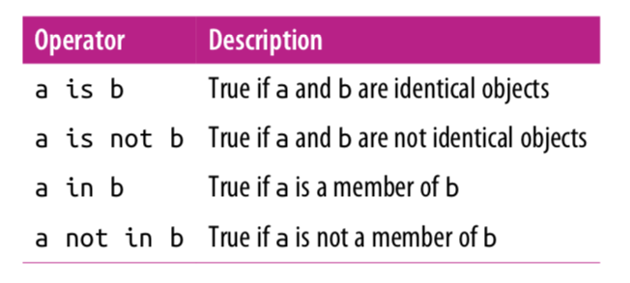
Membership and Operations

Slide 16
Identity Operations
The comparison operator == checks for object equality.
In [19]: a = [1,2,3]
b = [1,2,3]
In[20]: a == b
Out [20]: True
The identity operators, is and is not, check for object identity.
In[21]: a is b
Out [21]: False
In[22]: a is not b
Out [22]: True
In [23]: a = [1,2,3]
b = a
a is b
Out [23]: True

Slide 17
Membership Operations
Membership operators check for membership within compound objects like lists.
In [24]: 1 in [1, 2, 3]
Out [24]: True
In[25]: 2 not in [1,2,3]
Out [25]: False

Slide 18
Variables Are Pointers
In [2]: x = [1, 2, 3]
y = x
In [3]: print(y)
[1, 2, 3]
In [4]: x.append(4) # append 4 to the list pointed to by x print(y) # y's list is modified as well!
[1, 2, 3, 4]
In [5]: x = 'something else’
print(y) # y is unchanged
[1, 2, 3, 4]

Slide 19
References
Vanderplas, Jake, A Whirlwind Tour of Python, O’reilly Media.

