Slide 1

Understanding Data
Representing Information Digitally

Slide 2
Data
Data values can be stored in variables, lists of items, or standalone constants.
Computing devices represent data(text, numbers, audio, images) digitally, meaning that the lowest-level components of any value are bits.
Bit is shorthand for binary digit and is either 0 or a 1. This system of representing data is called binary (base 2) which uses only combinations of the digits zero and one.
name = "Mike Smith"
grades = [87, 91, 75] # represented internally as 0's and 1's
Thus, digital data is simply some sequence of 0's and 1s representing some information.

Slide 3
Abstraction
Abstraction is the process of reducing complexity by focusing on the main idea.
By hiding details irrelevant to the question at hand and bringing together related and useful details, abstraction reduces complexity and allows one to focus on the idea.
One type of abstraction we saw was procedural abstraction, which provides a name for a procedure(function) and allows it to be used only knowing what it does, not how it does it.
import random
print(random.randrange(10)) # random number from 0 - 9
We don't need to know how the randrange() function is implemented to be able use it.

Slide 4
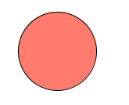
Abstraction
Bits are grouped to represent abstractions. These abstractions include, but are not limited to, numbers, characters, and color.
Sequences of 0's and 1's represent a string of characters, a numeric grade and a color below. The color example is done using Processing.
name = "Mike Smith"
grade = 87
c = color(255, 123, 110)
fill(c);
ellipse(250, 80, 100, 100)

Slide 5

Encoding
A computer cannot store “letters” or “pictures”. It can only work with bits(0 or 1).
To represent anything other than bits, we need to rules that will allow us to convert a sequence of bits into letters or pictures. This set of rules is called an encoding scheme, or encoding for short. For example,

Slide 6
ASCII
ASCII(American Standard Code for Information Exchange) is an encoding scheme that specifies the mapping between bits and characters.
There are 128 characters in the scheme. There are 95 readable characters and 33 values for nonprintable characters like space, tab, and backspace and so on.
The readable characters include a-z, A-Z, 0-9 and punctuation.
In ASCII, 65 represents A, 66 represents B and so on. The numbers are called code points.

Slide 7
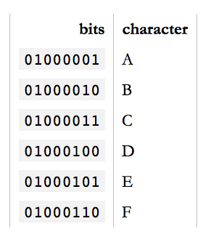
ASCII Sample
To encode something in ASCII,
follow the table from right to left,
substituting letters for bits.
To decode a string of bits into
human readable characters, follow
the table from left to right, substituting
bits for letters.
encode
decode

Slide 8
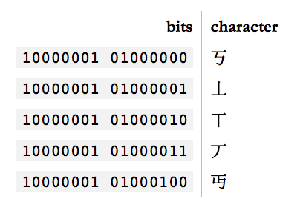
Other letters?
95 characters can cover English but what about French? Or how do you represent Swedish letters é, ß, ü, ä, ö or å in ASCII? Or Chinese?
For a time, there were many encoding schemes for different languages. For example, GB18030 covers traditional and simplified Chinese.
Finally, in 1991, Unicode was created to unify all
encoding standards. It defines a table of
1,114,112 code points that can be used for all
sorts of letters, symbols and languages.

Slide 9
Encoding/Decoding Documents
In an editor such as Word document, you can specify the language encoding.
Special software can help you type
special characters.
When you save the document, the
editor saves the character as 0’s
And 1’s as specified by the encoding.
When you reopen the document, the encoding setting will allow the editor to decode the 0’s and 1’s back to correct characters.

Slide 10
Unicode
So, how many bits does Unicode use to encode all these characters? None. Because Unicode is not an encoding.
Unicode first and foremost defines a table of code points for characters. That's a fancy way of saying "65 stands for A, 66 stands for B and 9,731 stands for ☃”.

Slide 11
UTF-32
To represent 1,114,112 different values, two bytes aren't enough. Three bytes are, but three bytes are often awkward to work with, so four bytes would be the comfortable minimum.
UTF-32(Unicode Transformation Format) is such an encoding that encodes all Unicode code points using 32 bits. That is, four bytes per character.

Slide 12
UTF-32
UTF-32 very simple, but often wastes a lot of space. For example, if A is always encoded as 00000000 00000000 00000000 01000001 and B as 00000000 00000000 00000000 01000010 and so on, documents would bloat to 4x its necessary size.
UTF-16 and UTF-8 are variable-length encodings. If a character can be represented using a single byte (because its code point is a very small number), UTF-8 will encode it with a single byte. If it requires two bytes, it will use two bytes and so on. UTF-16 is in the middle, using at least two bytes, growing to up to four bytes as necessary.

Slide 13
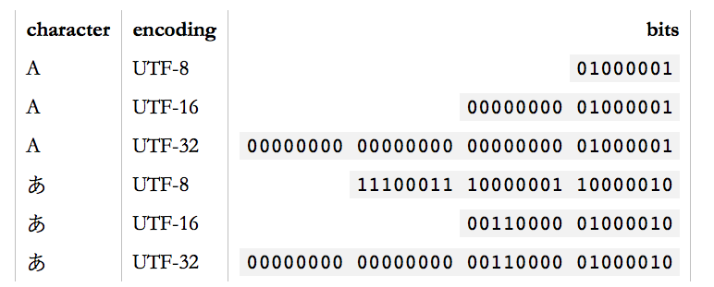
Unicode
Unicode is a large table mapping characters to numbers and the different UTF encodings specify how these numbers are encoded as bits.

Slide 14
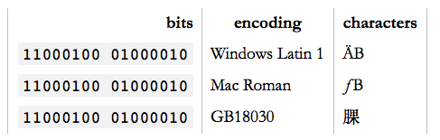
Encoding
Any character can be encoded in many different bit sequences and any particular bit sequence can represent many different characters, depending on which encoding is used to read or write them.
The reason is simply because different encodings use different numbers of bits per characters and different values to represent different characters.

Slide 15
Garbled Text?
You open a text file and it looks like:
ÉGÉìÉRÅ[ÉfÉBÉìÉOÇÕìÔÇµÇ≠Ç»Ç¢
Reason: Your text editor, browser, word processor or whatever else that's trying to read the document is assuming the wrong encoding.
In Safari or Firefox, you can change the text encoding. (Chrome only supports this through an extension.) For Safari, under “View”, select “Text Encoding” and “Japanese Shift JS” to see the correct text:
エンコーディングは難しくない

Slide 16
UTF-8
UTF-8 is the standard encoding for all email and webpages(HTML5).
The ingenious thing about UTF-8 is that it's binary compatible with ASCII, which is the de-facto baseline for all encodings.
All characters available in the ASCII encoding only take up a single byte in UTF-8 and they're the exact same bytes as are used in ASCII. In other words, ASCII maps 1:1 unto UTF-8. Any character not in ASCII takes up two or more bytes in UTF-8.
We will explore more on text encoding with Python in the next lecture.

Slide 17
Base 10 (Decimal numbers)
Why base 10?
We happened to use the current counting system, because we happened to have ten fingers.
Base 10(Decimal) uses 10 digits {0,1,2,3…,9}.
Base 2(Binary) uses 2 digits {0,1}.
Base 8(Octal) uses 8 digits {0,1,2,3,4,5,6,7}

Slide 18
Base 10 (Decimal numbers)
Each digit has a weight corresponding to a power of 10. Multiply each digit with its weight and then sum.
What does 157 mean?
157 = 1 x 100 + 5 x 10 + 7 x 1
= 1 x 10² + 5 x 10¹ + 7 x 10⁰

Slide 19
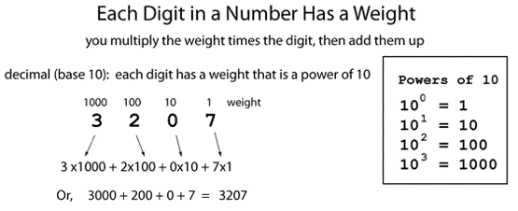
Base 10 (Decimal)

Slide 20
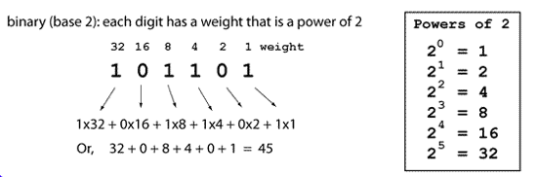
Base 2 (Binary)

Slide 21
Base 2 (Binary)
Base 2
1011 = 1 x 2³ + 0 x 2² + 1 x 2¹ + 1 x 2⁰
1011 = 1 x 8 + 0 x 4 + 1 x 2 + 1 x 1 =11 in Base 10

Slide 22
Bits and Bytes
1 bit is a single bit of information, a 1 or 0(Only two possible values)
1 byte is 8 bits, an 8 bit word
256 possible values from 0-255 base 10
or 00000000 to 11111111 base 2
For example, 10100110 is a single byte

Slide 23
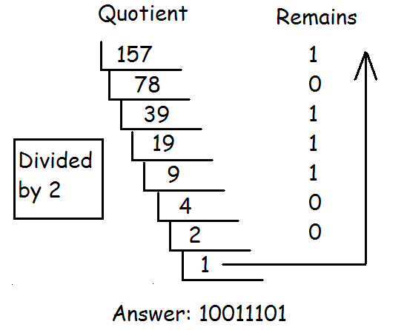
Decimal to Binary
Repeatedly modulo 2 and the divide by 2. Stop at 0. The remainder list read top to bottom are the digits from left to right.

Slide 24
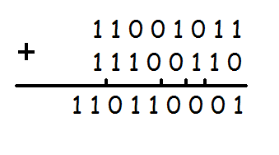
Adding Binary
Add from right to left as usual. Follow the three rules below and remember to carry.
0 + 0 = 0
1 + 0 = 1
1 + 1 = 10
Example:

Slide 25
People
There are 10 types of people in the world; those who understand binary and those who don’t.
There are 10 types of people in the world; those who understand binary and those who have friends.

Slide 26
Hexadecimal
Binary code is too long in representation. Hexadecimal is much shorter. Hexadecimal uses 16 digits
Problem: we are short of numbers.
A-10 B-11 C-12 D-13 E-14 F-15
Hexadecimal digits: {0,1,2,3,4…,9,A,B,C,D,E,F}
Converting a binary number to a Hex number is relatively easy. Every 4 bit can convert to a Hex.

Slide 27
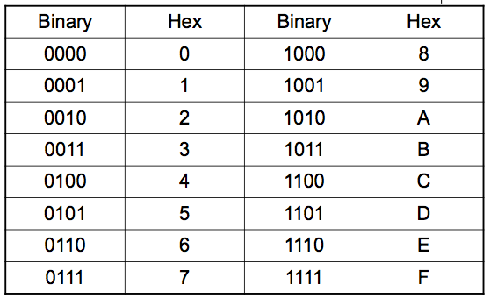
Hexadecimal

Slide 28
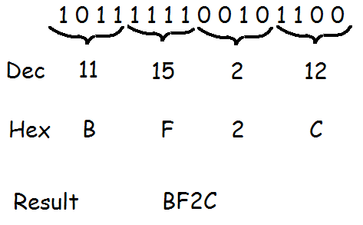
Binary to Hex

Slide 29
Counting
Let’s count in Base 10.
0,1,2,3,4,5,6,7,8,9,__,___,…,18,19,__,__.
Answer: 10,11…..,20,21. Good job!
Let’s count in Base 5.
0,1,2,3,4,__,__,__,__,__,___.
Answer:10,11,12,13,14,20.
Let’s keep going!
40,41,42,43,44,___,___,___.
Answer:100,101,102.

Slide 30






Quick Quiz
What’s the answer in base 8?
What’s the answer in base 5?
What’s the answer in base 12?

Slide 31
Character Encoding

Slide 32
Encoding
A computer cannot store “letters” or “pictures”. It can only work with bits(0 or 1).
To represent anything other than bits, we need to rules that will allow us to convert a sequence of bits into letters or pictures. This set of rules is called an encoding scheme, or encoding for short. For example,

Slide 33
Homework
Read and reread these lecture notes.
Do the problem set.

Slide 34
References
1) What Every Programmer Absolutely, Positively Needs To Know About Encodings And Character Sets To Work With Text, by David Zentgraf. http://kunststube.net/encoding/
2) Part of this lecture is taken from a lecture from an OpenCourseWare course below.
Computer Science E-1 at Harvard Extension School
Understanding Computers and the Internet
by Tommy MacWilliam.

