Slide 1


COMPUTER SCIENCE
S E D G E W I C K / W A Y N E
PA R T I : P R O G R A M M I N G I N JAVA
_{C}omputer
3. Arrays
_{S}cience
An Interdisciplinary Approach
1.4
R O B E R T S E D G E W I C K
KEVIN W A YNE
http:// introcs.cs.princeton.edu

Slide 2

COMPUTER SCIENCE
S E D G E W I C K / W A Y N E
PA R T I : P R O G R A M M I N G I N JAVA
Arrays
Basic concepts
Typical array-processing code
Two-dimensional arrays
CS.3.A.Arrays.Basics

Slide 3
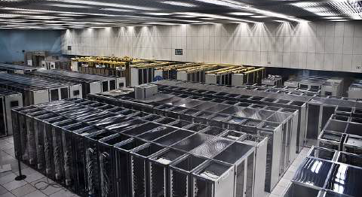
Basic building blocks for programming
any program you might want to write
objects
functions and modules
graphics, sound, and image I/O
arrays
arrays
conditionals and loops
Ability to store and process
huge amounts of data
Math
text I/O
primitive data types
assignment statements

Slide 4
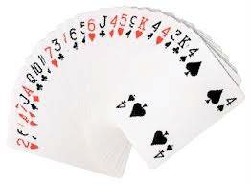
Your first data structure
A data structure is an arrangement of data that enables efficient processing by a program.
An array is an indexed sequence of values of the same type.
Examples.
52 playing cards in a deck.
100 thousand students in an online class.
1 billion pixels in a digital image.
4 billion nucleotides in a DNA strand.
73 billion Google queries per year.
86 billion neurons in the brain.
50 trillion cells in the human body.
6.02 × 10²³ particles in a mole.
index | value
0 | 2♥
1 | 6♠
2 | A♦
3 | A♥
...
49 | 3♣
50 | K♣
51 | 4♠
Main purpose. Facilitate storage and manipulation of data.

Slide 5



Processing many values of the same type
10 values, without arrays
double a0 = 0.0; double a1 = 0.0; double a2 = 0.0; double a3 = 0.0; double a4 = 0.0; double a5 = 0.0; double a6 = 0.0; double a7 = 0.0; double a8 = 0.0; double a9 = 0.0;
...
a4 = 3.0;
...
a8 = 8.0;
...
double x = a4 + a8;
10 values, with an array
1 million values, with an array
double[] a;
a = new double[10];
...
a[4] = 3.0;
...
a[8] = 8.0;
...
double x = a[4] + a[8];
double[] a;
a = new double[1000000];
...
a[234567] = 3.0;
...
a[876543] = 8.0;
...
double x = a[234567] + a[876543];
an easy alternative
scales to handle huge amounts of data
tedious and error-prone code

Slide 6

Memory representation of an array
An array is an indexed sequence of values of the same type.
A computer's memory is also an indexed sequence of memory locations.
Each primitive type value occupies a fixed number of locations.
Array values are stored in contiguous locations.
stay tuned for many details
a
for simplicity in this lecture, think of a as the memory address of the first location the actual implementation in Java is just slightly more complicated.
 |  |  |  |  |  |  |  |  |  |  |  |  |  |  |  | a[0] | a[1] | a[2] | a[3] | a[4] | a[5] | a[6] | a[7] | a[8] | a[9]
Critical concepts
Indices start at 0.
Given i, the operation of accessing the value a[i] is extremely efficient.
The assignment b = a makes the names b and a refer to the same array.
it does not copy the array, as with primitive types (stay tuned for details)

Slide 7
Java language support for arrays
Basic support
operation | typical code
Declare an array | double[] a;
Create an array of a given length | a = new double[1000];
Refer to an array entry by index | a[i] = b[j] + c[k];
Refer to the length of an array | a.length;
Initialization options
no need to use a loop like
for (int i = 0; i < 1000; i++)
operation | typical code
Default initialization to 0 for numeric types | a = new double[1000];
Declare, create and initialize in one statement | double[] a = new double[1000];
Initialize to literal values | double[] x = { 0.3, 0.6, 0.1 };
a[i] = 0.0;
BUT cost of creating an array is proportional to its length.

Slide 8



Copying an array
To copy an array, create a new array , then copy all the values.
double[] b = new double[a.length]; for (int i = 0; i < a.length; i++)
b[i] = a[i];
a
i
b
i
0.3
0.6
0.99
0.01
0.5
0.3
0.6
0.99
0.01
0.5
Important note: The code b = a does not copy an array (it makes b and a refer to the same array).
double[] b = new double[a.length]; b = a;
a
b
0.3
0.6
0.99
0.01
0.5

Slide 9






Programming with arrays: typical examples
Access command-line args in system array
For brevity, N is a.length and b.length in all this code.
Copy to another array
int stake = Integer.parseInt(args[0]); int goal = Integer.parseInt(args[1]); int trials = Integer.parseInt(args[2]);
double[] b = new double[N]; for (int i = 0; i < N; i++)
b[i] = a[i];
Create an array with N random values
double[] a = new double[N]; for (int i = 0; i < N; i++) a[i] = Math.random();
Print array values, one per line
for (int i = 0; i < N; i++) System.out.println(a[i]);
Compute the average of array values
Find the maximum of array values
double sum = 0.0;
for (int i = 0; i < N; i++) sum += a[i];
double average = sum / N;
double max = a[0];
for (int i = 1; i < N; i++)
if (a[i] > max) max = a[i];

Slide 10
Pop quiz 1 on arrays
Q. What does the following code print?
public class PQarray1
{
public static void main(String[] args)
{
int[] a = new int[6];
int[] b = new int[a.length];
b = a;
for (int i = 1; i < b.length; i++) b[i] = i;
for (int i = 0; i < a.length; i++) System.out.print(a[i] + " ");
System.out.println();
for (int i = 0; i < b.length; i++) System.out.print(b[i] + " ");
System.out.println();
}
}

Slide 11

Pop quiz 1 on arrays
Q. What does the following code print?
public class PQarray1
{
public static void main(String[] args)
{
int[] a = new int[6];
int[] b = new int[a.length];
b = a;
for (int i = 1; i < b.length; i++) b[i] = i;
After this, b and a refer to the same array
for (int i = 0; i < a.length; i++) System.out.print(a[i] + " ");
System.out.println();
for (int i = 0; i < b.length; i++) System.out.print(b[i] + " ");
System.out.println();
A.
% java PQ4_1
0 1 2 3 4 5
}
}
0 1 2 3 4 5

Slide 12





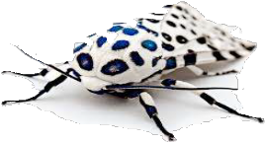

Programming with arrays: typical bugs
Array index out of bounds
double[] a = new double[10]; for (int i = 1; i <= 10; i++)
a[i] = Math.random();
No a[10] (and a[0] unused)
Uninitialized array
double[] a;
for (int i = 0; i < 9; i++) a[i] = Math.random();
Never created the array
Undeclared variable
a = new double[10];
for (int i = 0; i < 10; i++) a[i] = Math.random();
What type of data does a refer to?

Slide 13
COMPUTER SCIENCE
S E D G E W I C K / W A Y N E
PA R T I : P R O G R A M M I N G I N JAVA
Image sources
http://commons.wikimedia.org/wiki/File:CERN_Server_03.jpg
CS.3.A.Arrays.Basics

Slide 14
COMPUTER SCIENCE
S E D G E W I C K / W A Y N E
PA R T I : P R O G R A M M I N G I N JAVA
Arrays
Basic concepts
Examples of array-processing code
Two-dimensional arrays
CS.3.B.Arrays.Examples

Slide 15
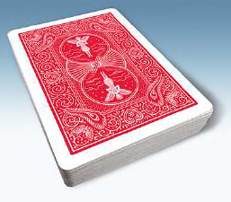
Example of array use: create a deck of cards
Define three arrays
Ranks.
Suits.
Full deck.
String[] rank = {"2", "3", "4", "5", "6", "7", "8", "9", "10", "J", "Q", "K", "A" };
String[] suit = { "♣", "♦", "♥", "♠" };
String[] deck = new String[52];
Use nested for loops to put all the cards in the deck.
better style to use rank.length and suit.length
j
for (int j = 0; j < 4; j++)
for (int i = 0; i < 13; i++)
clearer in lecture to use 4 and 13
0 | 1 | 2 | 3
♣ | ♦ | ♥ | ♠
deck[i + 13*j] = rank[i] + suit[j];
suit
i
rank
0 | 1 | 2 | 3 | 4 | 5 | 6 | 7 | 8 | 9 | 10 | 11 | 12
2 | 3 | 4 | 5 | 6 | 7 | 8 | 9 | 10 | J | Q | K | A
0 | 1 | 2 | 3 | 4 | 5 | 6 | 7 | 8 | 9 | 10 | 11 | 12 | 13 | 14 | 15 | 16 | 17 | 18 | 19 | 20 | ...
2♣ | 3♣ | 4♣ | 5♣ | 6♣ | 7♣ | 8♣ | 9♣ | 10♣ | J♣ | Q♣ | K♣ | A♣ | 2♦ | 3♦ | 4♦ | 5♦ | 6♦ | 7♦ | 8♦ | 9♦ | ...
deck

Slide 16



Example of array use: create a deck of cards
public class Deck
{
public static void main(String[] args)
{
String[] rank = {"2", "3", "4", "5", "6", "7", "8", "9", "10", "J", "Q", "K", "A" };
String[] suit = { "♣", "♦", "♥", "♠" };
String[] deck = new String[52]; for (int j = 0; j < 4; j++)
for (int i = 0; i < 13; i++)
no color in Unicode; artistic license for lecture
deck[i + 13*j] = rank[i] + suit[j];
for (int i = 0; i < 52; i++) System.out.print(deck[i] + " ");
System.out.println();
}
% java Deck
}
2♣ 3♣ 4♣ 5♣ 6♣ 7♣ 8♣ 9♣ 10♣ J♣ Q♣ K♣ A♣
2♦ 3♦ 4♦ 5♦ 6♦ 7♦ 8♦ 9♦ 10♦ J♦ Q♦ K♦ A♦
2♥ 3♥ 4♥ 5♥ 6♥ 7♥ 8♥ 9♥ 10♥ J♥ Q♥ K♥ A♥
2♠ 3♠ 4♠ 5♠ 6♠ 7♠ 8♠ 9♠ 10♠ J♠ Q♠ K♠ A♠
%

Slide 17
Pop quiz 2 on arrays
Q. What happens if the order of the for loops in Deck is switched?
for (int j = 0; j < 4; j++)
for (int i = 0; i < 13; i++)
deck[i + 13*j] = rank[i] + suit[j];
for (int i = 0; i < 13; i++) for (int j = 0; j < 4; j++)
deck[i + 13*j] = rank[i] + suit[j];

Slide 18
Pop quiz 2 on arrays
Q. What happens if the order of the for loops in Deck is switched?
for (int j = 0; j < 4; j++)
for (int i = 0; i < 13; i++)
deck[i + 13*j] = rank[i] + suit[j];
for (int i = 0; i < 13; i++) for (int j = 0; j < 4; j++)
deck[i + 13*j] = rank[i] + suit[j];
A. The array is filled in a different order, but the output is the same.
j
0 | 1 | 2 | 3
♣ | ♦ | ♥ | ♠
suit
i
rank
0 | 1 | 2 | 3 | 4 | 5 | 6 | 7 | 8 | 9 | 10 | 11 | 12
2 | 3 | 4 | 5 | 6 | 7 | 8 | 9 | 10 | J | Q | K | A
0 | 1 | 2 | ... | 12 | 13 | 14 | 15 | ... | 25 | 26 | 27 | 28 | ... | 38 | 39 | 40 | 41 | ... | 51
2♣ | 3♣ | 4♣ | ... | A♣ | 2♦ | 3♦ | 4♦ | ... | A♦ | 2♥ | 3♥ | 4♥ | ... | A♥ | 2♠ | 3♠ | 4♠ | ... | A♠
deck
NOTE: Error on page 92 in 3rd printing of text (see errata list on booksite).

Slide 19

Pop quiz 3 on arrays
Q. Change Deck to put the cards in rank order in the array.
% java Deck
2♣ 2♦ 2♥ 2♠ 3♣ 3♦ 3♥ 3♠ 4♣ 4♦ 4♥ 4♠ 5♣ 5♦ 5♥ 5♠ 6♣ 6♦ 6♥ 6♠ 7♣ 7♦ 7♥ 7♠ 8♣ 8♦ 8♥ 8♠ 9♣ 9♦ 9♥ 9♠
10♣ 10♦ 10♥ 10♠ J♣ J♦ J♥ J♠ Q♣ Q♦ Q♥ Q♠ K♣ K♦ K♥ K♠ A♣ A♦ A♥ A♠
%

Slide 20
Pop quiz 3 on arrays
Q. Change Deck to put the cards in rank order in the array.
% java Deck
2♣ 2♦ 2♥ 2♠ 3♣ 3♦ 3♥ 3♠ 4♣ 4♦ 4♥ 4♠ 5♣ 5♦ 5♥ 5♠ 6♣ 6♦ 6♥ 6♠ 7♣ 7♦ 7♥ 7♠ 8♣ 8♦ 8♥ 8♠ 9♣ 9♦ 9♥ 9♠
10♣ 10♦ 10♥ 10♠ J♣ J♦ J♥ J♠ Q♣ Q♦ Q♥ Q♠ K♣ K♦ K♥ K♠ A♣ A♦ A♥ A♠
%
A.
for (int i = 0; i < 13; i++) for (int j = 0; j < 4; j++)
deck[4*i + j] = rank[i] + suit[j];
j
0 | 1 | 2 | 3
♣ | ♦ | ♥ | ♠
suit
i
rank
0 | 1 | 2 | 3 | 4 | 5 | 6 | 7 | 8 | 9 | 10 | 11 | 12
2 | 3 | 4 | 5 | 6 | 7 | 8 | 9 | 10 | J | Q | K | A
0 | 1 | 2 | 3 | 4 | 5 | 6 | 7 | 8 | 9 | 10 | 11 | 12 | ...
2♣ | 2♦ | 2♥ | 2♠ | 3♣ | 3♦ | 3♥ | 3♠ | 4♣ | 4♦ | 4♥ | 4♠ | 5♣ | ...
deck

Slide 21

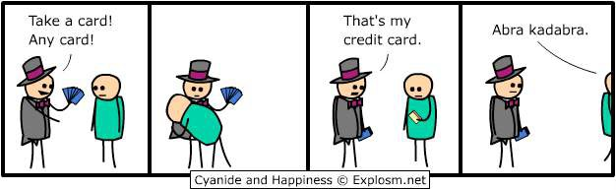

Slide 22
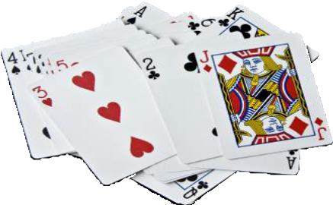

Array application: take a card, any card
Problem: Print a random sequence of N cards.
Algorithm
Take N from the command line and do the following N times
Calculate a random index r between 0 and 51.
Print deck[r].
Implementation: Add this code instead of printing deck in Deck.
for (int i = 0; i < N; i++)
{
int r = (int) (Math.random() * 52); System.out.println(deck[r]);
}
each value between 0 and 51 equally likely
Note: Same method is effective for printing a random sequence from any data collection.

Slide 23




Array application: random sequence of cards
public class DrawCards
{
public static void main(String[] args)
{
int N = Integer.parseInt(args[0]);
String[] rank = {"2", "3", "4", "5", "6", "7", "8", "9","10", "J", "Q", "K", "A" };
String[] suit = { "♣", "♦", "♥", "♠" };
String[] deck = new String[52];
for (int i = 0; i < 13; i++) for (int j = 0; j < 4; j++)
deck[i + 13*j] = rank[i] + suit[j];
% java DrawCards 10
6♥ K♦ 10♠ 8♦ 9♦ 9♥ 6♦ 10♠ 3♣ 5♦
for (int i = 0; i < N; i++)
{
int r = (int) (Math.random() * 52); System.out.print(deck[r] + " ");
}
System.out.println();
% java DrawCards 10
2♦ A♠ 5♣ A♣ 10♣ Q♦ K♣ K♠ A♣ A♦
% java DrawCards 10
6♠ 10♦ 4♥ A♣ K♥ Q♠ K♠ 7♣ 5♦ Q♠
}
}
% java DrawCards 10
A♣ J♣ 5♥ K♥ Q♣ 5♥ 9♦ 9♣ 6♠ K♥
Note: Sample is with replacement (same card can appear multiple times).
appears twice

Slide 24

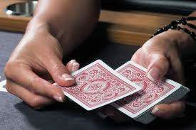

Array application: shuffle and deal from a deck of cards
Problem: Print N random cards from a deck.
Algorithm: Shuffle the deck, then deal.
Consider each card index i from 0 to 51.
Calculate a random index r between i and 51.
Exchange deck[i] with deck[r]
Print the first N cards in the deck.
Implementation
for (int i = 0; i < 52; i++)
{
int r = i + (int) (Math.random() * (52-i)); String t = deck[r];
deck[r] = deck[i]; deck[i] = t;
}
for (int i = 0; i < N; i++) System.out.print(deck[i]);
System.out.println();
each value between i and 51 equally likely

Slide 25

Array application: shuffle a deck of 10 cards (trace)
for (int i = 0; i < 10; i++)
{
int r = i + (int) (Math.random() * (10-i)); String t = deck[r];
deck[r] = deck[i]; deck[i] = t;
}
i | r | deck
 |  | 0 | 1 | 2 | 3 | 4 | 5 | 6 | 7 | 8 | 9
 |  | 2♣ | 3♣ | 4♣ | 5♣ | 6♣ | 7♣ | 8♣ | 9♣ | 10♣ | J♣
0 | 7 | 9♣ | 3♣ | 4♣ | 5♣ | 6♣ | 7♣ | 8♣ | 2♣ | 10♣ | J♣
1 | 3 | 9♣ | 5♣ | 4♣ | 3♣ | 6♣ | 7♣ | 8♣ | 2♣ | 10♣ | J♣
2 | 9 | 9♣ | 5♣ | J♣ | 3♣ | 6♣ | 7♣ | 8♣ | 2♣ | 10♣ | 4♣
3 | 9 | 9♣ | 5♣ | J♣ | 4♣ | 6♣ | 7♣ | 8♣ | 2♣ | 10♣ | 3♣
4 | 6 | 9♣ | 5♣ | J♣ | 4♣ | 8♣ | 7♣ | 6♣ | 2♣ | 10♣ | 3♣
5 | 9 | 9♣ | 5♣ | J♣ | 4♣ | 8♣ | 3♣ | 6♣ | 2♣ | 10♣ | 7♣
6 | 8 | 9♣ | 5♣ | J♣ | 4♣ | 8♣ | 3♣ | 10♣ | 2♣ | 6♣ | 7♣
7 | 9 | 9♣ | 5♣ | J♣ | 4♣ | 8♣ | 3♣ | 10♣ | 7♣ | 6♣ | 2♣
8 | 8 | 9♣ | 5♣ | J♣ | 4♣ | 8♣ | 3♣ | 10♣ | 7♣ | 6♣ | 2♣
9 | 9 | 9♣ | 5♣ | J♣ | 4♣ | 8♣ | 3♣ | 10♣ | 7♣ | 6♣ | 2♣
Q. Why does this method work?
Uses only exchanges, so the deck after the shuffle has the same cards as before.
N −i equally likely values for deck[i].
Therefore N ×(N −1)×(N −1)... ×2×1 = N !
equally likely values for deck[].
Initial order is immaterial.
Note: Same method is effective for randomly rearranging any type of data.

Slide 26



Array application: shuffle and deal from a deck of cards
public class DealCards
{
public static void main(String[] args)
{
int N = Integer.parseInt(args[0]);
String[] rank = {"2", "3", "4", "5", "6", "7", "8", "9", "10", "J", "Q", "K", "A" };
String[] suit = { "♣", "♦", "♥", "♠" };
String[] deck = new String[52]; for (int i = 0; i < 13; i++)
for (int j = 0; j < 4; j++)
deck[i + 13*j] = rank[i] + suit[j];
for (int i = 0; i < 52; i++)
{
int r = i + (int) (Math.random() * (52-i)); String t = deck[r];
deck[r] = deck[i]; deck[i] = t;
}
random poker hand
for (int i = 0; i < N; i++) System.out.print(deck[i]);
System.out.println();
% java DealCards 5 9♣ Q♥ 6♥ 4♦ 2♠
random bridge hand
}
}
% java DealCards 13
3♠ 4♥ 10♦ 6♥ 6♦ 2♠ 9♣ 8♠ A♠ 3♥ 9♠ 5♠ Q♥

Slide 27
Coupon collector
Coupon collector problem
M different types of coupons.
Collector acquires random coupons, one at a time, each type equally likely.
Q. What is the expected number of coupons needed to acquire a full collection?
Example: Collect all ranks in a random sequence of cards (M =
Sequence
9♣ | 5♠ | 8♥ | 10♦ | 2♠ | A♠ | 10♥ | Q♦ | 3♠ | 9♥ | 5♦ | 9♣ | 7♦ | 2♦ | 8♣ | 6♣ | Q♥ | K♣ | 10♥ | A♦ | 4♦ | J♥
Collection
2 | 3 | 4 | 5 | 6 | 7 | 8 | 9 | 10 | J | Q | K | A
2♠ | 3♠ | 4♦ | 5♠ | 6♣ | 7♦ | 8♥ | 9♣ | 10♦ | J♥ | Q♦ | K♣ | A♠
2♦ |  |  | 5♦ |  |  | 8♣ | 9♥ 9♣ | 10♥ 10♥ |  | Q♥ |  | A♦
22 cards needed to complete collection

Slide 28


Array application: coupon collector
Coupon collector simulation
Generate random int values between 0 and M −1.
Count number used to generate each value at least once.
public class Coupon
{
public static void main(String[] args)
{
int M = Integer.parseInt(args[0]);
int cards = 0; // number of cards collected int distinct = 0; // number of distinct cards
boolean[] found = new boolean[M]; while (distinct < M)
{
int r = (int) (Math.random() * M); cards++;
if (!found[r])
Key to the implementation
Create a boolean array of length M. (Initially all false by default.)
When r generated, check the r th value in the array.
If true, ignore it (not new).
If false, count it as new distinct value (and set r th entry to true)
{
% java Coupon 13 46
% java Coupon 13 22
distinct++; found[r] = true;
}
}
System.out.println(cards);
% java Coupon 13 54
% java Coupon 13 27
}
}

Slide 29

Array application: coupon collector (trace for M = 6)
r | found |  |  |  |  |  | distinct | cards
 | 0 | 1 | 2 | 3 | 4 | 5
 | F | F | F | F | F | F | 0 | 0
2 | F | F | T | F | F | F | 1 | 1
0 | T | F | T | F | F | F | 2 | 2
4 | T | F | T | F | T | F | 3 | 3
0 | T | F | T | F | T | F | 3 | 4
1 | T | T | T | F | T | F | 4 | 5
2 | T | T | T | F | T | F | 4 | 6
5 | T | T | T | F | T | T | 5 | 7
0 | T | T | T | F | T | T | 5 | 8
1 | T | T | T | F | T | T | 5 | 9
3 | T | T | T | T | T | T | 6 | 10
boolean[] found = new boolean[M]; while (distinct < M)
{
int r = (int) (Math.random() * M); cards++;
if (!found[r])
{
distinct++; found[r] = true;
}
}

Slide 30
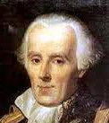

Simulation, randomness, and analysis (revisited)
Coupon collector problem
M different types of coupons.
Collector acquires random coupons, one at a time, each type equally likely.
Q. What is the expected number of coupons needed to acquire a full collection?
Pierre-Simon Laplace 1749-1827
A. (known via mathematical analysis for centuries) About M ln M + .57721M .
type | M | expected wait
playing card suits | 4 | 8
playing card ranks | 13 | 41
baseball cards | 1200 | 9201
Magic™ cards | 12534 | 125508
% java Coupon 4 11
% java Coupon 13 38
% java Coupon 1200 8789
% java Coupon 12534 125671
Remarks
Computer simulation can help validate mathematical analysis.
Computer simulation can also validate software behavior.
Example: Is Math.random()
simulating randomness?

Slide 31


Simulation, randomness, and analysis (revisited)
Once simulation is debugged, experimental evidence is easy to obtain.
Analogous code for coupon collector, this lecture
Gambler's ruin simulation, previous lecture
public class CouponCollector
{
public static void main(String[] args)
{
int M = Integer.parseInt(args[0]);
int trials = Integer.parseInt(args[1]); int cards = 0;
boolean[] found;
for (int i = 0; i < trials; i++)
{
int distinct = 0;
found = new boolean[M]; while (distinct < M)
{
int r = (int) (Math.random() * M); cards++;
if (!found[r])
{
distinct++; found[r] = true;
}
}
}
System.out.println(cards/trials);
}
}
public class Gambler
{
public static void main(String[] args)
{
int stake = Integer.parseInt(args[0]); int goal = Integer.parseInt(args[1]); int trials = Integer.parseInt(args[2]);
int wins = 0;
for (int i = 0; i < trials; i++)
{
int t = stake;
while (t > 0 && t < goal)
{
if (Math.random() < 0.5) t++; else t--;
}
if (t == goal) wins++;
}
System.out.println(wins + " wins of " + trials);
}
}

Slide 32


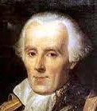
Simulation, randomness, and analysis (revisited)
Coupon collector problem
M different types of coupons.
Collector acquires random coupons, one at a time, each type equally likely.
Q. What is the expected number of coupons needed to acquire a full collection?
Predicted by mathematical analysis
type | M | M ln M + .57721M
playing card suits | 4 | 8
playing card ranks | 13 | 41
playing cards | 52 | 236
baseball cards | 1200 | 9201
magic cards | 12534 | 125508
Observed by computer simulation
% java CouponCollector 4 1000000
8
% java CouponCollector 13 1000000
41
% java CouponCollector 52 100000
236
% java CouponCollector 1200 10000
9176
% java CouponCollector 12534 1000
125920
Hypothesis. Centuries-old analysis is correct and Math.random() simulates randomness.

Slide 33
COMPUTER SCIENCE
S E D G E W I C K / W A Y N E
PA R T I : P R O G R A M M I N G I N JAVA
Image sources
http://www.vis.gr.jp/~nazoya/cgi-bin/catalog/img/CARDSBIC809_red.jpg http://www.alegriphotos.com/Shuffling_cards_in_casino-photo-deae1081e5ebc6631d6871f8b320b808.html http://iveypoker.com/wp-content/uploads/2013/09/Dealing.jpg http://upload.wikimedia.org/wikipedia/commons/b/bf/Pierre-Simon,_marquis_de_Laplace_(1745-1827)_-_Guérin.jpg
CS.3.B.Arrays.Examples

Slide 34
COMPUTER SCIENCE
S E D G E W I C K / W A Y N E
PA R T I : P R O G R A M M I N G I N JAVA
Arrays
Basic concepts
Examples of array-processing code
Two-dimensional arrays
CS.3.C.Arrays.2D

Slide 35
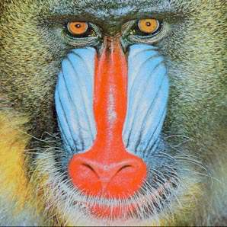
Two-dimensional arrays
A two-dimensional array is a doubly-indexed sequence of values of the same type.
grade
Examples
Matrices in math calculations.
Grades for students in an online class.
Outcomes of scientific experiments.
Transactions for bank customers.
Pixels in a digital image.
Geographic data
...
 | 0 | 1 | 2 | 3 | 4 | 5 | ...
0 | A | A | C | B | A | C
1 | B | B | B | B | A | A
2 | C | D | D | B | C | A
3 | A | A | A | A | A | A
4 | C | C | B | C | B | B
5 | A | A | A | B | A | A
...
student ID
y-coordinate
Main purpose. Facilitate storage and manipulation of data.
x-coordinate
35

Slide 36
Java language support for two-dimensional arrays (basic support)
operation | typical code
Declare a two-dimensional array | double[][] a;
Create a two-dimensional array of a given length | a = new double[1000][1000];
Refer to an array entry by index | a[i][j] = b[i][j] * c[j][k];
Refer to the number of rows | a.length;
Refer to the number of columns | a[i].length; ^{can be} for
Refer to row i | _{a[i]} no wa to co
different each row
y to refer lumn j
a[][]
a[0][0] | a[0][1] | a[0][2] | a[0][3] | a[0][4] | a[0][5] | a[0][6] | a[0][7] | a[0][8] | a[0][9]
a[1][0] | a[1][1] | a[1][2] | a[1][3] | a[1][4] | a[1][5] | a[1][6] | a[1][7] | a[1][8] | a[1][9]
a[2][0] | a[2][1] | a[2][2] | a[2][3] | a[2][4] | a[2][5] | a[2][6] | a[2][7] | a[2][8] | a[2][9]
a[1]
a 3-by-10 array

Slide 37
Java language support for two-dimensional arrays (initialization)
no need to use nested loops like
operation
typical code
for (i
for
nt i = 0; i < 1000; i++)
(int j = 0; j < 1000; j++) a[i][j] = 0.0;
Default initialization to 0 for numeric types
a = new double[1000][1000];
BUT cost of creating an array is proportional to its size.
Declare, create and initialize in a single statement
double[][] a = new double[1000][1000];
Initialize to literal values
double[][] { | p =
{ .92, | .02, | .02, | .02, | .02 | },
{ .02, | .92, | .32, | .32, | .32 | },
{ .02, | .02, | .02, | .92, | .02 | },
{ .92, | .02, | .02, | .02, | .02 | },
{ .47, | .02, | .47, | .02, | .02 | },
};

Slide 38


Application of arrays: vector and matrix calculations
Mathematical abstraction: vector Java implementation: 1D array
Mathematical abstraction: matrix Java implementation: 2D array
Vector addition
Matrix addition
double[] c = new double[N]; for (int i = 0; i < N; i++)
c[i] = a[i] + b[i];
double[][] c = new double[N][N]; for (int i = 0; i < N; i++)
for (int j = 0; j < N; j++) c[i][j] = a[i][j] + b[i][j];
.70 | .20 | .10
.30 | .60 | .10
.50 | .10 | .40
.80 | .30 | .50
.10 | .40 | .10
.10 | .30 | .40
1.5 | .50 | .60
.40 | 1.0 | .20
.60 | .40 | .80
.30 | .60 | .10
+
.50 | .10 | .40
=
.80 | .70 | .50
+
=

Slide 39

Application of arrays: vector and matrix calculations
Mathematical abstraction: vector Java implementation: 1D array
Mathematical abstraction: matrix Java implementation: 2D array
Vector dot product
Matrix multiplication
double sum = 0.0;
for (int i = 0; i < N; i++) sum += a[i]*b[i];
double[][] c = new double[N][N]; for (int i = 0; i < N; i++)
for (int j = 0; j < N; j++) for (int k = 0; k < N; k++)
c[i][j] += a[i][k] * b[k][j];
.30 | .60 | .10
·
.50 | .10 | .40
=
.25
i | x[i] | y[i] | x[i]*y[i] | sum
0 | 0.3 | 0.5 | 0.15 | 0.15
1 | 0.6 | 0.1 | 0.06 | 0.21
2 | 0.1 | 0.4 | 0.04 | 0.25
.70 | .20 | .10
.30 | .60 | .10
.50 | .10 | .40
.80 | .30 | .50
.10 | .40 | .10
.10 | .30 | .40
.59 | .32 | .41
.31 | .36 | .25
.45 | .31 | .42
*
=
end-of-loop trace

Slide 40

Pop quiz 4 on arrays
Q. How many multiplications to multiply two N-by-N matrices?
double[][] c = new double[N][N]; for (int i = 0; i < N; i++)
for (int j = 0; j < N; j++) for (int k = 0; k < N; k++)
c[i][j] += a[i][k] * b[k][j];
N
N ²
N ³
N ⁴

Slide 41
Pop quiz 4 on arrays
Q. How many multiplications to multiply two N-by-N matrices?
double[][] c = new double[N][N]; for (int i = 0; i < N; i++)
for (int j = 0; j < N; j++) for (int k = 0; k < N; k++)
c[i][j] += a[i][k] * b[k][j];
N
N ²
3. N ³
Nested for loops: N × N × N
4. N ⁴

Slide 42

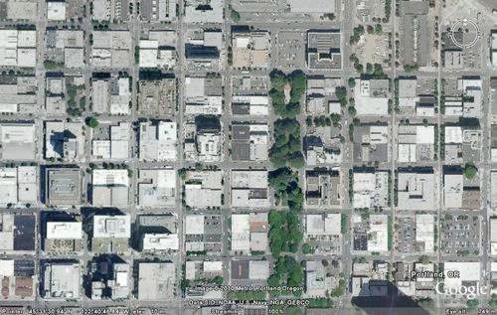
Self-avoiding random walks
A dog walks around at random in a city, never revisiting any intersection.
Q. Does the dog escape?
Model: a random process in an N-by-N lattice
Start in the middle.
Move to a random neighboring intersection but do not revisit any intersection.
Outcome 1 (escape): reach edge of lattice.
Outcome 2 (dead end): no unvisited neighbors.
escape
Q. What are the chances of reaching a dead end?
dead end
Approach: Use Monte Carlo simulation, recording visited positions in an N-by-N array.

Slide 43
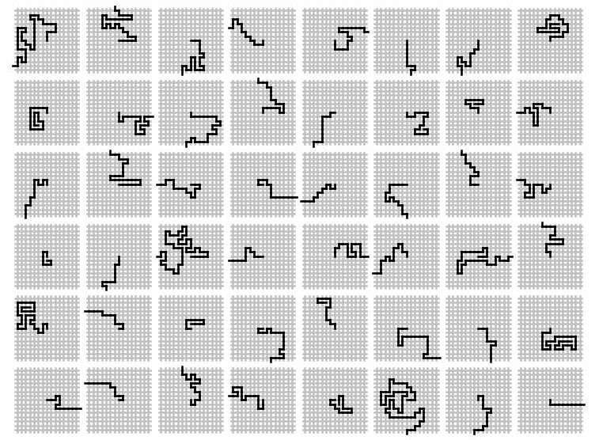
Self-avoiding random walks

Slide 44


Application of 2D arrays: self-avoiding random walks
public class SelfAvoidingWalker
{
public static void main(String[] args)
{
int N = Integer.parseInt(args[0]);
int trials = Integer.parseInt(args[1]); int deadEnds = 0;
for (int t = 0; t < trials; t++)
{
boolean[][] a = new boolean[N][N]; int x = N/2, y = N/2;
}
System.out.println(100*deadEnds/trials + "% dead ends");
}
}
% java SelfAvoidingWalker 5% dead ends | 10 | 100000
% java SelfAvoidingWalker 32% dead ends | 20 | 100000
% java SelfAvoidingWalker 58% dead ends | 30 | 100000
% java SelfAvoidingWalker 77% dead ends | 40 | 100000
% java SelfAvoidingWalker 87% dead ends | 50 | 100000
% java SelfAvoidingWalker 93% dead ends | 60 | 100000
% java SelfAvoidingWalker 96% dead ends | 70 | 100000
% java SelfAvoidingWalker 98% dead ends | 80 | 100000
% java SelfAvoidingWalker 99% dead ends | 90 | 100000
% java SelfAvoidingWalker 100 100000 99% dead ends
while (x > 0 && x < N-1 && y > 0 && y < N-1)
{
if (a[x-1][y] && a[x+1][y] && a[x][y-1] && a[x][y+1])
{ deadEnds++; break; }
a[x][y] = true;
double r = Math.random();
if (r < 0.25) { if (!a[x+1][y]) x++; }
else if (r < 0.50) { if (!a[x-1][y]) x--; }
else if (r < 0.75) { if (!a[x][y+1]) y++; }
else if (r < 1.00) { if (!a[x][y-1]) y--; }
}
100%
75%
50%
25%
0%
10
20
30
40
50
60
70
80
90
100

Slide 45
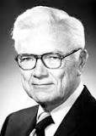
Simulation, randomness, and analysis (revisited again)
Self-avoiding walk in an N-by-N lattice
Start in the middle.
Move to a random neighboring intersection (do not revisit any intersection).
Applications
Model the behavior of solvents and polymers.
Model the physics of magnetic materials.
(many other physical phenomena)
Paul Flory 1910-1985
Nobel Prize 1974
Q. What is the probability of reaching a dead end?
A. Nobody knows (despite decades of study).
Mathematicians and physics researchers cannot solve the problem.
A. 99+% for N >100 (clear from simulations).
Computational models play an essential role in modern scientific research.
YOU can!
Remark: Computer simulation is often the only effective way to study a scientific phenomenon.

Slide 46


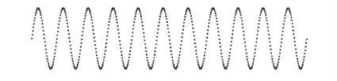
Your first data structure
Arrays: A basic building block in programming
They enable storage of large amounts of data (values all of the same type).
With an index, a program can instantly access a given value.
Efficiency derives from low-level computer hardware organization (stay tuned).
Some applications in this course:
^
digital images
N-body simulation
LFSR
digital audio

Slide 47
COMPUTER SCIENCE
S E D G E W I C K / W A Y N E
PA R T I : P R O G R A M M I N G I N JAVA
Image sources
http://en.wikipedia.org/wiki/Airedale_Terrier#mediaviewer/File:Airedale_Terrier.jpg http://www.nobelprize.org/nobel_prizes/chemistry/laureates/1974/flory_postcard.jpg
CS.3.C.Arrays.2D

Slide 48
COMPUTER SCIENCE
S E D G E W I C K / W A Y N E
PA R T I : P R O G R A M M I N G I N JAVA
_{C}omputer
3. Arrays
_{S}cience
An Interdisciplinary Approach
1.4
R O B E R T S E D G E W I C K
KEVIN W A YNE
http:// introcs.cs.princeton.edu

