Slide 1

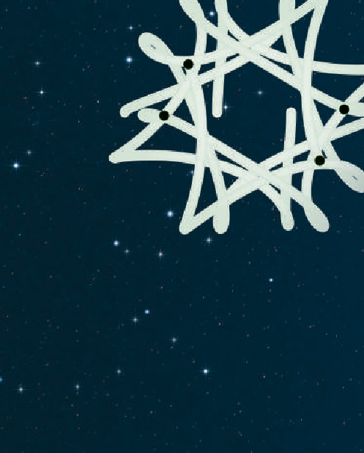
COMPUTER SCIENCE
S E D G E W I C K / W A Y N E
PA R T I : P R O G R A M M I N G I N JAVA
_{C}omputer
4. Input and Output
_{S}cience
An Interdisciplinary Approach
1.5
R O B E R T S E D G E W I C K
KEVIN W A YNE
http:// introcs.cs.princeton.edu

Slide 2

COMPUTER SCIENCE
S E D G E W I C K / W A Y N E
PA R T I : P R O G R A M M I N G I N JAVA
Input and Output
Standard input and output
Standard drawing
Fractal drawings
Animation
CS.4.A.IO.Standard

Slide 3

Basic building blocks for programming
any program you might want to write
objects
functions and modules
graphics, sound, and image I/O
graphics, sound, and image I/O
arrays
conditionals and loops
Ability to interact with the outside world
Math
text I/O
text I/O
primitive data types
assignment statements

Slide 4

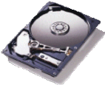


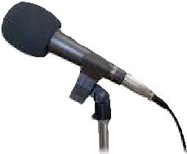

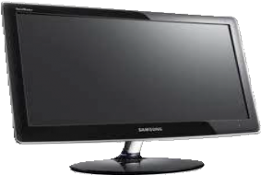
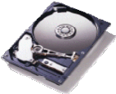



Input and output
Goal: Write Java programs that interact with the outside world via input and output devices.
Typical
INPUT
devices
Keyboard
Trackpad
Storage
Network
Camera
Microphone
Typical OUTPUT
devices
Storage
Network
Printer
Speakers
Display
Our approach.
Define input and output abstractions.
Use operating system (OS) functionality to connect our Java programs to actual devices.

Slide 5
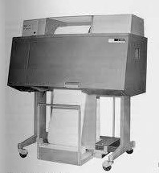
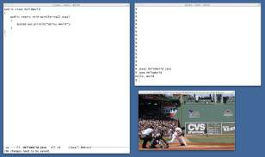
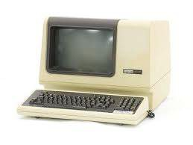
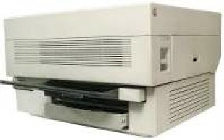
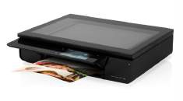

Abstraction
plays an essential role in understanding computation.
Interested in thinking more deeply about this concept?
Consider taking a philosophy course.
An abstraction is something that exists only as an idea.
Example: "Printing" is the idea of a program producing text as output.
Good abstractions simplify our view of the world, by unifying diverse real-world artifacts.
This lecture. Abstractions for delivering input to or receiving output from our programs.

Slide 6
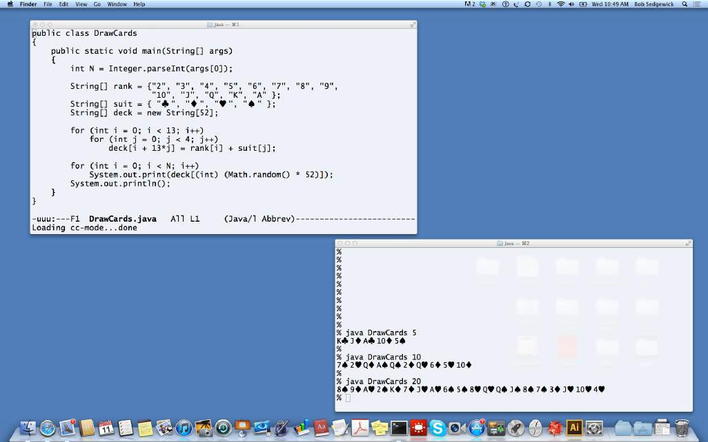

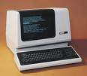
Quick review
Terminal. An abstraction for providing input and output to a program.
Input from command line
% java DrawCards 10
7♠ 2♥ Q♦ A♠ Q♠ 2♦ Q♥ 6♦ 5♥ 10♦
Output to standard output stream
Virtual VT-100
terminal

Slide 7
Input-output abstraction (so far)
A mental model of what a Java program does.
command-line arguments
Java program
standard output stream

Slide 8


Review: command-line input
Command-line input. An abstraction for providing arguments (strings) to a program.
Basic properties
Strings you type after the program name are available as args[0], args[1], ... at run time.
Arguments are available when the program begins execution.
Need to call system conversion methods to convert the strings to other types of data.
public class RandomInt
{
public static void main(String[] args)
{
int N = Integer.parseInt(args[0]); double r = Math.random();
int t = (int) (r * N); System.out.println(t);
}
}
% java RandomInt 6 3
% java RandomInt 10000 3184

Slide 9



Review: standard output
Infinity. An abstraction describing something having no limit.
Standard output stream. An abstraction for an infinite output sequence.
Basic properties
Strings from System.out.println() are added to the end of the standard output stream.
Standard output stream is sent to terminal application by default.
public class RandomSeq
{
public static void main(String[] args)
{
int N = Integer.parseInt(args[0]); for (int i = 0; i < N; i++)
System.out.println(Math.random());
}
}
% java RandomSeq 4 0.9320744627218469
0.4279508713950715
0.08994615071160994
0.6579792663546435
% java RandomSeq 1000000 0.09474882292442943
0.2832974030384712
0.1833964252856476
0.2952177517730442
0.8035985765979008
0.7469424300071382
0.5835267075283997
0.3455279612587455
...
No limit on amount of output
9

Slide 10
Improved input-output abstraction
Add an infinite input stream.
command-line arguments
standard input stream
Java program
standard output stream

Slide 11
Standard input
Infinity. An abstraction describing something having no limit.
Standard input stream. An abstraction for an infinite input sequence.
standard input stream
Java program
Advantages over command-line input
Can provide new arguments while the program is executing.
No limit on the amount of data we can input to a program.
Conversion to primitive types is explicitly handled (stay tuned).

Slide 12
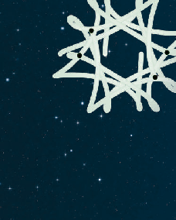
StdIn library
Developed for this course, but broadly useful
Implement abstractions invented for UNIX in the 1970s.
Available for download at booksite.
Included in introcs software you downloaded at the beginning of the course.
_{C}omputer
_{S}cience
An Interdisciplinary Approach
R O B E R T S E D G E W I C K
KEVIN W A YNE
public class StdIn
boolean isEmpty() | true iff no more values
int readInt() | read a value of type int
double readDouble() | read a value of type double
long readLong() | read a value of type long
boolean readBoolean() | read a value of type boolean
char readChar() | read a value of type char
String readString() | read a value of type String
String readAll() | read the rest of the text
standard input stream
Java program

Slide 13
StdOut library
Developed for this course, but broadly useful
Implement abstractions invented for UNIX in the 1970s.
Available for download at booksite.
Included in introcs software you downloaded at the beginning of the course.
_{C}omputer
_{S}cience
An Interdisciplinary Approach
R O B E R T S E D G E W I C K
KEVIN W A YNE
public class StdOut
void print(String s) | put s on the output stream
void println() | put a newline on the output stream
void println(String s) | put s, then a newline on the stream
void printf(String f, ...) | formatted output
Java program
standard output stream
Q. These are the same as System.out. Why not just use System.out?
A. We provide a consistent set of simple I/O abstractions in one place.
A. We can make output independent of system, language, and locale.
use StdOut
from now on

Slide 14


StdIn/StdOut warmup
Interactive input
Prompt user to type inputs on standard input stream.
Mix input stream with output stream.
public class AddTwo
{
public static void main(String[] args)
{
StdOut.print("Type the first integer: "); int x = StdIn.readInt(); StdOut.print("Type the second integer: "); int y = StdIn.readInt();
int sum = x + y;
StdOut.println("Their sum is " + sum);
}
}
% java AddTwo
Type the first integer: 1 Type the second integer: 2 Their sum is 3

Slide 15


StdIn application: average the numbers on the standard input stream
Average
Read a stream of numbers.
Compute their average.
public class Average
{
public static void main(String[] args)
{
double sum = 0.0; // cumulative total int n = 0; // number of values while (!StdIn.isEmpty())
{
double x = StdIn.readDouble(); sum = sum + x;
n++;
}
StdOut.println(sum / n);
}
}
Q. How do I specify the end of the stream?
A. <Ctrl-d> (standard for decades).
A. <Ctrl-z> (Windows).
Key points
No limit on the size of the input stream.
Input and output can be interleaved.
% java Average
10.0 5.0 6.0
3.0 7.0 32.0
<Ctrl-d> 10.5

Slide 16


Summary: prototypical applications of standard output and standard input
StdOut: Generate a stream of random numbers
StdIn: Compute the average of a stream of numbers
public class RandomSeq
{
public static void main(String[] args)
{
int N = Integer.parseInt(args[0]); for (int i = 0; i < N; i++)
StdOut.println(Math.random());
}
}
public class Average
{
public static void main(String[] args)
{
double sum = 0.0; // cumulative total int n = 0; // number of values while (!StdIn.isEmpty())
{
double x = StdIn.readDouble(); sum = sum + x;
n++;
}
StdOut.println(sum / n);
}
}
Both streams are infinite (no limit on their size).
Q. Do I always have to type in my input data and print my output?
A. No! Keep data and results in files on your computer, or use piping to connect programs.

Slide 17



Redirection: keep data in files on your computer
Redirect standard output to a file
% java RandomSeq 1000000 > data.txt
Redirect from a file to standard input
% java Average < data.txt 0.4947655567740991
% more data.txt
"redirect standard output to"
"take standard input from"
0.09474882292442943
0.2832974030384712
0.1833964252856476
0.2952177517730442
0.8035985765979008
0.7469424300071382
0.5835267075283997
0.3455279612587455
...
RandomSeq
standard output stream
file
standard input stream
Slight problem. Still limited by maximum file size.
Average

Slide 18

Piping: entirely avoid saving data
Q. There's no room for a huge file on my computer. Now what?
A. No problem! Use piping.
Piping. Connect standard output of one program to standard input of another.
set up a pipe
% java RandomSeq 1000000 | java Average 0.4997970473016028
% java RandomSeq 1000000 | java Average 0.5002071875644842
RandomSeq
standard output stream
standard input stream
Average
Critical point. No limit within programs on the amount of data they can handle.
It is the job of the system to collect data on standard output and provide it to standard input.

Slide 19
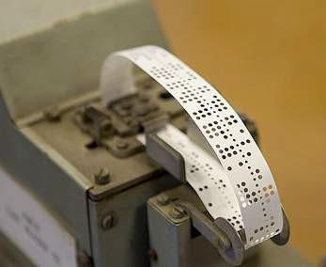
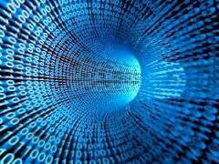
Streaming algorithms
Early computing
Amount of available memory was much smaller than amount of data to be processed.
But dramatic increases happened every year.
Redirection and piping enabled programs to handle much more data than computers could store.
Modern computing
Amount of available memory is much smaller than amount of data to be processed.
Dramatic increases still happen every year.
Streaming algorithms enable our programs to handle much more data than our computers can store.
Lesson. Avoid limits within your program whenever possible.

Slide 20
COMPUTER SCIENCE
S E D G E W I C K / W A Y N E
PA R T I : P R O G R A M M I N G I N JAVA
Image sources
http://www.digitalreins.com/wp-content/uploads/2013/05/Binary-code.jpg http://en.wikipedia.org/wiki/Punched_tape#mediaviewer/File:Harwell-dekatron-witch-10.jpg
CS.4.A.IO.Standard

Slide 21
COMPUTER SCIENCE
S E D G E W I C K / W A Y N E
PA R T I : P R O G R A M M I N G I N JAVA
Input and Output
Standard input and output
Standard drawing
Fractal drawings
Animation
CS.4.B.IO.Drawing

Slide 22

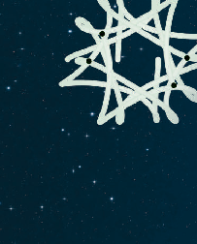
Further improvements to our I/O abstraction
Add the ability to create a drawing.
command-line arguments
standard input stream
Java program
standard output stream
StdDraw library
Developed for this course, but broadly useful.
Available for download at booksite.
Included in introcs software.
standard drawing
Computer
_{S}cience
An Interdisciplinary Approach
R O B E R T S E D G E W I C K
KEVIN W A YNE

Slide 23
StdDraw library
public class StdDraw
void line(double x0, double y0, double x1, double y1) void point(double x, double y)
void text(double x, double y, String s)
void circle(double x, double y, double r)
also filledCircle(), filledSquare(),
and filledPolygon()
void square(double x, double y, double r)
void polygon(double x, double y, double r)
void picture(double x, double y, String filename)
place .gif, .jpg or .png file
Java program
void setPenRadius(double r)
void setPenColor(Color c)
void setXscale(double x0, double x1)
reset x range to [x0, x1)
void setYscale(double y0, double y1)
reset y range to [y0, y1)
void show(int dt)
show all; pause dt millisecs
standard drawing

Slide 24




“Hello, World” for StdDraw
public class Triangle
{
public static void main(String[] args)
{
double c = Math.sqrt(3.0) / 2.0; StdDraw.setPenRadius(0.01); StdDraw.line(0.0, 0.0, 1.0, 0.0);
StdDraw.line(1.0, 0.0, 0.5, c);
StdDraw.line(0.5, c, 0.0, 0.0); StdDraw.point(0.5, c/3.0); StdDraw.text(0.5, 0.5, "Hello, World");
}
}
Trace of drawing
(0.5, 0.866025...)
Hello, World
(0, 0)
(1, 0)

Slide 25
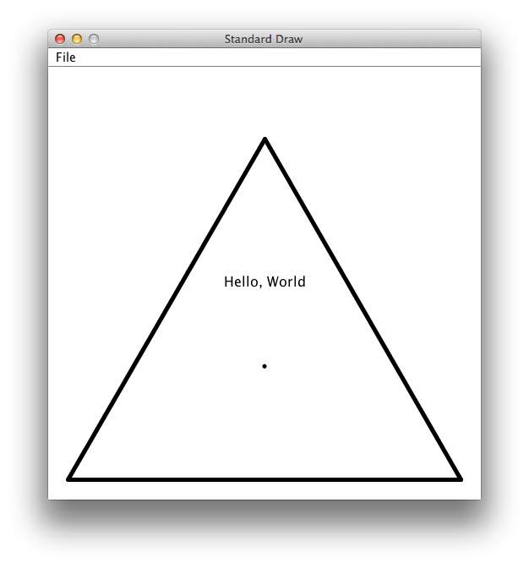
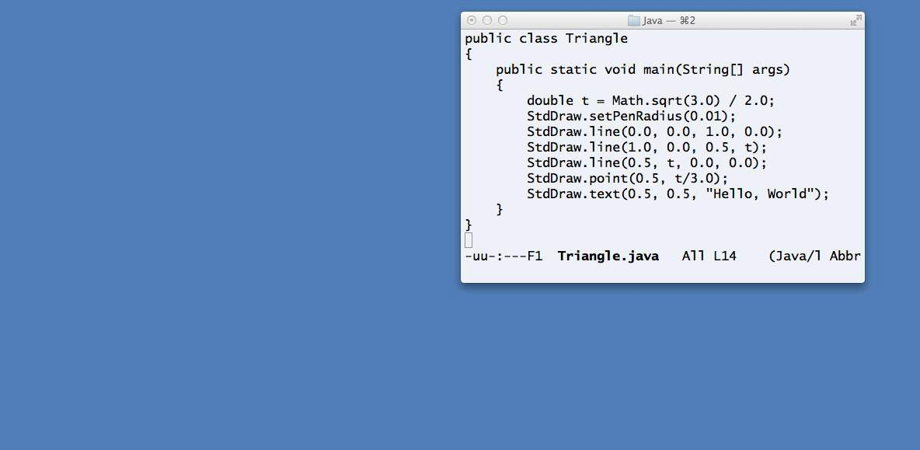
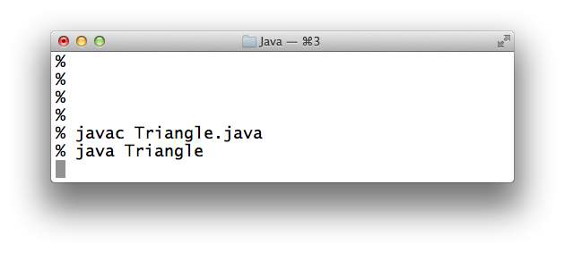
“Hello, World” for StdDraw
window for standard drawing
virtual terminal for editor
public class Triangle
{
public static void main(String[] args)
{
double c = Math.sqrt(3.0) / 2.0; StdDraw.setPenRadius(0.01); StdDraw.line(0.0, 0.0, 1.0, 0.0);
StdDraw.line(1.0, 0.0, 0.5, c);
StdDraw.line(0.5, c, 0.0, 0.0); StdDraw.point(0.5, c/3.0); StdDraw.text(0.5, 0.5, "Hello, World");
}
}
%
% javac Triangle.java
% java Triangle
virtual terminal for OS commands

Slide 26


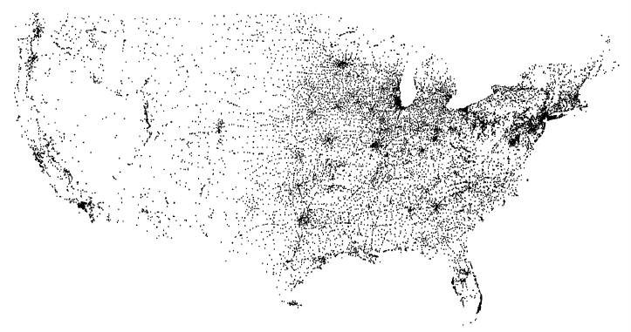
StdDraw application: data visualization
bounding box coords
% more < USA.txt
669905.0 247205.0 1244962.0 490000.0
sequence of point coordinates
(13,509 cities)
% java PlotFilter < USA.txt
public class PlotFilter
{
public static void main(String[] args)
{
double xmin = StdIn.readDouble();
1097038.8890 | 245552.7780
1103961.1110 | 247133.3330
1104677.7780 | 247205.5560
...
read coords of
double ymin = StdIn.readDouble();
bounding box
double xmax = StdIn.readDouble();
double ymax = StdIn.readDouble(); StdDraw.setXscale(xmin, xmax); StdDraw.setYscale(ymin, ymax); while (!StdIn.isEmpty())
{
rescale
double x = StdIn.readDouble(); double y = StdIn.readDouble(); StdDraw.point(x, y);
read and plot a point
}
}
}

Slide 27

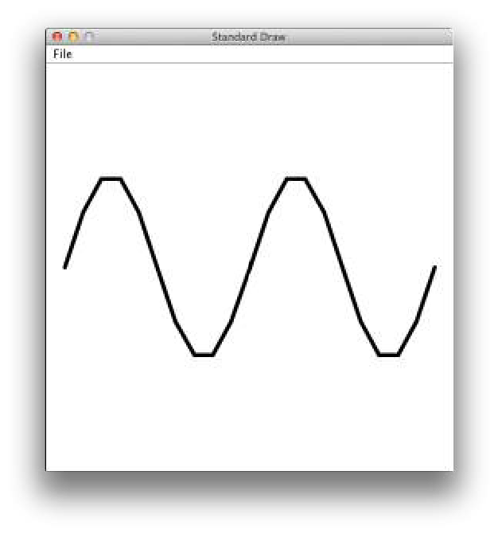


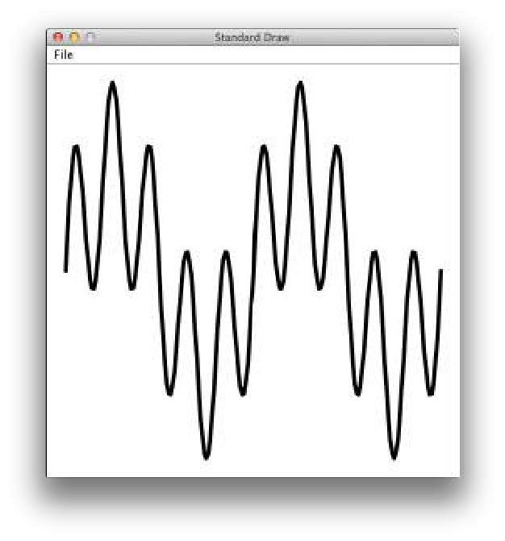
StdDraw application: plotting a function
Goal. Plot y = sin(4x)+ sin(20x) in the interval (0, π).
% java PlotFunctionEx 20
Method. Take N samples, regularly spaced.
public class PlotFunctionEx
{
public static void main(String[] args)
{
int N = Integer.parseInt(args[0]); double[] x = new double[N+1]; double[] y = new double[N+1];
for (int i = 0; i <= N; i++)
{
x[i] = Math.PI * i / N;
y[i] = Math.sin(4*x[i]) + Math.sin(20*x[i]);
}
StdDraw.setXscale(0, Math.PI); StdDraw.setYscale(-2.0, +2.0); for (int i = 0; i < N; i++)
StdDraw.line(x[i], y[i], x[i+1], y[i+1]);
}
}
Lesson 1: Plotting is easy.
% java PlotFunctionEx 200
Lesson 2: Take a sufficiently large sample—otherwise you might miss something!

Slide 28
COMPUTER SCIENCE
S E D G E W I C K / W A Y N E
PA R T I : P R O G R A M M I N G I N JAVA
CS.4.B.IO.Drawing

Slide 29
COMPUTER SCIENCE
S E D G E W I C K / W A Y N E
PA R T I : P R O G R A M M I N G I N JAVA
Input and Output
Standard input and output
Standard drawing
Fractal drawings
Animation
CS.4.C.IO.Fractals

Slide 30

StdDraw application: a random game
Draw an equilateral triangle, number the vertices 0, 1, 2 and make 0 the current point.
Pick a vertex at random.
Draw a point halfway between that vertex and the current point.
Repeat.
0 | 1 | 2 | 3 | 4 | 5 | 6 | 7 | 8 | 9 | 10
2 | 1 | 2 | 0 | 1 | 0 | 0 | 0 | 2 | 1 | 1
2
vertex | ID | probability | new x | new y
(0, 0) | 0 | 1/3 | .5x | .5y
(1, 0) | 1 | 1/3 | .5x + .5 | .5y
(.5, √3/2) | 2 | 1/3 | .5x + .25 | .5y + .433
0
1

Slide 31




StdDraw application: a random game
public class Chaos
{
public static void main(String[] args)
{
int trials = Integer.parseInt(args[0]);
double c = Math.sqrt(3.0) / 2.0; double[] cx = { 0.000, 1.000, 0.500 };
double[] cy = { 0.000, 0.000, c };
StdDraw.setPenRadius(0.01); double x = 0.0, y = 0.0;
for (int t = 0; t < trials; t++)
{
int r = (int) (Math.random() * 3); x = (x + cx[r]) / 2.0;
y = (y + cy[r]) / 2.0; StdDraw.point(x, y);
}
}
}
% java Chaos 10000

Slide 32
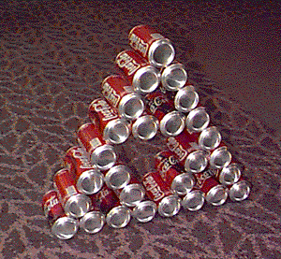
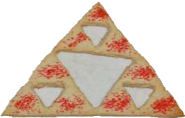
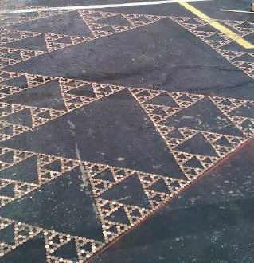

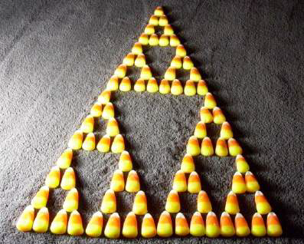

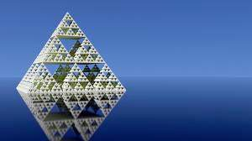
Sierpinski triangles in the wild
1
1 1
odd numbers
1 2 1
1 3 3 1
1 4 6 4 1
1 5 10 10 5 1
1 6 15 20 15 6 1
1 7 21 35 35 21 7 1
Pascal's triangle

Slide 33

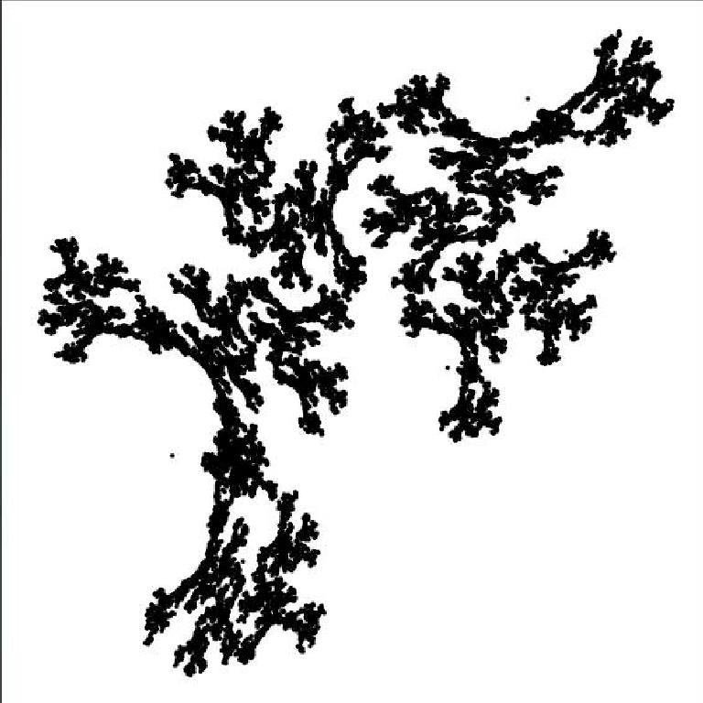

Iterated function systems
What happens when we change the rules?
% java IFS 10000 < coral.txt
probability | new x | new y
40% | .31x − .53y + .89 | −.46x − .29y + 1.10
15% | .31x − .08y + .22 | .15x − .45y + .34
45% | .55y + .01 | .69x − .20y + .38
IFS.java (Program 2.2.3) is a data-driven program that takes the coefficients from standard input.
% more coral.txt 3
0.40 0.15 0.45
3 3
0.307692 | -0.531469 | 0.8863493
0.307692 | -0.076923 | 0.2166292
0.000000 | 0.545455 | 0.0106363
3 3
-0.461538 | -0.293706 | 1.0962865
0.153846 | -0.447552 | 0.3383760
0.692308 | -0.195804 | 0.3808254

Slide 34



Iterated function systems
Another example of changing the rules
% java IFS 10000 < barnsley.txt
probability | new x | new y
2% | 0.5 | .27y
15% | −.14x + .26y + .57 | .25x + .22y - .04
13% | .17x − .21y + .41 | .22x + .18y + .09
70% | .78x + .03y + .11 | −.03x + .74y + .27
% more barnsley.txt 4
.02 .15 .13 .70
4 3
.000 | .000 | .500
-.139 | .263 | .570
.170 | -.215 | .408
.781 | .034 | .1075
3 .000 .270 .000
.246 | .224 | -.036
.222 | .176 | .0893
-.032 | .739 | .270
4

Slide 35

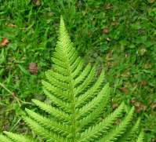
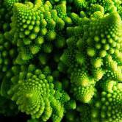
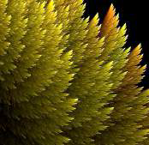
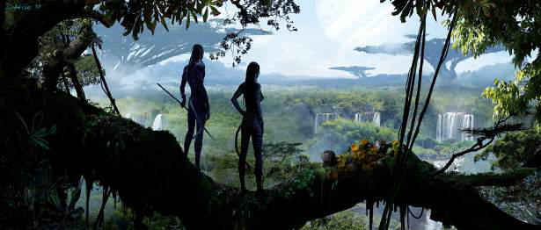
Iterated function systems
Simple iterative computations yield patterns that are remarkably similar to those found in the natural world.
Q. What does computation tell us about nature?
an IFS fern
a real fern
Q. What does nature tell us about computation?
20th century sciences. Formulas.
21st century sciences. Algorithms?
a real plant
an IFS plant
Note. You have seen many practical applications of integrated function systems, in movies and games.

Slide 36
COMPUTER SCIENCE
S E D G E W I C K / W A Y N E
PA R T I : P R O G R A M M I N G I N JAVA
Image sources
http://paulbourke.net/fractals/gasket/cokegasket.gif http://www.buzzfeed.com/atmccann/11-awesome-math-foods#39wokfk http://sheilakh.deviantart.com/art/The-Legend-of-Sierpinski-308953447 http://commons.wikimedia.org/wiki/File:Lady_Fern_frond_-_normal_appearance.jpg
http://img3.wikia.nocookie.net/ cb20100707172110/jamescameronsavatar/images/e/e1/Avatar_concept_art-3.jpg
CS.4.C.IO.Fractals

Slide 37
COMPUTER SCIENCE
S E D G E W I C K / W A Y N E
PA R T I : P R O G R A M M I N G I N JAVA
Input and Output
Standard input and output
Standard drawing
Fractal drawings
Animation
CS.4.D.IO.Animation

Slide 38


Animation
rx+vx
To create animation with StdDraw. Repeat the following:
Clear the screen.
Move the object.
Draw the object.
Display and pause briefly.
When display time is much greater than the screen-clear time, we have the illusion of motion.
ry
ry+vy
vy
vx
rx
Bouncing ball.
Ball has position (rx, ry) and constant velocity (vx, vy).
To move the ball, update position to (rx+vx, ry+vy).
If the ball hits a vertical wall, set vx to -vx.
If the ball hits a horizontal wall, set vy to -vy.

Slide 39



Bouncing ball
public class BouncingBall
% java BouncingBall
{
public static void main(String[] args)
{
double rx = .480, ry = .860; double vx = .015, vy = .023; double radius = .05; StdDraw.setXscale(-1.0, +1.0);
StdDraw.setYscale(-1.0, +1.0); while(true)
{
StdDraw.setPenColor(StdDraw.LIGHT_GRAY); StdDraw.filledSquare(0.0, 0.0, 1.0);
if (Math.abs(rx + vx) + radius > 1.0) vx = -vx; if (Math.abs(ry + vy) + radius > 1.0) vy = -vy; rx = rx + vx;
ry = ry + vy; StdDraw.setPenColor(StdDraw.BLACK); StdDraw.filledCircle(rx, ry, radius); StdDraw.show(20);
}
}
}

Slide 40

Pop quiz on animation
Q. What happens if we move clear the screen out of the loop?
public class BouncingBall
{
public static void main(String[] args)
{
double rx = .480, ry = .860; double vx = .015, vy = .023; double radius = .05; StdDraw.setXscale(-1.0, +1.0);
StdDraw.setYscale(-1.0, +1.0); while(true)
{
StdDraw.setPenColor(StdDraw. LIGHT_GRAY); StdDraw.filledSquare(0.0, 0.0, 1.0);
if (Math.abs(rx + vx) + radius > 1.0) vx = -vx;
if (Math.abs(ry + vy) + radius > 1.0) vy = -vy; rx = rx + vx;
ry = ry + vy;
StdDraw.setPenColor(StdDraw.BLACK); StdDraw.filledCircle(rx, ry, sz); StdDraw.show(20);
}
}

Slide 41


Pop quiz on animation
Q. What happens if we move clear the screen out of the loop?
public class BouncingBall
{
public static void main(String[] args)
{
double rx = .480, ry = .860; double vx = .015, vy = .023; double radius = .05; StdDraw.setXscale(-1.0, +1.0);
StdDraw.setYscale(-1.0, +1.0); StdDraw.setPenColor(StdDraw. LIGHT_GRAY); StdDraw.filledSquare(0.0, 0.0, 1.0); while(true)
{
if (Math.abs(rx + vx) + radius > 1.0) vx = -vx;
if (Math.abs(ry + vy) + radius > 1.0) vy = -vy; rx = rx + vx;
ry = ry + vy;
StdDraw.setPenColor(StdDraw.BLACK); StdDraw.filledCircle(rx, ry, radius); StdDraw.show(20);
}
}
A. We see the ball’s entire path.

Slide 42


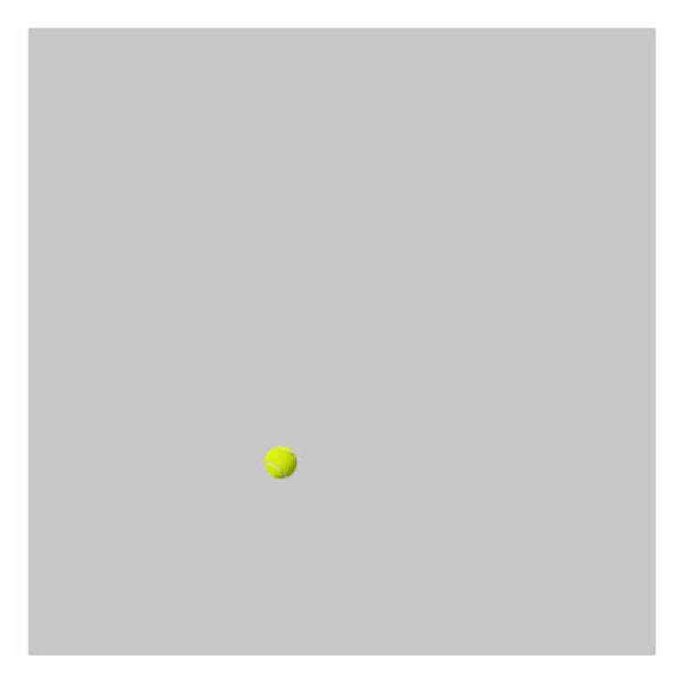
Deluxe bouncing ball
public class BouncingBallDeluxe
{
public static void main(String[] args)
{
double rx = .480, ry = .860; double vx = .015, vy = .023; double radius = .05; StdDraw.setXscale(-1.0, +1.0);
StdDraw.setYscale(-1.0, +1.0); while(true)
{
StdDraw.setPenColor(StdDraw. LIGHT_GRAY); StdDraw.filledSquare(0.0, 0.0, 1.0);
rx = rx + vx; ry = ry + vy;
StdDraw.show(20);
}
}
}
% java BouncingBallDeluxe
if (Math.abs(rx + vx) + radius > 1.0)
{ StdAudio.play("pipebang.wav"); vx = -vx; } if (Math.abs(ry + vy) + radius > 1.0)
{ StdAudio.play("pipebang.wav"); vy = -vy; }
StdDraw.picture(rx, ry, "TennisBall.png");
Stay tuned to next lecture for full description of StdAudio.

Slide 43


A set of I/O abstractions for Java
Developed for this course, but broadly useful
StdIn, StdOut, StdDraw, and StdAudio.
Available for download at booksite (and included in introcs software).
Computer
_{S}cience
An Interdisciplinary Approach
R O B E R T S E D G E W I C K
KEVIN W A YNE
command-line arguments
standard input stream
Java program
standard output stream
standard drawing
standard audio

Slide 44
COMPUTER SCIENCE
S E D G E W I C K / W A Y N E
PA R T I : P R O G R A M M I N G I N JAVA
CS.4.D.IO.Animation

Slide 45
COMPUTER SCIENCE
S E D G E W I C K / W A Y N E
PA R T I : P R O G R A M M I N G I N JAVA
_{C}omputer
4. Input and Output
_{S}cience
An Interdisciplinary Approach
1.5
R O B E R T S E D G E W I C K
KEVIN W A YNE
http:// introcs.cs.princeton.edu

