Slide 1


COMPUTER SCIENCE
S E D G E W I C K / W A Y N E
PA R T I : P R O G R A M M I N G I N JAVA
_{C}omputer
6. Recursion
_{S}cience
An Interdisciplinary Approach
Section 2.3
R O B E R T S E D G E W I C K
KEVIN W A YNE
http:// introcs.cs.princeton.edu

Slide 2

COMPUTER SCIENCE
S E D G E W I C K / W A Y N E
PA R T I : P R O G R A M M I N G I N JAVA
Recursion
Foundations
A classic example
Recursive graphics
Avoiding exponential waste
Dynamic programming
CS.6.A.Recursion.Foundations

Slide 3
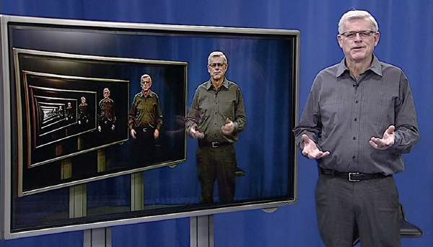
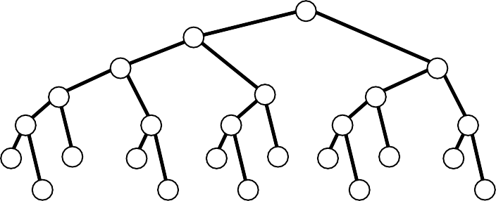
Overview
Q. What is recursion?
A. When something is specified in terms of itself.
Why learn recursion?
Represents a new mode of thinking.
Provides a powerful programming paradigm.
Enables reasoning about correctness.
Gives insight into the nature of computation.
Many computational artifacts are naturally self-referential.
File system with folders containing folders.
Fractal graphical patterns.
Divide-and-conquer algorithms (stay tuned).
3

Slide 4


Example: Convert an integer to binary
Recursive program
public class Binary
{
public static String convert(int N)
{
To compute a function of a positive integer N
Base case. Return a value for small N .
Reduction step. Assuming that it works for smaller values of its argument, use the function to compute a return value for N.
int 0 or 1 automatically
if (N == 1) return "1";
return convert(N/2) + (N % 2);
converted to
String "0" or "1"
}
public static void main(String[] args)
{
int N = Integer.parseInt(args[0]); StdOut.println(convert(N));
}
}
% java Binary 6
110
% java Binary 37 100101
% java Binary 999999 11110100001000111111
Q. How can we be convinced that this method is correct?
A. Use mathematical induction.

Slide 5
Mathematical induction (quick review)
To prove a statement involving a positive integer N
Base case. Prove it for some specific values of N.
Induction step. Assuming that the statement is true for all positive integers less than N, use that fact to prove it for N.
Example
The sum of the first N odd integers is N ².
Base case. True for N = 1.
Induction step. The N th odd integer is 2N − 1. Let TN = 1 + 3 + 5 + ... + (2N − 1) be the sum of the first N odd integers.
Assume that TN − 1 = (N − 1)².
Then TN = (N − 1)² + (2N − 1) = N ².
1
 | 3
 |  | 5
 |  |  | 7
 |  |  |  | 9
An alternate proof

Slide 6

Proving a recursive program correct
Recursion
Mathematical induction
To compute a function of N
Base case. Return a value for small N .
Reduction step. Assuming that it works for smaller values of its argument, use the function to compute a return value for N.
To prove a statement involving N
Base case. Prove it for small N.
Induction step. Assuming that the statement is true for all positive integers less than N, use that fact to prove it for N.
Recursive program Correctness proof, by induction
public static String convert(int N)
{
if (N == 1) return "1";
return convert(N/2) + (N % 2);
}
convert() computes the binary representation of N
Base case. Returns "1" for N = 1.
Induction step. Assume that convert() works for N/2
Correct to append "0" if N is even, since N = 2(N/2).
N/2 N
Correct to append "1" if N is odd since N = 2(N/2) + 1.
N/2 N
 |  |  |  |  |  |  | 0
 |  |  |  |  |  |  | 1

Slide 7







Mechanics of a function call
System actions when any function is called
Save environment (values of all variables and call location).
Initialize values of argument variables.
convert(26)
if (N == 1) return "1";
return "1101" + "0";
convert(13)
if (N == 1) return "1";
return "110" + "1";
convert(6)
if (N == 1) return "1";
return "11" + "0";
convert(3)
if (N == 1) return "1";
return "1" + "1";
convert(1)
if (N == 1) return "1"; return convert(0) + "1";
convert(13)
Transfer control to the function.
Restore environment (and assign return value)
Transfer control back to the calling code.
convert(6)
public class Binary
{
public static String convert(int N)
{
if (N == 1) return "1";
return convert(N/2) + (N % 2);
}
public static void main(String[] args)
{
int N = Integer.parseInt(args[0]); System.out.println(convert(N));
}
}
convert(3)
convert(1)
% java Convert 26 11010

Slide 8






Programming with recursion: typical bugs
Missing base case
public static double bad(int N)
{
return bad(N-1) + 1.0/N;
}
No convergence guarantee
public static double bad(int N)
{
if (N == 1) return 1.0; return bad(1 + N/2) + 1.0/N;
}
Try N = 2
Both lead to infinite recursive loops (bad news).
need to know how to stop them on your computer

Slide 9


Collatz Sequence
Collatz function of N.
If N is 1, stop.
If N is even, divide by 2.
If N is odd, multiply by 3 and add 1.
7 | 22 | 11 | 34 | 17 | 52 | 26 | 13 | 49 | 20 | ...
public static void collatz(int N)
{
StdOut.print(N + " "); if (N == 1) return;
if (N % 2 == 0) collatz(N / 2);
collatz(3*N + 1);
}
% java Collatz 7
7 22 11 34 17 52 26 13 40 20 10 5 16 8 4 2 1
Amazing fact. No one knows whether or not this function terminates for all N (!)
Note. We usually ensure termination by only making recursive calls for smaller N.

Slide 10
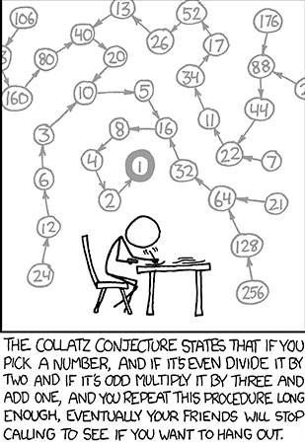

Slide 11
COMPUTER SCIENCE
S E D G E W I C K / W A Y N E
PA R T I : P R O G R A M M I N G I N JAVA
Image sources
http://xkcd.com/710/
CS.6.A.Recursion.Foundations

Slide 12
COMPUTER SCIENCE
S E D G E W I C K / W A Y N E
PA R T I : P R O G R A M M I N G I N JAVA
Recursion
Foundations
A classic example
Recursive graphics
Avoiding exponential waste
Dynamic programming
CS.6.B.Recursion.Hanoi

Slide 13



Warmup: subdivisions of a ruler (revisited)
ruler(n): create subdivisions of a ruler to 1/2^{n} inches.
Return one space for n = 0.
Otherwise, sandwich n between two copies of ruler(n-1).
1 2 1 3 1 2 1 4 1 2 1 3 1 2 1
public class Ruler
{
}
public static void main(String[] args)
{
int n = Integer.parseInt(args[0]); StdOut.println(ruler(n));
}
}
% java 1 | Ruler | 1
% java 1 2 1 | Ruler | 2
% java | Ruler | 3
1 2 1 | 3 1 2 | 1
% java | Ruler | 4
1 2 1 | 3 1 2 | 1 4 1 2 1 3 1 2 1
% java | Ruler | 50
public static String ruler(int n)
{
if (n == 0) return " ";
return ruler(n-1) + n + ruler(n-1);
Exception in thread "main" java.lang.OutOfMemoryError: Java heap space
2⁵⁰ − 1 integers in output.

Slide 14
Tracing a recursive program
Use a recursive call tree
One node for each recursive call.
Label node with return value after children are labeled.
ruler(4)
1 2 1 3 1 2 1 4 1 2 1 3 1 2 1
ruler(3)
1 2 1 3 1 2 1
1 2 1 3 1 2 1
ruler(2)
1 2 1
1 2 1
1 2 1
1 2 1
ruler(1)
1
1
1
1
1
1
1
1
ruler(0) ⎵
⎵
⎵
⎵
⎵
⎵
⎵
⎵
⎵
⎵
⎵
⎵
⎵
⎵
⎵
⎵

Slide 15
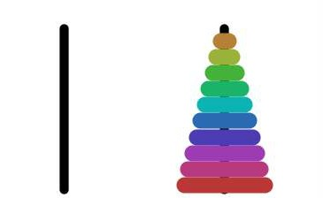


Towers of Hanoi puzzle
A legend of uncertain origin
n = 64 discs of differing size; 3 posts; discs on one of the posts from largest to smallest.
An ancient prophecy has commanded monks to move the discs to another post.
When the task is completed, the world will end.
n = 10
Rules
Move discs one at a time.
Never put a larger disc on a smaller disc.
before
Q. Generate list of instruction for monks ?
Q. When might the world end ?
after

Slide 16
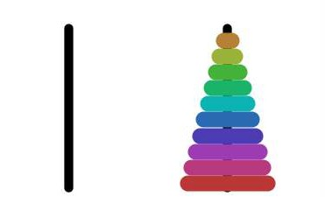


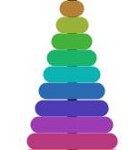

Towers of Hanoi
For simple instructions, use cyclic wraparound
Move right means 1 to 2, 2 to 3, or 3 to 1.
Move left means 1 to 3, 3 to 2, or 2 to 1.
0
1 2
1
2
3
A recursive solution
Move n − 1 discs to the left (recursively).
Move largest disc to the right.
Move n − 1 discs to the left (recursively).

Slide 17
Towers of Hanoi solution (n = 3)
1R
2L
1R
3R
1R
1R | 2L | 1R | 3R | 1R | 2L | 1R
2L
1R

Slide 18


Towers of Hanoi: recursive solution
hanoi(n): Print moves for n discs.
Return one space for n = 0.
Otherwise, set move to the specified move for disc n.
Then sandwich move between two copies of hanoi(n-1).
public class Hanoi
{
public static String hanoi(int n, boolean left)
{
if (n == 0) return " "; String move;
if (left) move = n + "L";
else move = n + "R";
return hanoi(n-1, !left) + move + hanoi(n-1, !left);
}
public static void main(String[] args)
{
int n = Integer.parseInt(args[0]);
StdOut.println(hanoi(n, false));
% java Hanoi 3
}
1R 2L 1R 3R 1R 2L 1R
}

Slide 19







Recursive call tree for towers of Hanoi
Structure is the same as for the ruler function and suggests 3 useful and easy-to-prove facts.
Each disc always moves in the same direction.
Moving smaller disc always alternates with a unique legal move.
Moving n discs requires 2^{n} − 1 moves.
hanoi(4, true)
1 2 1 3 1 2 1 4 1 2 1 3 1 2 1
R L R R R L R L R L R R R L R
hanoi(3, false)
1 2 1 3 1 2 1
R L R R R L R
1 2 1 3 1 2 1
R L R R R L R
hanoi(2, true)
1 2 1
R L R
hanoi(1, false)
1
R
hanoi(0, true)
⎵ ⎵ ⎵
1 2 1
R L R
1 2 1
R L R
1 2 1
R L R
1
R
1
R
1
R
1
R
1
R
1
R
1
R
⎵
⎵
⎵
⎵
⎵
⎵
⎵
⎵
⎵
⎵
⎵
⎵
⎵

Slide 20
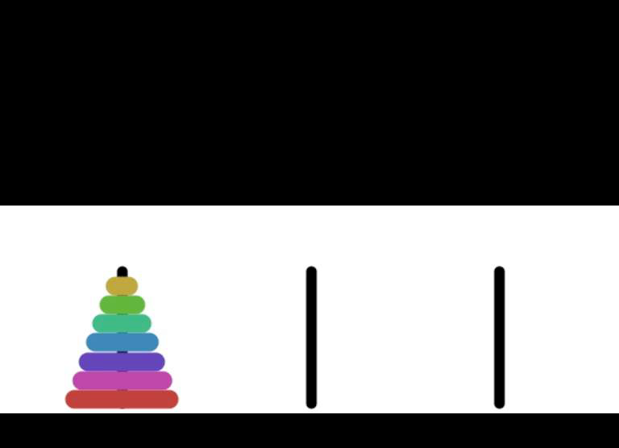
Answers for towers of Hanoi
Q. Generate list of instructions for monks ?
A. (Long form). 1L 2R 1L 3L 1L 2R 1L 4R 1L 2R 1L 3L 1L 2R 1L 5L 1L 2R 1L 3L 1L 2R 1L 4R ...
A. (Short form). Alternate "1L" with the only legal move not involving the disc 1.
"L" or "R" depends on whether n is odd or even
Q. When might the world end ?
moves per second
end of world
1
5.84 billion centuries
A. Not soon: need 2⁶⁴ − 1 moves.
1 billion
5.84 centuries
Note: Recursive solution has been proven optimal.

Slide 21
COMPUTER SCIENCE
S E D G E W I C K / W A Y N E
PA R T I : P R O G R A M M I N G I N JAVA
CS.6.B.Recursion.Hanoi

Slide 22
COMPUTER SCIENCE
S E D G E W I C K / W A Y N E
PA R T I : P R O G R A M M I N G I N JAVA
Recursion
Foundations
A classic example
Recursive graphics
Avoiding exponential waste
Dynamic programming
CS.6.C.Recursion.Graphics

Slide 23

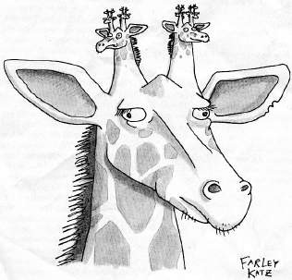
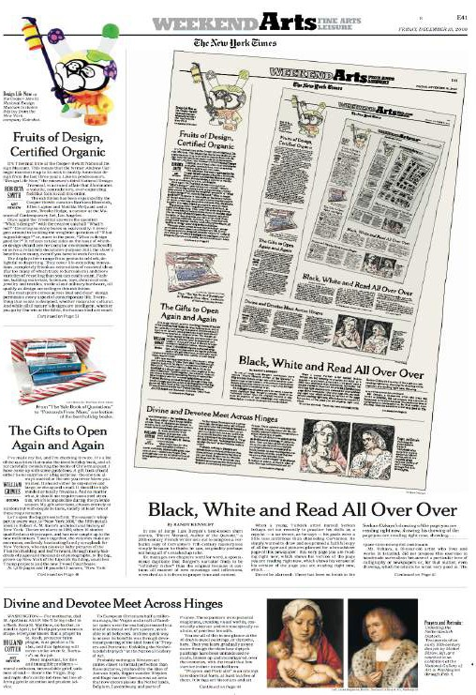
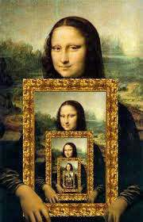
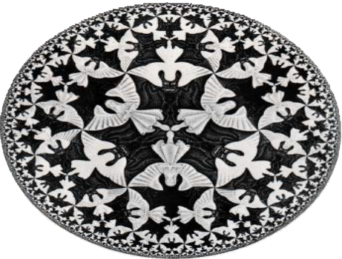
Recursive graphics in the wild

Slide 24

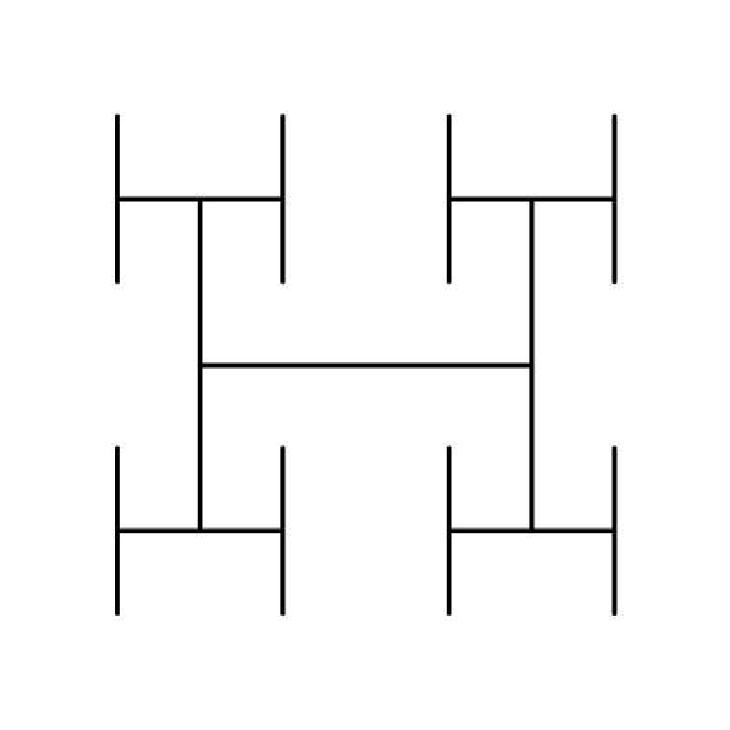
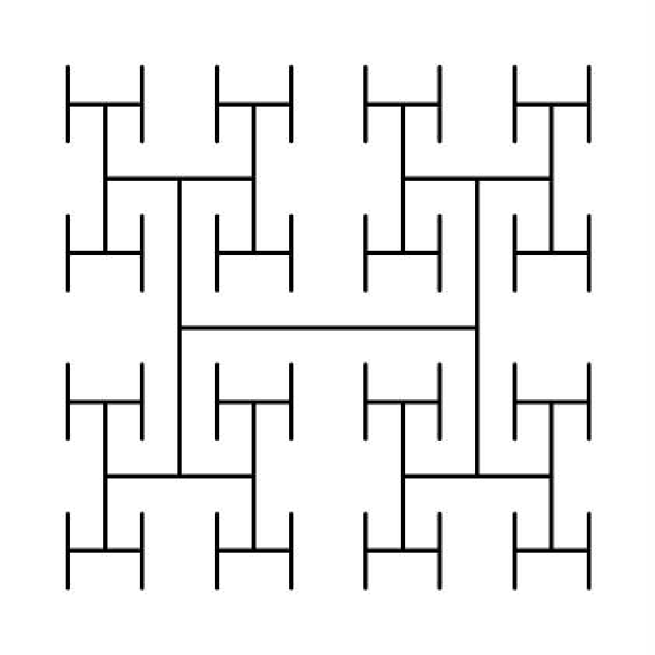
"Hello, World" of recursive graphics: H-trees
H-tree of order n
If n is 0, do nothing.
Draw an H, centered.
Draw four H-trees of order n −1 and half the size, centered at the tips of the H.
order 1
order 2
order 3

Slide 25

H-trees
Application. Connect a large set of regularly spaced sites to a single source.
order 6
order 1
order 2
order 3
order 4
order 5

Slide 26


Recursive H-tree implementation
public class Htree
{
public static void draw(int n, double sz, double x, double y)
{
if (n == 0) return;
double x0 = x - sz/2, x1 = x + sz/2; double y0 = y - sz/2, y1 = y + sz/2;
sz
y 1
y
StdDraw.line(x0, y, x1, y);
StdDraw.line(x0, y0, x0, y1); StdDraw.line(x1, y0, x1, y1);
draw the H,
centered on (x, y )
draw(n-1, sz/2, x0, y0);
draw(n-1, sz/2, x0, y1);
draw(n-1, sz/2, x1, y0);
draw(n-1, sz/2, x1, y1);
y 0
draw four half-size H-trees
x0
x
x1
}
public static void main(String[] args)
% java Htree 3
{
int n = Integer.parseInt(args[0]); draw(n, .5, .5, .5);
}
}

Slide 27

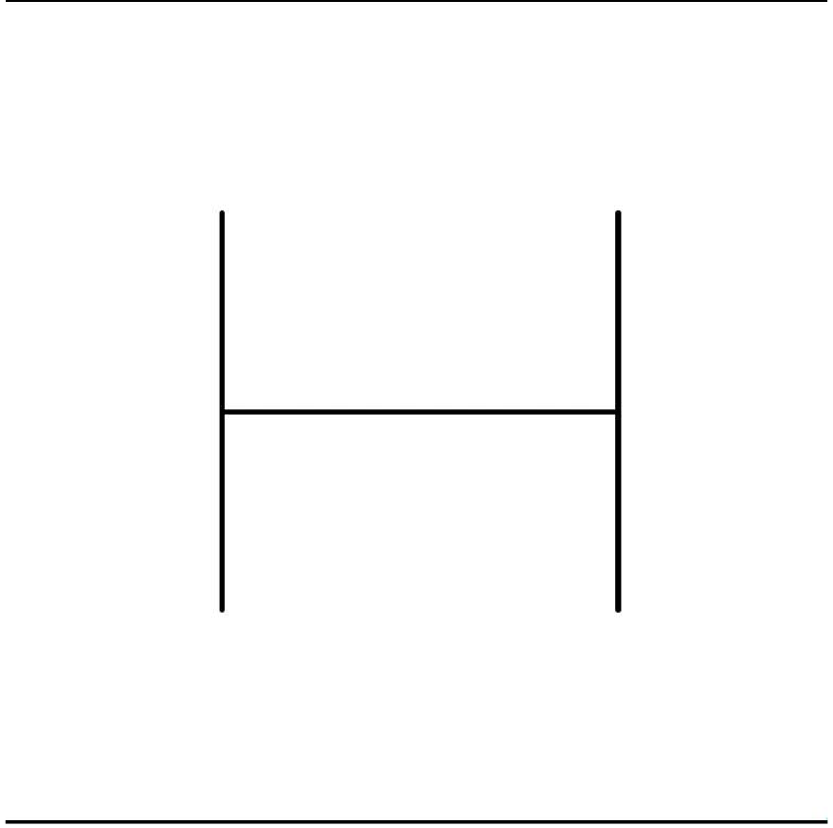
Deluxe H-tree implementation
public class HtreeDeluxe
{
public static void draw(int n, double sz,
double x, double y)
{
if (n == 0) return;
double x0 = x - sz/2, x1 = x + sz/2; double y0 = y - sz/2, y1 = y + sz/2; StdDraw.line(x0, y, x1, y); StdDraw.line(x0, y0, x0, y1); StdDraw.line(x1, y0, x1, y1);
% java HtreeDeluxe 4
StdAudio.play(PlayThatNote.note(n, .25*n));
draw(n-1, sz/2, x0, y0);
draw(n-1, sz/2, x0, y1);
draw(n-1, sz/2, x1, y0);
draw(n-1, sz/2, x1, y1);
}
public static void main(String[] args)
{
int n = Integer.parseInt(args[0]); draw(n, .5, .5, .5);
}
}
Note. Order in which Hs are drawn is instructive.

Slide 28


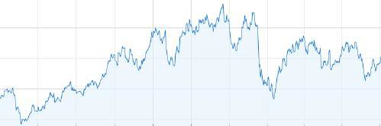
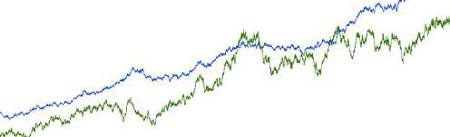
Fractional Brownian motion
A process that models many phenomenon.
Price of stocks.
Dispersion of fluids.
Rugged shapes of mountains and clouds.
Shape of nerve membranes.
. . .
Brownian bridge model
An actual mountain
Price of an actual stock
Black-Scholes model (two different parameters)

Slide 29
Fractional Brownian motion simulation
Midpoint displacement method
Consider a line segment from (x₀, y₀) to (x₁, y₁).
If sufficiently short draw it and return
Divide the line segment in half, at (x_{m}, y_{m}).
Choose δ at random from Gaussian distribution.
Add δ to y_{m}.
Recur on the left and right line segments.
(x_{m}, y_{m} + δ)
δ
(x , y )
1 1
(x_{m}, y_{m} )
(x₀, y₀)

Slide 30




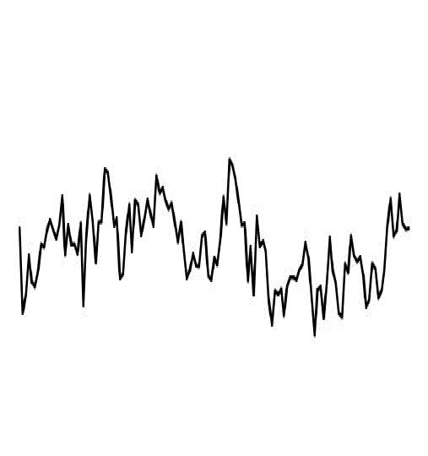
Brownian motion implementation
public class Brownian
{
public static void
curve(double x0, double y0, double x1, double y1,
double var, double s)
{
if (x1 - x0 < .01)
{ StdDraw.line(x0, y0, x1, y1); return; } double xm = (x0 + x1) / 2;
double ym = (y0 + y1) / 2; double stddev = Math.sqrt(var);
double delta = StdRandom.gaussian(0, stddev); curve(x0, y0, xm, ym+delta, var/s, s); curve(xm, ym+delta, x1, y1, var/s, s);
}
public static void main(String[] args)
{
double hurst = Double.parseDouble(args[0]); double s = Math.pow(2, 2*hurst);
curve(0, .5, 1.0, .5, .01, s);
% java Brownian 1
% java Brownian .125
control parameter (see text)
}
}

Slide 31
A 2D Brownian model: plasma clouds
Midpoint displacement method
Consider a rectangle centered at (x, y) with pixels at the four corners.
If the rectangle is small, do nothing.
Color the midpoints of each side the average of the endpoint colors.
Choose δ at random from Gaussian distribution.
Color the center pixel the average of the four corner colors plus δ
Recurse on the four quadrants.
Booksite code actually draws a rectangle to avoid artifacts
0
10
20
30
49
60
60
80
100
31

Slide 32

A Brownian cloud
32

Slide 33

A Brownian landscape
33

Slide 34
COMPUTER SCIENCE
S E D G E W I C K / W A Y N E
PA R T I : P R O G R A M M I N G I N JAVA
Image sources
http://en.wikipedia.org/wiki/Droste_effect#mediaviewer/File:Droste.jpg http://www.mcescher.com/gallery/most-popular/circle-limit-iv/ http://www.megamonalisa.com/recursion/ http://fractalfoundation.org/OFC/FractalGiraffe.png http://www.nytimes.com/2006/12/15/arts/design/15serk.html?pagewanted=all&_r=0 http://www.geocities.com/aaron_torpy/gallery.htm
CS.6.C.Recursion.Graphics

Slide 35
COMPUTER SCIENCE
S E D G E W I C K / W A Y N E
PA R T I : P R O G R A M M I N G I N JAVA
Recursion
Foundations
A classic example
Recursive graphics
Avoiding exponential waste
Dynamic programming
CS.6.D.Recursion.Waste

Slide 36


Fibonacci numbers
Let Fn = Fn−1 + Fn−1 for n > 1 with F0 = 0 and F1 = 1.
n | 0 | 1 | 2 | 3 | 4 | 5 | 6 | 7 | 8 | 9 | 10 | 11 | 12 | 13 | ...
Fn | 0 | 1 | 1 | 2 | 3 | 5 | 8 | 13 | 21 | 34 | 55 | 89 | 144 | 233 | ...
Models many natural phenomena and is widely found in art and architecture.
Leonardo Fibonacci
c. 1170 – c. 1250
Examples.
Model for reproducing rabbits.
Nautilus shell.
Mona Lisa.
...
golden ratio Fn / Fn−1
8
21
13
Facts (known for centuries).
Fn / Fn−1 ➛ Φ = 1.618... as n ➛ ∞
Fn is the closest integer to Φ^{n}/√5
21
13

Slide 37
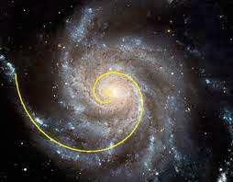

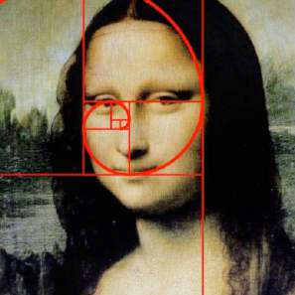
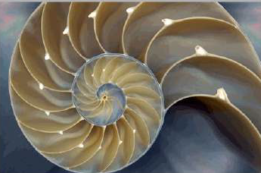
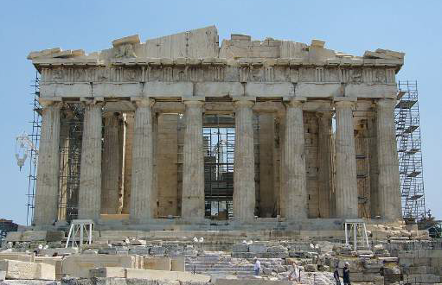
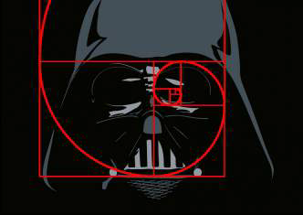
Fibonacci numbers and the golden ratio in the wild
1
1
2
3
5
8
13
21
1
1 1
1 2 1
1 3 3 1
1 4 6 4 1
1 5 10 10 5 1
1 6 15 20 15 6 1
1 7 21 35 35 21 7 1

Slide 38


Computing Fibonacci numbers
Q. [Curious individual.] What is the exact value of F60 ?
A. [Novice programmer.] Just a second. I'll write a recursive program to compute it.
public class FibonacciR
{
public static long F(int n)
{
if (n == 0) return 0;
if (n == 1) return 1; return F(n-1) + F(n-2);
}
public static void main(String[] args)
{
int n = Integer.parseInt(args[0]); StdOut.println(F(n));
}
}
% java FibonacciR 5 5
% java FibonacciR 6 8
% java FibonacciR 10 55
% java FibonacciR 12 144
% java FibonacciR 50 12586269025
% java FibonacciR 60
takes a few minutes Hmmm. Why is that?
Is something wrong with my computer?

Slide 39
Recursive call tree for Fibonacci numbers
F(6)
8
F(5)
5
F(4)
3
3
F(3)
2
2
2
F(2)
1
1
1
1
1
F(1)
1
1
1
1
1
1
1
1
F(0)
0
0
0
0
0

Slide 40
Exponential waste
Let Cn be the number of times F(n) is called when computing F(60).
n | Cn
60 | 1 | F1
59 | 1 | F2
58 | 2 | F3
57 | 3 | F4
56 | 5 | F5
55 | 8 | F6
 | ... | ...
0 | >2.5×10¹² | F61
F(60)
F(59)
F(58)
F(58)
F(57)
F(57)
F(56)
F(55)
Exponentially wasteful to recompute all these values.
( trillions of calls on F(0), not to mention calls on F(1), F(2),...)

Slide 41
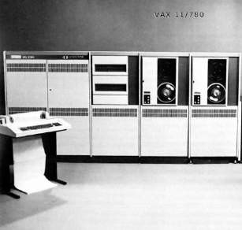


Exponential waste dwarfs progress in technology
If you engage in exponential waste, you will not be able to solve a large problem.
1970s
2010s: 10,000+ times faster
n | time to compute Fn
30 | minutes
40 | hours
50 | weeks
60 | years
70 | centuries
80 | millenia
n | time to compute Fn
50 | minutes
60 | hours
70 | weeks
80 | years
90 | centuries
100 | millenia
Macbook Air
VAX 11/780
1970s: "That program won't compute F60 before you graduate! "
2010s: "That program won't compute F80 before you graduate! "

Slide 42


Avoiding exponential waste
public class FibonacciM
{
static long[] memo = new long[100]; public static long F(int n)
{
if (n == 0) return 0;
if (n == 1) return 1; if (memo[n] == 0)
memo[n] = F(n-1) + F(n-2); return memo[n];
}
public static void main(String[] args)
{
int n = Integer.parseInt(args[0]); StdOut.println(F(n));
% java FibonacciM 50 12586269025
% java FibonacciM 60 1548008755920
% java FibonacciM 80 23416728348467685
Memoization
Maintain an array memo[] to remember all computed values.
If value known, just return it.
Otherwise, compute it, remember it, and then return it.
}
}
Simple example of dynamic programming (next).

Slide 43
COMPUTER SCIENCE
S E D G E W I C K / W A Y N E
PA R T I : P R O G R A M M I N G I N JAVA
Image sources
http://en.wikipedia.org/wiki/Fibonacci http://www.inspirationgreen.com/fibonacci-sequence-in-nature.html
http://www.goldenmeancalipers.com/wp-content/uploads/2011/08/mona_spiral-1000x570.jpg http://www.goldenmeancalipers.com/wp-content/uploads/2011/08/darth_spiral-1000x706.jpg http://en.wikipedia.org/wiki/Ancient_Greek_architecture#mediaviewer/
File:Parthenon-uncorrected.jpg
https://openclipart.org/detail/184691/teaching-by-ousia-184691
CS.6.D.Recursion.Waste

Slide 44
COMPUTER SCIENCE
S E D G E W I C K / W A Y N E
PA R T I : P R O G R A M M I N G I N JAVA
Recursion
Foundations
A classic example
Recursive graphics
Avoiding exponential waste
Dynamic programming
CS.6.E.Recursion.DP

Slide 45
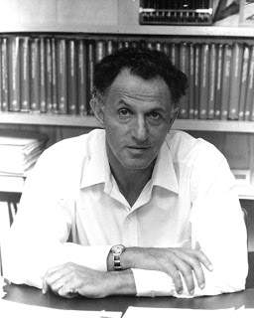


An alternative to recursion that avoids recomputation
Dynamic programming.
Build computation from the "bottom up".
Solve small subproblems and save solutions.
Use those solutions to build bigger solutions.
Fibonacci numbers
public class Fibonacci
{
public static void main(String[] args)
{
int n = Integer.parseInt(args[0]); long[] F = new long[n+1];
F[0] = 0; F[1] = 1;
for (int i = 2; i <= n; i++) F[i] = F[i-1] + F[i-2];
StdOut.println(F[n]);
}
}
Richard Bellman 1920-1984
% java Fibonacci 50 12586269025
% java Fibonacci 60 1548008755920
% java Fibonacci 80 23416728348467685
Key advantage over recursive solution. Each subproblem is addressed only once.

Slide 46
DP example: Longest common subsequence
Def. A subsequence of a string s is any string formed by deleting characters from s.
Ex 1.
s = ggcaccacg
cac gcaacg ggcaacg ggcacacg
...
Ex 2.
t = acggcggatacg gacg
ggggg cggcgg ggcaacg ggggaacg
...
ggcaccacg ggcaccacg ggcaccacg ggcaccacg
acggcggatacg acggcggatacg acggcggatacg acggcggatacg acggcggatacg
[2^{n} subsequences in a string of length n]
longest common subsequence
Def. The LCS of s and t is the longest string that is a subsequence of both.
Goal. Efficient algorithm to compute the LCS and/or its length
numerous scientific applications

Slide 47
Longest common subsequence
Goal. Efficient algorithm to compute the length of the LCS of two strings s and t.
Approach. Keep track of the length of the LCS of s[i..M) and t[j..N) in opt[i, j]
Ex: i = 6, j = 7
s[6..9) = acg t[7..12) = atacg LCS(cg, tacg) = cg LCS(acg, atacg) = acg
Three cases:
i = M or j = N
opt[i][j] = 0
s[i] = t[j]
opt[i][j] = opt[i+1, j+1] + 1
otherwise
opt[i][j] = max(opt[i, j+1], opt[i+1][j])
Ex: i = 6, j = 4
s[6..9) = acg t[4..12) = cggatacg
LCS(acg, ggatacg) = acg LCS(cg, cggatacg) = cg LCS(acg, cggatacg) = acg

Slide 48
LCS example
 | 0 | 1 | 2 | 3 | 4 | 5 | 6 | 7 | 8 | 9 | 10 | 11 | 12
 | a | c | g | g | c | g | g | a | t | a | c | g
0 g | 7 | 7 | 7 | 6 | 6 | 6 | 5 | 4 | 3 | 3 | 2 | 1 | 0
1 g | 6 | 6 | 6 | 6 | 5 | 5 | 5 | 4 | 3 | 3 | 2 | 1 | 0
2 c | 6 | 5 | 5 | 5 | 5 | 4 | 4 | 4 | 3 | 3 | 2 | 1 | 0
3 a | 6 | 5 | 4 | 4 | 4 | 4 | 4 | 4 | 3 | 3 | 2 | 1 | 0
4 c | 5 | 5 | 4 | 4 | 4 | 3 | 3 | 3 | 3 | 3 | 2 | 1 | 0
5 c | 4 | 4 | 4 | 4 | 4 | 3 | 3 | 3 | 3 | 3 | 2 | 1 | 0
6 a | 3 | 3 | 3 | 3 | 3 | 3 | 3 | 3 | 3 | 3 | 2 | 1 | 0
7 c | 2 | 2 | 2 | 2 | 2 | 2 | 2 | 2 | 2 | 2 | 2 | 1 | 0
8 g | 1 | 1 | 1 | 1 | 1 | 1 | 1 | 1 | 1 | 1 | 1 | 1 | 0
9 | 0 | 0 | 0 | 0 | 0 | 0 | 0 | 0 | 0 | 0 | 0 | 0 | 0
opt[i][j] = max(opt[i, j+1], opt[i+1][j])
opt[i][j] = opt[i+1, j+1] + 1

Slide 49


LCS length implementation
public class LCS
{
public static void main(String[] args)
{
String s = args[0]; String t = args[1]; int M = s.length(); int N = t.length();
int[][] opt = new int[M+1][N+1];
for (int i = M-1; i >= 0; i--)
% java LCS ggcaccacg acggcggatacg
7
for (int j = N-1; j >= 0; j--)
if (s.charAt(i) == t.charAt(j)) opt[i][j] = opt[i+1][j+1] + 1;
else
opt[i][j] = Math.max(opt[i+1][j], opt[i][j+1]);
System.out.println(opt[0][0]);
}
}
Exercise. Add code to print LCS itself (see LCS.java on booksite for solution).

Slide 50
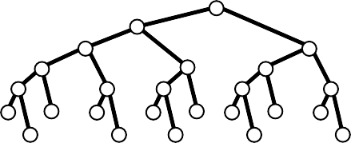
Dynamic programming and recursion
Broadly useful approaches to solving problems by combining solutions to smaller subproblems.
Why learn DP and recursion?
Represent a new mode of thinking.
Provide powerful programming paradigms.
Give insight into the nature of computation.
Successfully used for decades.
 | recursion | dynamic programming
advantages | Decomposition often obvious. Easy to reason about correctness. | Avoids exponential waste. Often simpler than memoization.
pitfalls | Potential for exponential waste. Decomposition may not be simple. | Uses significant space. Not suited for real-valued arguments. Challenging to determine order of computation

Slide 51
COMPUTER SCIENCE
S E D G E W I C K / W A Y N E
PA R T I : P R O G R A M M I N G I N JAVA
Image sources
http://upload.wikimedia.org/wikipedia/en/7/7a/Richard_Ernest_Bellman.jpg http://apprendre-math.info/history/photos/Polya_4.jpeg
http://www.advent-inc.com/documents/coins.gif http://upload.wikimedia.org/wikipedia/commons/a/a0/2006_Quarter_Proof.png http://upload.wikimedia.org/wikipedia/commons/3/3c/Dime_Obverse_13.png http://upload.wikimedia.org/wikipedia/commons/7/72/Jefferson-Nickel-Unc-Obv.jpg http://upload.wikimedia.org/wikipedia/commons/2/2e/US_One_Cent_Obv.png
CS.6.E.Recursion.DP

Slide 52
COMPUTER SCIENCE
S E D G E W I C K / W A Y N E
PA R T I : P R O G R A M M I N G I N JAVA
_{C}omputer
6. Recursion
_{S}cience
An Interdisciplinary Approach
Section 2.3
R O B E R T S E D G E W I C K
KEVIN W A YNE
http:// introcs.cs.princeton.edu

