Slide 1
Breadth-First Search

Slide 2
Searching Problems
The following problems can all be solved the same way:
- finding shortest path(by distance or time) between two location(etc. Google maps)
- solving Rubik’s cube, 8-puzzle
- word segmentation(given a sequence of letters without spaces, insert spaces to form words, e.g. “haveagoodday” -> “have a good day”)
Each of these problems can be defined as a search problem and represented by a graph. A solution may be found by applying a graph search algorithm.

Slide 3
Searching Problem
A search problem can be defined formally as follows:
A set of possible states that the environment can be in. We call this the state space. For example, each position of a Rubik’s cube is a state. The state space is the set of all possible positions.
The initial state that the agent starts in. For example: initial position of the Rubik’s cube.
A set of one or more goal states. For example: solved state of the Rubik’s cube.
The actions available to the agent. An example of an action: turn the front face 90 degrees clockwise.
A transition model, which describes what each action does. RESULT(s,a) returns the state that results from doing action a in state s. For example, consider a state which is a location on the x-y plane and the action moveUp which moves up one unit. Then RESULT( (3, 1), moveUp) = (3, 2).
The state space can be represented as a graph in which the vertices are states and the directed edges between them are actions.

Slide 4
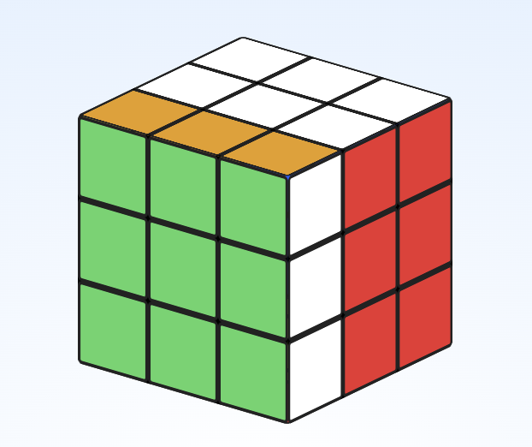
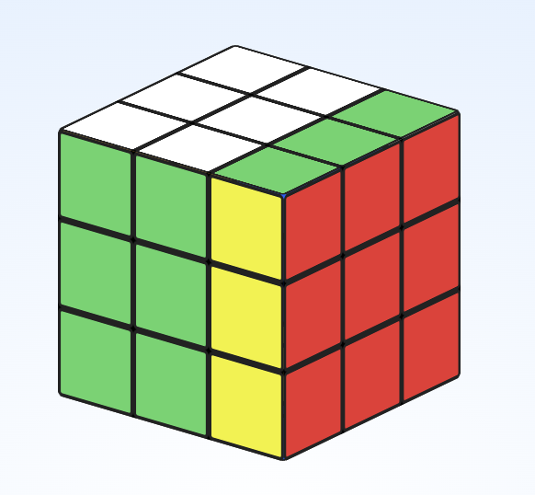
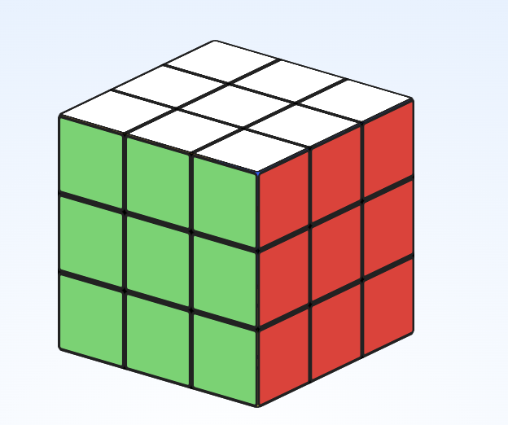
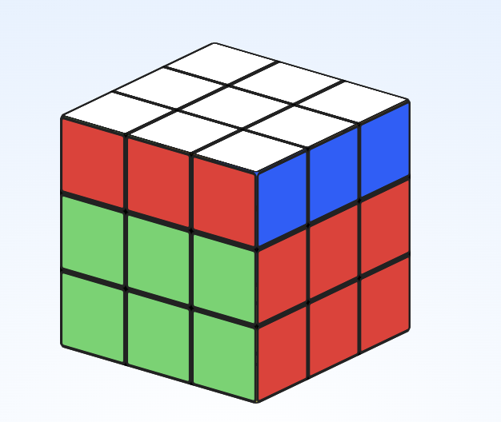
Rubik’s Cube
These four cubes represents four states of a Rubik’s cube.
Each state is a vertex in the graph.
An action is an allowed move that takes one
state to another state. An action is an edge in the graph.
For example, at the solved state, one action is F which is
rotating the front face(green) 90 degrees clockwise.
R action is rotating the right side(red) 90 degrees clockwise.
U action is rotating the up side(white) 90 degrees clockwise.
On the picture here, the three resulting states are
three neighbors of the solved state.
F
R
U

Slide 5
Search Algorithm
A search algorithm takes a search problem as input and returns a solution, or an indication of failure.
We consider algorithms that superimpose a search tree over the state-space graph, forming various paths from the initial state, trying to find a path that reaches a goal state.
Each node in the search tree corresponds to a state in the state space and the edges in the search tree correspond to actions. The root of the tree corresponds to the initial state of the problem.
Breadth-first search(BFS) is search algorithm which starts at the initial state and first search that state’s nearest neighbors and then expanding the search outward to other neighbors systematically.
BFS keeps track of nodes it has already visited as well as frontier nodes. Frontier nodes are nodes that are at the boundary of the search. Think of this algorithm as an expanding circle where the nodes in the circle have already been visited and the frontier nodes are the nodes at the perimeter of the circle.

Slide 6
Breadth-First Search
Algorithm: Given a search problem, return the solution state or failure
def function(search problem):
frontier = []
visited = []
add initial state to frontier
while frontier is not empty:
remove first node from frontier list, call it s.
if s is goal state:
we found our goal; return path to goal
if s is not in visited list:
add s to visited list
expand at s by creating list of neighbor nodes to s
for each neighbor of s:
add neighbor to frontier list
return failure
Expanding at s means to
create a list of neighbor nodes of s
where each neighbor node contains a pointer
to s. This allows us to recover the solution path
back to s once we find our goal state.

Slide 7
Expanding at a node(get neighbors)
Expanding at s means to create a list of neighbor nodes of s
where each neighbor node contains a pointer to s.
This allows us to recover the solution path
back to s once we find our goal state.

Slide 8
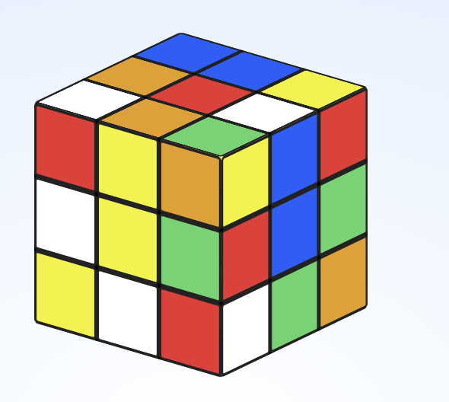
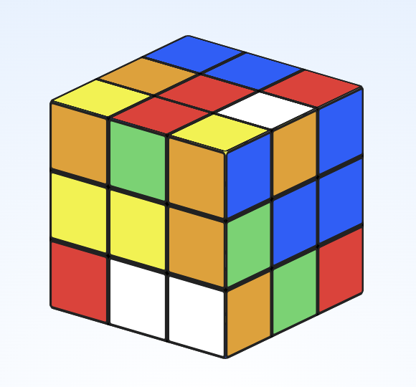
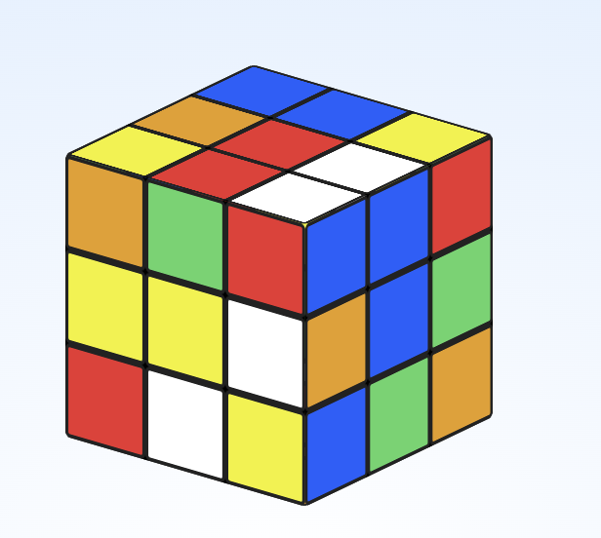
Expanding at a node(get neighbors)
Expanding at s means to create a list of neighbor nodes of s.
Each neighbor node contains the following information:
- state of node
- parent node(in this case, node s)
- action that gets to this node
For example, the node s in the picture is the current node.
Node t is a neighbor of node s and contains:
- state of node t(see cube position in picture)
- pointer to parent which is node s
- action that gets from node s to node t is the action F.
Node t: a neighbor of node s.
F
pointer to
parent node
R
Node r: another neighbor
of node s.
Node s

Slide 9
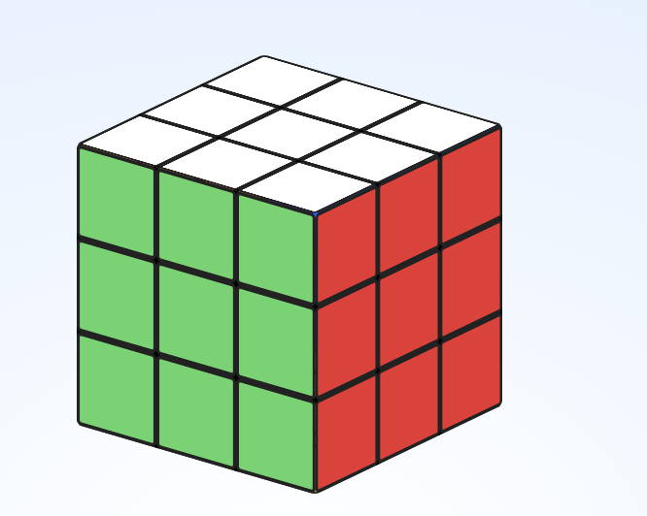
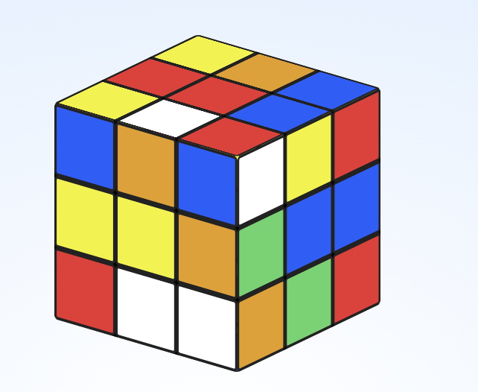
Once we get to the goal state(solved state), these pointers
to parents will allow us to recover the solution path.
B
…
F
U
Backtrack by following pointers backwards:
{B.., F, U, R}.
The reverse the list to get solution path:
{R, U, F…, B}
R

Slide 10
D
C
F
A
B

Slide 11
D
C
F
A
B

Slide 12
Breadth-First Search
 |  |  | B
A

Slide 13
Breadth-First Search
 |  |  | B
A

Slide 14
Breadth-First Search
 |  |  | B
A

Slide 15
Breadth-First Search
 |  |  | B
A

Slide 16
Breadth-First Search
 |  |  | B
A

Slide 17
Breadth-First Search
 |  |  | B
A

Slide 18
Breadth-First Search
 |  |  | B
A

Slide 19
Breadth-First Search
 |  |  | B
A

Slide 20
Breadth-First Search
 |  |  | B
A

Slide 21
Breadth-First Search
 |  |  | B
A

Slide 22
Breadth-First Search
 |  |  | B
A

Slide 23
Breadth-First Search
 |  |  | B
A

Slide 24
Breadth-First Search
 |  |  |  |  |  |  |  |  |  |  | B
A

Slide 25
Breadth-First Search
 |  |  |  |  |  |  |  |  |  |  | B
A

Slide 26
Breadth-First Search
 |  |  |  |  |  |  |  |  |  |  | B
A

Slide 27
Breadth-First Search
 |  |  |  |  |  |  |  |  |  |  | B
A

Slide 28
Breadth-First Search
 |  |  |  |  |  |  |  |  |  |  | B
A

Slide 29
Breadth-First Search
 |  |  |  |  |  |  |  |  |  |  | B
A

Slide 30
Breadth-First Search
 |  |  |  |  |  |  |  |  |  |  | B
A

Slide 31
Breadth-First Search
 |  |  |  |  |  |  |  |  |  |  | B
A

Slide 32
Breadth-First Search
 |  |  |  |  |  |  |  |  |  |  | B
A

Slide 33
Breadth-First Search
 |  |  |  |  |  |  |  |  |  |  | B
A

Slide 34
Breadth-First Search
 |  |  |  |  |  |  |  |  |  |  | B
A

Slide 35
Breadth-First Search
 |  |  |  |  |  |  |  |  |  |  | B
A

Slide 36
Breadth-First Search
 |  |  |  |  |  |  |  |  |  |  | B
A

Slide 37
Breadth-First Search
 |  |  |  |  |  |  |  |  |  |  | B
A

Slide 38
Breadth-First Search
 |  |  |  |  |  |  |  |  |  |  | B
A

Slide 39
Breadth-First Search
 |  |  |  |  |  |  |  |  |  |  | B
A

Slide 40
Breadth-First Search
 |  |  |  |  |  |  |  |  |  |  | B
A

Slide 41
Breadth-First Search
 |  |  |  |  |  |  |  |  |  |  | B
A

Slide 42
Breadth-First Search
 |  |  |  |  |  |  |  |  |  |  | B
A

Slide 43
Breadth-First Search
 |  |  |  |  |  |  |  |  |  |  | B
A

Slide 44
Breadth-First Search
 |  |  |  |  |  |  |  |  |  |  | B
A

Slide 45
Breadth-First Search
 |  |  |  |  |  |  |  |  |  |  | B
A

Slide 46
Breadth-First Search
 |  |  |  |  |  |  |  |  |  |  | B
A

Slide 47
Breadth-First Search
 |  |  |  |  |  |  |  |  |  |  | B
A

Slide 48
Breadth-First Search
 |  |  |  |  |  |  |  |  |  |  | B
A

Slide 49
Breadth-First Search
 |  |  |  |  |  |  |  |  |  |  | B
A

Slide 50
Breadth-First Search
 |  |  |  |  |  |  |  |  |  |  | B
A

Slide 51
Breadth-First Search
 |  |  |  |  |  |  |  |  |  |  | B
A

Slide 52
Breadth-First Search
 |  |  |  |  |  |  |  |  |  |  | B
A

Slide 53
Breadth-First Search
 |  |  |  |  |  |  |  |  |  |  | B
A

Slide 54
Breadth-First Search
 |  |  |  |  |  |  |  |  |  |  | B
A

Slide 55
Breadth-First Search
 |  |  |  |  |  |  |  |  |  |  | B
A

Slide 56
Breadth-First Search
 |  |  |  |  |  |  |  |  |  |  | B
A

Slide 57
Breadth-First Search
 |  |  |  |  |  |  |  |  |  |  | B
A

Slide 58
Breadth-First Search
 |  |  |  |  |  |  |  |  |  |  | B
A

Slide 59
Breadth-First Search
 |  |  |  |  |  |  |  |  |  |  | B
A

Slide 60
Breadth-First Search
 |  |  |  |  |  |  |  |  |  |  | B
A

Slide 61
Breadth-First Search
 |  |  |  |  |  |  |  |  |  |  | B
A

Slide 62
Breadth-First Search
 |  |  |  |  |  |  |  |  |  |  | B
A

Slide 63
Breadth-First Search
 |  |  |  |  |  |  |  |  |  |  | B
A

Slide 64
Breadth-First Search
 |  |  |  |  |  |  |  |  |  |  | B
A

Slide 65
Breadth-First Search
 |  |  |  |  |  |  |  |  |  |  | B
A

Slide 66
Breadth-First Search
 |  |  |  |  |  |  |  |  |  |  | B
A

Slide 67
Breadth-First Search
 |  |  |  |  |  |  |  |  |  |  | B
A

Slide 68
Breadth-First Search
 |  |  |  |  |  |  |  |  |  |  | B
A

Slide 69
Breadth-First Search
 |  |  |  |  |  |  |  |  |  |  | B
A

