Slide 1
Introduction to Python
Basic Datatypes

Slide 2
Topics
Software, Python Scripts
replit
Printing with print()
Basic Built-In Number Types
Integers
Floats
Booleans
Casting
User inputs

Slide 3
Software
A program is a collection of program statements that performs a specific task when run by a computer. A program is often referred to as software.
A program can be written in many programming languages. We will be using Python in this course.
By convention, Python code is stored in a file called a script with a .py extension. Scripts are written using an IDE(Integrated Development Environment).
We will initially use an online IDE (repl.it, login with your Google account) to learn the basics of Python. A popular IDE that can be installed locally on your computer is Visual Studio Code.

Slide 4
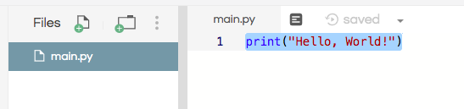

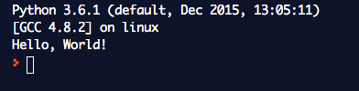
Python Scripts
repl.it: Create a new repl and pick Python as the language, name the repl.
Type in the code in the file main.py. Click on run.
print("Hello, World!")

Slide 5
Our First Program
print("Hello, World!")
1) The print() function prints messages on the console.
2) Characters enclosed in quotes(single or double) forms a literal string.
3) The console output string does not include the quotes.

Slide 6
print()
By default, print() will end each output with a newline character. A newline character is a special control character used to indicate the end of a line.
In a string literal, '\n' denote a newline character.
print("hello")
print("Mike")
print()
print("line1\nline2\nline3")
Output:
hello
Mike
line1
line2
line3
empty line

Slide 7
print()
print("hello")
print(4)
print(3.14)
print(3 + 4)
Output:
hello
4
3.14
7
Note: The console output string does not include the quotes.
print() will evaluate math expressions before printing.

Slide 8
print()
The print function can accept any number of positional arguments, including zero, one, or more arguments.
Arguments are separated by commas. This is useful when you’d want to join a few elements together(e.g. strings, numbers, math expressions, etc…). print() concatenated all arguments passed to it, and it inserted a single space between them.
print("I have", 3, "apples.")
print("You have", 3+2, "apples.")
Output:
I have 3 apples.
You have 5 apples.

Slide 9
Dynamic Typing
Python is dynamically typed: variable names can point to objects of any type.
Unlike Java or C, there is no need to “declare” the variable.
x = 1 # x is an integer
x = ‘hello’ # now x is a string
Comments are a form of program documentation written into the program to be read by people and do not affect how a program runs. Python uses # for comments.

Slide 10
Variables
We can use variables to refer to values that can be used later. You can create a new variable by given it a value.
x = 4
print(x) # 4
Variable names can use letters, digits, and the underscore symbol (but they can’t start with a digit). It is considered best practice to use meaningful variable names:
num_apples = 10
num_oranges = 5
total = num_apples + num_oranges

Slide 11
= is not equality
Unlike in math, = is not equality in Python.
It is an assignment: assign the expression on the right side of = to the variable on the left.
x = 4
x = x + 1 # in math, this has no solutions!
# evaluate right side, assigns to left side variable
print(x) # 5
Assignment is not symmetric.
x = 4 # correct!
10 = y # error!

Slide 12
Try It 1.1
See JuiceMind lesson “Basic Datatypes” for this Try It lab.
Fill in the code as instructed below.
x = 5
# Use one print statement to print "I have 5 apples.".
# You must use the x variable above.
# Use one print statement to print "I have 7 apples."
# Use the x variable again in your code.

Slide 13
Try It 1.2
See JuiceMind lesson “Basic Datatypes” for this Try It lab.
Fill in the code to match the output below. You must use the points variable in your code. Write exactly FOUR lines of code for this problem.
points = 3
# update the variable points by multiplying it by 2
# then print out "You got a star! Your score is doubled to 6". Use the points variable in your code.
# update the variable points by multiplying it by 3
# then print out "You got a coin! Your score is tripled to 18". Use the points variable in your code.

Slide 14
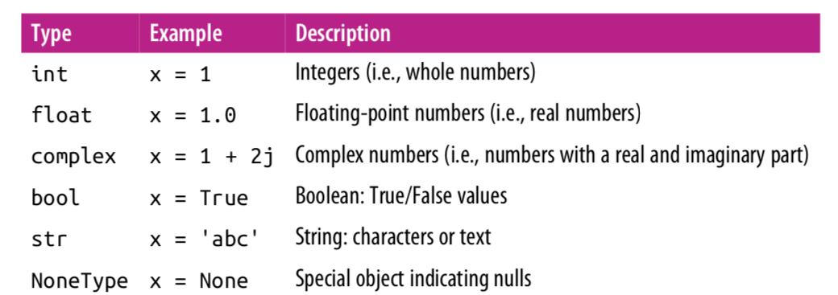
Basic Built-In Types
In this lecture, we'll focus on integers, floating-point numbers, strings and
boolean values.

Slide 15
Integers
The most basic numerical type is the integer. Any number without a decimal point is an integer.
Python integers are variable-precision, so you can do computations that would overflow in other languages.
x = 1
y = 2 ** 200
print("x:", x)
print("y:", y)
Output:
x: 1
y: 1606938044258990275541962092341162602522202993782792835301376

Slide 16
Floating Point
The floating-point type can store fractional numbers(i.e. real numbers).
x = 0.5
print(x) # 0.5
y = 2.3451
print(y) # 2.3451

Slide 17
Boolean Type
The Boolean type is a simple type with two possible values: True and False.
Boolean values are case-sensitive: unlike some other languages, True and False
must be capitalized!
Comparison operators return True or False values.
result = (4 < 5)
print(result) # True
print(3 >= 5) # False
print(3 != 5) # True
print(3 == 5) # False

Slide 18
Strings
In Python, text is represented as a string, which is a sequence of characters (letters, digits, and symbols). We indicate that a value is a string by putting either single or double quotes around it.
p1 = "Aristotle"
p2 = 'Isaac Newton'
Whenever you create a string by surrounding text with quotation marks, the string is called a string literal. The name indicates that the string is literally written out in your code.
You can use + operator to concatenate two strings.
a = "Isaac"
b = "Newton"
name = a + ‘ ‘ + b # Isaac Newton

Slide 19
Casting
The int(), float() and str() functions can be called to cast a value to an integer, float, or string respectively.
x = 1.8
y = int("3") # String is casted to an integer.
z = float("3") # String is casted to a float.
w = int(x) # float is casted to an integer(truncates), 1
v = str(x) # float is casted to string "1.8”
print(z) # 3.0
print(w) # 1, decimal is truncated.

Slide 20
Program Inputs
Program input is data sent to a computer for processing by a program. Input can come in a variety of forms such as:
tactile(swipes from a tablet)
audio(input can be an audio/voice to be processed by a program)
visual(an image to be filtered by a program)
text(user input from keyboard or can be a text file input)
Program outputs are any data sent from a program to a device. Program output can come in a variety of forms, such as tactile, audio, visual, or text.

Slide 21
Program Inputs
A program is useful if it takes some input from the user, process it and outputs something meaningful.
We will start with a simple program that accepts user inputs from the keyboard and outputs some result by printing it on the console.
The input function input() can be used to accept inputs from the user.

Slide 22
Input
Programs may use the input function input() to obtain information from the user. The program waits for the user to enter some input. The inputted value can be stored in a variable once the user presses Enter.
print('Please enter some text:')
x = input()
print('You entered:', x)
print('Type:', type(x))
Please enter some text:
123
You entered: 123
Type: <class 'str'>
The type() function allows you to see the datatype of a variable.
Note that user input is always a string.
The variable x stores the string literal "123". (x belongs to the string(str) class)
x is not the integer 123!

Slide 23
Input
Since user input almost always requires a message to the user about the expected input, the input function optionally accepts a string that it prints just before the program stops to wait for the user to respond.
x = input('Please enter an integer value: ')
y = input('Please enter another integer value: ')
x = int(x) # casts to an integer
y = int(y) # casts to an integer
print(x, '+', y, '=', x+y)
Please enter an integer value: 4
Please enter another integer value: 5
4 + 5 = 9

Slide 24
Input
Or even more succinctly.
x = int(input(‘Please enter an integer value: ’))
y = int(input('Please enter another integer value: ‘))
print(x, '+', y, '=', x+y)
Please enter an integer value: 4
Please enter another integer value: 5
4 + 5 = 9

Slide 25
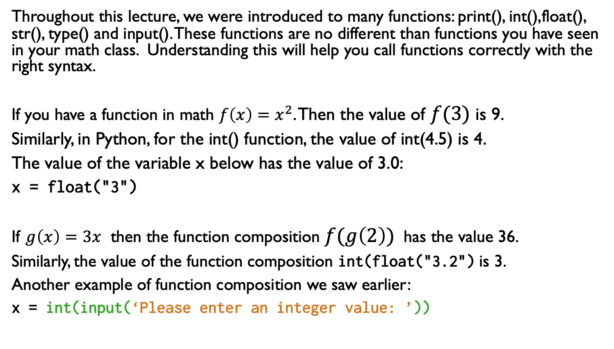
Functions
Throughout this lecture, we were introduced to many functions: print(), int(),float(), str(), type() and input(). These functions are no different than functions you have seen in your math class. Understanding this will help you call functions correctly with the right syntax.
If you have a function in math ${f\left(x\right)=x}^{2}$. Then the value of $f(3)$ is 9.
Similarly, in Python, for the int() function, the value of int(4.5) is 4.
The value of the variable x below has the value of 3.0:
x = float("3")
If $g\left(x\right)=3x$ then the function composition $f(g\left(2\right))$ has the value 36.
Similarly, the value of the function composition int(float("3.2") is 3.
Another example of function composition we saw earlier:
x = int(input(‘Please enter an integer value: ’))

Slide 26
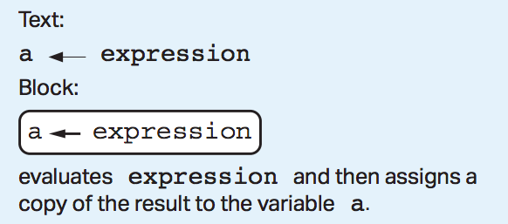
AP Exam Info
The AP Exam does not mandate a particular language for APCS Principles. AP Exam questions will use a language-agnostic syntax to test programming questions.
Syntax on the AP Exam can either be in "text" format or "block" format. The assignment operator on the AP Exam will use an arrow notation instead of the = in Python. In addition, the print() function is replaced by the display() function.

Slide 27
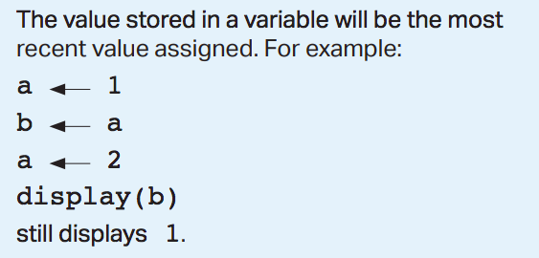
AP Exam Info

Slide 28
Lab 1: Using Variables
Create a new repl on repl.it. Write code to match the following console output:
Enter your name: Mike
Hello Mike
Enter an integer: 10
Your number 10 doubled is 20
The next number after 10 is 11

Slide 29
References
Vanderplas, Jake, A Whirlwind Tour of Python, O’reilly Media.
This book is completely free and can be downloaded online at O’reilly’s site.

