Slide 1

Understanding Data
Digital Audio Processing with Python
Part 1: Audio Basics

Slide 2
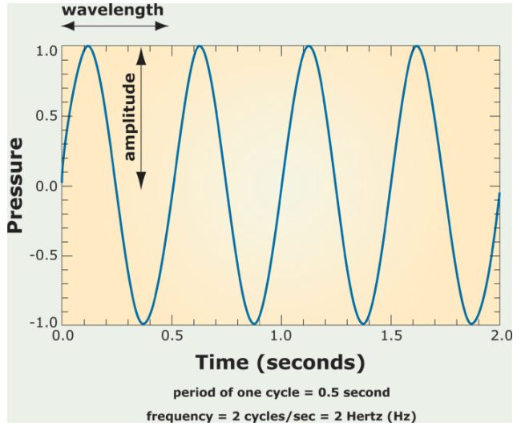
Sound Wave
sound is oscillating pressure travelling through some medium(air/water).
Important sound quantities:
amplitude: maximum
displacement from
equilibrium.
period: time to complete one
cycle.(sec or sec per cycle)
frequency: reciprocal of period
(cycle per second or hert(hz))
(frequency of a note determines its pitch)
Notes:
Crash Course: Cybersecurity

Slide 3
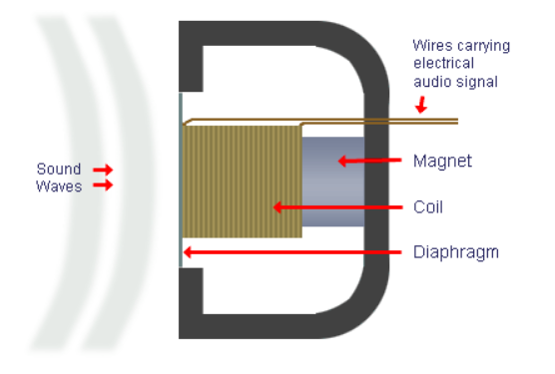
Microphone vs. Speaker
Sound(pressure waves) vibrate a diaphragm(plastic, paper, metal)
which moves the electromagnet(coil) back and forth
and causes the magnetic field to fluctuate
inducing a current = electrical signal
A microphone is also known as a transducer; it converts acoustic energy to electrical energy.
Notes:
Crash Course: Cybersecurity

Slide 4
Microphone vs. Speaker
Speakers work in reverse: An electrical signal cause the magnetic field to change and vibrate the diaphragm to produce the sound waves.
Notes:
Crash Course: Cybersecurity

Slide 5
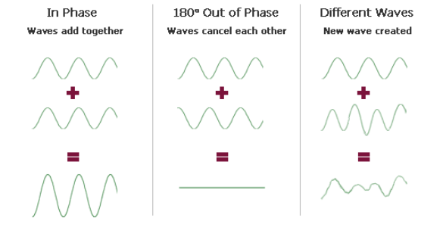
Sound Wave
sound waves interact to produce different waves.
Notes:
Crash Course: Cybersecurity

Slide 6
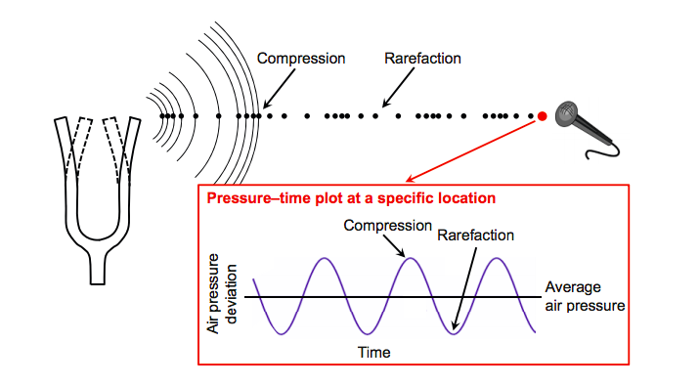
Sound
Figure taken from [Meinard Müller, Fundamentals of Music Processing, Figure 1.17, Springer 2015]

Slide 7
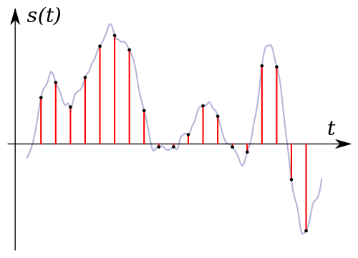
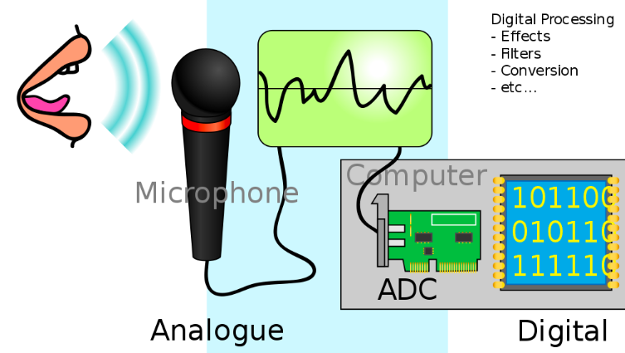
Analog to Digital Audio
Sampling the analog signal s(t)
The array of sampled values from the electrical signal is digital audio.
Electrical analog signal is sampled and convert to an array of numbers via ADC(Analog to Digital Converter).
The microphone converts acoustic energy to electrical energy.

Slide 8
Analog to Digital Audio
Sampling rate = 44,100 samples per second (CD quality)
analog signal s(t)
digital signal
{y0, y1, y2,…,yn}
array of 16-bit values(bit depth)
(1 bit for sign, 15 bits for value)
This allows for easy recording (just stores a list of numbers) of audio!

Slide 9
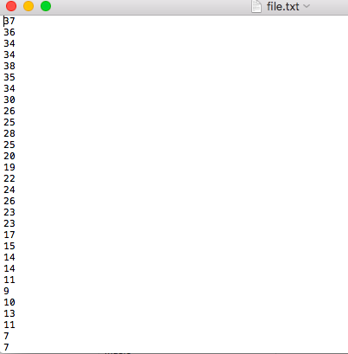
Play A List of Numbers as Audio
It is amazing that a digital sound file is
simply an array or list of numbers!
The "file.txt" file on the right is a list
of numbers sampled from an audio
recording at the rate of 44,100
samples per second.
Let's load them using Python. Then
send them to the speakers!

Slide 10
Play A List of Numbers as Audio
from IPython.display import Audio
import numpy as np
import matplotlib.pyplot as plt
ys = np.loadtxt("file.txt")
print(ys)
array([ 37., 36., 34., ..., 246., 262., 275.])
Audio(ys, rate = 44100)
See the Jupter Notebook Lab for this lecture to play the above audio.
The following code is best run in a Jupyter notebook.

Slide 11
Play A List of Numbers as Audio
Physics behind the following explanation
is beyond the scope of this course.
The numbers here are proportional to the
instantaneous velocities of the speaker cone.
(Smith)
This means that your speaker has to move 44,100
times a second to faithfully reproduce this
piano note sound!

Slide 12
Period, Amplitude and Frequency
A signal that exhibits the same repeated pattern(cycle) is periodic.
Notes:
\text{period} = \dfrac{1}{\text{frequency}}

Slide 13
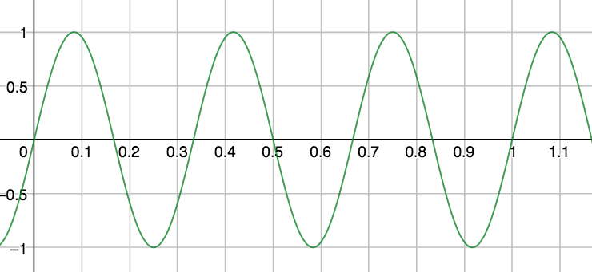
An Example
Period = 1/3 sec per cycle Frequency = 3 cycles per second

Slide 14
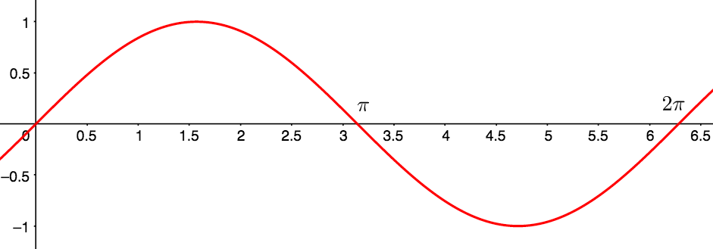
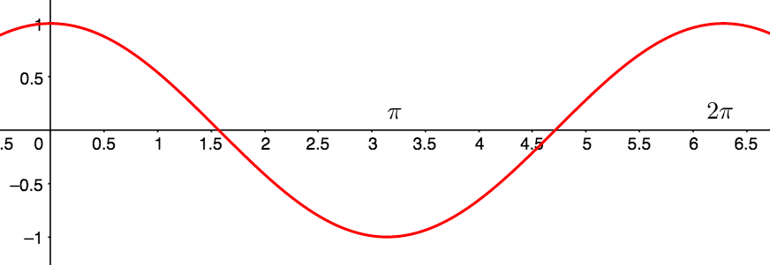
Sine and Cosine Wave

Slide 15
Sinusoids
Both the and completes one cycle in seconds:
Notes:
y=\sin(2\pi t), t\in[0,2\pi]\text{ (one cycle in } 2\pi \text{ seconds)}

Slide 16
Real Sinusoids
In general, the sinusoids and
has
Note: For simplicity, we'll ignore the phase of the sinusoids although the phase is an important attribute in digital audio/signal processing. Here's the full sinusoid with phase "phi":
Notes:
y=a\sin(2\pi ft) \text{ and } y=a\cos(2\pi ft),
y = 3\sin(2\pi\cdot 4t)

Slide 17
An Example
Suppose you have the signal .
Find the amplitude, frequency and period.
amplitude = 3
frequency = 4 Hz
period = 1/4 sec
Notes:
y = 3\sin(2\pi\cdot 4t + \pi/2).

Slide 18

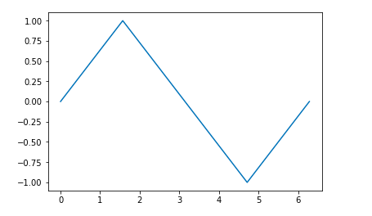
Plotting Functions
In the previous lectures, we used the Python and the matplotlib library to plot images. Now we will use it to plot functions.
Let's plot .
import matplotlib.pyplot as plt
# generate 5 equal-spaced
# samples in interval [0, 2*pi]
# more samples = better graph
ts = np.linspace(0, 2*np.pi, 5)
# apply the sin function to samples
ys = np.sin(ts)
# plot it
fig, ax = plt.subplots()
ax.plot(ts, ys)
The five points include the two endpoints.
Notes:
y = 3\sin(2\pi\cdot 4t + \pi/2).

Slide 19
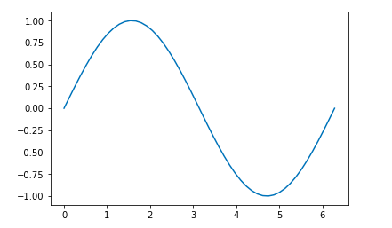
More Samples
Increasing the number of samples generate a smoother graph. Below uses 50 equally-spaced samples.
import matplotlib.pyplot as plt
ts = np.linspace(0, 2*np.pi, 50)
ys = np.sin(ts)
fig, ax = plt.subplots()
ax.plot(ts, ys)
Notes:
y = 3\sin(2\pi\cdot 4t + \pi/2).

Slide 20
Middle C
Middle C (or C4) has the frequency 261.6 Hz.
We'll simulate the above sound using Python in the lab for this lecture and will hear that it simulates the sound generated by a tuning fork.
Notes:
y=a\sin(2\pi ft) \text{ and } y=a\cos(2\pi ft),

Slide 21
C Major
The C major chord C-E-G has frequencies 261.6 Hz, 329.6 Hz, 392 Hz.
The analog signal for this chord is
Let's simulate these pure tones in Python.
Notes:
y(t)=\sin(2\pi\cdot 261.6\cdot t)+\sin(2\pi\cdot 329.6\cdot t)+\sin(2\pi\cdot 392\cdot t).

Slide 22
Middle C
Let's generate a 2 seconds interval of the pure Middle C tone(261.6 Hz) sampled at the frequency rate of 44100 Hz.
import matplotlib.pyplot as plt
fs = 44100
L = 2 # in seconds
N = fs * L # total samples
ts = np.linspace(0, L, N, endpoint=False)
ys = np.sin(2 * np.pi * 261.6 * ts)
# create Audio
Audio(ys, rate=fs)
# plot it
fig, ax = plt.subplots()
ax.plot(ts, ys)
Notes:
y = 3\sin(2\pi\cdot 4t + \pi/2).

Slide 23
Loudness vs Pitch
Loudness is our brain’s perception of amplitude.
Pitch is our brain’s perception of frequency.
Our perception of pitch is based on the logarithm of frequency.
The interval between two notes is the perceived difference between the two pitches.
As a result, the interval we hear from two notes depends on the ratio of their frequencies, not the difference.
Notes:
y = 3\sin(2\pi\cdot 4t + \pi/2).

Slide 24
Fundamental Frequency and Overtones
pure tone = one frequency
Most sounds are more complex.
E4 piano note = supposition of many frequencies: 330 Hz, 660 Hz, 990 Hz, 1320 Hz and 1650 Hz.
Fundamental frequency = 330 Hz.
Overtones or Harmonics = 660 Hz, 990 Hz, 1320 Hz, 1650 Hz.
Notes:
y = 3\sin(2\pi\cdot 4t + \pi/2).

Slide 25
Time vs Frequency Domains
In the time domain, the voltage/current signal is a function of time.
In the frequency domain, the signal is represented as a function of frequencies that are present in the signal.
.
Notes:
y(t)=\sin(2\pi\cdot 261.6\cdot t)+\sin(2\pi\cdot 329.6\cdot t)+\sin(2\pi\cdot 392\cdot t).

Slide 26
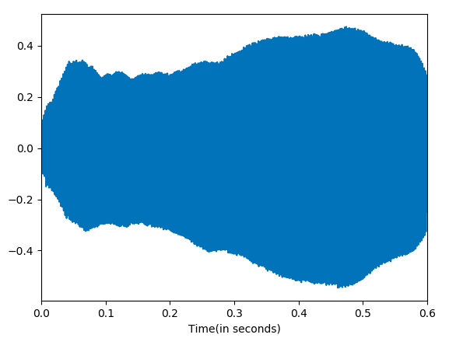
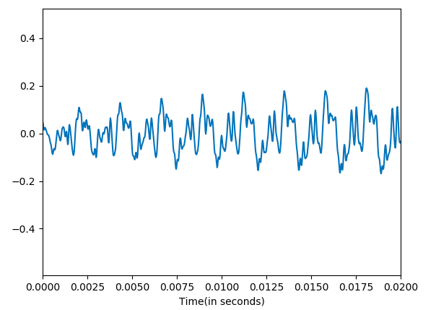
Time Domain
The signal in the time domain is very difficult to analyze. It is hard to know what sound is generated by the plot below.
The right plot is the zoomed in version of the left.
Notes:
y(t)=\sin(2\pi\cdot 261.6\cdot t)+\sin(2\pi\cdot 329.6\cdot t)+\sin(2\pi\cdot 392\cdot t).

Slide 27
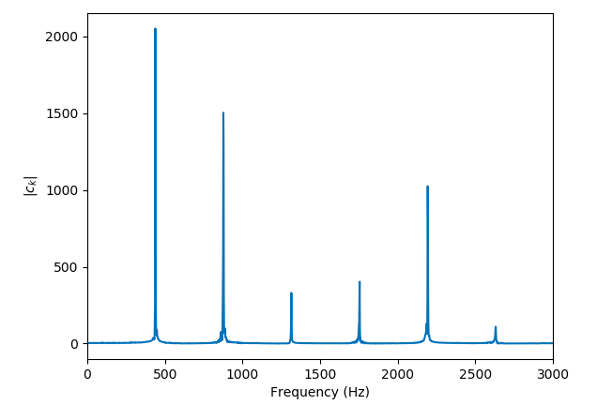
Frequency Domain
Converting the signal into
its frequency domain allows
us to understand its frequency
content.
What chord is this?
440 Hz = A4, 880 Hz = A5,
1320 Hz = E6, 1760 Hz = A6,
2200 Hz = C#7
The set of frequencies in a signal and their magnitudes is called the spectrum of the signal.
Notes:
y(t)=\sin(2\pi\cdot 261.6\cdot t)+\sin(2\pi\cdot 329.6\cdot t)+\sin(2\pi\cdot 392\cdot t).

Slide 28
Discrete Fourier Transform (DFT)
The Discrete Fourier Transform is an equation that converts the time domain signal into its frequency domain equivalence. The Inverse Discrete Fourier Transform is its inverse.
DFT
IDFT
Time Domain
Frequency Domain
Notes:
y(t)=\sin(2\pi\cdot 261.6\cdot t)+\sin(2\pi\cdot 329.6\cdot t)+\sin(2\pi\cdot 392\cdot t).

Slide 29
Spectrum Analyzers

Slide 30
Important Take Aways
1) Digital audio is simply sampling from a continuous, analog function at some sampling rate producing an array or list of numbers.
2) Sinusoids take on the form .
3) Pitch is our brain’s perception of frequency. (logarithm scale)
fundamental frequency vs harmonics
4) Time and Frequency domains are two equivalent representations of a signal.
5) The Discrete Fourier Transform and the Inverse Discrete Fourier Transform allows us to go back and forth between representations.
Notes:
y(t)=\sin(2\pi\cdot 261.6\cdot t)+\sin(2\pi\cdot 329.6\cdot t)+\sin(2\pi\cdot 392\cdot t).

Slide 31
Labs
Download the Jupyter Notebook from my website and work through the problems.
Notes:
y(t)=\sin(2\pi\cdot 261.6\cdot t)+\sin(2\pi\cdot 329.6\cdot t)+\sin(2\pi\cdot 392\cdot t).

Slide 32
References
1) Müller, Meinard, Fundamentals of Music Processing, Springer 2015.
2) Downey, Allen, ThinkDSP, Green Tea Press 2012.
3) Smith, Julius, The Mathematics of the Discrete Fourier Transform, W3K Publishing 2007.
4) Loy, Gareth, Musimathics, Volumes 1 and 2. The MIT Press 2011.
5) Newman, Mark, Computational Physics, Createspace Independent Publishing Platform 2012.
6) Soklaski, Ryan. MIT Lincoln Lab Researcher. Beaver Works Summer Institute.
Notes:
y(t)=\sin(2\pi\cdot 261.6\cdot t)+\sin(2\pi\cdot 329.6\cdot t)+\sin(2\pi\cdot 392\cdot t).

