Slide 1
Introduction to Python
Operations and Variables

Slide 2
Topics
Arithmetic Operations
Floor Division vs True Division
Modulo Operator
Operator Precedence
String Concatenation
Augmented Assignment

Slide 3
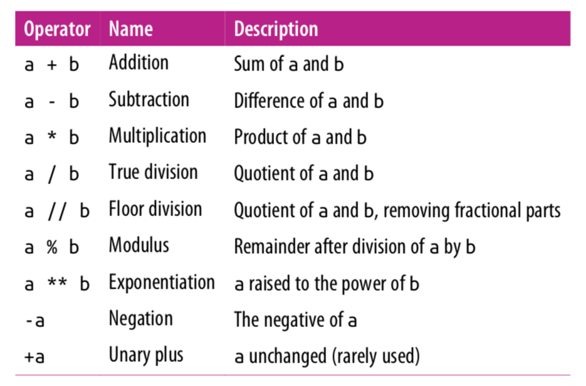
Arithmetic Operations

Slide 4
Mixing Types
Any expression that two floats produce a float.
x = 17.0 – 10.0
print(x) # 7.0
When an expression’s operands are an int and a float, Python automatically converts the int to a float.
x = 17.0 – 10
print(x) # 7.0
y = 17 – 10.0
print(y) # 7.0

Slide 5
True Division vs Floor Division
The operator / is true division and the operator // returns floor division(round down after true divide). True divide / always gives the answer as a float.
print(23 // 7) # 3
print(3 // 9) # 0
print(-4 // 3) # -2
print(6 / 5) # 1.2
print(6 / 3) # 2.0 NOT 2!

Slide 6
Remainder with %
The % operator computes the remainder after floor division.
14 % 4 is 2
218 % 5 is 3 3 43 4 ) 14 5 ) 218 12 20 2 18 15 3
Applications of % operator:
Obtain last digit of a number: 230857 % 10 is 7
Obtain last 4 digits: 658236489 % 10000 is 6489
See whether a number is odd: 7 % 2 is 1, 42 % 2 is 0
Notes:
6
What is 8 % 20? It's 8, but students often say 0.

Slide 7
Modulo Operator
The operator % returns the remainder after floor division.
print(18 % 5) # 3
print(2 % 9) # 2, if first number is smaller, it's the answer
print(125 % 10) # 5
print(0 % 10) # 0
print(10 % 0) # ZeroDivisionError

Slide 8
Why floor and modulo division are useful
Floor division allows us to extract the integer part of the division while the modulo operator extracts the remainder part of the division. Consider the question:
How many weeks and days are there in 25 days?
Answer: 3 weeks plus 4 days.
num_weeks = 25 // 7 # extracting number of weeks
print(num_weeks) # 3
num_days = 25 % 7 # extracting number of days
print(num_days) # 4

Slide 9
Why the modulo operator is useful
If today is a Tuesday, which day is 43 days from today?
Answer: 43 divided by 7 is 6 with a remainder of 1. Thus, it will be Wednesday.
print(43 % 7) # 1
Even/odd: A number x is even if x % 2 is 0 and odd if x % 2 is 1.
num = int(input(‘Please enter an integer value: ’))
print(num, 'is even:', num % 2 == 0)
Output 1:
Please enter an integer value: 4
4 is even: True
Output 2:
Please enter an integer value: 13
13 is even: False

Slide 10
Expressions
Find the exact change for 137 cents using quarters, dimes, nickels and cents. Use the least
number of coins.
How many quarters? 137 // 25 = 5 quarters (Floor Division!)
What’s leftover? 137 % 25 = 12 cents
How many dimes? 12 // 10 = 1 dime
What’s leftover? 12 % 10 = 2 cents
How many nickels? 2 // 5 = 0 nickels.
What’s leftover? 2 % 5 = 2 cents.
How many pennies? 2 // 1 = 2 pennies
What’s leftover? 2 % 1= 0 cents. Done!

Slide 11
Extracting Digits
Given a three-digit integer. Extract its the ones, tens and hundreds digits.
For example, if the integer is 352. Its ones digit is the 2, its tens digit is the 5 and
its hundreds digit is the 3.
number = 352
print("ones:", number % 10)
number = number // 10
print("tens:", number % 10)
number = number // 10
print("hundreds:", number % 10)
Note: Modulo 10 (% 10) extracts the last digit. Floor division (// 10) discards the
last digit. Later in another lecture, we will see how to generalize this to
any number of digits.
# ones: 2
# number = 35 (discards last digit)
# tens: 5
# number = 3 (discards last digit)
# hundreds:3

Slide 12
Extracting Digits
Alternatively:
number = 352
ones = number % 10
tens = (number // 10) % 10
hundreds = number // 100
print("ones:", ones, "tens", tens, "hundreds:", hundreds)
Output:
ones: 2 tens: 5 hundreds: 3

Slide 13
Exponentiation and Negation
x = 2 ** 3
print(x) # 8
Negation is a unary operator. It applies to only one operand. Other operations such as +, -, *, /, //, % are binary operators, they apply to two operands.
x = -5
y = --5
print(x) # -5
print(y) # 5

Slide 14
Operator Precedence
Precedence | Operator | Operation
highest | ** | exponentiation
 | - | negation
 | *, /, //, % | multiplication, division, floor division, modulus (left to right)
lowest | +, - | adding, subtraction(left to right)
Operators on the same row are applied left to right. Exponentiation, however, is
applied right to left. Expressions in parenthesis are evaluated first(PEMDAS).

Slide 15
Operator Precedence
x = -2 ** 4
print(x) # -16
y = 7 – 4 * 5 % (1 + 2)
print(y) # 5
7 - 4 * 5 % (1 + 2)
7 – 4 * 5 % 3
7 – 20 % 3
7 – 2
5

Slide 16
Augmented Assignment
An augmented assignment combines an assignment statement with an operator to make the statement more concise.
Shorthand Equivalent version
variable += value variable = variable + value
variable -= value variable = variable - value
variable *= value variable = variable * value
variable /= value variable = variable / value
variable %= value variable = variable % value
x = 4
x += 1 # equivalent to x = x + 1
print(x) # 5

Slide 17
Augmented Assignment
x = 3
x *= 2 + 5
print(x) # 21
number = 5
number *= number
print(number) # 25

Slide 18
String Concatenation
Two strings can be combined, or concatenated, using the + operator:
string1 = "abra" string2 = "cadabra" magic_string = string1 + string2
first = "Michael" last = "Smith" full_name = first + " " + last
Concatenating a string and a number raises a TypeError. Must first cast the number into a string using str().
apples = "I have " + 3 + "apples" # error! apples = "I have " + str(3) + "apples" # correct!

Slide 19
Errors
Beginning programmers make mistakes writing programs because of inexperience in programming in general or due to unfamiliarity with a programming language.
There are four general kinds of errors: syntax errors, run-time errors, overflow errors and logic errors.
The interpreter reads the Python source file and translates it into a executable form. This is the translation phase. If the interpreter detects an invalid program statement during the translation phase, it will terminate the program’s execution and report an error.
Such errors result from the programmer’s misuse of the language. A syntax error is a common error that the interpreter can detect when attempting to translate a Python statement into machine language.

Slide 20
Syntax Errors
A syntax error is a common error that the interpreter can detect when attempting to translate a Python statement into machine language.
x = 3
y = x + 5
y + 2 = x # SyntaxError
print(x # SyntaxError
z = "hello # SyntaxError

Slide 21
Run-time Errors
A syntactically correct Python program still can have problems. Some language errors depend on the context of the program’s execution. Such errors are called run-time exceptions or run-time errors.
We say the interpreter raises an exception. Run-time exceptions arise after the interpreter’s translation phase and during the program’s execution phase.
Run-time errors will cause the program to immediately terminate.
x = 3
y = x + 5
y = w + 1 # Syntactically correct but raises a run-time # error: "name w is not defined"

Slide 22
Run-time Errors
Here's another example of a run-time error.
# Get two integers from the user
print('Please enter two numbers to divide.')
dividend = int(input('Please enter the dividend: '))
divisor = int(input('Please enter the divisor: '))
# Divide them and report the result
print(dividend, '/', divisor, "=", dividend/divisor)
The expression dividend/divisor is potentially dangerous. If the user enters, for example, 32 and 4, the program works nicely.
If the user instead types the numbers 32 and 0, the program reports an error and terminates. Division by zero is undefined in mathematics, and division by zero in Python is illegal.

Slide 23
Run-time Errors
Another example of a run-time error is an overflow error. An overflow error is an error that occurs when a computer attempts to handle a number that is outside of the defined range of values.
print(2.0 ** 10000) # OverflowError: 'Result too large'

Slide 24
Logic Errors
The interpreter can detect syntax errors during the translation phase and uncover run-time exceptions during the execution phase. Both kinds of problems represent violations of the Python language.
Such errors are the easiest to repair because the interpreter indicates the exact location within the source code where it detected the problem.
A logic error is a mistake in the algorithm or program that causes it to behave incorrectly or unexpectedly. A logic error is subtle and will not cause the program to terminate.

Slide 25
Logic Errors
Consider the effects of replacing the expression dividend/divisor with divisor/dividend.
The program runs, and unless the user enters a value of zero for the dividend, the interpreter will report no errors. However, the answer it computes is not correct in general.
The only time the program will print the correct answer is when dividend equals divisor.
The program contains an error, but the interpreter is unable detect the problem. An error of this type is known as a logic error.

Slide 26
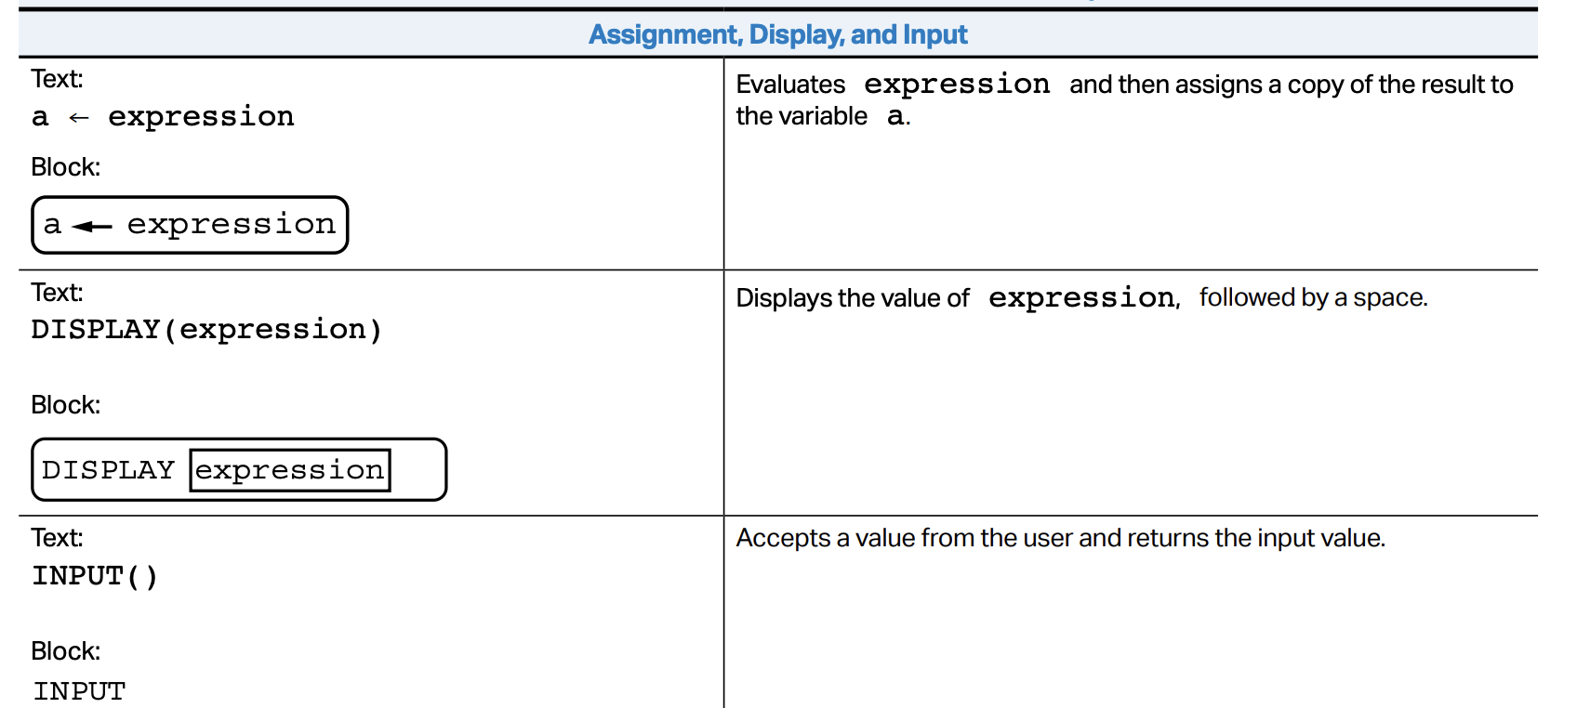
AP Exam Info

Slide 27
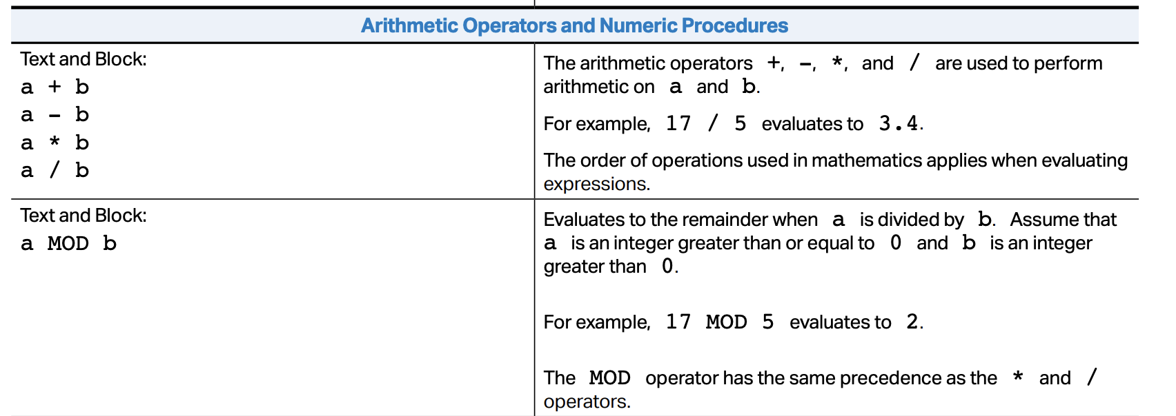
AP Exam Info
Note that there is no floor division on the AP exam.
On the AP, like Python, the operator / is true division.

Slide 28
Lab 1: Modulo Operator
Create a new repl on repl.it. Write code to match the following console output. Underline numbers are user inputs; you must use the input() function.
Create the following variables: ones, tens and hundreds
Enter a three-digit number: 245
The sum of the digits of 245 is 11.
Create the following variables: quarters, dimes, nickels and pennies.
Enter amount in cents: 137
Number of quarters: 5
Number of dimes: 1
Number of nickels: 0
Number of pennies: 2

Slide 29
References
Vanderplas, Jake, A Whirlwind Tour of Python, O’Reilly Media.
This book is completely free and can be downloaded online at O’reilly’s site.

