Slide 1

Reinforcement Learning
Group Project

Slide 2
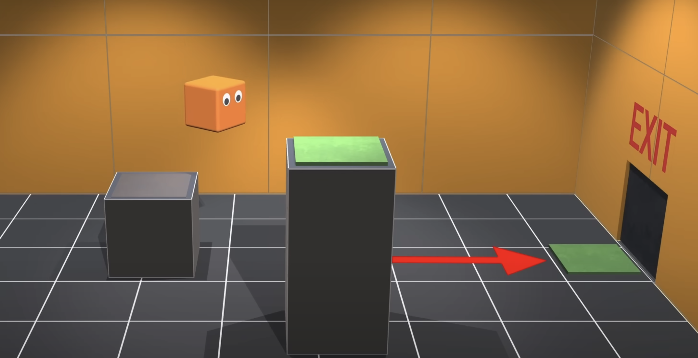
Reinforcement Learning: Albert
https://youtu.be/v3UBlEJDXR0?si=Ga13NYEoFXkHUARW
Notes:
Reinforcement learning is learning what to do—how to map situations to actions—so as to maximize a numerical reward signal.
The learner is not told which actions to take, but instead must discover which actions yield the most reward by trying them.
Imagine playing a new game whose rules you don’t know; after a hundred or so moves, the referee tells you “You lose.” You repeat this until you can find an optimal strategy for playing the game.

Slide 3
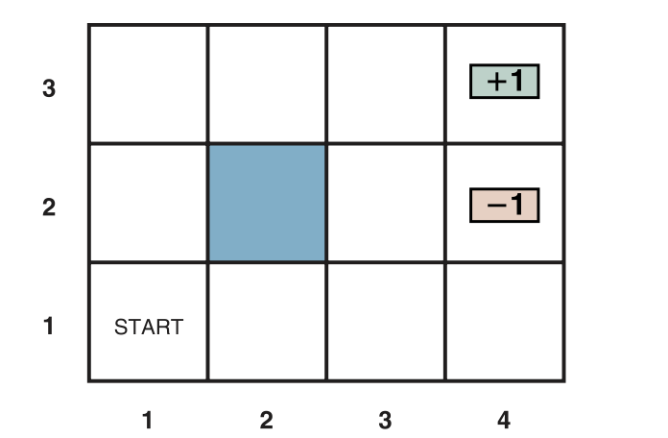
Notes:
Imagine that robot is trying to learn the following task: Exit the the maze by finding
the +1(green) cell. Successfully exiting the cell results in a win and gain a +1 reward.
If robot lands on the -1(red) cell, it loses and gain a -1 reward.

Slide 4
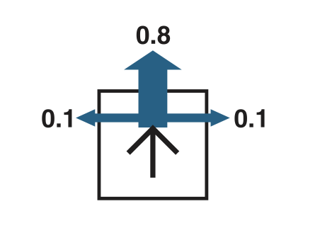
Uncertainty
Notes:
A robot movement, however, is unreliable. Each action achieves the intended effect
with probability 0.8, but the rest of the time, the action moves the agent at right
angles to the intended direction. Furthermore, if the agent bumps into a wall, it
stays in the same square.
If a robot intends to go right, for example, it goes right 80% of the time, goes up 10% of
the time and goes down 10% of the time.

Slide 5
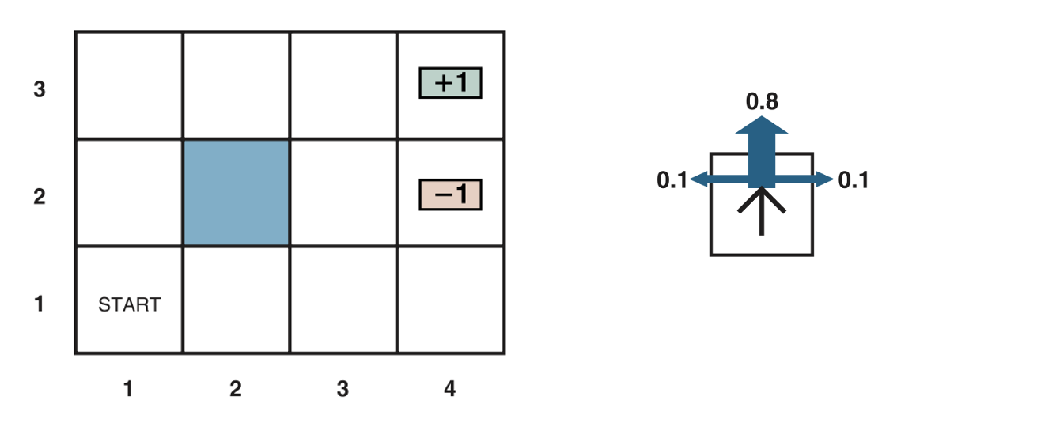
Transitions
For our particular example, the reward is −0.04 for all transitions except those entering
terminal states (which have rewards +1 and –1).
Notes:
For our particular example, the reward is −0.04 for all transitions except those entering
terminal states (which have rewards +1 and –1). The negative reward of –0.04 gives the agent an
incentive to reach (4,3) quickly.
Everytime the robot successful exit, it follows a certain path to get there. It receives a reward
of +1. But the robot will calculate the utility of that path by taking into account how many
steps it took to get there.
For example, if the agent reaches the +1 state after 10 steps, its total utility
will be (9 × − 0.04) + 1 = 0.64. Note that this utility function is a function of the starting state.

Slide 6
Utility(Value)
For example, if the agent reaches the +1 state after 9 steps: [up, up, down, up, right,
right, down, up, right], then its total utility will be (8 × -0.04) + 1 = 0.68.
Notes:
Because the robot does not know what the task is, early in the learning process, it’s possible for the robot to initially go in random directions, including backtracking.
For example, if the agent reaches the +1 state after 9 steps: [up, up, down, up, right,
right, down, up, right], then its total utility will be (8 × − 0.04) + 1 = 0.68.
Note that this utility function is a function of the starting state, in this case, (1, 1).

Slide 7

Policy
$$π:S→A$$
Notes:
The next question is, what does a solution to the problem look like? No fixed action sequence can solve the problem, because the agent might end up in a state other than the goal.
Therefore, a solution must specify what the agent should do for any state that the agent might reach. A solution of this kind is called a policy.
It is traditional to denote a policy by π, and π(s) is the action recommended by the policy π for state s. No matter what the outcome of the action, the resulting state will be in the policy, and the agent will know what to do next.

Slide 8
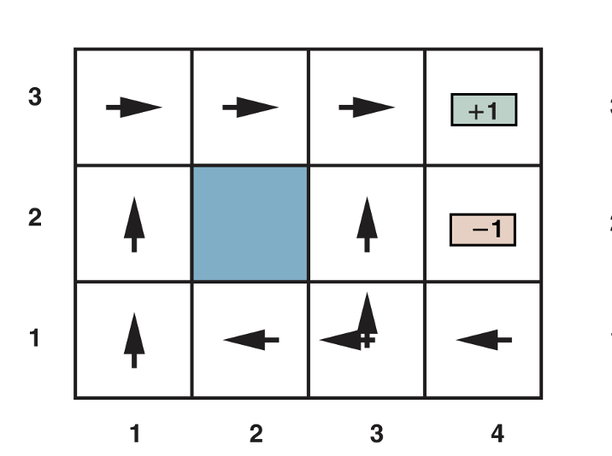
Optimal Policy
Notes:
The next question is, what does a solution to the problem look like? No fixed action sequence can solve the problem, because the agent might end up in a state other than the goal.
Therefore, a solution must specify what the agent should do for any state that the agent might reach. A solution of this kind is called a policy.
It is traditional to denote a policy by π, and π(s) is the action recommended by the policy π for state s. No matter what the outcome of the action, the resulting state will be in the policy, and the agent will know what to do next.

Slide 9
Expected Utility, Expected Value
Notes:
Each time a given policy is executed starting from the initial state, the stochastic (probabilistic) nature of the environment may lead to a different environment history.
The quality of a policy is therefore measured by the expected value(utility) of the possible environment histories generated by that policy.
An optimal policy is a policy that yields the highest expected utility. We use π∗ to denote an optimal policy. Given π∗, the agent decides what to do executing the action given by π∗(s).

Slide 10
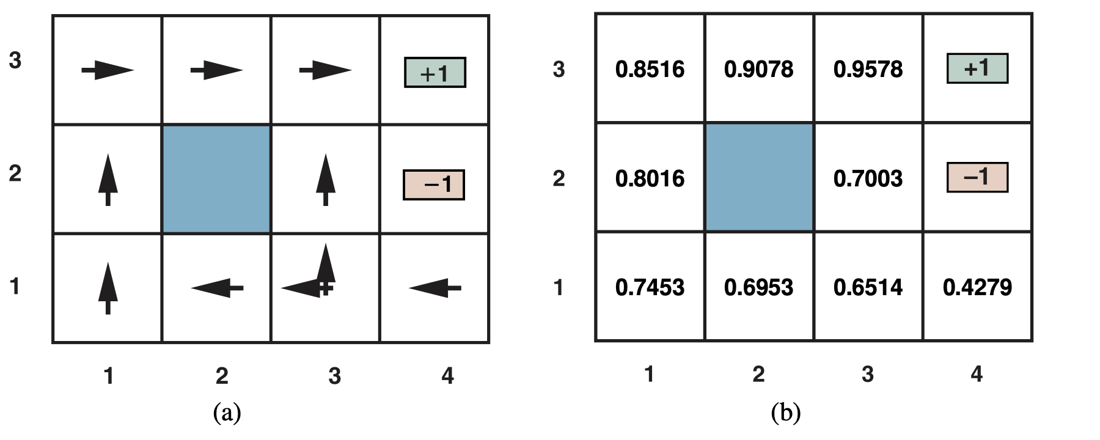
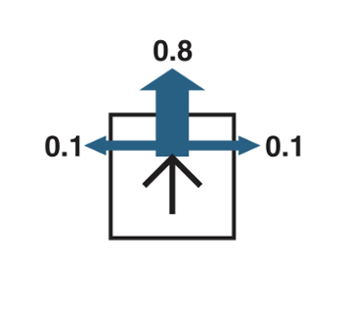
Optimal Policies, Expected Values of each State
Notes:
The optimal policies for the stochastic environment with r = − 0.04 for transitions
between nonterminal states.
Given a fixed policy, we can calculate the expected value(or expected utility) of the
possible environment histories generated by that policy. For example, the table b) on the right
is the utilities of states calculated from the policy on the left table a). The utility of value
function V(s) is the value of the state s.
Note that in the diagram above, there are TWO policies because in state (3,1) both Left and Up
are optimal. Why?

Slide 11
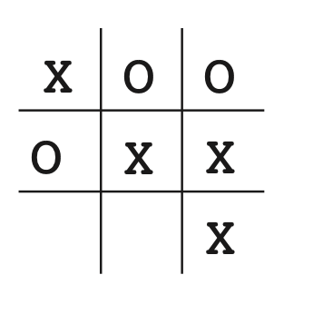
Here is how the tic-tac-toe problem would be approached with a method making use of a value function.
Similar to the robot problem, we like to find the expected value of every configuration(state) of the board relative to some player(X or O).

Slide 12
X | X | X
O | X | X
X | X | X

Slide 13
 |  |  | X
 | X | 0.74 | X
0.52 | 0.56 | 0.58 | 0.35

Slide 14
First we would set up a table of numbers, one for each possible state of the game. Each number will be the latest estimate of the probability of our winning from that state.
We treat this estimate as the state’s value, and the whole table is the learned value function.
State A has higher value than state B, or is considered “better” than state B, if the current estimate of the probability of our winning from A is higher than it is from B.

Slide 15
Assuming we always play Xs, then for all states with three Xs in a row the probability of winning is 1, because we have already won.
Similarly, for all states with three Os in a row, or that are filled up, the correct probability is 0, as we cannot win from them.
We set the initial values of all the other states to 0.5, representing a guess that we have a 50% chance of winning.

Slide 16
Exploitation vs Exploration
One of the challenges that arise in reinforcement learning, and not in other kinds of learning, is the trade-off between exploration and exploitation.
To obtain a lot of reward, a reinforcement learning agent must prefer actions that it has tried in the past and found to be effective in producing reward. But to discover such actions, it has to try actions that it has not selected before.
The agent has to exploit what it has already experienced in order to obtain reward, but it also has to explore in order to make better action selections in the future. The dilemma is that neither exploration nor exploitation can be pursued exclusively without failing at the task. The agent must try a variety of actions and progressively favor those that appear to be best.
Notes:
https://www.smartgrid.gov/the_smart_grid/smart_grid.html

Slide 17
To train the AI(first player), we let it play many games(e.g., 100k) against another AI opponent(second player).
To select our moves we examine the states that would result from each of our possible moves (one for each blank space on the board) and look up their current values in the table.
Most of the time we move greedily, selecting the move that leads to the state with greatest value, that is, with the highest estimated probability of winning.
Occasionally, however, we select randomly from among the other moves instead. These are called exploratory moves because they cause us to experience states that we might otherwise never see.

Slide 18
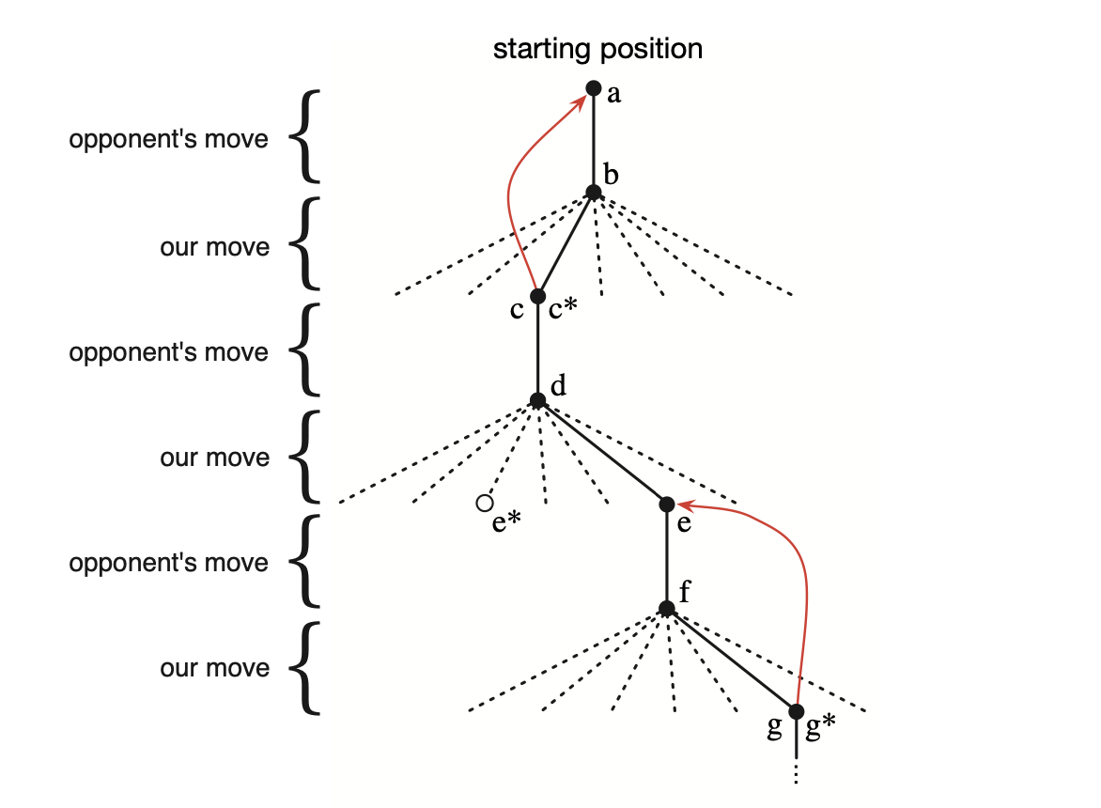
A sequence of tic-tac-toe moves. The solid black lines represent the moves taken during a game; the dashed lines represent moves that we (our reinforcement learning player) considered but did not make.
The * indicates the move currently estimated to be the best. Our second move was an exploratory move, meaning that it was taken even though another sibling move, the one leading to e*, was ranked higher.

Slide 19

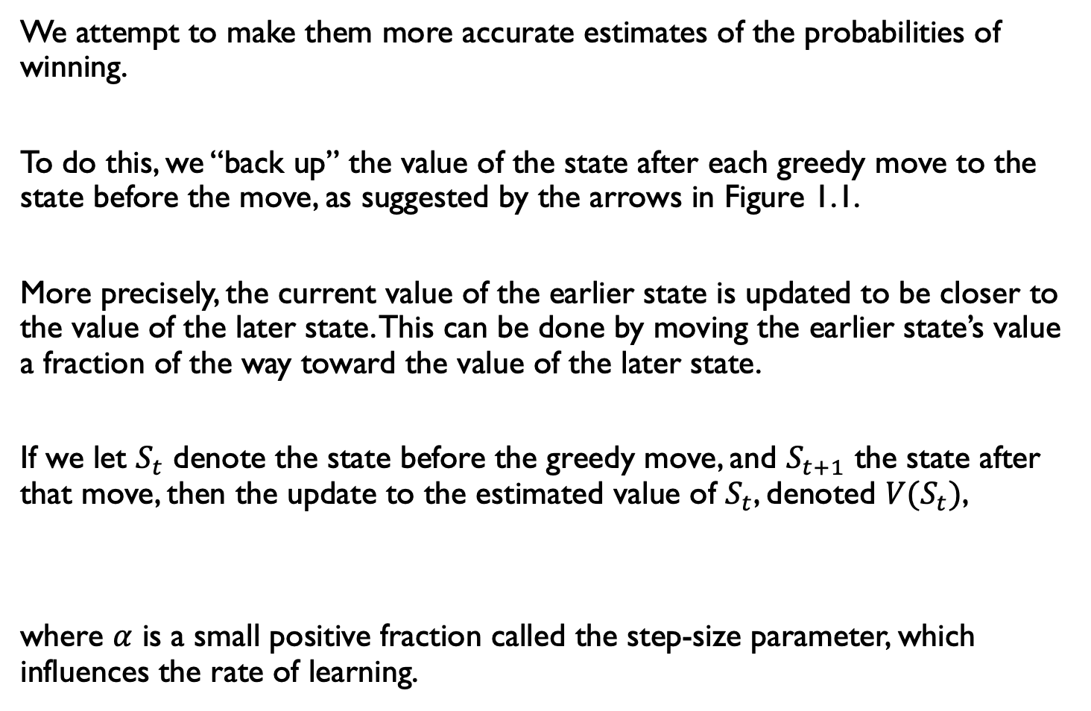
We attempt to make them more accurate estimates of the probabilities of winning.
To do this, we “back up” the value of the state after each greedy move to the state before the move, as suggested by the arrows in Figure 1.1.
More precisely, the current value of the earlier state is updated to be closer to the value of the later state. This can be done by moving the earlier state’s value a fraction of the way toward the value of the later state.
If we let $S_{t}$ denote the state before the greedy move, and $S_{t+1}$ the state after that move, then the update to the estimated value of $S_{t}$, denoted ${V(S}_{t})$,
where $α$ is a small positive fraction called the step-size parameter, which influences the rate of learning.

Slide 20
Values
For our particular example, the reward is −0.04 for all transitions except those entering
terminal states (which have rewards +1 and –1).
Notes:
For our particular example, the reward is −0.04 for all transitions except those entering
terminal states (which have rewards +1 and –1). The negative reward of –0.04 gives the agent an
incentive to reach (4,3) quickly.
Everytime the robot successful exit, it follows a certain path to get there. It receives a reward
of +1. But the robot will calculate the utility of that path by taking into account how many
steps it took to get there.
For example, if the agent reaches the +1 state after 10 steps, its total utility
will be (9 × − 0.04) + 1 = 0.64. Note that this utility function is a function of the starting state.

Slide 21
References

