Slide 1
Introduction to Python
Conditionals

Slide 2
Topics
Comparison Operators
Boolean Operations(and, or not)
Operator Precedence
Conditionals (if, if-if, if-elif, if-elif-else)

Slide 3
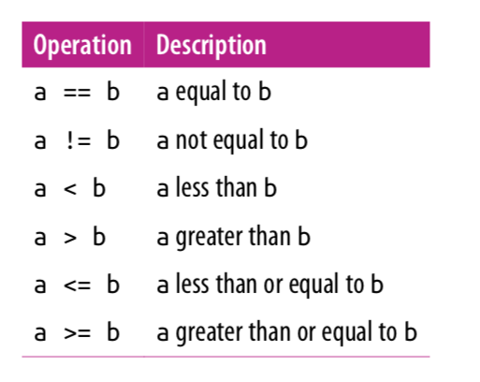
Comparison Operators
Note that = is for assignment and
== is for equals.
These operators return either True or
False.

Slide 4
Comparison Operators
a = (10 == 5) # value of a is False
print(a) # False is printed
print(3 <= 7) # True
print(3 != 7) # True
x = 1
b = (x > 10) # value of b is False
print(b) # False

Slide 5
Boolean Operations
Python provides operators to combine the values using the standard concepts of “and”, “or”, and “not”.
These operators are expressed using the words and, or, and not:
Note: The above Or is also know as the "inclusive or". The conversational "or" may sometime be used as the "exclusive or"(one or the other but not both).
X | Y | X or Y
True | True | True
True | False | True
False | True | True
False | False | False
X | Y | X and Y
True | True | True
True | False | False
False | True | False
False | False | False
X | not X
True | False
False | True

Slide 6
Boolean Operations
x = 4
print((x < 6) and (x > 2)) # True
a = (x > 10) or (x % 2 == 0)
print(a) # True
b = not (x < 6) print(b) # False
print(True or False) # True
print(True and False) # False

Slide 7
Operator Precedence
Precedence | Operator | Operation
highest | ** | exponentiation
 | - | negation
 | *, /, //, % | multiplication, division, floor division, modulus
 | +, - | adding, subtraction
 | ==,!=,<,>,<=,>= | comparisons
 | not | logical not
 | and | logical and
 | or | logical or
lowest | = | assignment

Slide 8
Boolean Operations
Math operators have the highest precedence. Then comparison operators are followed by logical operators. The assignment operator is evaluated last.
result = 3 + 2 * 4 < 14 or 3 == 5
print(result) # True
Although the above expression is correct, often for the sake of readability, and clarity it is often good practice to include parenthesis.
result = (3 + 2 * 4 < 14) or (3 == 5)
print(result) # True

Slide 9
Conditionals
Selection determines which parts of an algorithm are executed based on a condition being true or false.
The reserved word if begins an conditional block.
if condition: block
The condition determines if the block is to be executed.
A block contains one or more statements.
The statements inside of a block must be indented the same number of spaces from the left. The standard is 4 spaces.

Slide 10
If block
What's the output?
x = -5
if x > 0: print(x)
print(“x is positive”)
print(“outside of block”)
outside of block
Note: Since the conditional is false, the entire block is skipped. The print statement outside the block, however, is executed.

Slide 11
If block
What's the output?
x = 5
if x > 0:
print(x)
print(“x is positive”)
print(“outside of block”)
5
x is positive
outside of block
Note: The above conditional block is executed.

Slide 12
Sequence of Ifs
A sequence of consecutive if statements are independent. None, some or all of them can be executed.
x = 4
if x % 2 == 0:
print(“x is even”)
if x > 0:
print(“x is positive”)
x is even
x is positive
Note: Both of the above blocks are executed.

Slide 13
Sequence of Ifs
x = -8
if x % 2 == 0:
print(“x is even”)
if x > 0:
print(“x is positive”)
x is even

Slide 14
if-elif
An if block followed by a sequence of elif blocks will execute the first block whose condition evaluates to True. No block is executed if all conditions evaluate to False.
x = 25
if x < 5:
print(“x is less than 5”)
elif x < 10:
print(“x is less than 10”)
elif x < 15:
print(“x is less than 15”)
Note that all of the above conditions are false and thus no block is executed.

Slide 15
if-elif
x = 7
if x < 5:
print(“x is less than 5”)
elif x < 10:
print(“x is less than 10”)
elif x < 15:
print(“x is less than 15”)
x is less than 10
Note that only the middle elif block is executed!

Slide 16
if-elif
x = 1
if x < 5:
print(“x is less than 5”)
elif x < 10:
print(“x is less than 10”)
elif x < 15:
print(“x is less than 15”)
x is less than 5
Note that only the first if block is executed, even though all three conditions are true.

Slide 17
if-elif-else
An `if` statement followed by a sequence of `elif` statements and ending in an `else` statement will execute the first block whose condition evaluates to `True`. If all conditions evaluate to `False`, it will execute the default `else` block.
x = 0
if x < 0:
print(“x is negative”)
elif x > 0:
print(“x is positive”)
else:
print(“x is zero”)
x is zero

Slide 18
if-elif-else
x = 10
if x < 0:
print(“x is negative”)
elif x > 0:
print(“x is positive”)
else:
print(“x is zero”)
x is positive

Slide 19
and, or, not
Use and, or, and not Boolean operators to simplify conditionals.
The following
if x > 0:
if x < 10:
print(x)
is equivalent to
if x > 0 and x < 10:
print(x)
if 0 < x < 10:
print(x)

Slide 20
and, or, not
The following code prints the quadrant of an ordered (x,y) on the Cartesian plane.
x = 4
y = 7
if (x > 0) and (y > 0):
print(“first quadrant.”)
elif (x < 0) and (y > 0):
print(“second quadrant.”)
elif (x < 0) and (y < 0):
print(“third quadrant.”)
elif (x > 0) and (y < 0):
print(“fourth quadrant.”)
else:
print(“on x or y axis.”)
Output:
first quadrant

Slide 21
and, or, not
The following code prints the quadrant of an ordered (x,y) on the Cartesian plane.
x = -26
y = -31
if (x > 0) and (y > 0):
print(“first quadrant.”)
elif (x < 0) and (y > 0):
print(“second quadrant.”)
elif (x < 0) and (y < 0):
print(“third quadrant.”)
elif (x > 0) and (y < 0):
print(“fourth quadrant.”)
else:
print(“on x or y axis.”)
Output:
third quadrant

Slide 22
Example 1
Write a segment of code which asks the user to enter a number and prints out whether the number is even.
x = int(input(‘Enter an integer: ’))
if x % 2 == 0:
print(“x is even”)
else:
print(“x is odd”)

Slide 23
Example 2: FizzBuzz
Write a segment of code which asks the user to enter a number. Print "fizz" if the number is a multiple of 3, "buzz" if it is a multiple of 5 and "fizzbuzz" if it is a multiple of both 3 and 5. In all other cases, print the number.
x = int(input(‘Enter an integer: ’))
if x % 3 == 0:
print(“fizz”)
elif x % 5 == 0:
print(“buzz”)
elif x % 3 == 0 and x % 5 == 0:
print(“fizzbuzz”)
else:
print(x)
Does the code work?
No, if x = 15, it incorrectly
prints "fizz".

Slide 24
Example 2: FizzBuzz
Here's the correct way to implement FizzBuzz.
x = int(input(‘Enter an integer: ’))
if x % 3 == 0 and x % 5 == 0:
print(“fizzbuzz”)
elif x % 3 == 0:
print(“fizz”)
elif x % 5 == 0:
print(“buzz”)
else:
print(x)

Slide 25
Example 2: FizzBuzz
Does the following code work?
x = int(input(‘Enter an integer: ’))
answer = ""
if x % 3 == 0:
answer += "fizz"
if x % 5 == 0:
answer += "buzz"
if answer == "":
answer += str(x)
print(answer)
Yes! Compare this to the previous
slide.

Slide 26
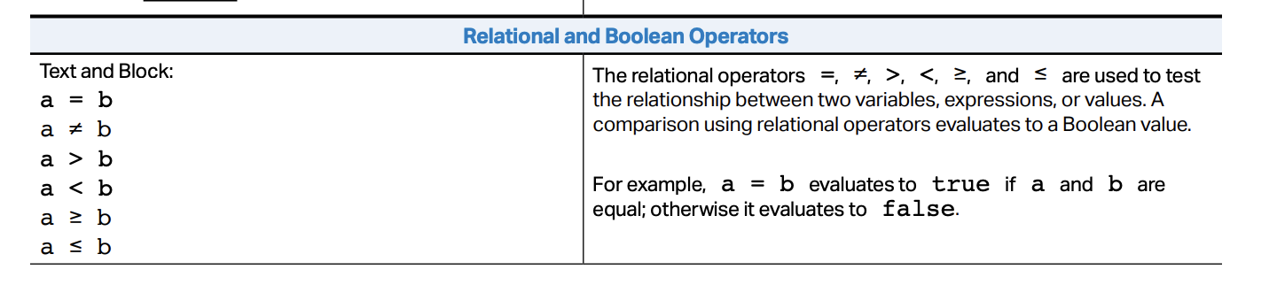
AP Exam
Note that the AP’s (a = b) is equivalent to Python’s boolean expression (a == b).

Slide 27
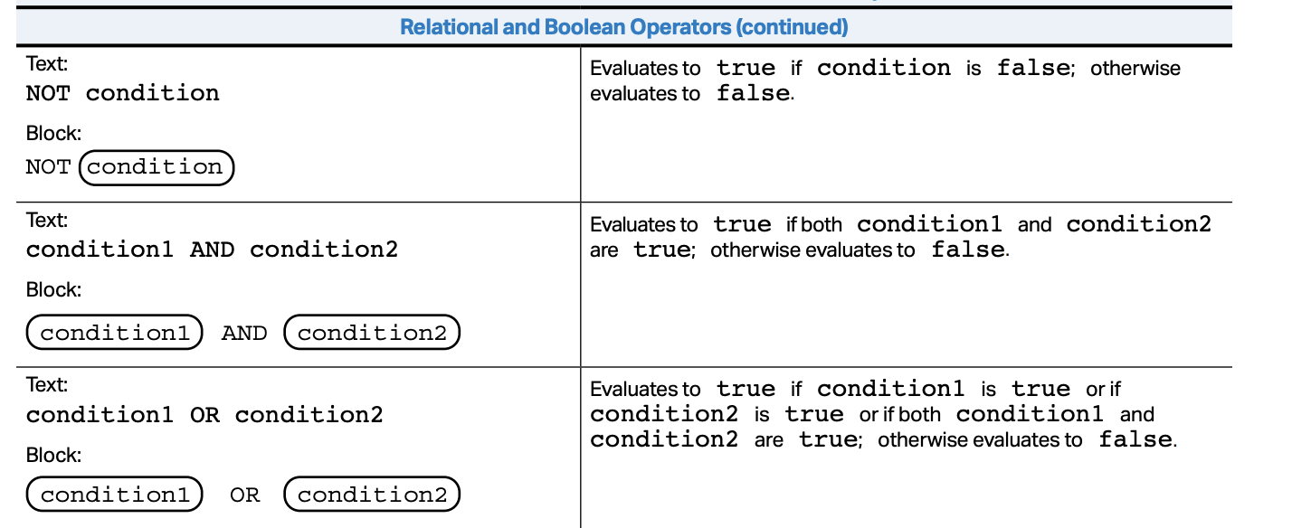
AP Exam

Slide 28
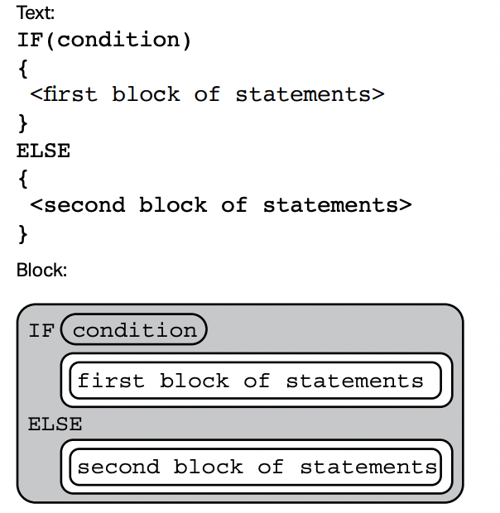
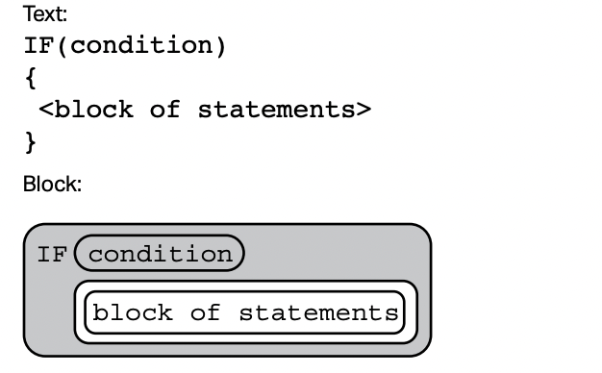
AP Exam
The AP exam only uses two types of if blocks:
If
If – Else
To cover more complex logic, nesting of conditionals are used.

Slide 29
Example
Write a program that asks the user to enter their gpa. Print out “With Distinction” if the gpa is at least 3.8 and “With Honor” if it’s between 3.3 and 3.8(not including end points) and “No distinction” otherwise.
Since the AP exam only uses if, and if-else. DO NOT use elif in the code.
gpa = float(input(‘Enter gpa: ’))
if gpa >= 3.8:
print(“With Distinction”)
else:
if gpa > 3.3:
print(“With Honor”)
else:
print(“No distinction”)

Slide 30
Lab 1: Absolute Value
Create a new repl on repl.it. If you wish, you can use this same repl for all of the labs in this lecture.
Write a program which asks for an integer and prints out the absolute value of the number.
Example output 1:
Enter a number: 34
Absolute value of 34 is 34.
Example output 2:
Enter a number: -11
Absolute value of -11 is 11.

Slide 31
Lab 2: Quadratic
Create a new repl on repl.it. Write a program which asks for the coefficients of the quadratic f(x) = ax^2 + bx + c and prints out the number of real roots of f(x).
Hint: Compute the discriminant b^2 – 4ac. If the discriminant is > 0, it has two real roots. If it is < 0 , it has no real roots and if it is = 0, it has one repeated root.
Enter a: 1
Enter b: -2
Enter c: -15
Two real roots.
Enter a: 1
Enter b: 0
Enter c: 1
No real roots.
Enter a: 1
Enter b: -2
Enter c: 1
One repeated real root.

Slide 32
References
Vanderplas, Jake, A Whirlwind Tour of Python, O’reilly Media.
Richard Halterman, Fundamental of Python Programming.

