Slide 1
Logic Puzzle Solver

Slide 2
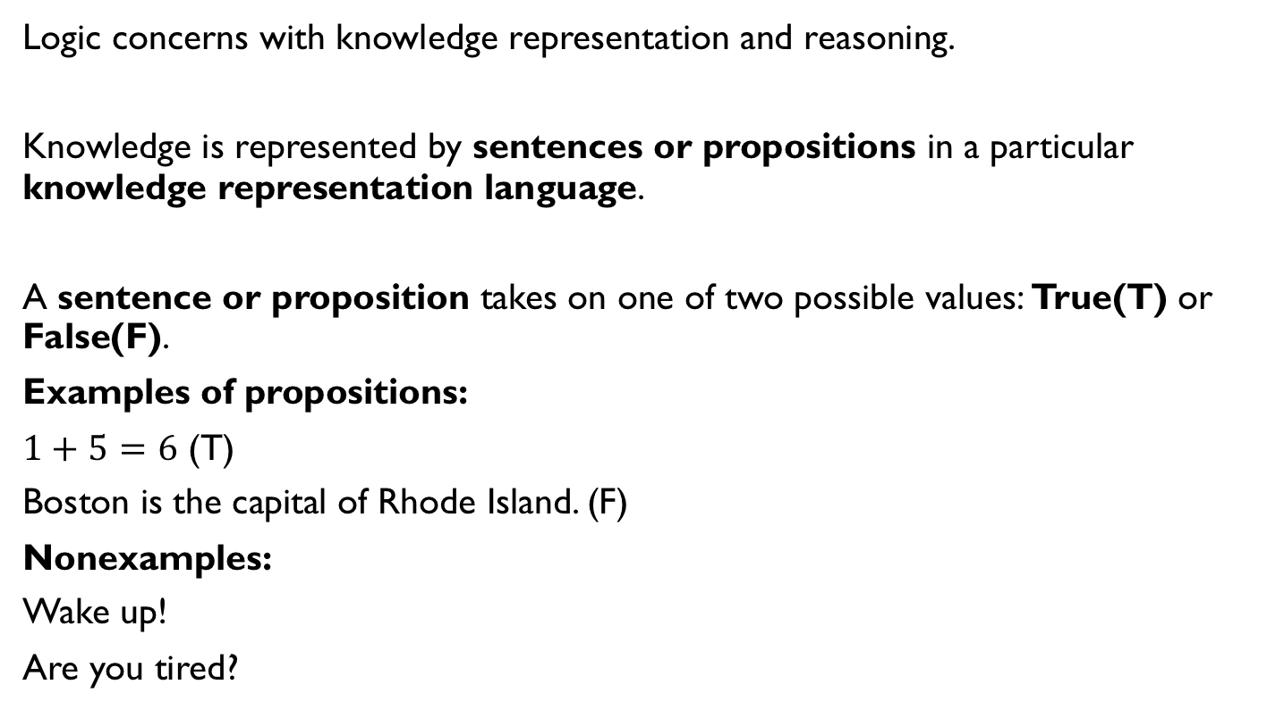
Sentence
Logic concerns with knowledge representation and reasoning.
Knowledge is represented by sentences or propositions in a particular knowledge representation language.
A sentence or proposition takes on one of two possible values: True(T) or False(F).
Examples of propositions:
$1+5=6$ (T)
Boston is the capital of Rhode Island. (F)
Nonexamples:
Wake up!
Are you tired?

Slide 3
Propositional Logic
Propositional logic is a simple but powerful example of a language representation.
The syntax of propositional logic defines the allowable sentences.
The atomic sentences consist of a single proposition symbol. Each such symbol stands for a proposition that can be true or false.
P = It is raining.
Q = The ground is wet.

Slide 4
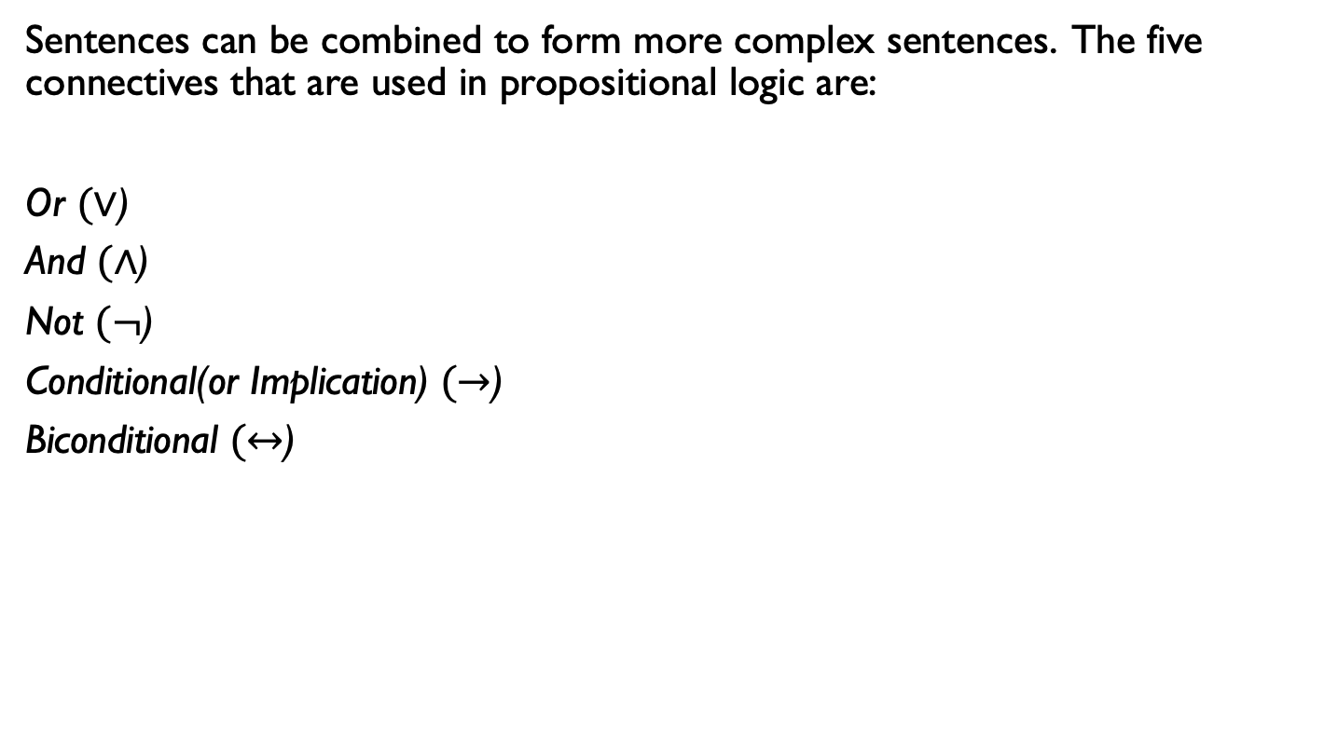
Connectives
Sentences can be combined to form more complex sentences. The five connectives that are used in propositional logic are:
Or $(∨$)
And $(∧$)
Not $(¬$)
Conditional(or Implication) $(→$)
Biconditional $(↔$)

Slide 5
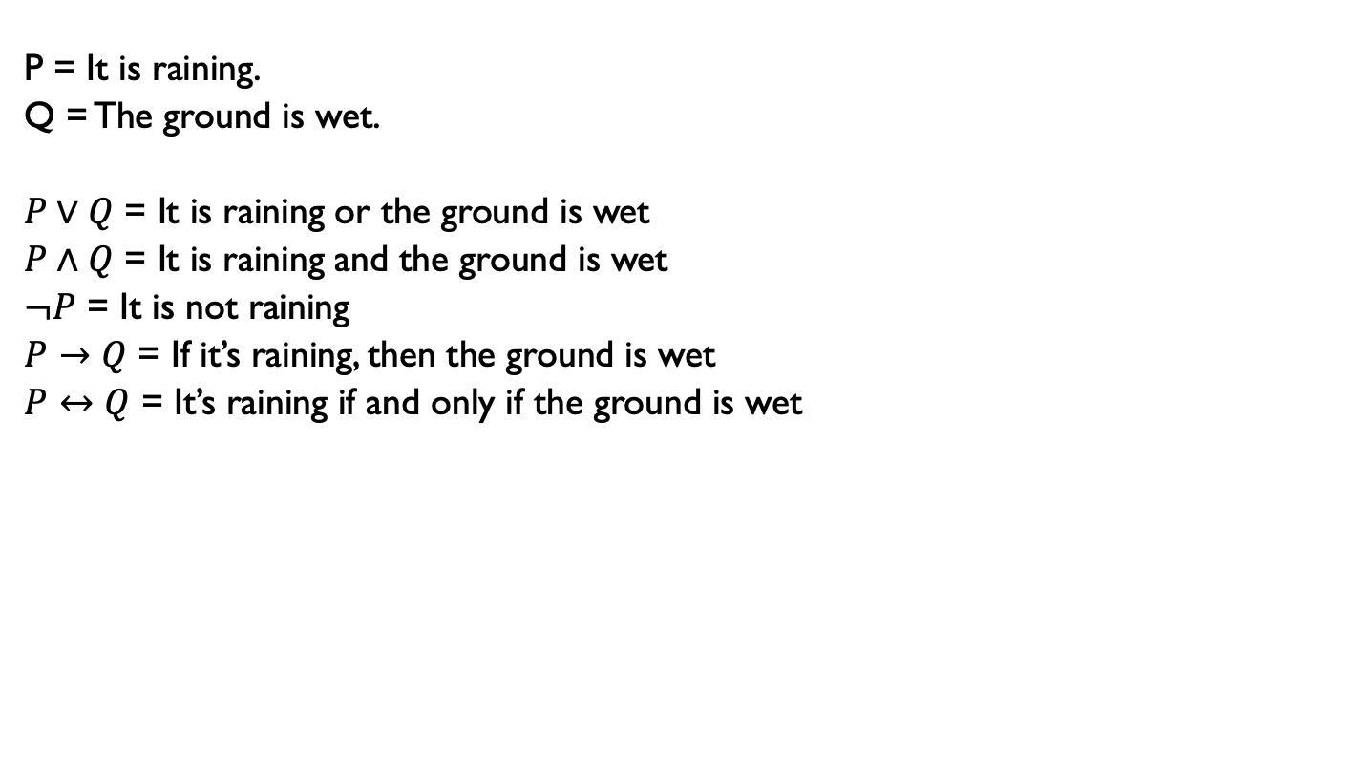
Examples
P = It is raining.
Q = The ground is wet.
$P∨Q$ = It is raining or the ground is wet
$P∧Q$ = It is raining and the ground is wet
$¬P$ = It is not raining
$P→Q$ = If it’s raining, then the ground is wet
$P↔Q$ = It’s raining if and only if the ground is wet

Slide 6
Entailment
To reason in this propositional logic, we need to define logical entailment between sentences— the idea that a sentence follows logically from another sentence.
Let P and Q be sentences. The sentence P entails the sentence Q(or P logically imply Q) if every assignment of truth values to proposition symbols which makes P true also makes Q true.
In mathematical notation, we use P |= Q to denote entailment.
The relation of entailment is familiar from arithmetic; we are happy with the idea that the sentence x = 0 entails the sentence xy = 0.

Slide 7
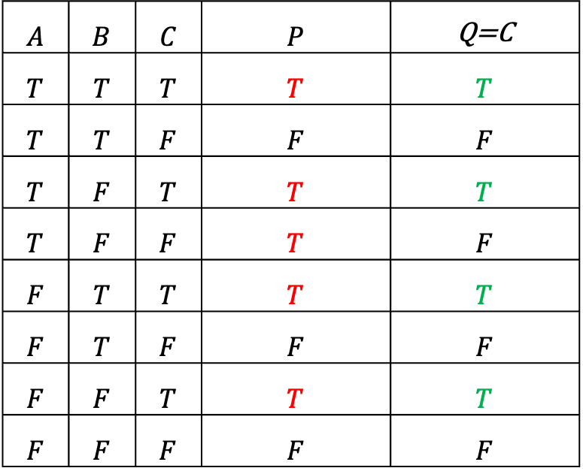

Entailment Example
Example: Let P = $\left(¬A∨B\right)⇒C$and Q = $C.$
Does P |= Q?
No. This model makes
P True but Q False.
Does Q |= P?
Yes, since every model which
makes Q True(green) also makes P
True(red).
$$A$$ | $$B$$ | $$C$$ | $$P$$ | Q=C
$$T$$ | $$T$$ | $$T$$ | $$T$$ | $$T$$
$$T$$ | $$T$$ | $$F$$ | $$F$$ | $$F$$
$$T$$ | $$F$$ | $$T$$ | $$T$$ | $$T$$
$$T$$ | $$F$$ | $$F$$ | $$T$$ | $$F$$
$$F$$ | $$T$$ | $$T$$ | $$T$$ | $$T$$
$$F$$ | $$T$$ | $$F$$ | $$F$$ | $$F$$
$$F$$ | $$F$$ | $$T$$ | $$T$$ | $$T$$
$$F$$ | $$F$$ | $$F$$ | $$F$$ | $$F$$

Slide 8
Knowledge-based Agent
Logical entailment can be applied to derive conclusions—that is, to carry out logical inference.
A human or artificial intelligence agent(e.g in games, smart assistants like Siri or Alexa) who is capable of reasoning does so from some prior knowledge.
A knowledge base or KB is a set of sentences. These sentences are taken to be true and represent some facts about the world.
A knowledge-base agent can learn by either adding new sentences that can be derived from the knowledge base or by learning from data directly inputted into the knowledge base(for example, sensors, data)

Slide 9
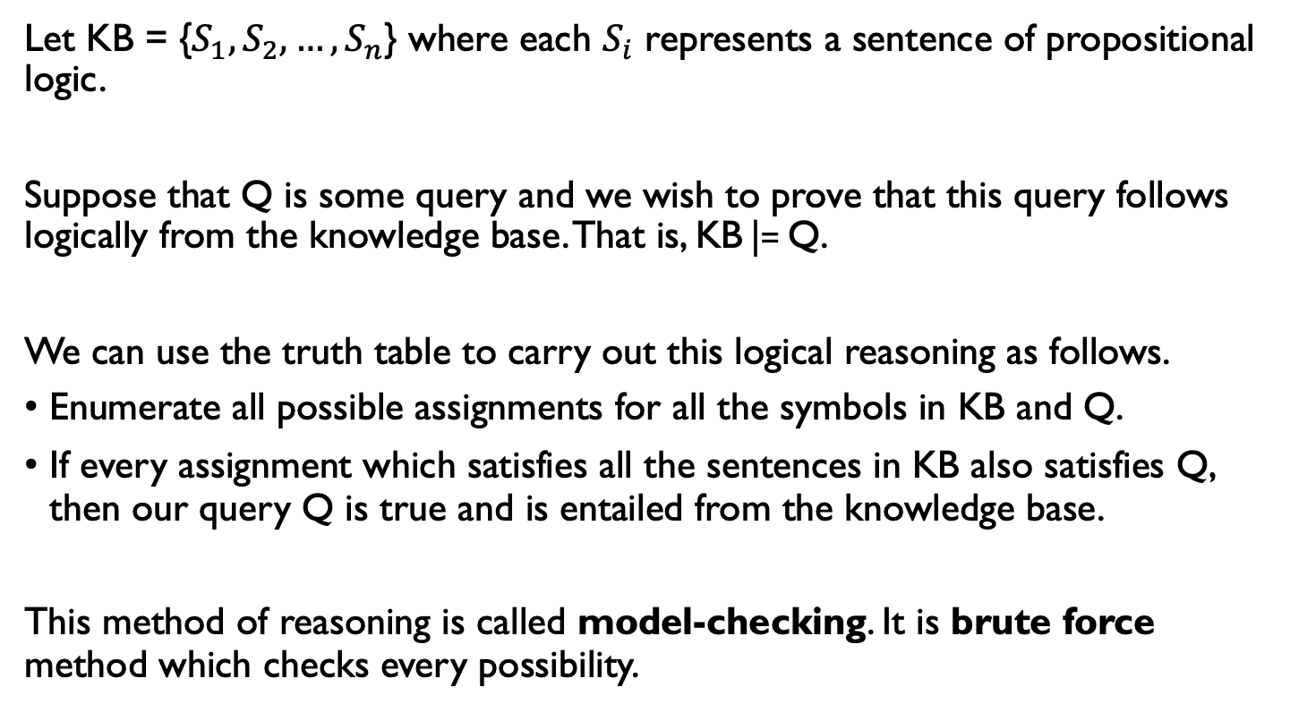
Knowledge-based Agent
Let KB = {$S_{1}, S_{2},…, S_{n}$} where each $S_{i}$ represents a sentence of propositional logic.
Suppose that Q is some query and we wish to prove that this query follows logically from the knowledge base. That is, KB |= Q.
We can use the truth table to carry out this logical reasoning as follows.
Enumerate all possible assignments for all the symbols in KB and Q.
If every assignment which satisfies all the sentences in KB also satisfies Q, then our query Q is true and is entailed from the knowledge base.
This method of reasoning is called model-checking. It is brute force method which checks every possibility.

Slide 10
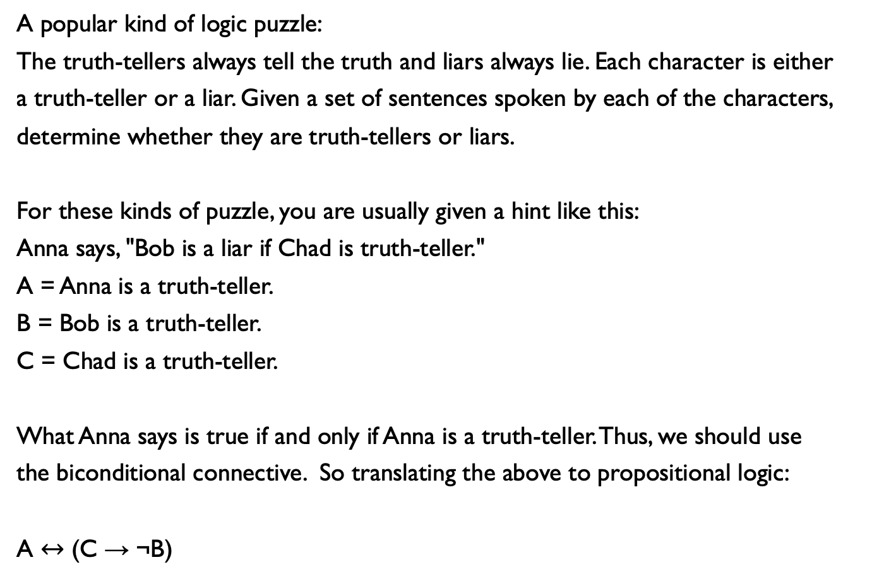
A popular kind of logic puzzle:
The truth-tellers always tell the truth and liars always lie. Each character is either
a truth-teller or a liar. Given a set of sentences spoken by each of the characters,
determine whether they are truth-tellers or liars.
For these kinds of puzzle, you are usually given a hint like this:
Anna says, "Bob is a liar if Chad is truth-teller."
A = Anna is a truth-teller.
B = Bob is a truth-teller.
C = Chad is a truth-teller.
What Anna says is true if and only if Anna is a truth-teller. Thus, we should use
the biconditional connective. So translating the above to propositional logic:
A $↔$ (C → ¬B)

Slide 11
Checking using the truth table is tedious. We’ll use a Python implementation which will do model checking for us.
from logic import *
R = Atom("It's raining.")
W = Atom("The ground is wet.")
# some examples
sentence1 = Not(R) # It is not raining
sentence2 = Or(R, W) # It's raining or the ground is wet.
sentence3 = And(R, W) # It's raining and the ground is wet.
sentence4 = Implies(R, W) # If it's raining, then the ground is wet.
sentence5 = Equiv(R, W) # It's raining if and only if the ground is wet.

Slide 12
We’ll create a knowledge base object. We can “tell” information to the knowledge base or “ask” the knowledge base.
from logic import *
R = Atom("It's raining.")
W = Atom("The ground is wet.")
kb = createModelCheckingKB() # Create the knowledge base
print(kb.tell(Implies(R, W))) # Prints "I learned something.
print(kb.ask(W)) # Prints "I don't know."
print(kb.tell(Not(W))) # Prints "I learned something.
print(kb.ask(R)) # Prints “No.”
print(kb.ask(Not(R))) # Prints “Yes.”

Slide 13
References
Mendelson, Elliot. Introduction of Mathematical Logic. Taylor and Francis Group. 2015.
Russell, Stuart and Norvig, Peter. Artificial Intelligence, A Modern Approach. Pearson. 2016.
CS221 Stanford.

