Slide 1
Introduction to Processing
Top-Down Games

Slide 2
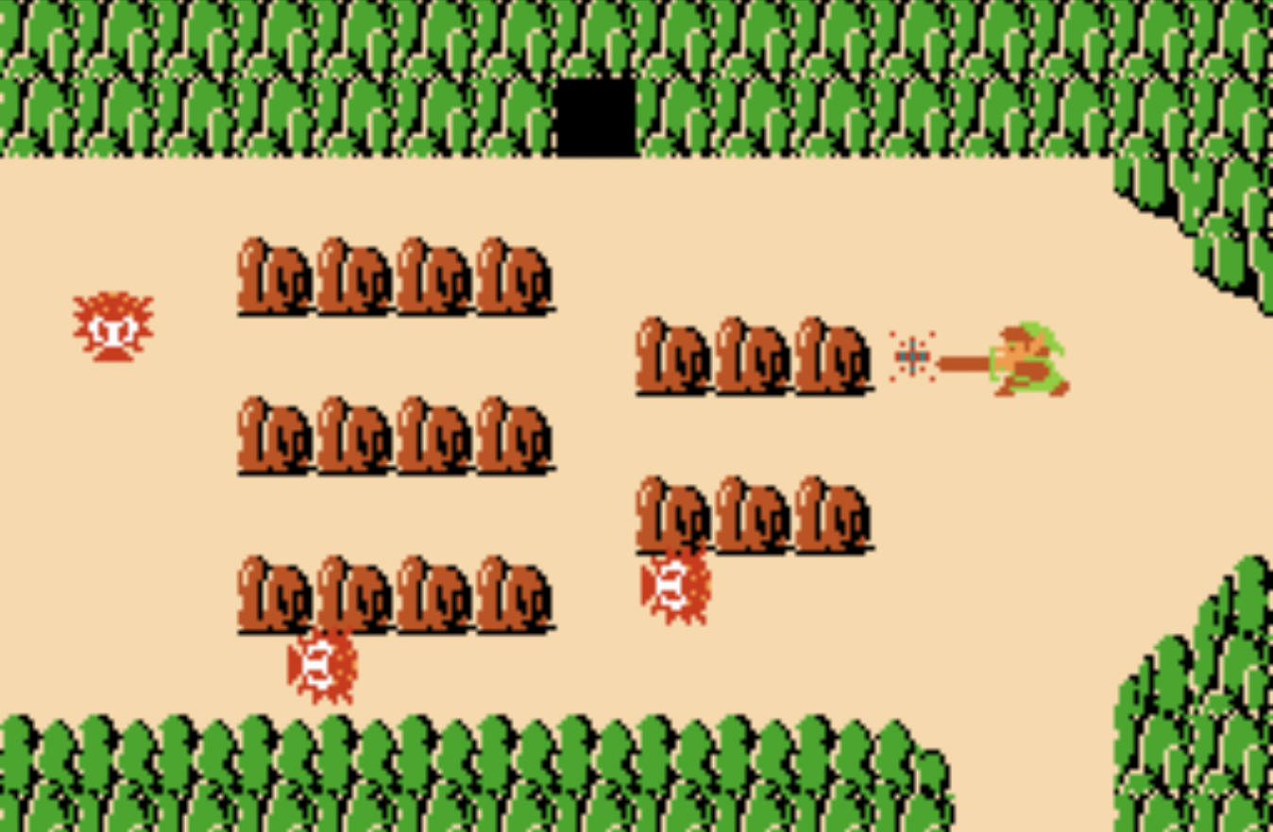
Top-Down Games
Top-down games, also sometimes referred to as bird's-eye view games, refers to games where the camera angle that shows players and the areas around them is directly above.

Slide 3


Top-Down Games
Top-down games, also sometimes referred to as bird's-eye view games, refers to games where the camera angle that shows players and the areas around them is directly above.

Slide 4
Collision Detection
Assume that we already implemented the two collision detection methods below:
def check_for_collision(sprite1, sprite2):
# returns whether sprite1 and sprite2 intersects
def check_for_collision_list(sprite, sprite_list):
#returns list of sprites in sprite_list which
#intersects with sprite.

Slide 5
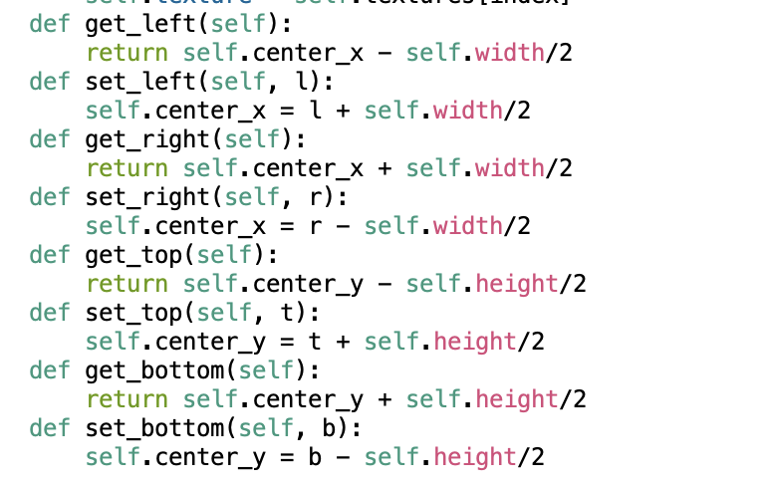
Sprite Functions

Slide 6
Sprite “get” functions
Use the get_left, get_right, get_top and get_bottom methods to get the respective boundaries of the sprite!
get_top()
get_left()
get_right()
get_bottom()

Slide 7
Sprite “set” functions
sprite1
sprite2
sprite1.set_right(sprite2.get_left())

Slide 8
Velocity
Velocity of an object is the rate of change of its position. It is a vector and can be decomposed into a x-component and a y-component.
A Sprite object has attributes change_x and change_y for its velocity.
Origin (0,0)
In our games, velocity is
measured in pixels per frame.
(center_x, center_y)
Y
change_x
center_x = center_x + change_x
center_y = center_y + change_y
change_y
X

Slide 9
Resolving Top-Down Collisions
Instead of moving in both the x and y directions and then try to resolve collisions, it is easier to
1) move in x direction, check for and resolve collision
2) then move in the y direction and then check for and resolve collision again.
center_x += change_x
center_y += change_y

Slide 10
Resolving Top-Down Collisions
# move in horizontal direction
center_x += change_x
# resolve collisions
# move in vertical direction
center_y += change_y
# resolve collisions

Slide 11
Horizontal Direction
move in horizontal direction

Slide 12
Horizontal Direction
move in horizontal direction
compute list of all platforms which collide with player
if list not empty:
if player is moving right:

Slide 13
Horizontal Direction
move in horizontal direction
compute list of all platforms which collide with player
if list not empty:
if player is moving right:
set right side of player = left side of a
collided platform

Slide 14
Horizontal Direction
move in horizontal direction
compute list of all platforms which collide with player
if list not empty:
if player is moving right:
set right side of player = left side of a
collided platform
if player is moving left:

Slide 15
Horizontal Direction
move in horizontal direction
compute list of all platforms which collide with player
if list not empty:
if player is moving right:
set right side of player = left side of a
collided platform
if player is moving left:

Slide 16
Horizontal Direction
move in horizontal direction
compute list of all platforms which collide with player
if list not empty:
if player is moving right:
set right side of player = left side of a
collided platform
if player is moving left:
set left side of player = right side of a
collided platform

Slide 17
Vertical Direction
Similarly for the vertical direction:
move in vertical direction
compute list of all platforms which collide with player
if list not empty:
if player is moving up:
set top side of player = bottom side of a
collided platform
if player is moving down:
set bottom side of player = top side of a
collided platform

