Slide 1
Introduction to Python
Loops

Slide 2
Topics
For Loops
Break vs. Continue
Nested Loops

Slide 3
For Loops
In general, a loop allows a sequence of instructions to execute repeatedly until some condition is met.
Python’s for loop iterates over items of a sequence(e.g. a list, string or tuple) and process them with some code.
for x in sequence: block
In[1]: for x in [2,3,5,7]: print(x, end=“ ”) # print all on same line
2 3 5 7
This is a list. More on lists in a later lecture.

Slide 4
For Loops
In[1]: for x in [2,3,5,7]: print(x)
2
3
5
7

Slide 5
range(stop)
A simple use of a for loop runs some code a specified number of times using the range() function.
range(stop): returns sequence of numbers from 0 (default) up to but not including stop. Increment by 1 (default).
In[1]: for i in range(10):
print(i, end=" ")
0 1 2 3 4 5 6 7 8 9

Slide 6
range(start, stop)
range(start, stop): from start up to but not including stop. Increment by 1(default).
In[2]: for i in range(2, 8):
print(i, end=' ‘)
2 3 4 5 6 7

Slide 7
range(start, stop, step)
range(start, stop, step): from start up to but not including stop, increment by step.
In[3]: for i in range(1, 10, 2):
print(i, end=' ')
1 3 5 7 9
If step is negative, a list can be traversed backwards.
In[4]: for i in range(10, 2, -1):
print(i, end=' ')
10 9 8 7 6 5 4 3

Slide 8
continue vs. break
The continue statement is used to skip the current iteration and move to the next iteration whereas the break statement is used to exit a for loop.
In [1]: for n in range(10): if n % 2 == 0:
continue
print(n, end=‘ ’)
1 3 5 7 9

Slide 9
continue vs. break
The continue statement is used to skip the current iteration and move to the next iteration whereas the break statement is used to exit a loop.
In [2]: for n in range(5): if n == 3:
break
print(n, end=‘ ’)
0 1 2

Slide 10
Definite Loop
The for loop is an example of a definite loop. We can determine ahead of time the number of times the loop repeats. Later, we will talk about indefinite loop, a loop where we cannot predict the number of times it repeats.
In [1]: for i in range(5): print("*", end="")
*****
The loop above prints five *'s. We can determine this from the for loop statement.

Slide 11
Summing Values
Write a segment of code that solve the problem
1 + 2 + 3 + … + 98 + 99 + 100.
In [1]: sum = 0
for i in range(1, 101): sum += i

Slide 12
Conditional Summing
Write a segment of code that compute the sum of all numbers from 1 to 100 that are multiples of 3.
In [1]: sum = 0
for i in range(0, 101, 3): sum += i
Or equivalently, we can use a conditional to select the numbers to add:
In [2]: sum = 0
for i in range(1, 101): if i % 3 == 0:
sum += i

Slide 13
Conditional Summing Example
Write a segment of code that compute the sum of all numbers from 1 to 100. However:
if a number is a multiple of 3, double it before adding,
if a number is a multiple of 5, triple it before adding,
If a number is a multiple of both, quadruple it before adding.

Slide 14
Conditional Summing Solution?
Is the following a correct solution?
sum = 0
for i in range(1, 101):
if i % 3 == 0:
sum += 2 * i
elif i % 5 == 0:
sum += 3 * i
elif i % 3 == 0 and i % 5 == 0:
sum += 4 * i
else:
sum += i
No! Why not?

Slide 15
Conditional Summing Solution
The following is correct.
sum = 0
for i in range(1, 101):
if i % 3 == 0 and i % 5 == 0:
sum += 4 * i
elif i % 3 == 0:
sum += 2 * i
elif i % 5 == 0 :
sum += 3 * i
else:
sum += i

Slide 16
Nested Loops
A nested loop is a loop inside of another loop.
In[1]: for i in range(1, 4):
for j in range(1, 5):
print(i * j, end=‘ ’)
print()
1 2 3 4
2 4 6 8
3 6 9 12

Slide 17
Nested Loops Example 1
In[1]: for i in range(1, 6):
for j in range(1, i+1):
print(j, end=‘ ’)
print()
1
1 2
1 2 3
1 2 3 4
1 2 3 4 5

Slide 18
Nested Loops Example 2
In[2]: for i in range(1, 6):
for j in range(6, i, -1):
print(j, end=‘ ’)
print()
6 5 4 3 2
6 5 4 3
6 5 4
6 5
6

Slide 19
For Loop in Movies and TV-Shows
Movies:
Groundhog Day(1993); Bill Murray.
Looper(2010); Bruce Willis and Joseph Gordon-Levitt, Emily Blunt.
Edge of Tomorrow(2014); Tom Cruise, Emily Blunt.
Happy Death Day(2017).
TV-Show:
Russian Doll(Netflix, Emmy-Nominated)

Slide 20
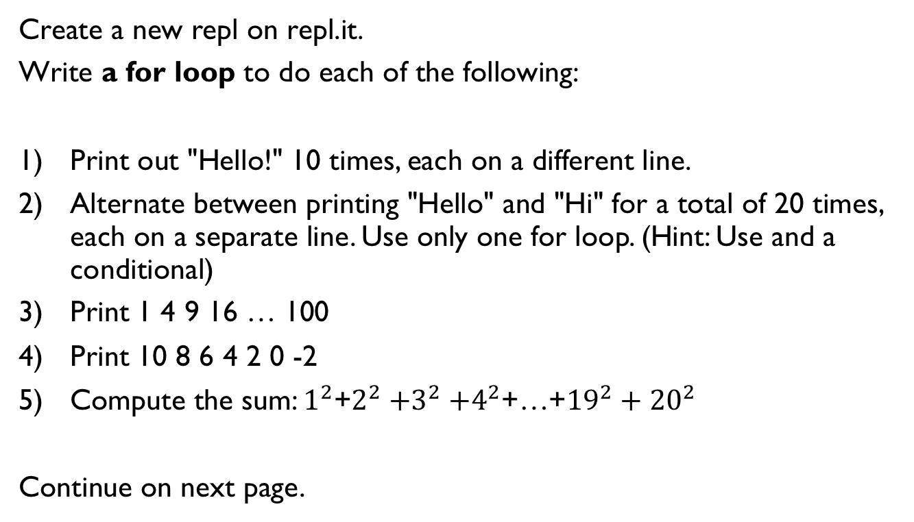
Lab 1
Create a new repl on repl.it.
Write a for loop to do each of the following:
Print out "Hello!" 10 times, each on a different line.
Alternate between printing "Hello" and "Hi" for a total of 20 times, each on a separate line. Use only one for loop. (Hint: Use and a conditional)
Print 1 4 9 16 … 100
Print 10 8 6 4 2 0 -2
Compute the sum: $1^{2}$+$2^{2}{+3}^{2}+4^{2}$+…+${19}^{2}+{20}^{2}$
Continue on next page.

Slide 21
Lab 1
Write a nested for loop to do each of the following:
Print out 10 lines, each line containing 5 "Hello" separated by spaces.
2) ******
******
******
3) Print
*
**
***
****
*****

Slide 22
References
Vanderplas, Jake, A Whirlwind Tour of Python, O’reilly Media.

