Slide 1

AP Exam Free Response Questions

Slide 2
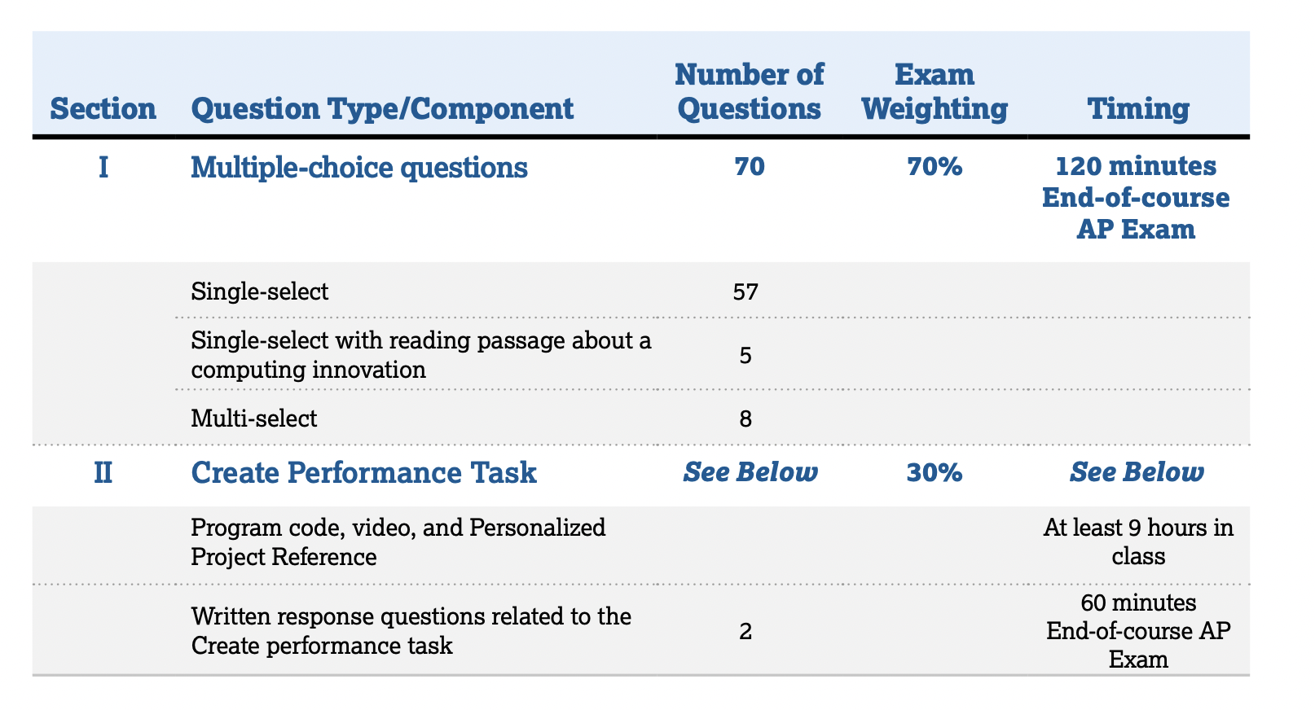
AP Exam

Slide 3
The Create performance task section of the end-of-course exam consists of two questions that require students to write responses that demonstrate understanding of their personal Create performance task.
The two written response questions include four distinct prompts: Written Response 1, Written Response 2(a), Written Response 2(b), and Written Response 2(c).
The following are sample prompts – but the specific prompts will vary across the different versions of the exam.
Students will have access to their student-authored Personalized Project Reference, as long as it was submitted as final via the AP Digital Portfolio, when responding to these prompts.

Slide 4
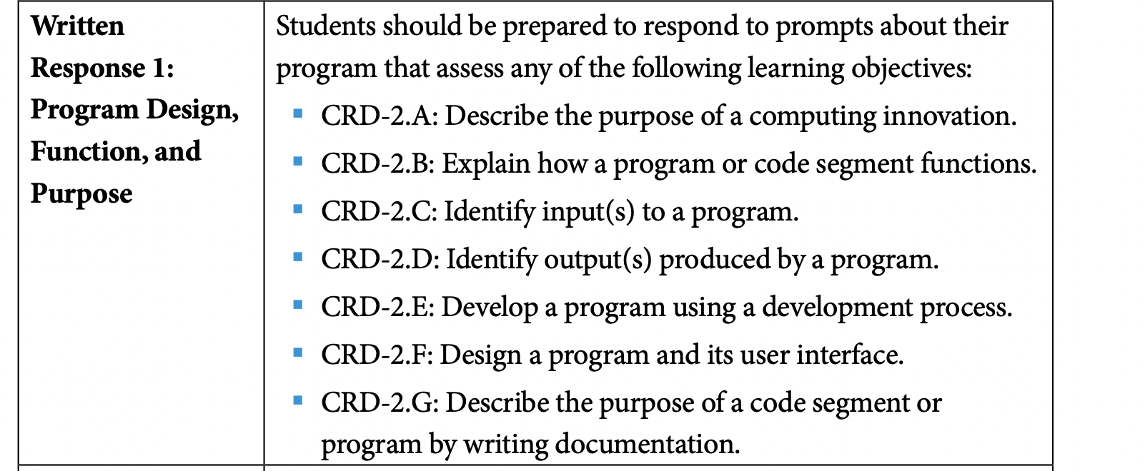
Written Response 1:
The function of a program(program functionality) is how a program behaves
during execution and is usually described by how the user interacts with it.
The purpose of a program is the goal or the motivation for writing a
program. One purpose is to solve problems or to pursue interests through creative
expression or to provide entertainment(e.g. write a game).

Slide 5
Sample Questions for Written Response 1
The following questions are from FRQ 1 and FRQ 2 worksheets.
FRQ 2 corresponds to 3 sets of questions from AP Classroom FRQ.
1) Identify an expected user of your program. Describe one way your program’s design meets the needs of this user. (See FRQ 1 solutions)
2) Describe the problem that your program was created to address or the creative expression it pursues.
3) Explain how you used or could have used feedback, testing, or reflection in the development of your program.
4) Describe one piece of documentation that would be appropriate to include with or in your program. Describe the intended purpose of this documentation by identifying who would use it and what they would do with it.

Slide 6
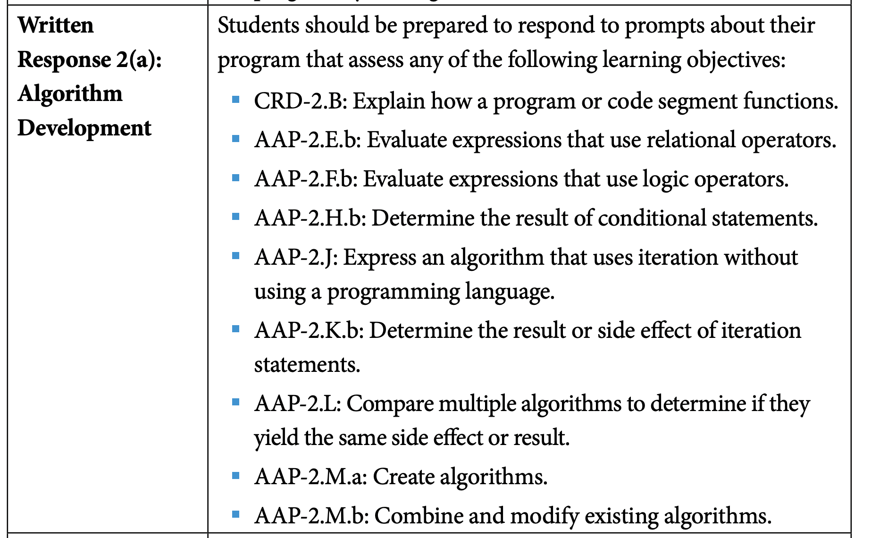
Written Response 2(a):

Slide 7
Sample Questions for Written Response 2(a)
The following questions are from FRQ 1 and FRQ 2 worksheets.
FRQ 2 corresponds to 3 sets of questions from AP Classroom FRQ.
1) Consider the first iteration statement included in the Procedure section of your Personalized Project Reference. Identify the number of times the body of your iteration statement will execute. Describe a condition or error that would cause your iteration statement to not terminate and cause an infinite loop. If no such condition or error exists, explain how the loop could be modified to cause an infinite loop.
2) Consider the code segment in part (ii) of the List section of your Personalized Project Reference that shows how your list is being used. Explain in detailed steps how this code segment works. Your explanation must be detailed enough for someone else to write the code segment.
3) Consider the first conditional statement included in the Procedure section of your Personalized Project Reference. Write an equivalent Boolean expression for this conditional statement.
4) Consider the first iteration statement included in the Procedure section of your Personalized Project Reference. Describe the condition(s) that will cause the body of the iteration statement to execute at least once.

Slide 8
Testing Code for Errors
The following are effective ways to find and correct errors:
test cases(call functions with different arguments and check outputs)
hand tracing(write down variables on sheet of paper, and mentally execute each line of code and update variables appropriately)
visualizations
Debuggers(even if you never used one, you can say that using debugging helped you fix errors!)
adding extra output(print statements) statement(s)

Slide 9
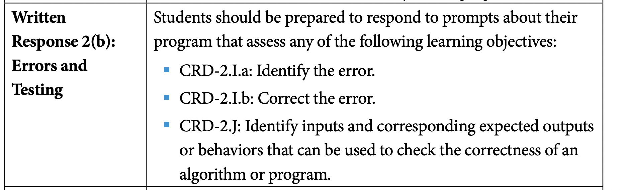
Written Response 2(b):

Slide 10
Sample Questions for Written Response 2(b)
The following sample questions are from FRQ 1 and FRQ 2 worksheets.
FRQ 2 corresponds to 3 sets of questions from AP Classroom FRQ.
1) Consider the procedure included in part (i) of the Procedure section of your Personalized Project Reference. Describe a change to your procedure that will result in a run-time error. Explain why this change will result in a run-time error.
2) Consider the procedure identified in part (i) of the Procedure section of your Personalized Project Reference. Passing different values as arguments to a procedure can cause different segments of code to execute. Based on one of your arguments, describe where you could insert output statements in your procedure to test whether a block of code is executed or not. If it is not possible for different arguments to cause different segments of code to execute in your procedure, explain why not.
3) Consider the procedure identified in part (i) of the Procedure section of your Personalized Project Reference. Identify a strategy, other than using test cases, that you can use to test the correctness of your procedure. Describe how you would use this strategy.
4) Consider the procedure identified in part (i) of the Procedure section of your Personalized Project Reference. Write a call to your procedure with specific argument(s) that you could use for testing this procedure. Describe the program functionality that is related to this call.

Slide 11
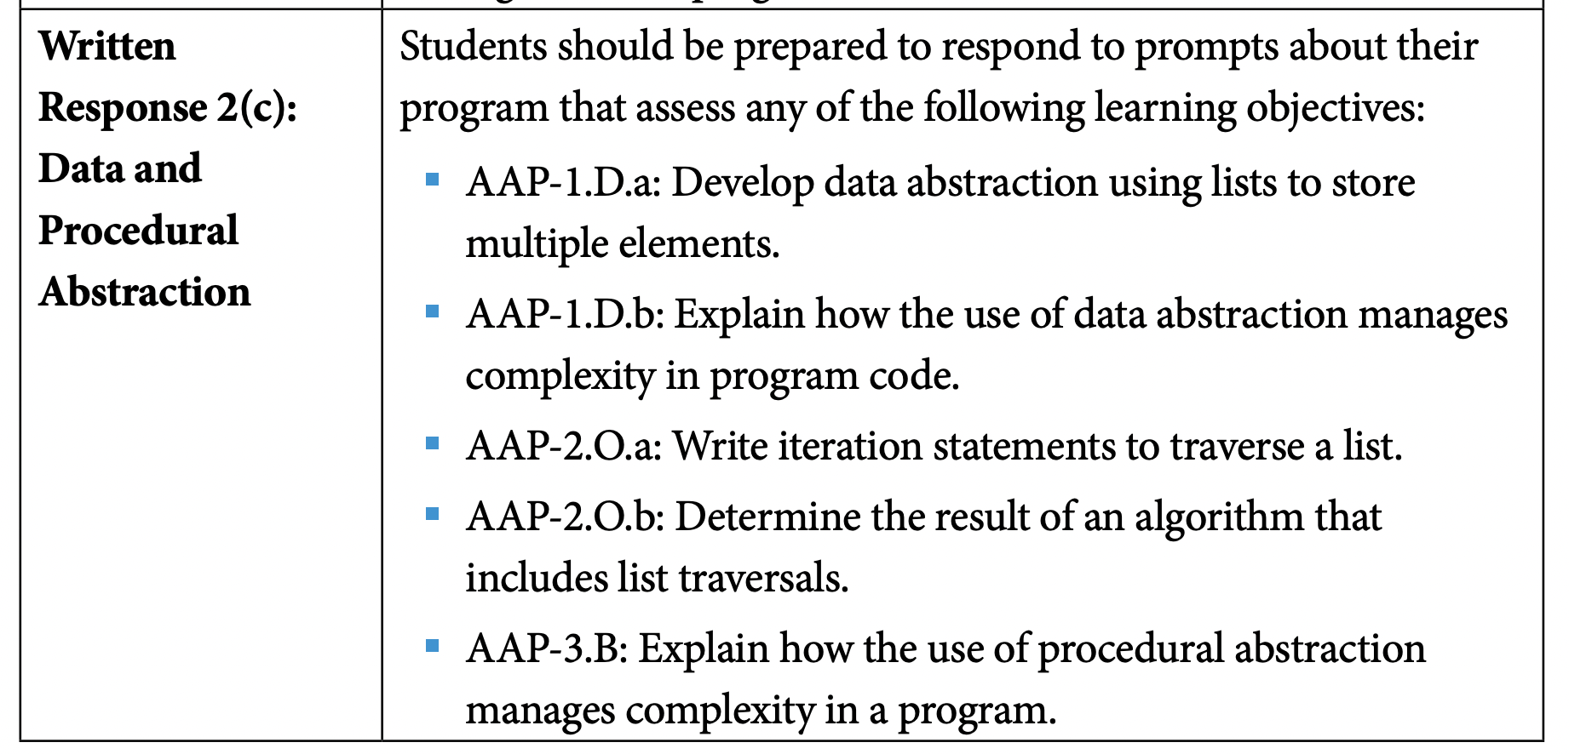
Written Response 2(c):

Slide 12
Sample Questions for Written Response 2(c)
The following sample questions are from FRQ 1 and FRQ 2 worksheets.
FRQ 2 corresponds to 3 sets of questions from AP Classroom FRQ.
1) Suppose you are provided with a procedure called isEqual(value1, value2). The procedure returns true if the two parameters value1 and value2 are equal in value and returns false otherwise. Using the list you identified in the List section of your Personalized Project Reference, explain in detailed steps an algorithm that uses isEqual to count the number of times a certain value appears in your list. Your explanation must be detailed enough for someone else to write the program code.
2) Consider the procedure identified in part (i) of the Procedure section of your Personalized Project Reference. Explain how your program could be written differently if one of your parameters was removed from your procedure.
3) Consider the procedure identified in part (i) of the Procedure section of your Personalized Project Reference. Procedures are often used to organize larger problems into subproblems or smaller tasks. Identify the subproblem being solved or task that is being accomplished by your procedure. Explain how the procedure is used to accomplish the overall functionality of your program.
4) Consider the list identified in the List section of your Personalized Project Reference. Explain how you would need to adjust this part of your program if the list was not included in your code.

