Slide 1
Unit 8: 2D Arrays
Introduction to 2D Arrays
Adapted from:
1) Building Java Programs: A Back to Basics Approach
by Stuart Reges and Marty Stepp
2) Runestone CSAwesome Curriculum
https://longbaonguyen.github.io

Slide 2
2D Arrays
We have only worked with one-dimensional arrays so far, which have a single row of elements.
But in the real world, data is often represented in a two-dimensional table with rows and columns.
Programming languages can also represent arrays this way with multiple dimensions.
A two-dimensional (2D) array has rows and columns. A 2D array in Java is actually an array of arrays.
A row has horizontal elements. A column has vertical elements. In the picture below there are 3 rows of lockers and 6 columns.
Notes:
How would we print a multiplication table?
try printing each of the following inside the inner loop:
System.out.print(i + " ");
System.out.print(j + " ");
System.out.print((i * j) + " ");

Slide 3
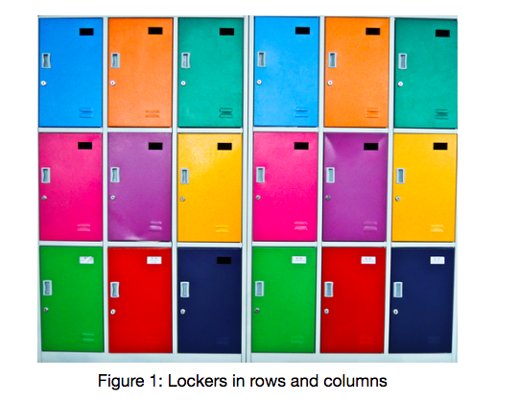
2D Arrays
A two-dimensional (2D) array has rows and columns.
A row has horizontal elements. A column has vertical elements. In the picture below there are 3 rows of lockers and 6 columns.
Two dimensional arrays are especially
useful when the data is naturally
organized in rows and columns like
in a spreadsheet, bingo, battleship,
theater seats, classroom seats,
connect-four game, or a picture.
Notes:
How would we print a multiplication table?
try printing each of the following inside the inner loop:
System.out.print(i + " ");
System.out.print(j + " ");
System.out.print((i * j) + " ");

Slide 4
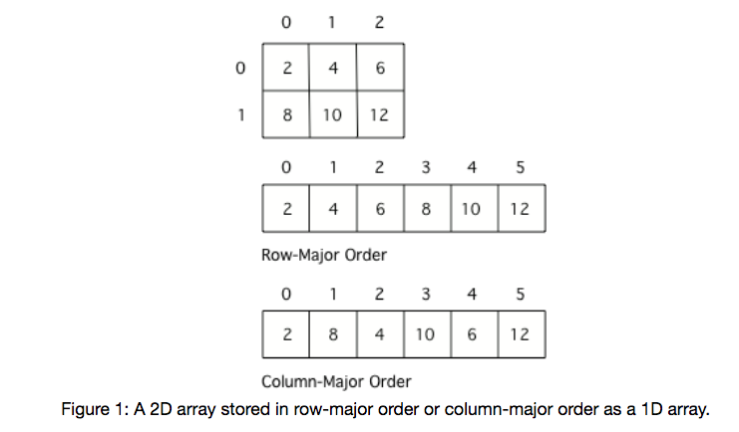
2D Arrays
Many programming languages actually store two-dimensional array data in a one-dimensional array. The typical way to do this is to store all the data for the first row followed by all the data for the second row and so on. This is called row-major order.
Some languages store all the data for the first column followed by all the data for the second column and so on. This called column-major order.
Notes:
How would we print a multiplication table?
try printing each of the following inside the inner loop:
System.out.print(i + " ");
System.out.print(j + " ");
System.out.print((i * j) + " ");

Slide 5
Declare and Initialize
To declare and initialize a 2D array,
type[][] name = new type[row][col];
where row, col is the number of rows/columns. When arrays are created their
contents are automatically initialized to 0 for numeric types, null for object
references, and false for type boolean.
int[][] matrix = new int[3][4]; //3 rows, 4 columns
//initialized to 0.
0 | 0 | 0 | 0
0 | 0 | 0 | 0
0 | 0 | 0 | 0

Slide 6
2D Array
To explicitly put a value in an array, you can use assignment
statements specifying the row and column of the entry.
int[][] matrix = new int[3][4]; //3 rows, 4 columns
//initialized to 0.
matrix[0][0] = 2;
matrix[1][2] = -6;
matrix[2][1] = 7;
2 | 0 | 0 | 0
0 | 0 | -6 | 0
0 | 7 | 0 | 0

Slide 7
Initializer List
You can also initialize (set) the values for the array when you
create it. In this case you don’t need to specify the size of the
array, it will be determined from the values you give. This is called
using initializer list.
int[] array={1,4,3}; // 1D array initializer list.
// 2D array initializer list.
int[][] mat = {{3,4,5}, {6,7,8}};
// 2 rows, 3 columns
3 | 4 | 5
6 | 7 | 8

Slide 8
Declare and Initialize
Declaring and initializing 2D arrays.
int[][] table; //2D array of ints, null reference
double[][] matrix=new double[4][5];
// 4 rows, 5 columns
// initialized all to 0.0
String[][] strs=new String[2][5];
// strs reference 2x5 array of
// String objects. Each element is
// null
// Using initializer list.
String[][] seatingInfo = {{"Jamal", "Maria"},
{"Jake", "Suzy"}, {"Emma", "Luke"}};

Slide 9
Array of Arrays
A 2D array is implemented as an array of row arrays. Each row is a one-dimensional array of elements. Suppose that mat is the 2D array:
Then mat is an array of three arrays:
mat[0] is the one-dimensional array {3,-4,1,2}.
mat[1] is the one-dimensional array {6,0,8,1}.
mat[2] is the one-dimensional array {-2,9,1,7}.
mat.length is the number of rows.
3 | -4 | 1 | 2
6 | 0 | 8 | 1
-2 | 9 | 1 | 7

Slide 10
Array of Arrays
1) mat.length is the number of rows. In this case, it equals 3 because there are three row-arrays in mat.
2) For each k, where 0<=k<mat.length, mat[k].length is the number of elements in that row, namely the number of columns. In this case, mat[k].length=4 for all k.
3) Java allows “jagged arrays” where each row array may have different lengths. However, on the AP exam, assume all arrays are rectangular.
3 | -4 | 1 | 2
6 | 0 | 8 | 1
-2 | 9 | 1 | 7

Slide 11
Example
int[][] mat={{3,4,5},{1,2},{0,1,-3,5}};
mat[0] = {3,4,5}
mat[1] = {1,2}
mat[2] = {0,1,-3,5}
mat.length = 3
mat[0].length = 3
mat[1].length = 2
mat[2].length = 4

Slide 12
Row-Column Traversal
Suppose that mat is a 2D array initialized with integers. Use
nested for loop to print out the elements of the array. Traverse by
row-major order.
for(int row = 0;i < mat.length;i++){
for(int col = 0;j < mat[row].length;j++)
System.out.print(mat[row][col]+ " ");
System.out.println();
}

Slide 13
Row-by-Row
Suppose the following method has been implemented.
public void printArray(int[] array)
{/*implementation not shown*/}
Use it to print out the 2D array mat.
for(int i=0;i<mat.length;i++){
printArray(mat[i]); //mat[i] is the i^{th} row of mat
System.out.println();
}

Slide 14
2D Arrays of Objects
Point[][] pointMatrix;
Suppose that pointMatrix is initialized with Point objects. Change
the x-coordinate of each Point to 1.
for(int row=0;row<pointMatrix.length;row++)
for(int col=0;col<pointMatrix[0].length;col++)
pointMatrix[row][col].setX(1);

Slide 15
Lab 1
Write the following methods.
sum: Write method sum which accepts a 2D array of integers and returns the sum of all of the elements. Use row-column traversal method. Nested Loop.
rowSum: rowSum accepts two parameters: a 2D array of integers and an integer row. rowSum returns the sum of the integers of elements in the row given by row.
sum2: This method is the same as sum above but you must use rowSum in your code. One loop.

Slide 16
Lab 1
Write the following methods.
largest accepts a 2D array of integers and returns the largest value. Use row-column traversal method to examine each value.
largestByRow accepts two parameters: a 2D array of integers and an integer row. largestByRow returns the largest value in the row given by row.
largest2 accepts a 2D array of integers and returns the largest value. You must call largestByRow. One loop.

Slide 17
Lab 1
printTranspose: Given 2D array of integers, print the transpose of the array. The transpose of a 2D array is the array whose rows are the columns of the original array. Do not create a new array, instead, use for loops to traverse the original array.
If mat={{1,2,3},{4,5,6}}; printTranspose(mat) will
print:
1 4
2 5
3 6

Slide 18
Lab 2
A magic square is an NxN array of numbers such that
Every number from 1 through N² must appear exactly once.
Every row, column, major and minor diagonal must add up to the same total.
Example: N=4
16 | 3 | 2 | 13
5 | 10 | 11 | 8
9 | 6 | 7 | 12
4 | 15 | 14 | 1

Slide 19
Lab 2
Write the class MagicSquare with instance methods given in the next few slides. MagicSquare should have an instance 2D array variable square. MagicSquare should have a constructor that accepts a 2D array.
The methods rowSum, colSum, diagSums and exactlyOnce are intermediate methods to help you write the isMagic method, which determines whether a square is magic.
You must use the method headers indicated for each method.
Write a driver class with a main method to test your MagicSquare class.

Slide 20
Lab 2
public int rowSum(int row){…}
Returns the row sum indicated by row.
public int colSum(int col){…}
Returns the column sum indicated by col.

Slide 21
Lab 2
public boolean diagSums(int sum){…}
Returns whether both the major and minor diagonal sums are equal to sum. The major and minor diagonal are highlighted below.
16 | 3 | 2 | 13
5 | 10 | 11 | 8
9 | 6 | 7 | 12
4 | 15 | 14 | 1

Slide 22
Lab 2
public boolean exactlyOnce(){…}
Returns true if the numbers 1 to N² occurs exactly once in square and false otherwise. N is the number of rows(and columns) in square.
You must use the each of the above methods to write the following isMagic method.
public boolean isMagic(){…}
Returns true if square is magic and false otherwise.

Slide 23
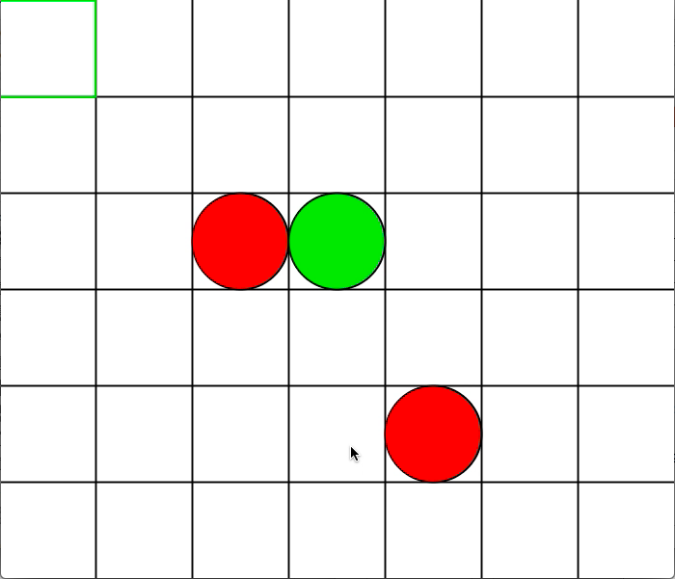
Lab 3(Grid)
Write a program that creates a 2D(6 rows x 7 cols) grid as shown.
If a mouse is clicked inside of a
Cell, a centered circle is drawn. The
color of the circle alternates between red
and green representing two players.
This program can be converted into
Connect 4.
A template is provided on my website if
you wish to get some help.

Slide 24
Lab 3
Add a transparent square(green square, top left in image below) to the grid
that responds to keyboard inputs.
If a Cell is selected and ENTER is pressed,
then that Cell displays the the circle
as before.

