Slide 1
Unit 4: Iteration
Nested Loops
Adapted from:
1) Building Java Programs: A Back to Basics Approach
by Stuart Reges and Marty Stepp
2) Runestone CSAwesome Curriculum
https://longbaonguyen.github.io

Slide 2
Nested loops
nested loop: A loop placed inside another loop.
  for (int i = 1; i <= 5; i++) {
  for (int j = 1; j <= 10; j++) {
  System.out.print("*");
  }
  System.out.println(); // to end the line
  }
Output:
  **********
  **********
  **********
  **********
  **********
The outer loop repeats 5 times; the inner one 10 times.
  "sets and reps" exercise analogy
Notes:
How would we print a multiplication table?
try printing each of the following inside the inner loop:
System.out.print(i + " ");
System.out.print(j + " ");
System.out.print((i * j) + " ");

Slide 3
Nested for loop exercise
What is the output of the following nested for loops?
  for (int i = 1; i <= 5; i++) {
  for (int j = 1; j <= i; j++) {
  System.out.print("*");
  }
  System.out.println();
  }
Output:
  *
  **
  ***
  ****
  *****

Slide 4
Nested for loop exercise
What is the output of the following nested for loops?
  for (int i = 1; i <= 5; i++) {
  for (int j = 1; j <= i; j++) {
  System.out.print(i);
  }
  System.out.println();
  }
Output:
  1
  22
  333
  4444
  55555

Slide 5
Nested for loop exercise
What is the output of the following nested for loops?
  for (int i = 1; i <= 5; i++) {
  for (int j = i; j <= 5; j++) {
  System.out.print(i);
  }
  System.out.println();
  }
Output:
  11111
  2222
  333
  44
  5

Slide 6
Common errors
  for (int i = 1; i <= 5; i++) {
  for (int j = 1; i <= 10; j++) {
  System.out.print("*");
  }
  System.out.println();
  }
  Infinite loops!
  for (int i = 1; i <= 5; i++) {
  for (int j = 1; j <= 10; i++) {
  System.out.print("*");
  }
  System.out.println();
  }
  Infinite loops!
Notes:
Both cases produce infinite loops.

Slide 7
Computational Complexity
Computational complexity of an algorithm is the amount of computational resources(e.g. math operations) needed to perform the algorithm.
For example, how many iterations does a for loop execute?

Slide 8
Some Examples
What’s the total number of x++ operations?
int x = 0;
for(int i = 0; i < 10; i++){
x++;
}
for(int j = 1; j <= 15; j++){
x++;
}
Answer: 10 + 15 = 25

Slide 9
Some Examples
What’s the total number of x++ operations?
int x = 0;
for(int i = 0; i < 10; i++){
for(int j = 0; j < 15; j++)
x++;
}
Answer: 10 * 15 = 150

Slide 10
Some Examples
What’s the total number of x++ operations in terms of n?
int x = 0;
for(int i = 0; i < n; i++){
x++;
}
for(int j = 1; j <= n; j++){
x++;
}
Answer: n + n = 2n (linear)

Slide 11
Some Examples
What’s the total number of x++ operations in terms of n?
int x = 0;
for(int i = 0; i < n; i++){
for(int j = 0; j < n; j++){
x++;
}
}
Answer: n * n = n^2 (quadratic)

Slide 12
Some Examples
What’s the total number of operations in terms of n?
for(int i = 0; i < n; i++){
for(int j = i; j < n; j++)
x++;
}
Answer:
n + (n-1) + (n-2) + .. + 2 + 1 = n(n+1)/2 (quadratic)
where the equality is obtained from using the summation equation for an arithmetic series.
(For example, 1+2+3+4+…+100=100*101/2)

Slide 13
Computational Complexity
The next four slides are optional and won't be covered on the AP exam but they give context to the current material.

Slide 14
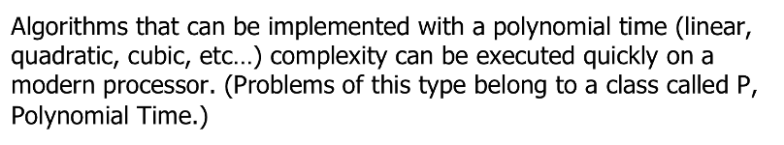
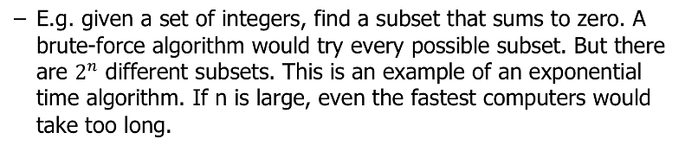
Exponential Complexity Problems

Slide 15
Travelling Salesman(TSP)
Given a set of cities and paths connecting them, find the shortest path that visit each of them exactly once. This famous problem is known as the travelling salesman problem(TSP).
There is no known polynomial time algorithm that solves TSP. Solving TSP can, for example, lead to better transportation and bus routes.
TSP belongs to a class of related problems called NP(Non-deterministic Polynomial Time). None of these problems has a polynomial time solution. But if one does, then so do the rest.

Slide 16
Is P=NP?
Is P=NP? In other words, can Travelling salesman and the other NP-complete problems be solved in polynomial time? Mathematicians believe that P is not equal to NP. No proof is known.
This is one of 7 Millenium Problems. The Clay Mathematics Institute has offered a million dollar prize for solving any of them.
Grigori Perelman solved one of the Millenium Problems, the Poincare Conjecture. He declined the million dollar prize as well as the Fields Medal, the equivalent of the Nobel Prize for Mathematics.
https://medium.com/@phacks/how-grigori-perelman-solved-one-of-maths-greatest-mystery-89426275cb7

Slide 17
What if P=NP?
What if P=NP? Many very important problems in math, physics and engineering are currently intractable, i.e., solutions take exponential time. If P=NP, then there are efficient algorithms for solving them. This can lead to many advances in science.
But P=NP can have negative consequences.
For example, cryptography relies on certain problems being difficult. Public-key cryptography, a foundation for security applications including financial transactions over the internet, would be vulnerable if one can prove P=NP constructively.
Most mathematicians believe that P is not equal to NP.

Slide 18
Lab 1
Create a new repl on repl.it.
Implement a static void method called printLadder which accepts a nonnegative integer n and print a ladder shape of 1's consisting of n steps. For example:
printLadder(1);
1
printLadder(4);
1
11
111
1111

Slide 19
Lab 1
Implement a static void method called multiplicationTable which accepts a positive integer n and print the multiplication table starting at 1 up to and including n.(use tab to separate values "\t")
multiplicationTable(2);
1 2 3 4 5 6 7 8 9 10
2 4 6 8 10 12 14 16 18 20
multiplicationTable(3);
1 2 3 4 5 6 7 8 9 10
2 4 6 8 10 12 14 16 18 20
3 6 9 12 15 18 21 24 27 30

Slide 20
References
For more tutorials/lecture notes in Java, Python, game programming, artificial intelligence with neural networks:
https://longbaonguyen.github.io
Building Java Programs: A Back to Basics Approach by Stuart Reges and Marty Stepp
2) Runestone CSAwesome Curriculum: https://runestone.academy/runestone/books/published/csawesome/index.html

