Slide 1

AP Exam Preparation

Slide 2
AP Exam
When: Monday June 7, 2021 at 4PM Eastern Standard Time.
At home. On Digital Testing App.
Preparing:
1) Download! https://download.app.collegeboard.org/
2) Practice with Example Questions in the Digital Testing App.
3) 1–3 Days Before Exam Day, Complete Exam Setup for Each Digital Exam. You cannot take the exam without completing this step!
4) On Exam Day: 30 Minutes Before the Exam | Check In to the Exam
On exam day, you must check in 30 minutes before the official start time of the exam—at 11:30 a.m. EDT for 12 p.m. exams and 3:30 p.m. EDT for 4 p.m. exams—to complete final pre-exam checks.

Slide 3
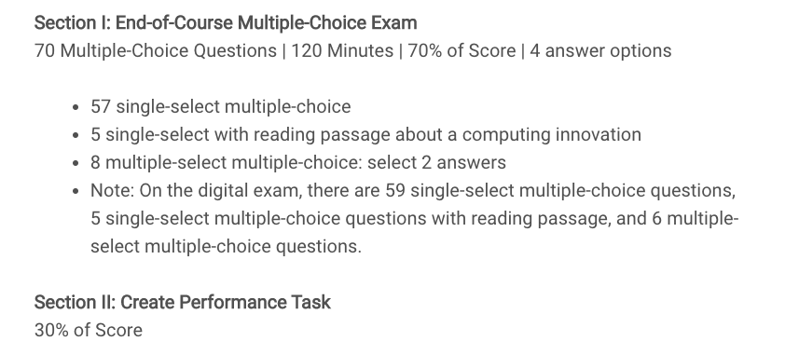
AP Exam

Slide 4
Topics
The AP Multiple Choice end-of-year covers 5 Big Ideas:
Creative Development(10%-13%)
Data(17%-22%)
Algorithms and Programming(30%-35%)
Computer Systems and Networks(11%-15%)
Impact of Computing(21%-26%)

Slide 5
AP Exam Review
Up to this point, I have been teaching Computer Science principles rather than teaching to the AP test.
This lecture slides is teaching to the AP test. It will provide review material for the AP test that we might not have covered during the course of the year.
We will go over each of the 5 ideas in summary.

Slide 6
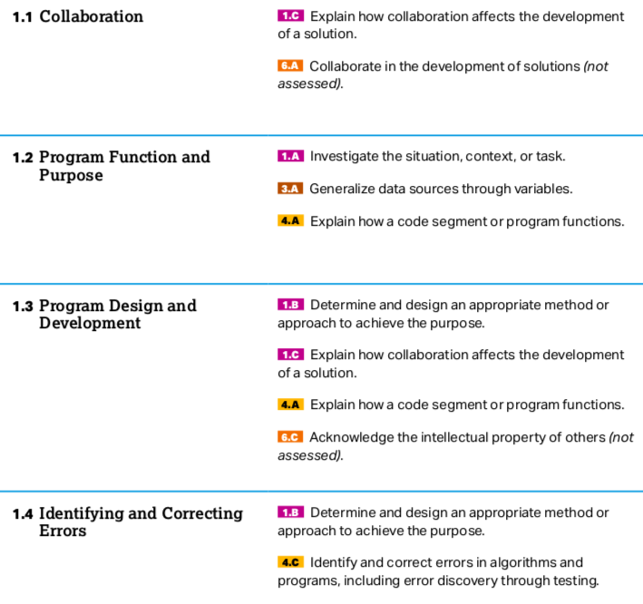
Big Idea 1

Slide 7
Big Idea 1
Please read Chapter 2: Big Idea 1: Creative Development. of the AP Barron's book. The following slides provide a summary of the material covered in this chapter.
A computing innovation includes a program as an integral part of its function.
A computing innovation can be physical (e.g., self-driving car), nonphysical computing software (e.g., picture editing software),or a nonphysical computing concept (e.g., e-commerce).
﻿Hardware is the physical components of a computing device, while software is the instructions in a programming language to the computing device. A computing innovation can have hardware components. However, the computing innovation is about the software, not the hardware.

Slide 8
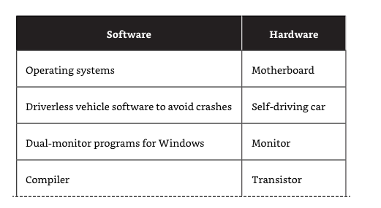
Big Idea 1
﻿Computing hardware has gotten smaller and more powerful over the years. Moore’s law predicts that the size of transistors halves every two years while the cost also halves every two years. Computers went from taking up 1,800 square feet and weighing almost 50 tons to being able to fit in your pocket.

Slide 9
Big Idea 1
﻿Collaboration helps people learn from each other. Collaboration that includes diverse perspectives helps to avoid bias in the development of computing innovations.
For example, if females play video games at the same percentage as males, a game company might not avoid bias if it employed males to write the code for the games. Bringing in female coders could bring additional perspectives that might not have been achieved otherwise.
Programming companies often hire people who not only are good programmers but also have interpersonal skills needed to collaborate effectively. Effective collaboration can help one gain insight and knowledge by applying multiple perspectives, experiences, and skill sets.

Slide 10
Big Idea 1
﻿﻿Collaboration is a learned skill. That skill includes but is not limited to: ■​Communication
■​Consensus building
■​Conflict resolution
■​Negotiation
﻿
Collaboration with others can make the programmer more self-aware.
Group programming can match up your weaknesses with someone else’s strengths, which results in a better product and leads to insight and knowledge not obtainable when working alone.
﻿

Slide 11
Big Idea 1
﻿
Collaboration is not limited by location. Current computing tools allow people in different physical locations to share data.
Online collaboration tools, such as Google Docs, Zoom, Slack, Yammer, and—by the time you read this—dozens of other tools, allow programmers to collaborate from home or from anywhere that has internet access.
﻿﻿A program is a collection of program statements that performs a specific task when run by a computer. A program is often referred to as software.
﻿
A code segment refers to a collection of program statements that are part of a program.

Slide 12
Big Idea 1
﻿Program input is data sent to a computer for processing by a program. Input can come in a variety of forms, such as tactile, audio, visual, or text. For example, a cell phone can convert voice (audio) to text to send a message.
﻿A weather program on your phone could take input in many forms.﻿This weather app was triggered by the user saying (audio) “Hey Phone…,” which would be an example of audio input.
This triggering is called an event. The event is the action that supplies input data to a program. Events can be generated when a key is pressed, a mouse is clicked, a program is started, or by any other defined action that affects the flow of execution.

Slide 13
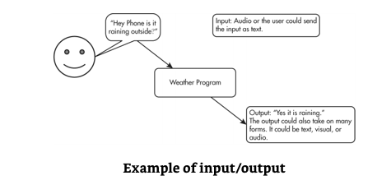
Big Idea 1
Program outputs are any data sent from a program to a device. Program output can come in a variety of forms, such as tactile, audio, visual, or text. Program output is usually based on a program’s input or prior state (e.g., internal values).

Slide 14
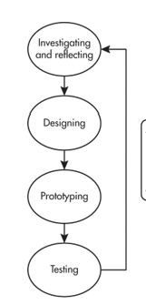
Big Idea 1
A development process can be ordered and intentional, or exploratory in nature.
A development process that is incremental is one that
breaks the problem into smaller pieces and makes sure
each piece works before adding it to the whole.
A development process that is iterative requires refinement
and revision based on feedback, testing, or reflection
throughout the process. This may require revisiting earlier
phases of the process.

Slide 15
Big Idea 1
﻿The design of a program incorporates investigations to determine its requirements. Most programs are designed to be used by people other than the programmers.
To meet the needs of the users, the investigation must identify the program constraints as well as the concerns and interests of people who will use the program.
Some ways investigations can be performed are as follows:
■​Collecting data through surveys
■​User testing
■​Interviews
■​Direct observations

Slide 16
Big Idea 1
﻿The design phase of a program may include:
■​Brainstorming
■​Planning and storyboarding
■​Organizing the program into modules and functional components
■​Creating diagrams that represent the layouts of the user interface ■​Developing a testing strategy for the program
﻿Program documentation is a written description of the function of a code segment, event, procedure, or program and how it was developed.
Program documentation helps in developing and maintaining correct programs when working individually or in collaborative programming environments.

Slide 17
Big Idea 1
Programmers should document a program throughout its development.
Documentation helps the programmer remember what he or she was thinking or the collaborative partners were thinking at the time they were programming.
Comments are a form of program documentation written into the program that do not affect how the program runs. Comments do not affect the run speed of a program. Python, for example, uses # for comments.

Slide 18
Big Idea 1
﻿Three types of program errors can occur:
■​Logic error—This is a mistake in the algorithm or program that causes it to behave incorrectly or unexpectedly. (incorrect implementation of algorithm)
■​Syntax error—This is a mistake in the program where the rules of the programming language are not followed. (missing parenthesis, incorrect indentation, misspelling name of function calls)
■​Runtime error—This is a mistake in the program that occurs during the execution of a program. Programming languages define their own runtime errors.(divide by 0, accessing out-of-bounds index of a list)

Slide 19
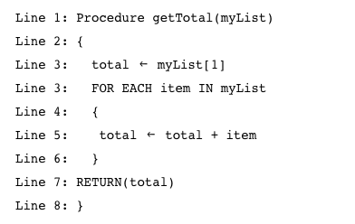
Big Idea 1
Read the code below. Assume that myList is a nonempty list of numbers. Identify the error. What kind of error is it?
Logic Error. The code adds the first number twice in the sum.

Slide 20
Big Idea 2
We will come back to Big Idea 2: Data next week.

Slide 21
Big Idea 3: Programming and Algorithms
The AP exam will use a language-agnostic syntax for programming and algorithm questions.
Please see the following reference sheet(also available during the actual exam) for more details about the syntax.
https://apcentral.collegeboard.org/pdf/ap-computer-science-principles-exam-reference-sheet.pdf

Slide 22
Big Idea 3: Programming and Algorithms
﻿In computer science, an abstraction is a way to represent essential features without including the background details or explanations. Abstractions reduce complexity and allow for efficient design and implementation of complex software systems.
Abstractions become a necessity as systems become more complex. For example, anytime you check your stories on Instagram, you are using a bunch of processes in the background that you have no control over.
Without these abstractions, it would be difficult to send a message to a friend. With the use of abstractions, you can focus on content, not the technical details of how the application works.

Slide 23
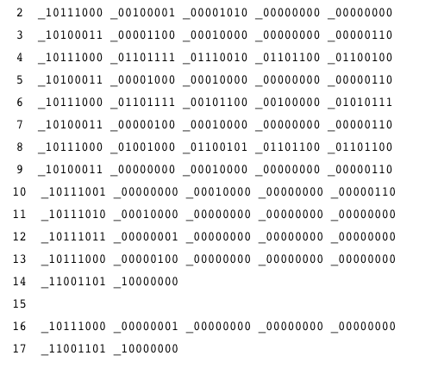
Big Idea 3: Programming and Algorithms
﻿Programmers also use abstractions. The purpose of abstraction is to hide coding details so the programmer can focus on the current problem.
Computers can understand only binary machine code. Machine code is a strictly numerical language that runs fast but is hard to use.
The code on the right is written in machine
code to outputs "Hello World" to the
screen.
In Python it can be done using the print()
abstraction:
print("Hello World")

Slide 24
Big Idea 3: Programming and Algorithms
﻿Abstractions allow for programmers to use semihuman language to program(Python, Java, etc…).
﻿Rarely will programmers deal directly in machine code. Machine code is a base language where no abstractions are implemented. Programmers have worked to hide details by using abstractions.
﻿Different program languages offer different levels of abstractions. High-level programming languages provide more abstractions than do lower-level languages.
Coding in a programming language is often translated into code in another low-level language that the computer can execute.

Slide 25
Big Idea 3: Programming and Algorithms
﻿Abstraction Examples Used on the AP Exam:
﻿DISPLAY(expression) is an abstraction that is used on your AP exam to display a value of expression followed by a space. The input parameter for the DISPLAY abstraction is expression.
﻿Another abstraction used on your AP exam is RANDOM(a, b), which evaluates to a random number from a to b inclusive. The input parameters in this abstraction are a and b.
﻿An abstraction generalizes functionality with input parameters that allow software reuse. Being aware of and using multiple levels of abstractions in developing programs helps to apply available resources and tools more effectively to solve problems.

Slide 26
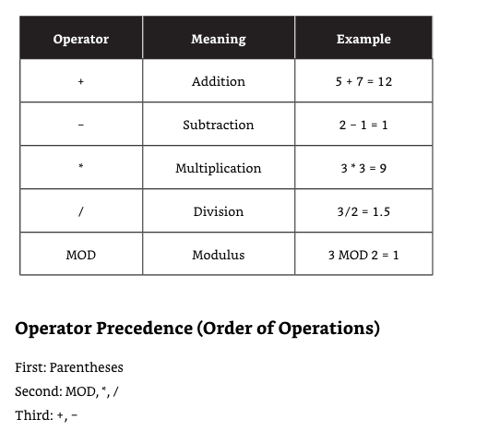

Slide 27
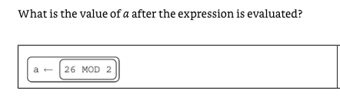
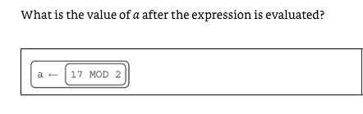
Big Idea 3: Programming and Algorithms

Slide 28
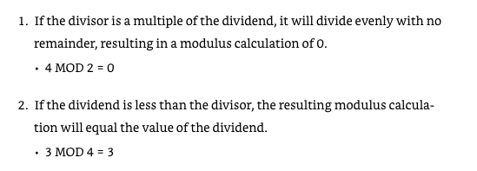
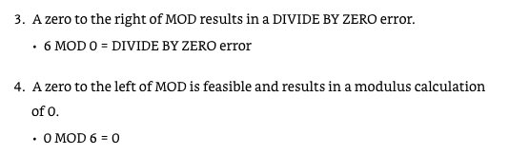
Big Idea 3: Programming and Algorithms

Slide 29
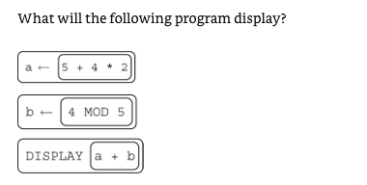

Big Idea 3: Programming and Algorithms

Slide 30
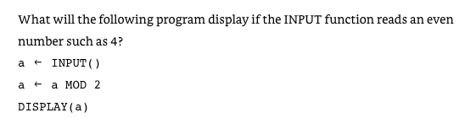
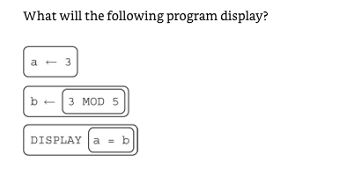

Big Idea 3: Programming and Algorithms

Slide 31
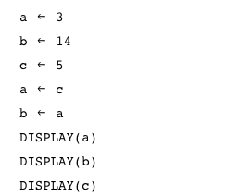
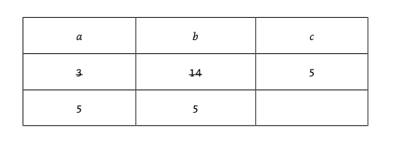
Big Idea 3: Programming and Algorithms

Slide 32
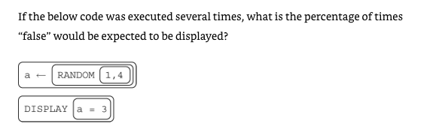

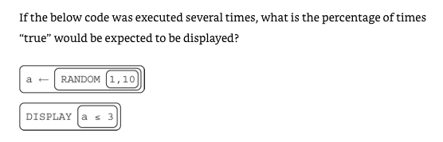

Slide 33
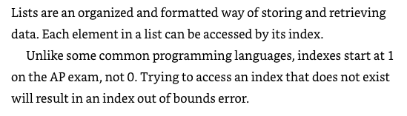
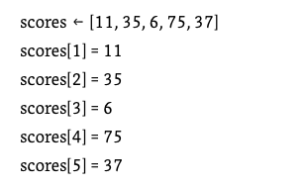
Lists

Slide 34
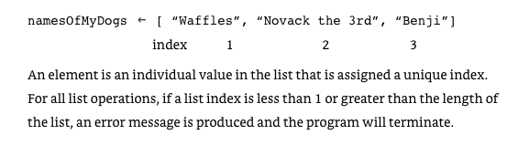
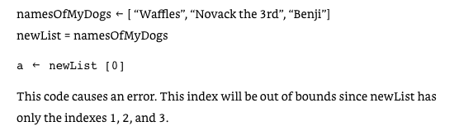
Lists

Slide 35


The INSERT(list, i, item) will insert the item at index i and shift right items at index i or higher.

Slide 36
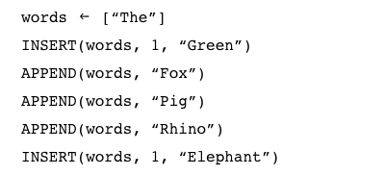
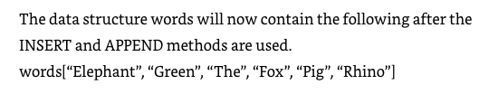
The APPEND(list, item) will add the item to the end of the list.

Slide 37

The REMOVE(list, i) will remove the item at index i and shift left items at index i or higher.
Line 4: REMOVE(words, 3)
Line 5: DISPLAY(words)
Answer: ["Green", "The", "Pig", "Rhino", "Fox"]

Slide 38
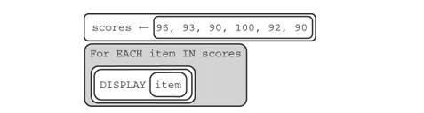


Slide 39
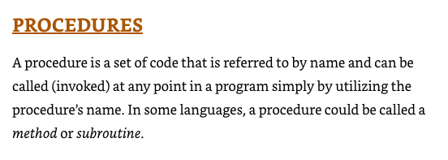

Slide 40
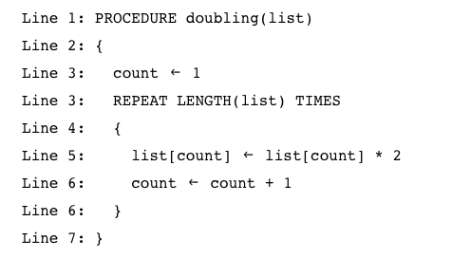
What does the code do?
Answer: Double each value in the list.

Slide 41
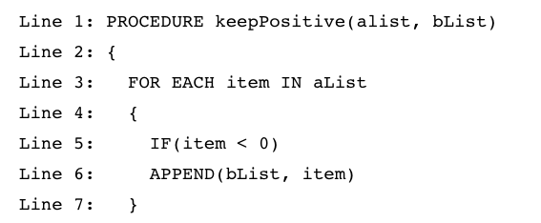
What does the code do?
Answer: Add negative numbers from alist to the end of bList.

Slide 42
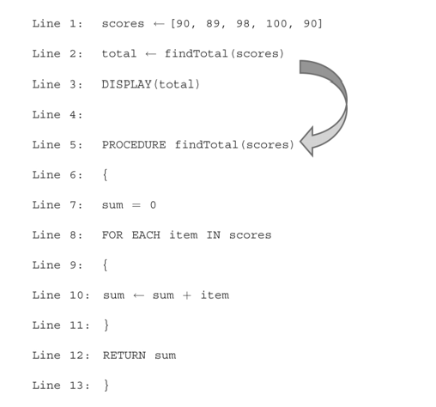
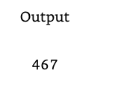

Slide 43
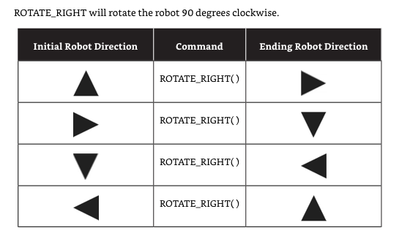
Big Idea 3: Programming and Algorithms

Slide 44
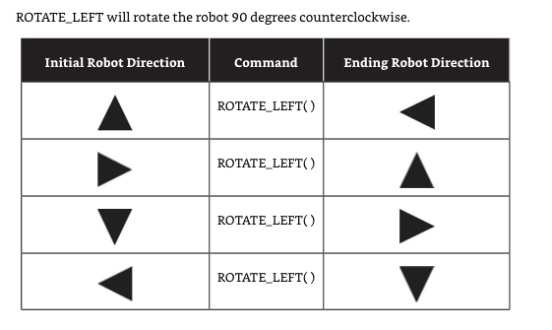
Big Idea 3: Programming and Algorithms

Slide 45
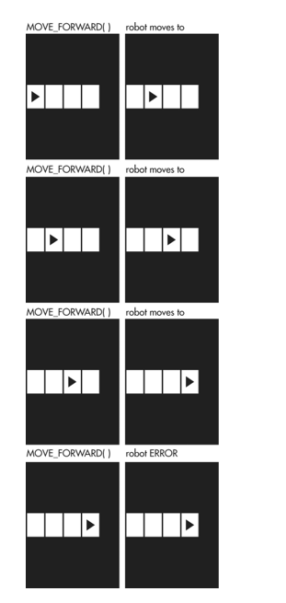

Slide 46
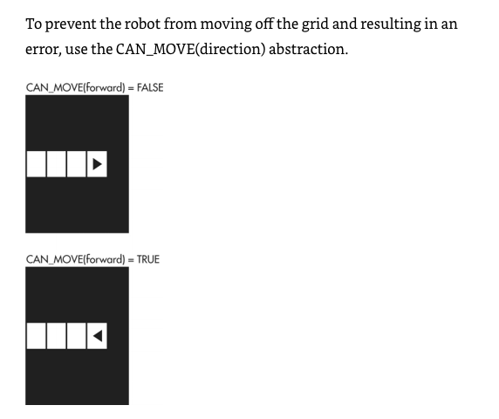

Slide 47
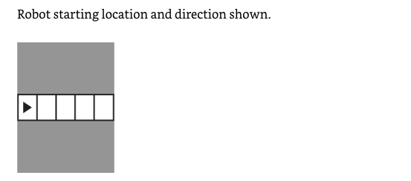
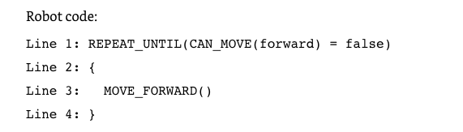
What is the result of executing the above code?
Answer: Robot moves forward 4 steps.

Slide 48
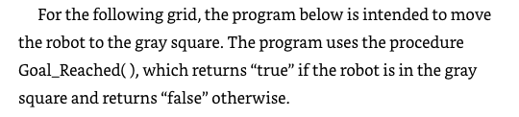
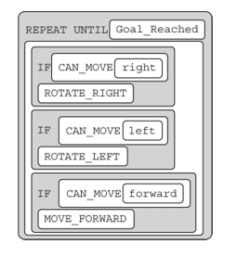
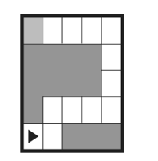
Does the code work as intended?
Yes, as an exercise, trace the code to convince yourself that the robot will reach destination.

Slide 49
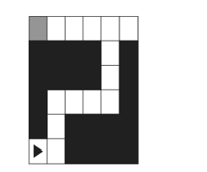
Does the code work as intended?
No! Robot get stuck in an infinite loop at the top right corner.

Slide 50
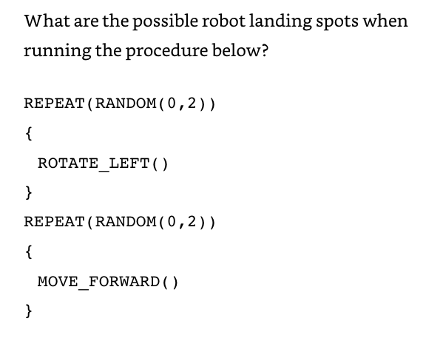
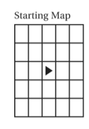
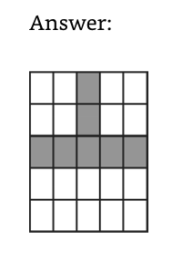

Slide 51
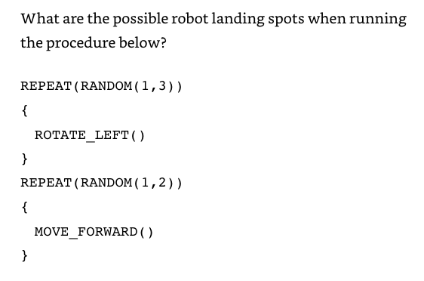

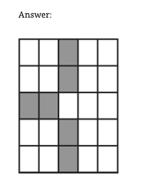

Slide 52
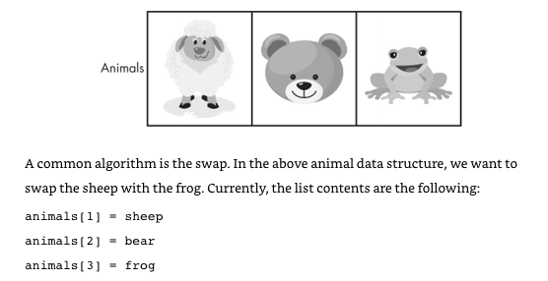


Slide 53





Slide 54
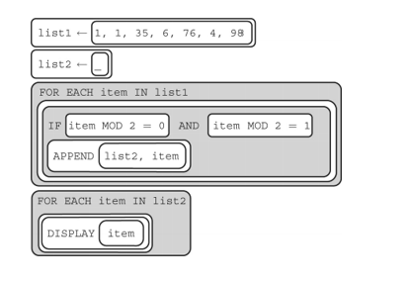
What is the output?
Answer: Empty list, a number cannot be both even and odd. No number is appended to list2.

Slide 55
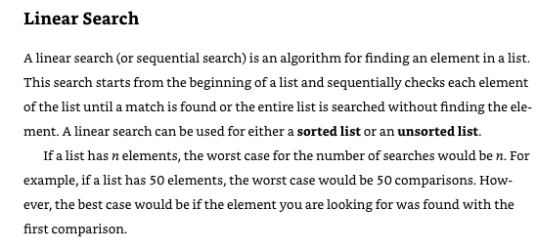

Slide 56
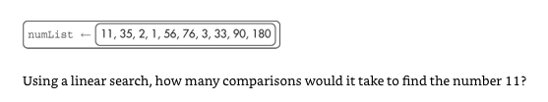


Slide 57



Slide 58


Slide 59



Slide 60


Slide 61



Slide 62
Algorithmic Efficiency
Some problems cannot be solved in a reasonable amount of time because there is no efficient algorithm for solving them. In these cases, approximate solutions are sought.
Algorithms with a polynomial efficiency(constant, linear, square, cube, etc.) are said to run in a reasonable amount of time. They can be executed quickly on a modern processor.
However, there exists important and practical problems for which there exists no known polynomial time algorithm. Algorithms with exponential or factorial efficiencies are examples of algorithms that run in an unreasonable amount of time.

Slide 63
Algorithmic Efficiency
A heuristic is an approach to a problem that produces a solution that is not guaranteed to be optimal but may be used when techniques that are guaranteed to always find an optimal solution are impractical.
For example, ﻿a file-organizing algorithm determines the content of a file based on a certain number of bytes in the beginning of the file. This is an approximate solution since only a few bytes are examined. But it is more practical and faster to run than examining every byte of every file.

Slide 64
Programmers break down problems into smaller and more manageable pieces. By creating procedures and leveraging parameters, programmers generalize processes that can be reused.
Procedures allow programmers to draw upon existing code that has already been tested, allowing them to write programs more quickly and with more confidence.
A software library contains procedures that may be used in creating new programs. (e.g. Python's random, numpy libraries)
The use of libraries simplifies the task of creating complex programs(abstraction).

Slide 65
Application program interfaces (APIs) are specifications for how the procedures in a library behave and can be used.
For example, Twitter's API allow programmers to access and analyze tweets.
Documentation for an API/library is necessary in understanding the behaviors provided by the API/library and how to use them. Twitter has documentation that allows programmers to learn how to use their API.

Slide 66
References
Reichelson, Seth. AP Computer Science Principles Premium with 6 Practice Tests (Barron's Test Prep) (p. 92). Barrons Educational Series.

