Slide 1
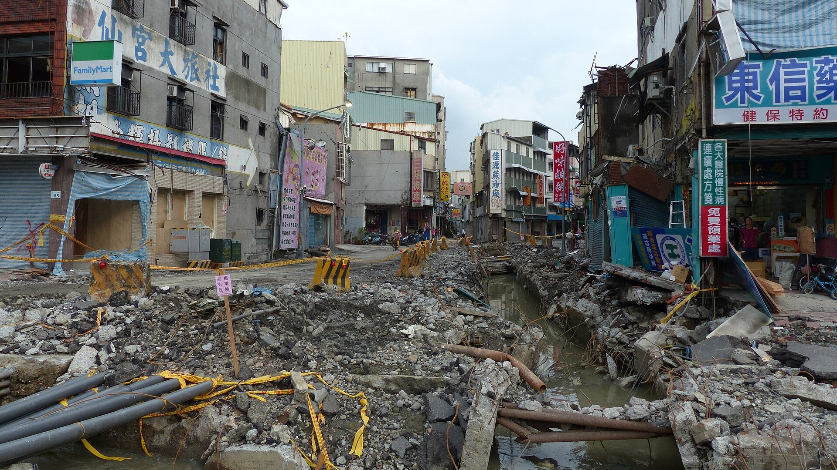

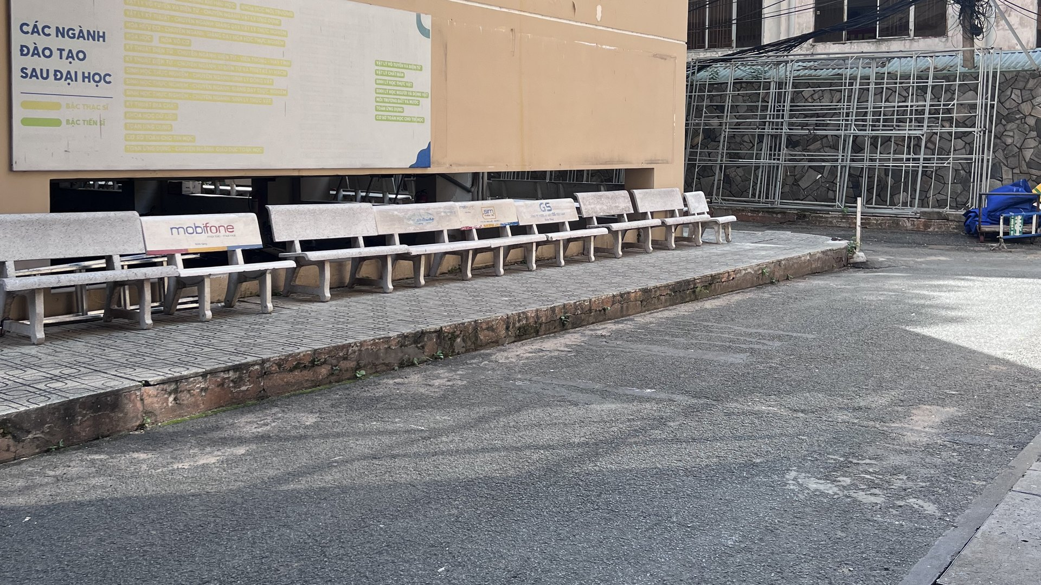


This courtyard · HCMUS campus
And this is not rare.
500,000+
$30B
32 dead
31 JULY 2014
buried utilities hit by digging each year (US)
in damage, every year
321 injured
Kaohsiung, Taiwan
What is under our feet?
“Dig up any street, and you hit a spider web.”
A leaking pipe under the street.
Nobody could see it.
Application of GPR in Surveying Underground Cables and Utilities
— headline, Người Lao Động newspaper, Ho Chi Minh City (translated)
Quốc Long · Quốc Tài · Thành Trung · Đăng Khoa · Đăng Quang
Group [ ] · Supervisor: [ ] · Non-Destructive Testing Methods · Faculty of Physics & Engineering Physics – HCMUS
Sources: Common Ground Alliance, DIRT Report 2019 · nld.com.vn
Sanduo 1st Rd, Kaohsiung, 11 Aug 2014 · Photo: 玄史生 / Wikimedia Commons · CC BY-SA 4.0
Notes:
[0:00–1:00] [Black screen. Stand still, look at the audience, 2 seconds of silence.]
July 31st, 2014. Kaohsiung, Taiwan.
Late in the evening, people on the street begin to smell gas.
Firefighters arrive. They search for the leak — for almost three hours.
They cannot find it. [pause 1 s]
[CLICK 1] Just before midnight, the street explodes.
Thirty-two people dead. Three hundred and twenty-one injured.
The cause? A leaking pipe — buried right under their feet — that nobody could see.
[CLICK 2] And this is not rare. In the US alone, buried utilities are hit more than half a million times a year.
Here in Ho Chi Minh City, newspapers put it simply: dig up any street, and you hit a spider web.
[CLICK 3] Now look at this. Our own campus. We walk across it every day.
Under this asphalt there is a water pipe and a power cable — and no drawing of where they are.
If someone digs here tomorrow… where is it safe?
Today, we will answer that — without digging a single hole.
[One sentence: "We are Quốc Long, Quốc Tài, Thành Trung, Đăng Khoa and Đăng Quang — and this is GPR for underground utilities."]
CHECK BEFORE PRESENTING: confirm the timeline (~20:46 gas reports, explosions ~23:57) on Wikipedia "2014 Kaohsiung gas explosions".

Slide 2
GPR for buried utilities: abroad and in Vietnam
International
Vietnam · HCMUS Geophysics group
Metje et al. (2007) · UK, Mapping the Underworld
Nguyễn Thành Vấn et al. (2018)
Review of utility-locating methods: no single sensor finds every utility, so GPR and EM locators are combined.
GPRTVN processing software; water pipe Φ0.2 m on Nguyễn Hồng St. with the IDS Detector Duo 250/700 MHz.
Royal et al. (2011) · UK
Nguyễn Văn Thuận & Lê Văn Anh Cường (2021)
Site trials of multi-sensor approaches for buried utility detection.
Kirchhoff migration and energy analysis to find the wave velocity; power, telecom and water lines in Gò Vấp.
Lai, Dérobert & Annan (2018)
Đặng Hoàng Duy et al. (2020)
30 years of GPR in civil engineering: from locating and testing to imaging and diagnosis.
2D profiles assembled in 3D: 10 objects 0.45–1 m deep, cross-checked with an EM method.
Our work: the same IDS Detector Duo on our own campus — the full chain from field scan to a utility map.
Full references in the report: Metje 2007, Royal 2011, Lai 2018 (international); Nguyễn T.V. 2018, Nguyễn V.T. 2021, Đặng H.D. 2020 (Vietnam)
Notes:
[1:00–1:45] We are not the first. Abroad, the UK "Mapping the Underworld" project reviewed every locating method and concluded that no single sensor finds every utility — so radar and electromagnetic locators are used together. A 2018 review shows thirty years of GPR moving from simply locating objects to imaging and diagnosis.
In Vietnam, the Geophysics group at our own university has used the same radar — the IDS Detector Duo — to find water pipes and cables in Ho Chi Minh City, and to build 3D pictures from 2D lines.
What we add is small but complete: the whole chain, from scanning our own courtyard to a map of what is under it.

Slide 3
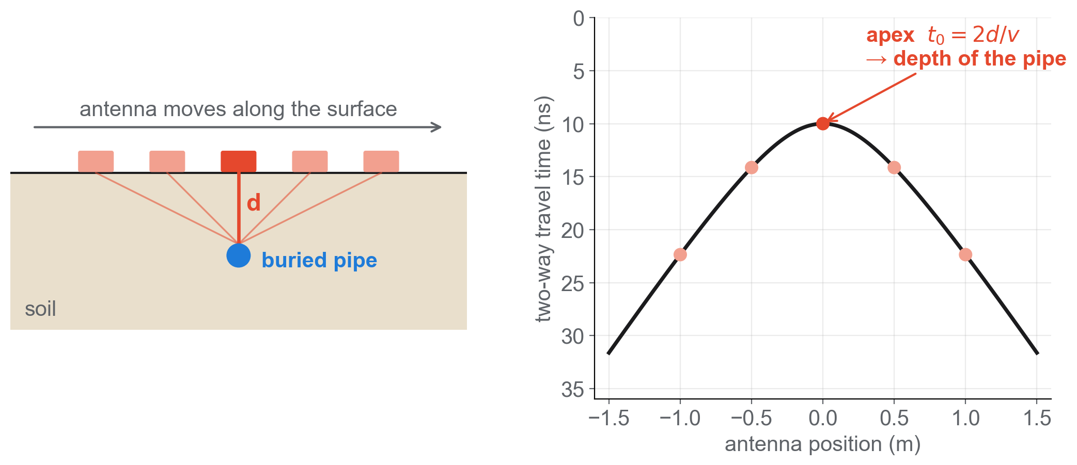
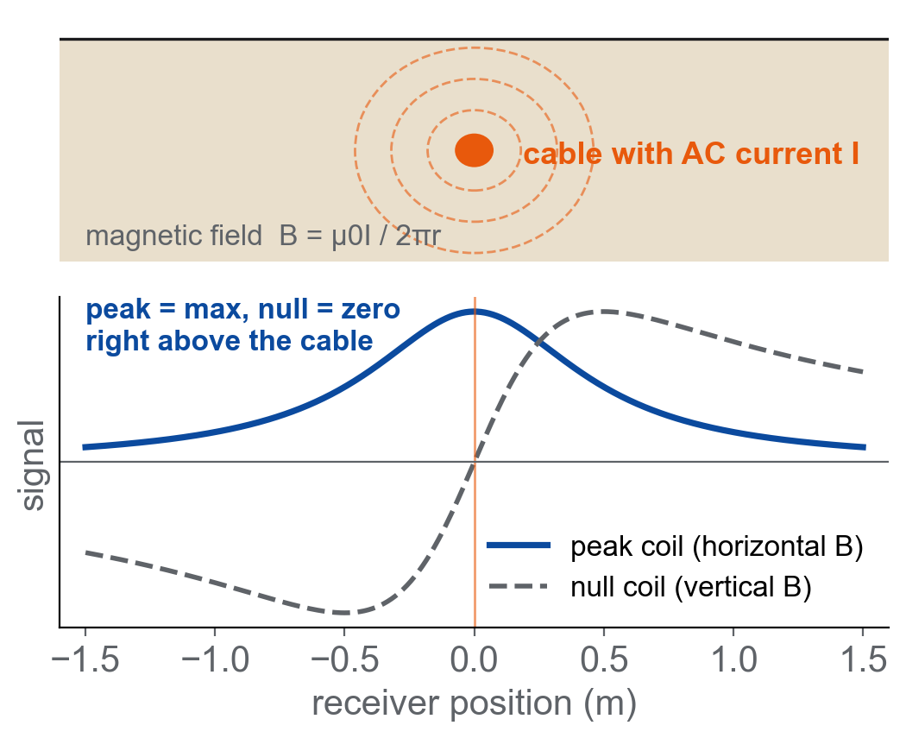
Two NDT methods: radar echoes and induced currents
GPR · ground penetrating radar
RD7000 · electromagnetic locator
Ultrasonic pulse–echo → electromagnetic pulse → GPR
AC current → induced magnetic field → coils
v = c / √εr speed set by soil permittivity
d = v · t / 2 two-way time · site: 0.12 concrete | 0.10 soil (m/ns)
Finds metallic lines only
plastic pipes are invisible → GPR needed
Daniels (2004), Ground Penetrating Radar, 2nd ed. · Jol (2009) · Radiodetection RD7000+ manual
Notes:
[1:45–3:00] We studied two physical ideas.
GPR works like the ultrasonic pulse-echo method from this course — only with radio waves. The antenna sends a short pulse; anything with different electrical properties — a pipe, a cable — sends part of it back. Depth is speed times the two-way time, divided by two.
As we push the antenna across a pipe, the echo arrives earliest right above it and later on both sides — so a small round object draws a hyperbola. Its top tells us where the pipe is and how deep.
The RD7000 works differently: an alternating current in a metal cable creates a magnetic field around it. The receiver coils see a maximum — the peak — or a zero — the null — right above the cable. But it only works for metal. A plastic water pipe is invisible to it — that is why we need GPR.

Slide 4
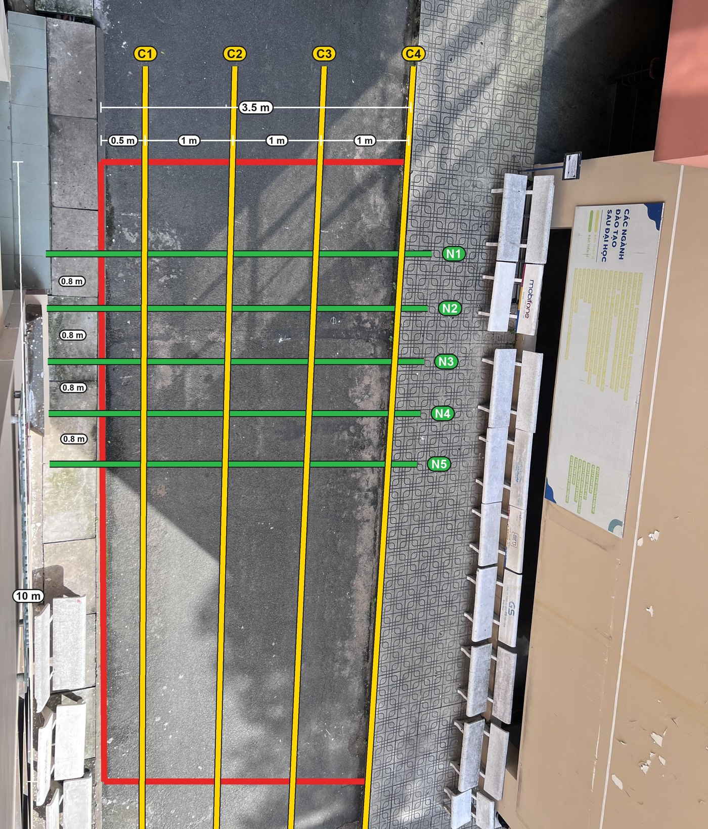
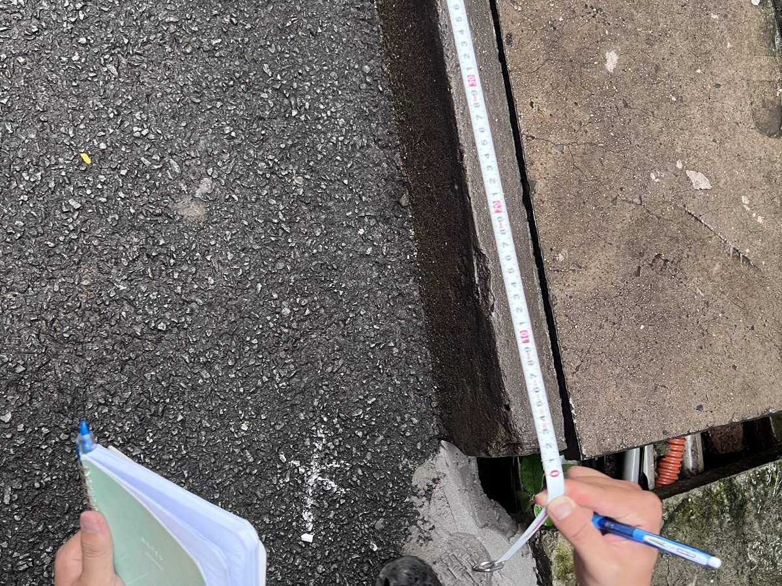
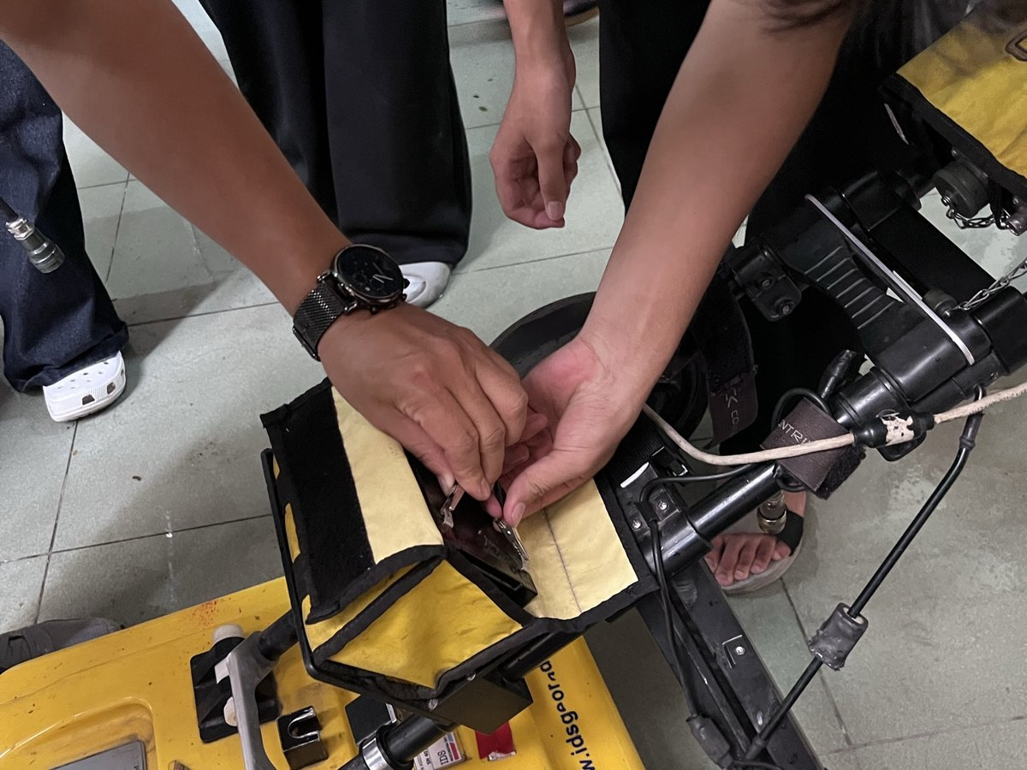
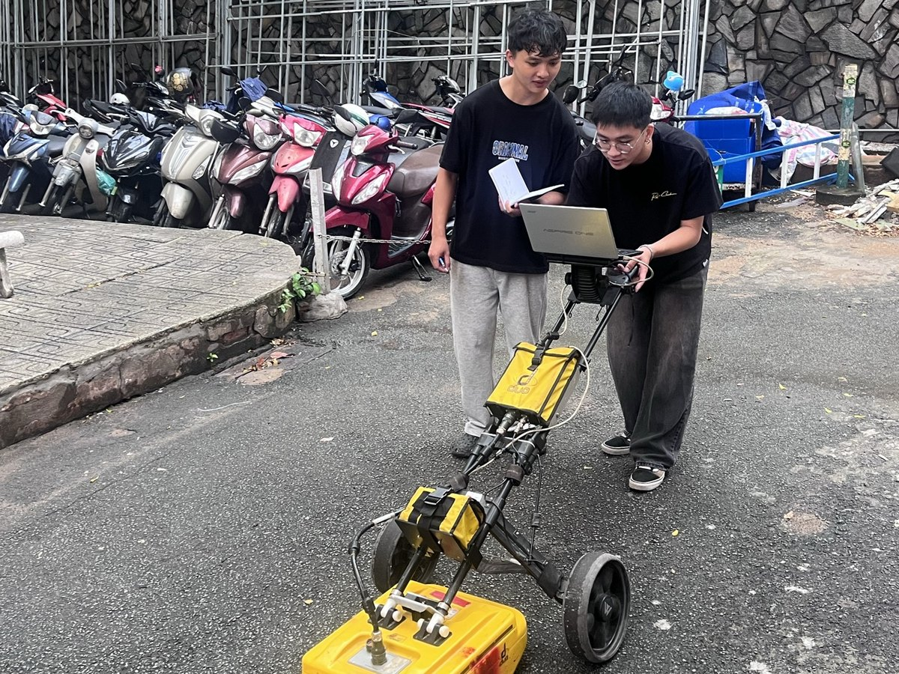
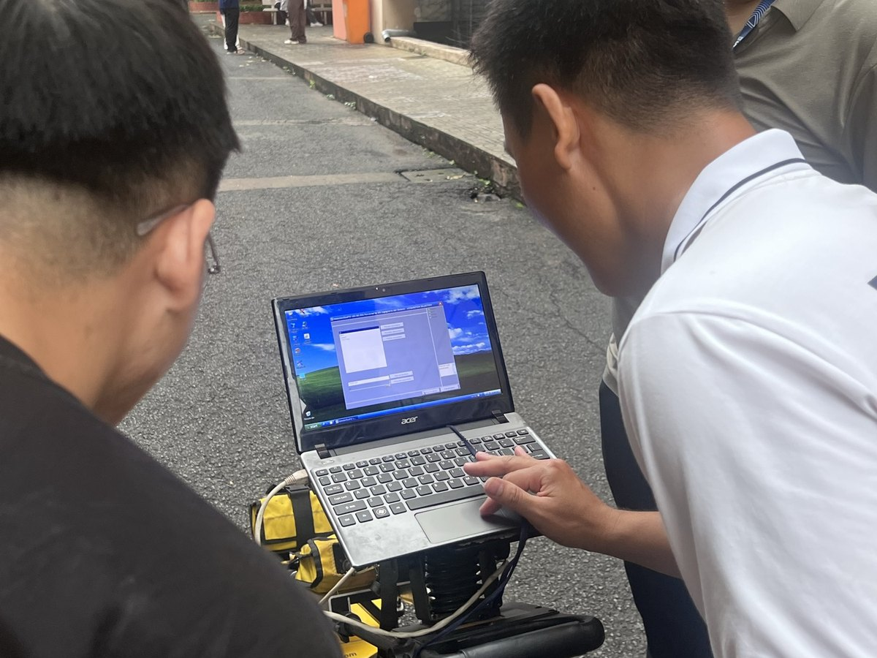
We scanned a 10 m × 3.5 m grid with 9 lines
1 Mark the grid
2 Set up the radar
3 Scan each line
4 Check data on site
C1–C4 along the road, 1 m apart → cable
N1–N5 across the road, ~0.8 m apart → pipe
IDS Detector Duo · 250 + 700 MHz antennas · one trace every 2.78 cm · 10 scans (incl. 1 repeat of N5)
Notes:
[3:00–4:15] This is how we did it, on the courtyard you saw.
We planned a grid, 10 metres by 3.5. GPR sees a pipe best when we cross it at a right angle. The cable runs across the road, so four lines go along the road — C1 to C4, one metre apart. The water pipe runs along the road, so five lines cross it — N1 to N5.
[point to the photos] We marked the lines with a tape, set up the IDS Detector Duo with its two antennas — 250 and 700 megahertz — pushed it along every line, and checked each radargram on the laptop before moving on.
Ten scans in total, including one repeat of N5 to check repeatability.

Slide 5
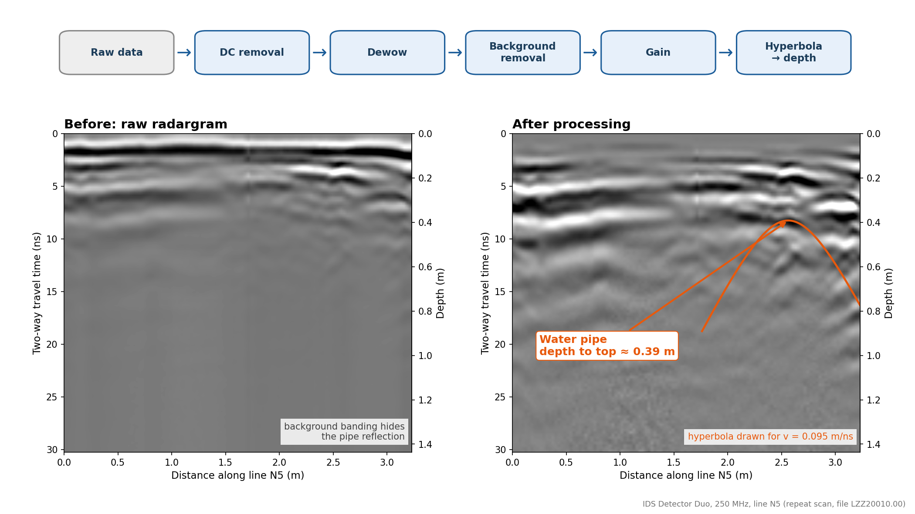
Processing reveals the hidden hyperbola
Notes:
[4:15–5:00] Left: what the radar gives us on line N5 — strong horizontal bands hide almost everything.
Each processing step removes one problem: DC removal and dewow remove the slow drift; background removal deletes the bands that are the same on every trace; gain boosts the weak, deeper echoes.
Right: the water pipe now appears as a clear hyperbola. With v = 0.095 m/ns its top is about 0.4 m deep.

Slide 6
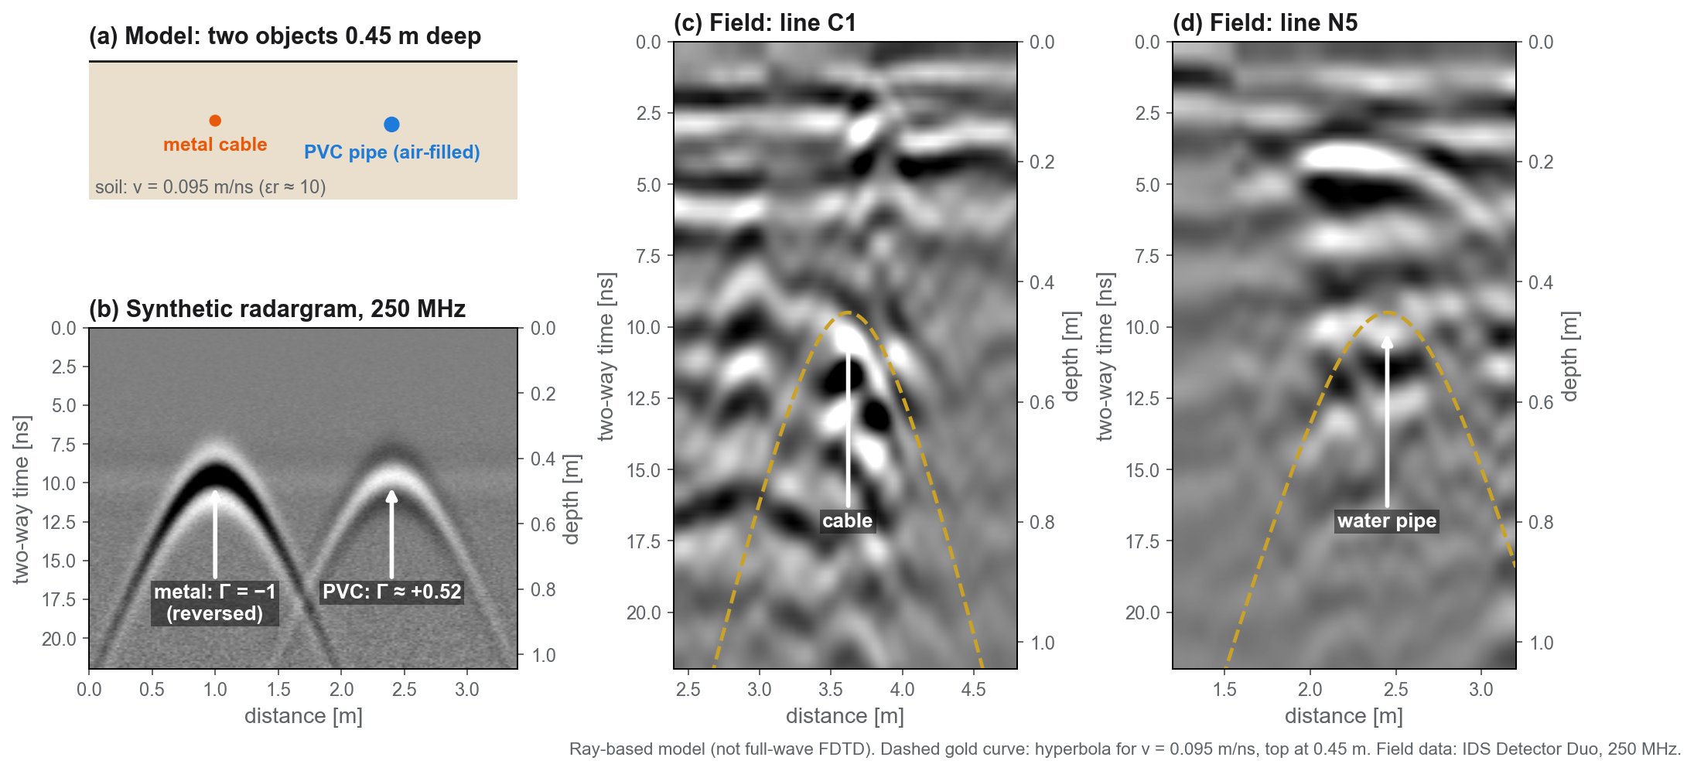
A simple model reproduces the measured hyperbolas
Notes:
[5:00–5:45] Before trusting the field data, we built a simple model: soil with v = 0.095 m/ns, a metal cable and an air-filled PVC pipe, both 0.45 m deep, a 250 MHz pulse.
The model predicts two things. First, a hyperbola with its top at about 9.5 ns — and on the real lines C1 and N5 the measured hyperbolas follow the same curve, the dashed gold line.
Second, metal and plastic reflect with opposite polarity — metal reverses the wave, air in the PVC pipe does not. That is how we can tell them apart.
This is a ray model, not a full-wave simulation; a gprMax input file is prepared for that next step.

Slide 7
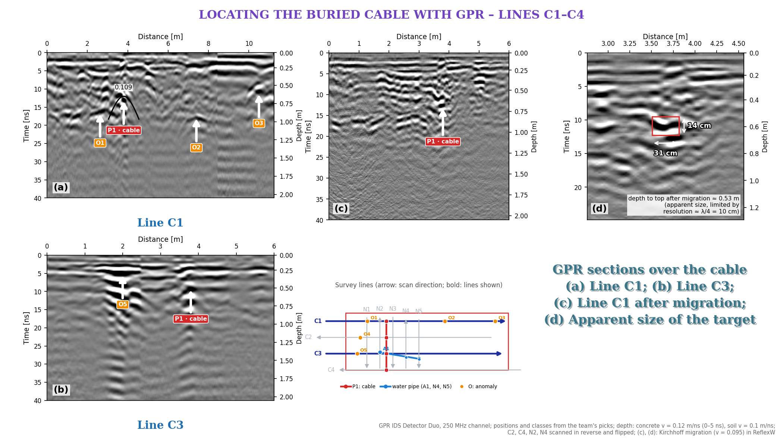
Notes:
[5:45–6:15] The raw evidence, as ReflexW shows it: distance on top, time on the left, depth on the right.
(a) Line C1 and (b) line C3: the red labels mark P1 — a strong hyperbola with a long ringing tail, typical of metal. The orange labels are other anomalies we do not claim.
(c) After Kirchhoff migration P1 on C1 collapses towards one point. (d) Its apparent size, about 31 by 14 cm, is limited by the ~10 cm resolution — not the real cable diameter.
But one hyperbola on one line is just a point. To get a cable, we need the same echo on neighbouring lines.

Slide 8
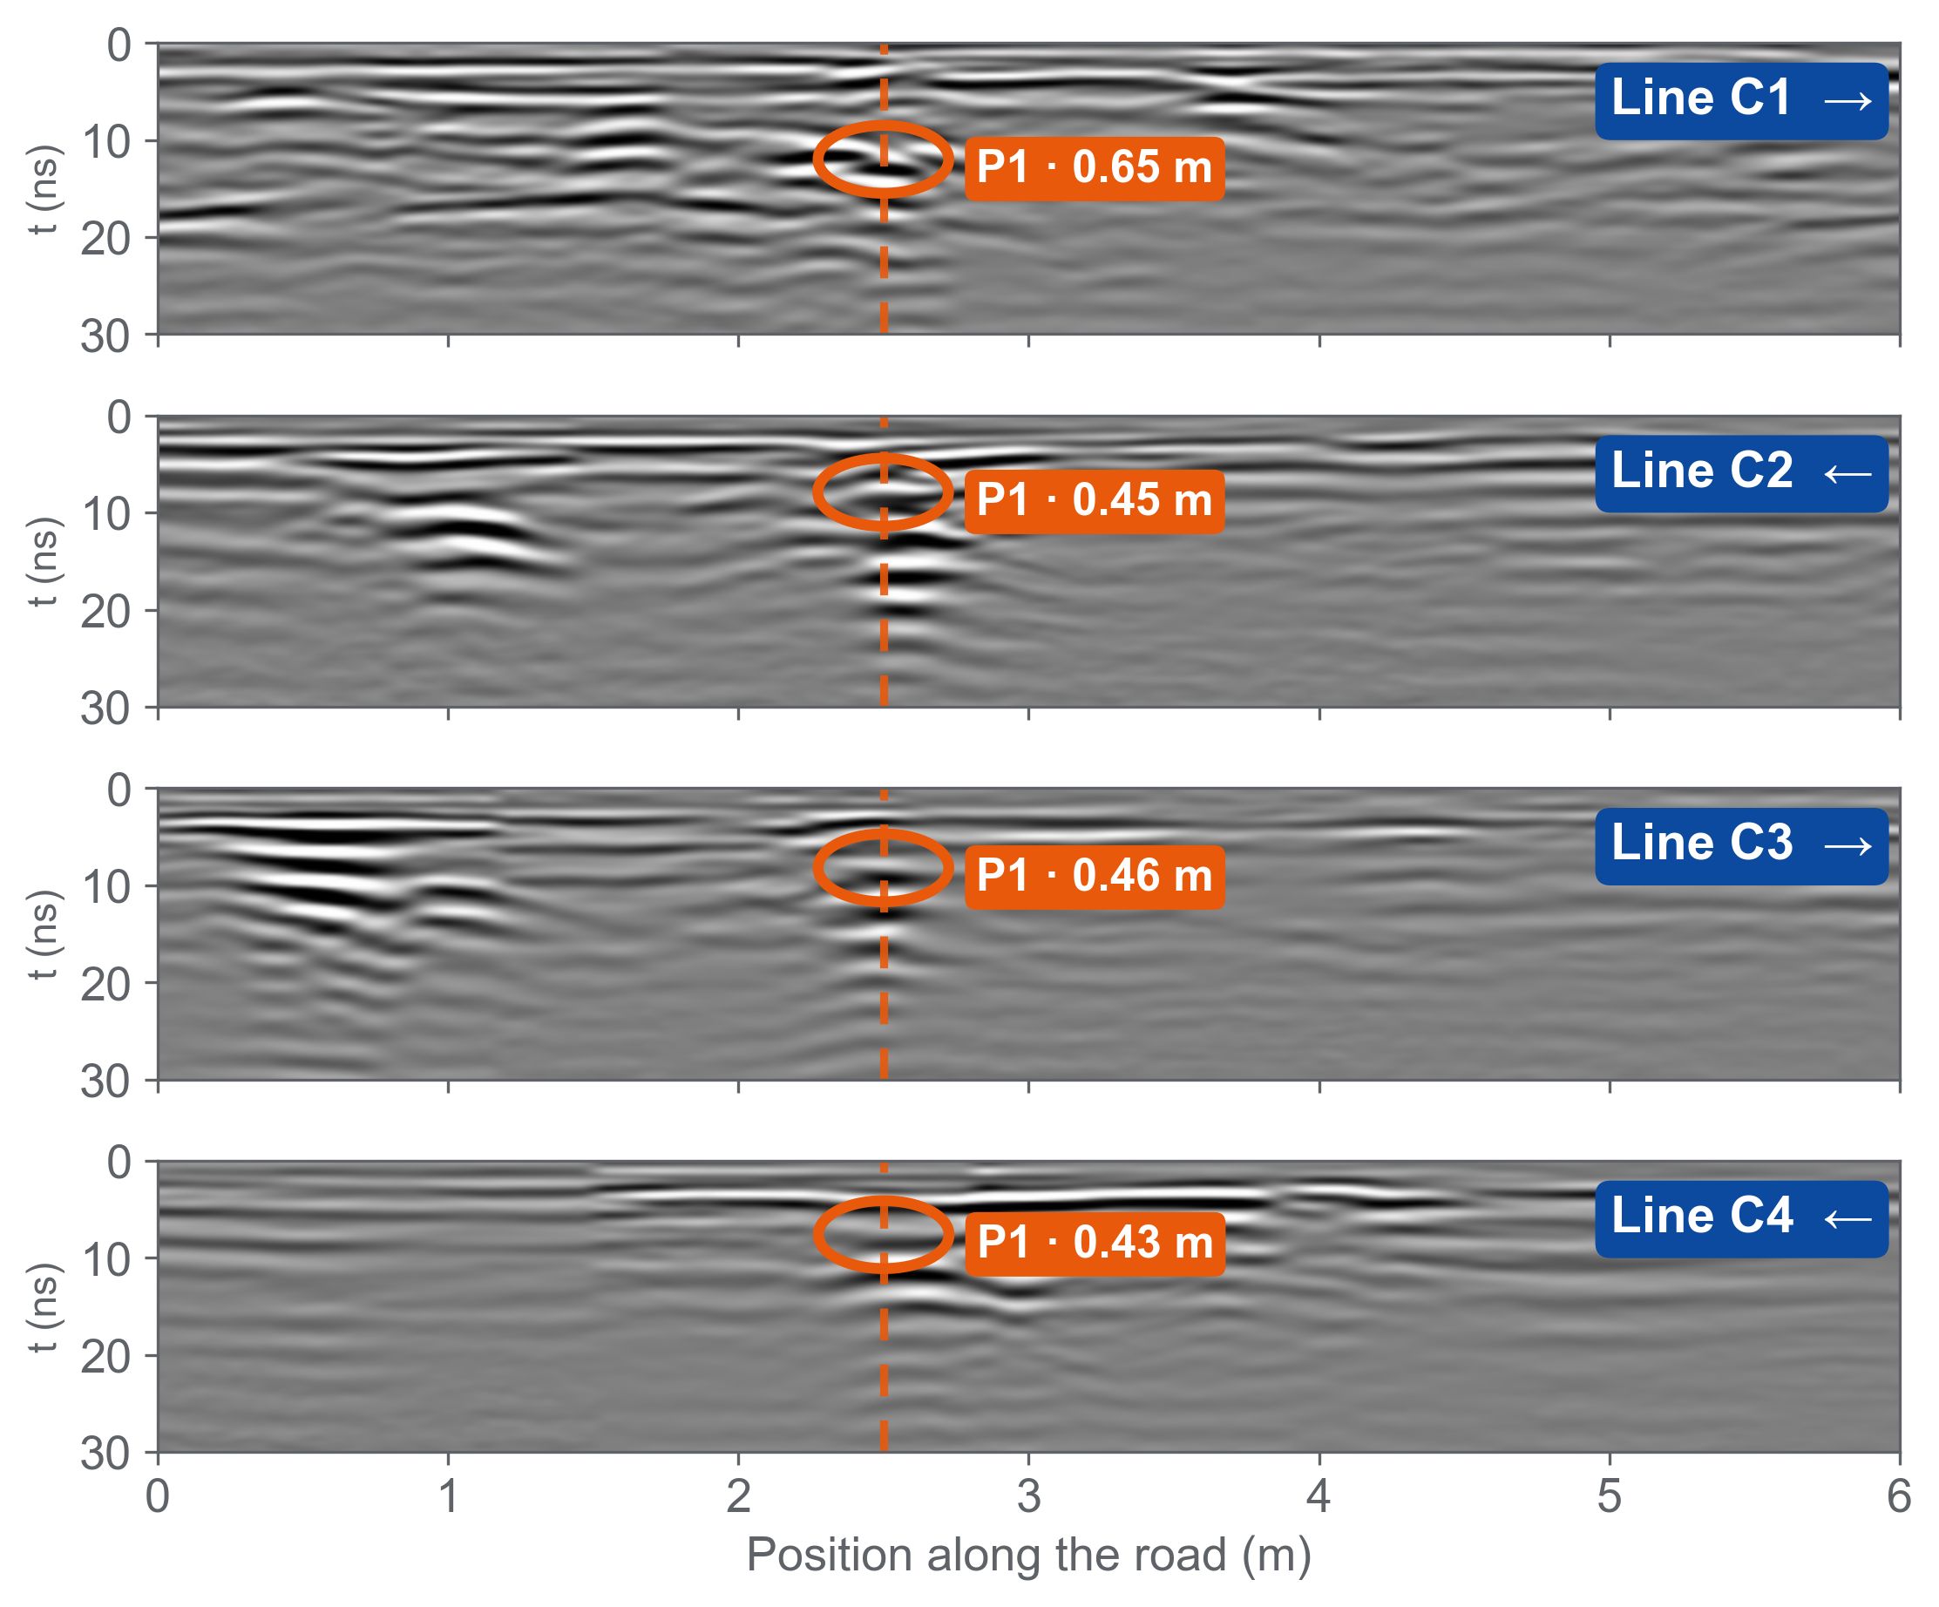
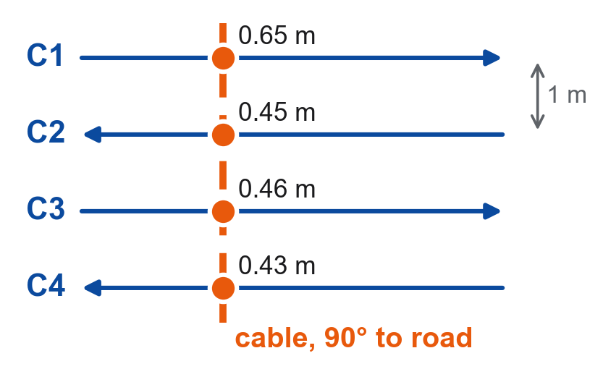
Four aligned anomalies trace one buried cable
Plan view
4 / 4
Same echo on every line
strong, ringing hyperbola → metal
90°
Straight across the road
C1, C3 at 2.50 m · field marks agree
≈ 0.45 m
Depth to the top
C2–C4: 0.43–0.46 m · C1: 0.65 m
250 MHz, lines C1–C4 (LZZ20001–20004; C3 = LZZ20003.11 flipped back), team picks. Depth: 0.12 m/ns concrete, 0.10 m/ns soil. C2, C4 walked in reverse, placed from the cable marked on site.
Notes:
[6:15–6:50] One hyperbola alone could be anything — a stone, a pocket of fill. So we look for the same echo on neighbouring lines.
[left, top to bottom] Lines C1 to C4 run parallel, one metre apart, drawn on the same position axis. On every line we find the same anomaly, P1 — a strong hyperbola with a long ringing tail, typical of metal.
[dashed line] The four tops sit in one column, at 2.5 m: the cable crosses the road straight, at a right angle. That is also what we saw on site — each time we hit the anomaly we marked the ground, and the marks lined up straight across the road.
[cards] Depth to the top is about 0.45 m on C2 to C4, and a little deeper on C1, 0.65 m.
(If asked: C2 and C4 were walked in the opposite direction. We flipped them, as the team did in ReflexW, and placed their start so that P1 sits on the cable we marked. C1 and C3, walked forward, already agree at 2.50 m on their own.)

Slide 9
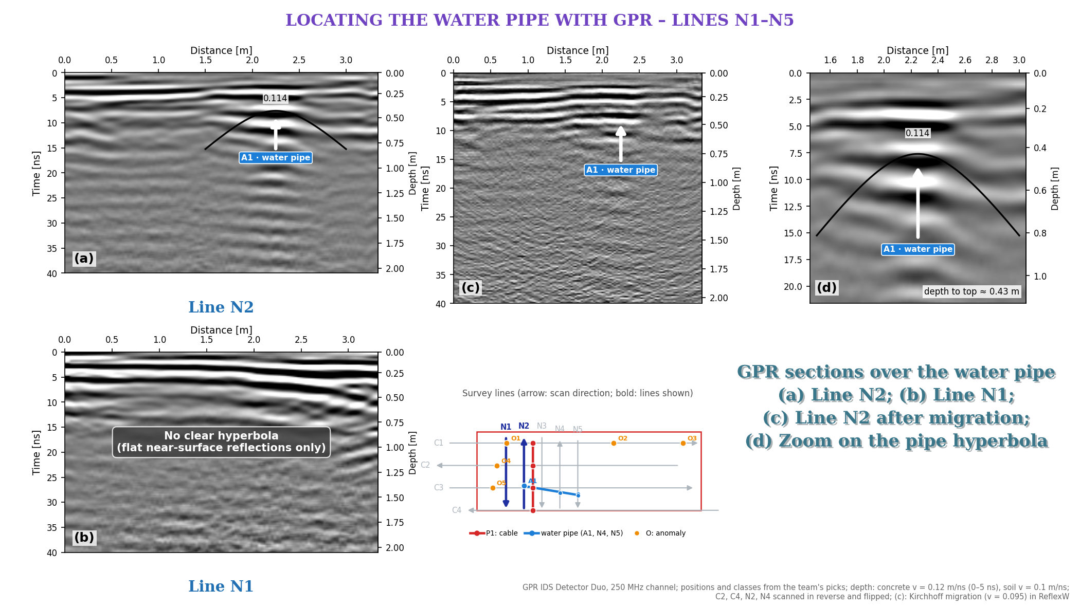
Notes:
[6:50–7:25] Same idea for the water pipe, on the lines across the road.
(a) N2: a clear hyperbola, A1, about 2.25 m along the line; its top is about 0.43 m deep, and the black curve fits it.
(b) N1: no clear hyperbola — only flat reflections from the pavement layers. We say so rather than guess.
(c) After migration this hyperbola does not focus well, so we do not claim a pipe size — (d) only zooms in on it.

Slide 10
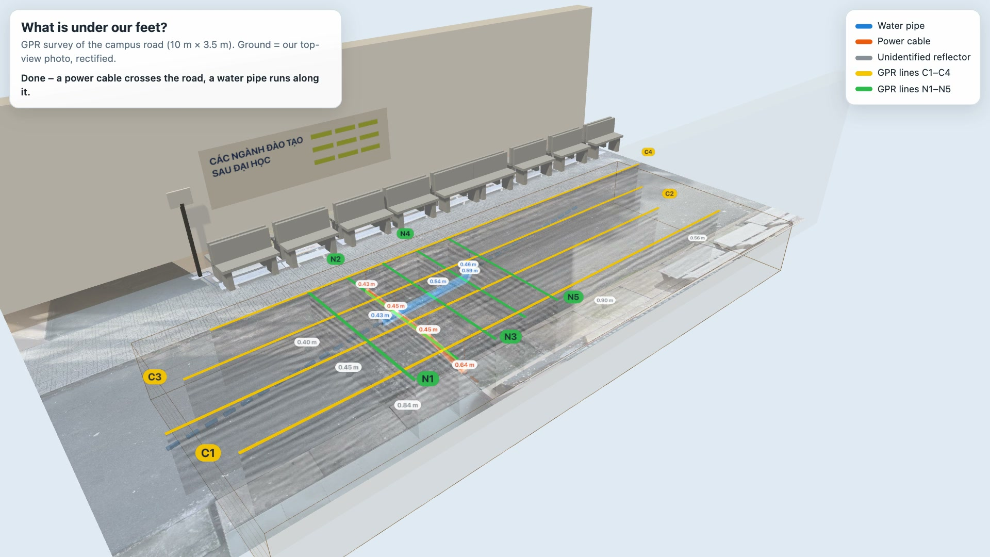
Notes:
[7:25–7:45] (The video starts by itself – 19 s; the scanning part runs at 3× speed. Talk over it.)
This is our survey in 3D, built from the real data: the ground is our own top-view photo.
Watch the radar cart scan each line — sped up three times — every C line, then every N line. Under each line, its radargram appears.
At the end, the hyperbola tops are joined: the orange cable straight across the road, the blue water pipe along it.
(Live version for questions: open 02_SoDoTuyen_BanDo/ket_qua/Canh3D_HienTruong.html in a browser and click the pipe or cable.)

Slide 11
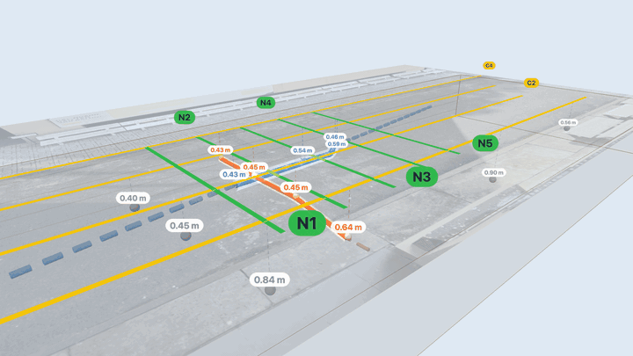
One cable crosses the road; one pipe runs along it
Power cable
0.43–0.65 m
straight across the road · on C1–C4
depth to top
Water pipe
0.43–0.59 m
along the road, ~1 m from the benches · N2, N4, N5
depth to top
Other reflectors
5
O1–O5 · 1 line each
single-line hits
360° view, ground made transparent · blue = water pipe · orange = power cable · labels = depth to top
Depth to the top: v = 0.12 m/ns in concrete, 0.10 m/ns in soil. Dashed lines are straight-line extensions, not measurements.
Notes:
[7:45–8:30] So, what is under our feet? [the view turns around the site, the ground is see-through]
[orange] A power cable crosses the road at a right angle, about 0.45 m to its top — the same echo on all four lines, exactly where we marked it on site.
[blue] A water pipe runs along the road, about one metre from the edge by the benches, 0.43 to 0.59 m deep — seen on N2, N4 and N5.
[grey] Five other reflectors appear on one line only — so we do not claim what they are. The dashed parts are extensions — we did not measure there.
In Kaohsiung, nobody could see the pipe. Here, we can. If someone digs here tomorrow — now we know where NOT to dig.

Slide 12
What we learned, and what we would do next
Conclusions
Limits → recommendations
1
GPR located a cable and a water pipe under asphalt — without digging.
Depth depends on the velocity: our 2-layer model vs 0.095 m/ns shifts depths by ~20 %.
Cross the target at a right angle: that is what makes the hyperbola visible.
→ Calibrate with the RD7000 or one small test pit.
2
Line positions were paced, not surveyed: lines walked backwards had to be placed from our field marks.
3
700 MHz gives sharp images, 250 MHz sees deeper — using both is safer.
→ Use an odometer wheel or GPS.
28 % of utility strikes in the US are traced to locating errors (CGA, 2019). Locating well is exactly what GPR is for.
Notes:
[8:30–9:20] Three conclusions.
One: with nine lines on a small grid, GPR found a cable and a water pipe under asphalt — no digging. The key was finding the same echo on neighbouring lines.
Two: geometry matters — crossing the target at a right angle is what makes the hyperbola appear.
Three: the two antennas complement each other — 700 MHz is sharper, 250 MHz goes deeper.
Two honest limits. Our depths depend on the wave speed: our two-layer model and the migration velocity give depths about 20 % apart — so next time we calibrate with the RD7000 or one small test pit. And our line positions were paced by hand — for the lines walked backwards we had to rely on our marks on the ground; an odometer wheel or GPS would make the map more accurate.
More than a quarter of utility strikes start with a locating mistake. Locating well is exactly what GPR is for.

Slide 13
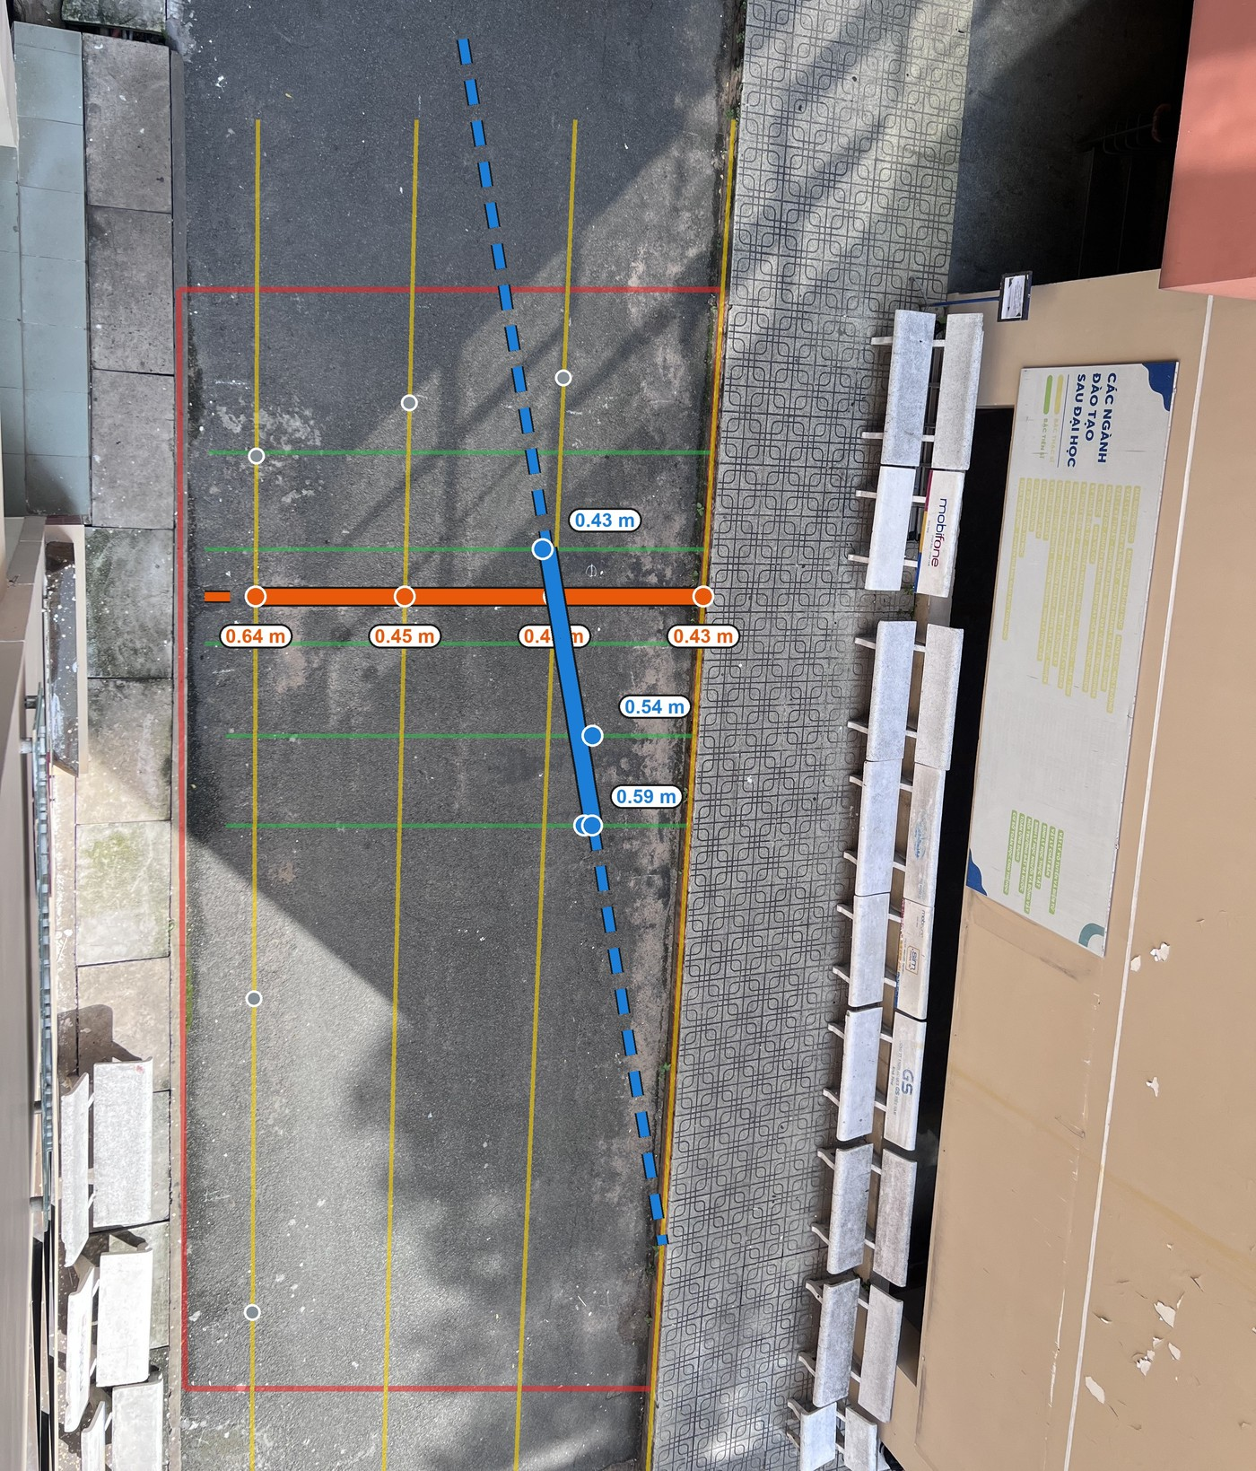
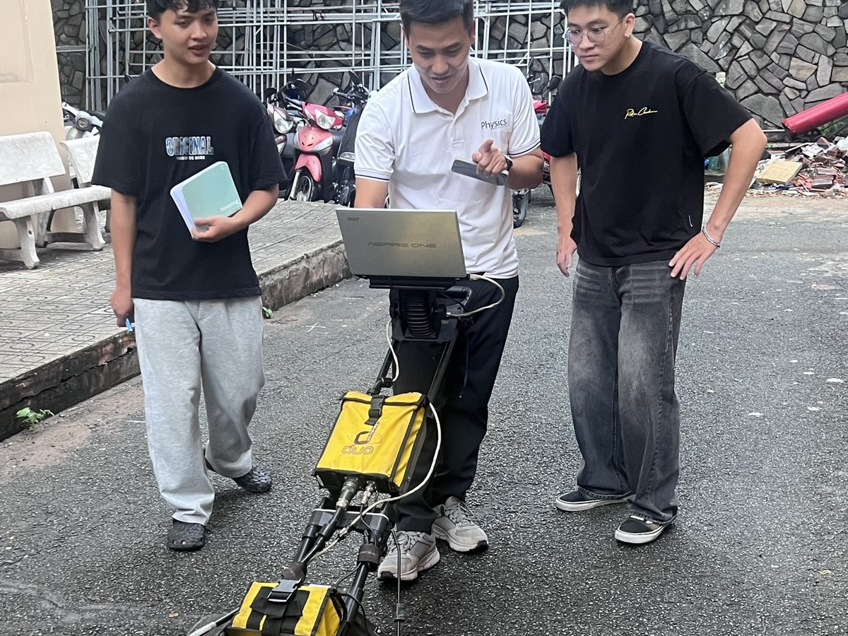
What is under our feet?
Now we know.
Thank you — Questions?
Our team
Quốc Long
Quốc Tài
Thành Trung
Đăng Khoa
Đăng Quang
Group [ ] · Supervisor: [ ]
Daniels, D. J. (2004). Ground Penetrating Radar, 2nd ed. IET.
Metje, N. et al. (2007). Mapping the Underworld – state-of-the-art review. Tunn. Undergr. Space Technol. 22, 568–586.
Lai, W. W.-L., Dérobert, X., Annan, P. (2018). A review of GPR application in civil engineering. NDT & E Int. 96, 58–78.
Notes:
[9:20–9:50] At the start we asked: what is under our feet? Now we know — a cable crossing the road and a water pipe along it, about half a metre down.
Thank you for listening. We are happy to take your questions.
(Backup slides follow: plan-view map, depth slices, migration on line C1, comparison of NDT methods.)

Slide 14
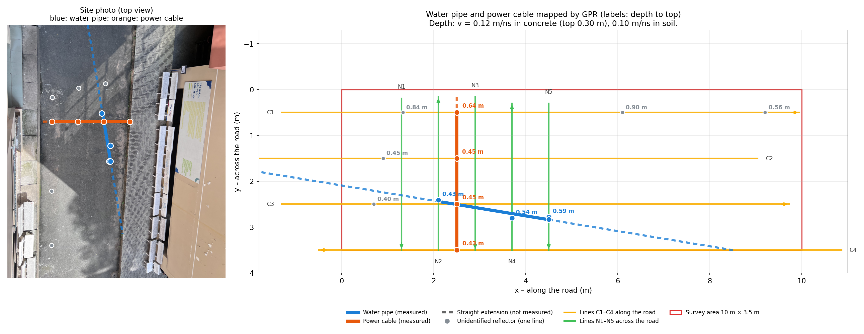
Backup · Plan view: every target with its depth
Notes:
Use if asked where exactly each point was measured, or about the dashed extensions.

Slide 15
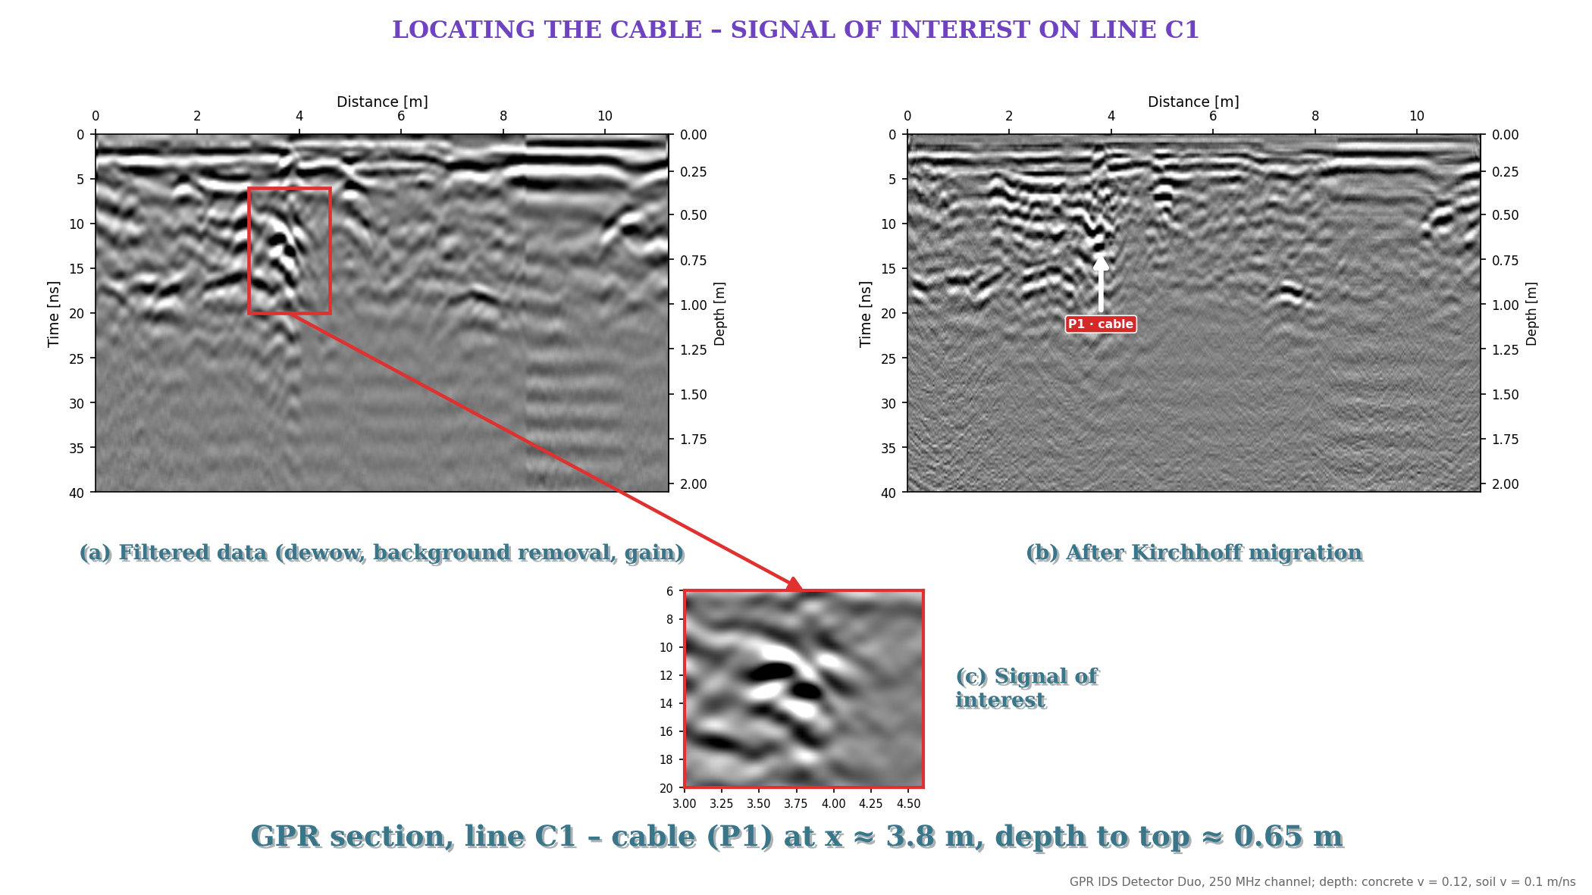
Notes:
Backup – use if asked what migration does: (a) filtered line C1 with the cable region boxed, (b) after Kirchhoff migration, (c) zoom on the signal of interest.

Slide 16
Backup · Why GPR? NDT methods compared
Method | What it detects | Plastic pipes? | Main limitation
Ground penetrating radar (GPR) | Any contrast in permittivity: metal, plastic, voids | Yes | Signal fades fast in wet clay
EM locator (e.g. RD7000) | Metallic lines carrying a current | Only with a tracer wire or sonde | Blind to non-metallic pipes
Magnetometer | Ferrous (iron, steel) objects | No | Disturbed by nearby metal
Electrical resistivity (ERT) | Large resistivity contrasts | Poorly | Low resolution for small pipes
Acoustic methods | Leak noise and vibration in pipes | Yes, if filled with water | Needs access to the pipe
Based on Metje et al. (2007) and Royal et al. (2011)
Notes:
Use if asked why GPR: it is the only method here that sees both metallic and plastic utilities without touching them.

