Slide 1
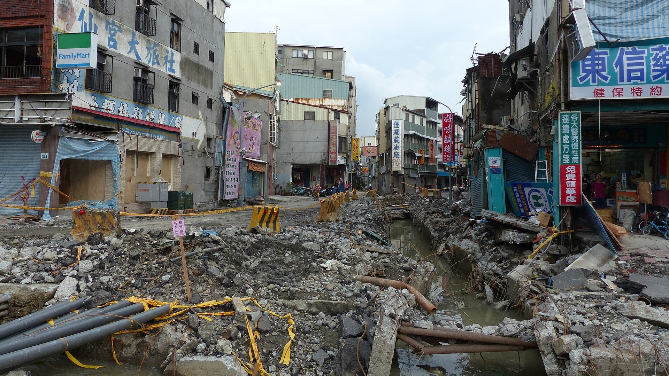

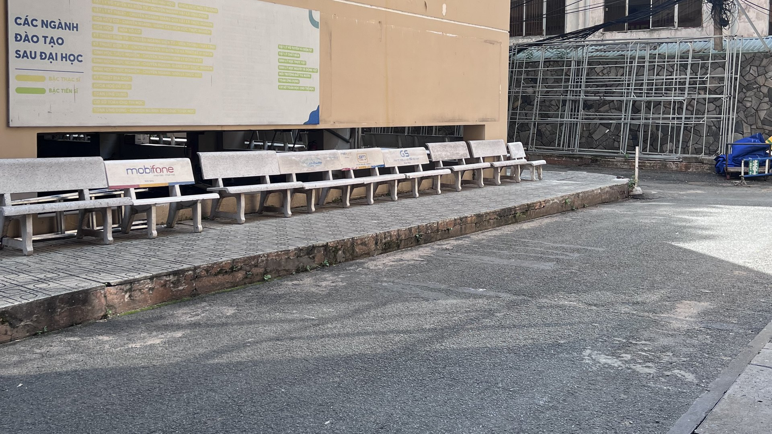


This courtyard · HCMUS campus
And this is not rare.
500,000+
$30B
32 dead
31 JULY 2014
buried utilities hit by digging each year (US)
in damage, every year
321 injured
Kaohsiung, Taiwan
What is under our feet?
“Dig up any street, and you hit a spider web.”
A leaking pipe under the street.
Nobody could see it.
Application of GPR in Surveying Underground Cables and Utilities
— headline, Người Lao Động newspaper, Ho Chi Minh City (translated)
Quốc Long · Quốc Tài · Thành Trung · Đăng Khoa · Đăng Quang
Group [ ] · Supervisor: [ ] · Non-Destructive Testing Methods · Faculty of Physics & Engineering Physics – HCMUS
Sources: Common Ground Alliance, DIRT Report 2019 · nld.com.vn
Sanduo 1st Rd, Kaohsiung, 11 Aug 2014 · Photo: 玄史生 / Wikimedia Commons · CC BY-SA 4.0
Notes:
[0:00–1:00] [Black screen. Stand still, look at the audience, 2 seconds of silence.]
July 31st, 2014. Kaohsiung, Taiwan.
Late in the evening, people on the street begin to smell gas.
Firefighters arrive. They search for the leak — for almost three hours.
They cannot find it. [pause 1 s]
[CLICK 1] Just before midnight, the street explodes.
Thirty-two people dead. Three hundred and twenty-one injured.
The cause? A leaking pipe — buried right under their feet — that nobody could see.
[CLICK 2] And this is not rare. In the US alone, buried utilities are hit more than half a million times a year.
Here in Ho Chi Minh City, newspapers put it simply: dig up any street, and you hit a spider web.
[CLICK 3] Now look at this. Our own campus. We walk across it every day.
Under this asphalt there is a water pipe and a power cable — and no drawing of where they are.
If someone digs here tomorrow… where is it safe?
Today, we will answer that — without digging a single hole.
[One sentence: "We are Quốc Long, Quốc Tài, Thành Trung, Đăng Khoa and Đăng Quang — and this is our seminar on GPR for underground cables and utilities."]
CHECK BEFORE PRESENTING: confirm the timeline (~20:46 gas reports, explosions ~23:57) on Wikipedia "2014 Kaohsiung gas explosions".

Slide 2
1
Introduction
Problem, objectives and approach
2
Overview
Outline
Previous work abroad and in Vietnam · NDT methods for buried utilities
3
Methods
Application of GPR in Surveying Underground Cables and Utilities
GPR and electromagnetic-induction principles · field survey · data processing
4
Results
Model · cable and pipe sections · utility map and evaluation
5
Conclusions
Conclusions, limitations and recommendations
Seminar · Non-Destructive Testing Methods
Notes:
[1:00–1:15] Our talk has five parts: the problem and what we set out to do; what others have done; the physics and how we measured; what we found; and what we learned.

Slide 3
1 Introduction: problem, objectives and approach
1 Introduction 2 Overview 3 Methods 4 Results 5 Conclusions
Problem
Objectives
A water pipe and a power cable lie under the courtyard, but there is no as-built drawing.
Digging blind risks a strike: 28 % of US utility damage starts with a locating error (CGA, 2019).
Locate the buried cable and water pipe without digging.
Estimate the depth to the top of each.
Draw a 2D / 3D utility map of the site.
Approach
Expected results
Main: GPR, IDS Detector Duo, 250 + 700 MHz.
Complementary: RD7000 EM locator (metal lines).
ReflexW processing; Python maps.
Each utility shows as a hyperbola on every line that crosses it.
Joining the hyperbola apexes across parallel lines gives its path; the apex time gives its depth.
Survey site: asphalt courtyard, HCMUS campus
Notes:
[1:15–2:00] Problem: under this courtyard there is a water pipe and a power cable, but no drawing of where they are. Digging blind is how strikes happen — more than a quarter of utility damage in the US starts with a locating error.
Our objectives: locate both lines without digging, estimate how deep they are, and draw a map.
Approach: ground-penetrating radar is the main method; an electromagnetic locator, the RD7000, is the complementary method for metal lines. We processed the data in ReflexW and built the maps in Python.
What we expected: each utility should appear as a hyperbola on every line that crosses it; joining the apexes gives its path and depth.

Slide 4
2.1 Previous work: abroad and in Vietnam
1 Introduction 2 Overview 3 Methods 4 Results 5 Conclusions
International
Vietnam · HCMUS Geophysics group
Metje et al. (2007) · UK, Mapping the Underworld
Nguyễn Thành Vấn et al. (2018)
Review of utility-locating methods: no single sensor finds every utility, so GPR and EM locators are combined.
GPRTVN processing software; water pipe Φ0.2 m on Nguyễn Hồng St. with the IDS Detector Duo 250/700 MHz.
Royal et al. (2011) · UK
Nguyễn Văn Thuận & Lê Văn Anh Cường (2021)
Site trials of multi-sensor approaches for buried utility detection.
Kirchhoff migration and energy analysis to find the wave velocity; power, telecom and water lines in Gò Vấp.
Lai, Dérobert & Annan (2018)
Đặng Hoàng Duy et al. (2020)
30 years of GPR in civil engineering: from locating and testing to imaging and diagnosis.
2D profiles assembled in 3D: 10 objects 0.45–1 m deep, cross-checked with an EM method.
Gap we address: the same equipment, applied end to end by students on an undocumented site — from field scan to a utility map.
References [3]–[7] on the last slide
Notes:
[2:00–2:40] Abroad, the UK "Mapping the Underworld" project reviewed every locating method and concluded that no single sensor finds every utility — so radar and electromagnetic locators are used together. A 2018 review shows thirty years of GPR moving from locating objects to imaging and diagnosis.
In Vietnam, the Geophysics group at our own university has used the same radar — the IDS Detector Duo — to find water pipes and cables in Ho Chi Minh City, and to build 3D pictures from 2D lines.
We apply the same chain end to end on a site with no drawings.

Slide 5
2.2 NDT methods for buried utilities, and our scope
1 Introduction 2 Overview 3 Methods 4 Results 5 Conclusions
Method | Physical principle | What it detects | Plastic pipes? | Main limitation
Ground-penetrating radar (GPR) | EM pulse reflected at permittivity contrasts | Metal, plastic, voids | Yes | Signal fades fast in wet clay
EM locator (e.g. RD7000) | Magnetic field of a current in the line | Metallic lines | Only with a sonde | Blind to non-metallic pipes
Magnetometer | Distortion of the Earth's magnetic field | Ferrous objects | No | Disturbed by nearby metal
Electrical resistivity (ERT) | Current injected, voltage measured | Large resistivity contrasts | Poorly | Low resolution for small pipes
Acoustic methods | Sound / vibration travelling along the pipe | Leaks, water-filled pipes | Yes, if water-filled | Needs access to the pipe
Scope of this work
Shallow utilities (< 1 m) under asphalt and concrete, one 10 m × 3.5 m courtyard.
GPR as the main method — it is the only one that sees both the metal cable and a plastic water pipe.
Based on Metje et al. (2007) [3] and Royal et al. (2011) [4]
Notes:
[2:40–3:10] Five NDT methods are used for buried utilities. Only GPR sees both metal and plastic without touching anything; the EM locator is fast but sees metal only. So our scope: shallow utilities, under one metre, in one courtyard — with GPR as the main method.

Slide 6
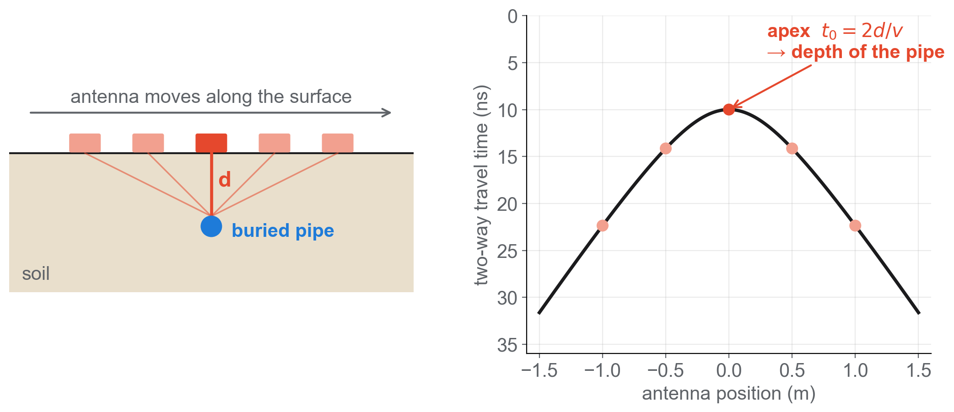
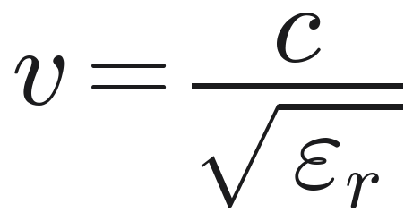
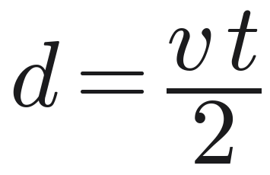
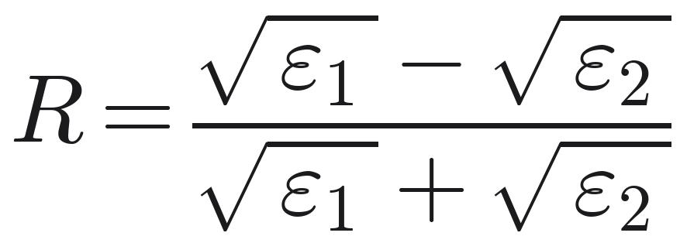
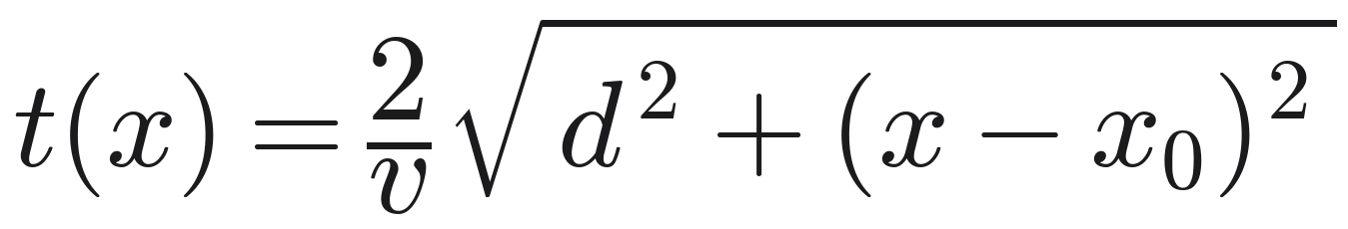
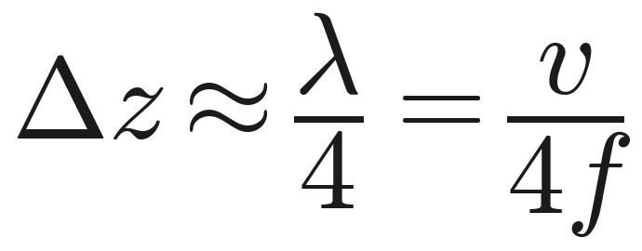
3.1 Principle of ground-penetrating radar
1 Introduction 2 Overview 3 Methods 4 Results 5 Conclusions
Wave speed
1
c = 0.3 m/ns · ε_{r}: relative permittivity of the ground
Depth
2
t: two-way travel time, down and back
Pulse–echo, like ultrasound
Pulse → echo at an interface → time gives depth. The wave is electromagnetic: no contact, no couplant.
Reflection coefficient
3
ε₁, ε₂: either side of the interface · metal: R = −1 · air: R > 0
Resolution vs. depth
Hyperbola
250 MHz ≈ 10 cm · deeper
700 MHz ≈ 3.6 cm · sharper
4
x₀: target position · apex t₀ = 2d / v
Daniels (2004) [1]; Jol (2009) [2]; ASTM D6432-19. Resolution at v = 0.10 m/ns.
Notes:
[3:10–4:05] GPR is the pulse-echo method from this course — but with radio waves instead of ultrasound, so it needs no contact with the ground.
(1) The wave speed depends on the relative permittivity of the ground. (2) Depth is speed times the two-way time, divided by two.
(3) Energy reflects wherever the permittivity changes. The sign matters: metal reflects with R = −1, an air-filled pipe with a positive R — so metal and an empty pipe have opposite polarity. (A water-filled pipe reflects with the same sign as metal, only weaker.)
(4) As we push the antenna across a small target, the echo arrives earliest right above it — the target draws a hyperbola, and the apex gives its position and depth.
Resolution is about a quarter wavelength: 10 cm at 250 MHz, under 4 cm at 700 MHz. Lower frequency sees deeper, higher is sharper — our radar records both at once.

Slide 7
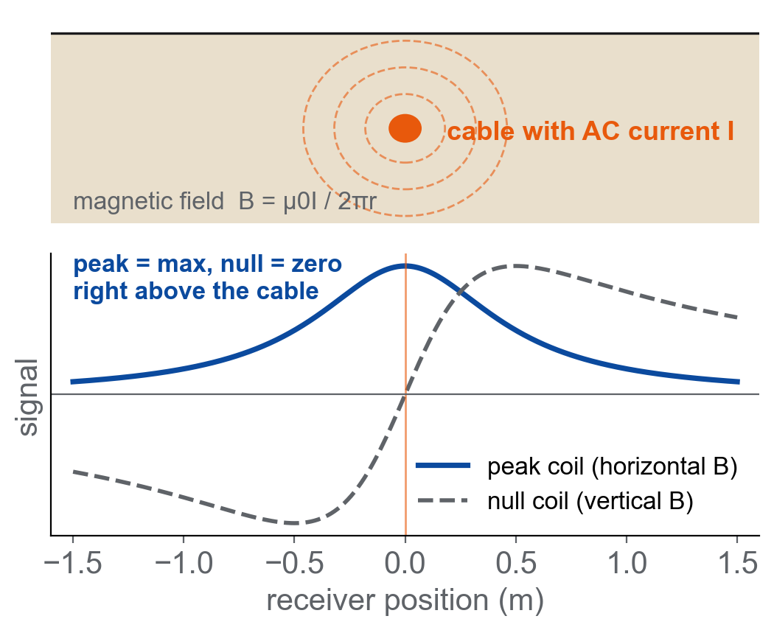
3.2 Principle of the electromagnetic locator (RD7000)
1 Introduction 2 Overview 3 Methods 4 Results 5 Conclusions
B = μ₀I / (2πr)
An AC current I in a buried conductor makes a circular magnetic field that falls off as 1/r.
Peak and null
Horizontal coil: maximum (peak) right above the line.
Vertical coil: zero (null) above the line; peak = null → undistorted field.
Two stacked coils give the depth (±5 %).
Modes and role in this work
Passive: Power 50/60 Hz, Radio VLF. Active: transmitter by direct connection, clamp, induction or sonde.
Sees metallic lines only — a plastic pipe is invisible, hence GPR.
Here: proposed cross-check of the cable depth (not yet measured).
Radiodetection RD7000+ manual; Metje et al. (2007) [3]
Notes:
[4:05–4:35] The second method is electromagnetic induction. An alternating current in a metal cable creates a magnetic field around it, falling off as one over r.
The receiver has coils: the horizontal coil gives a maximum — the peak — right above the cable, the vertical coil a zero — the null. When peak and null agree, the field is clean; two coils give the depth.
It is fast, but it only sees metal: a plastic water pipe is invisible. In our project it is the planned cross-check for the cable depth — we have not measured with it yet.

Slide 8
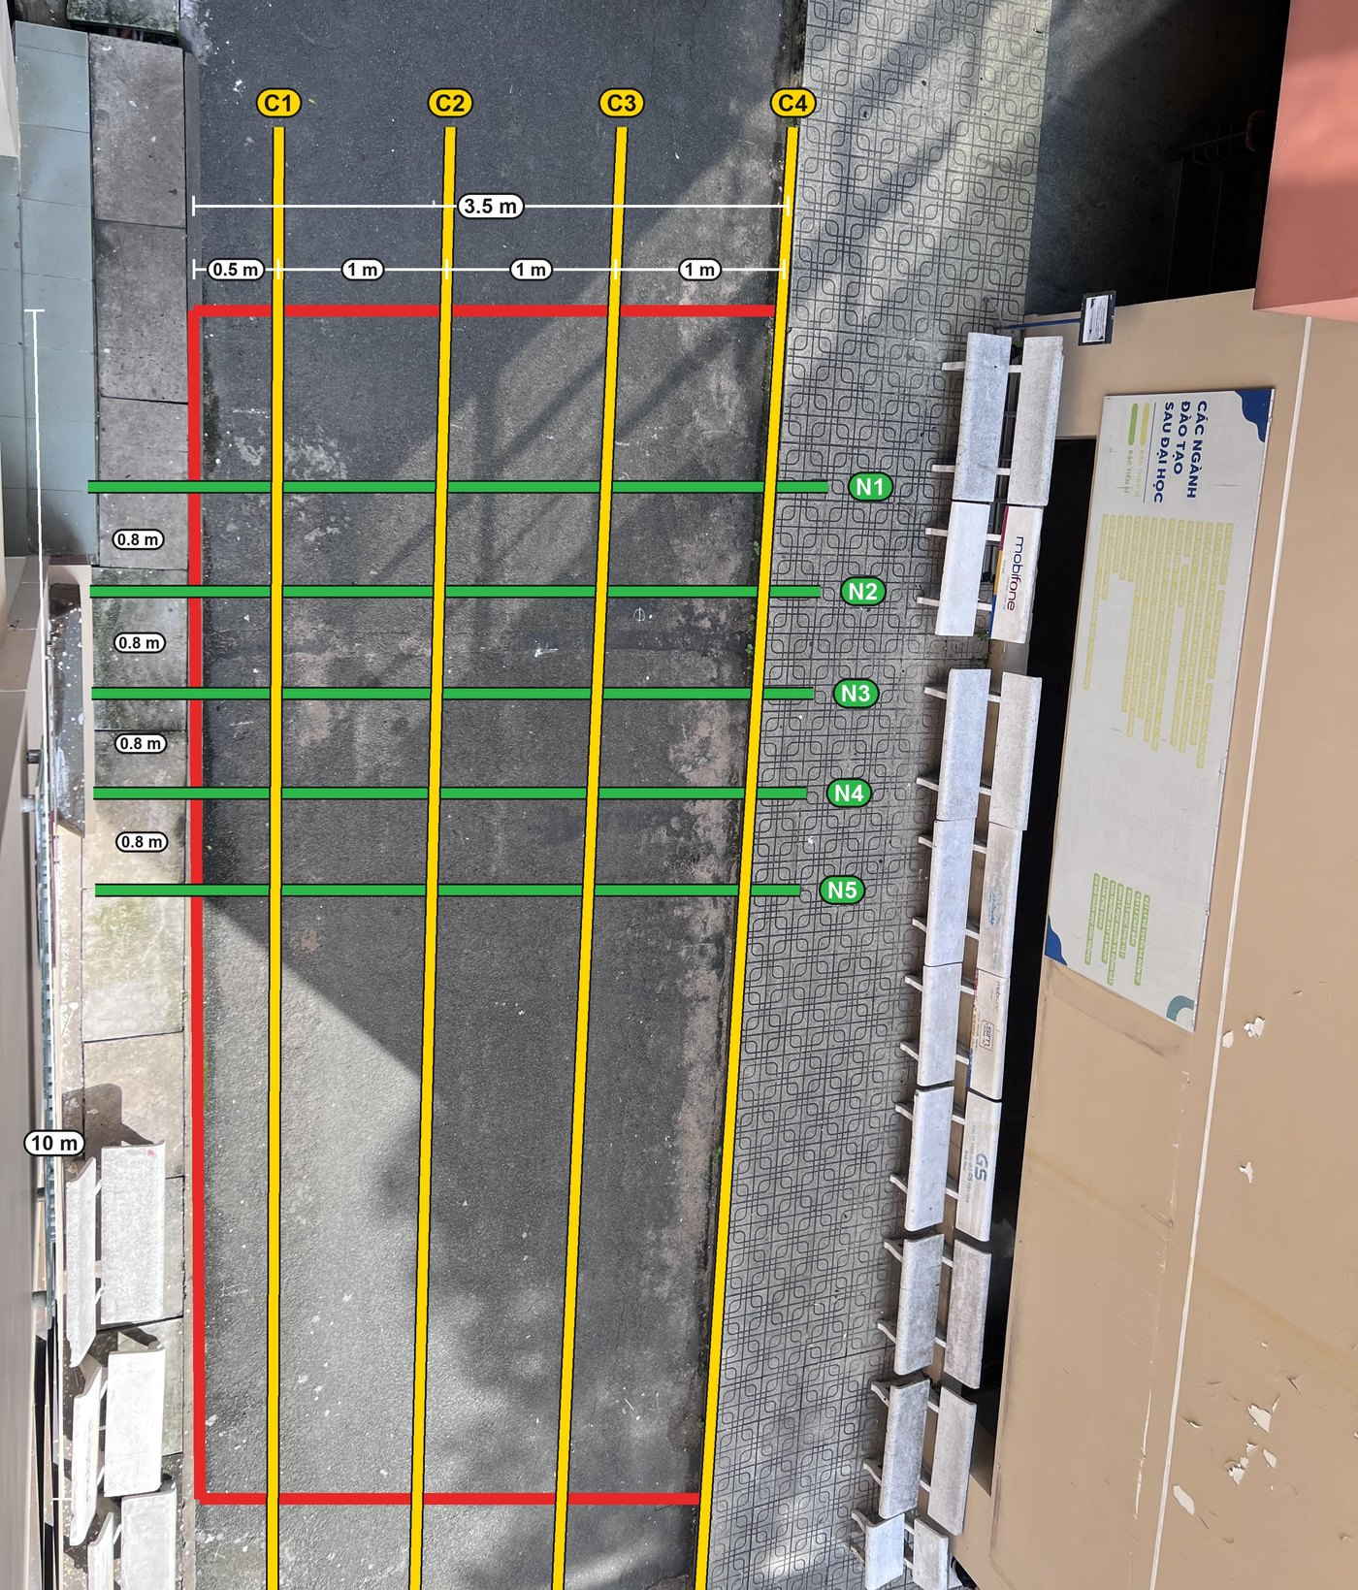
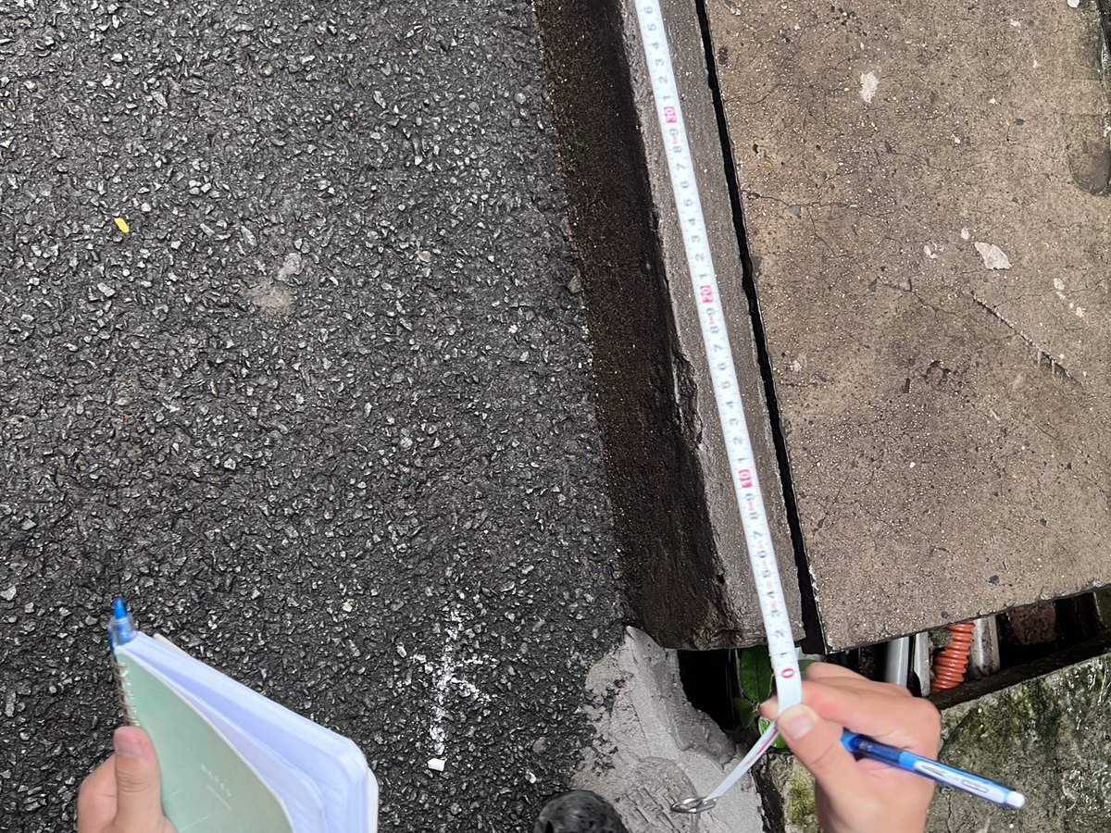
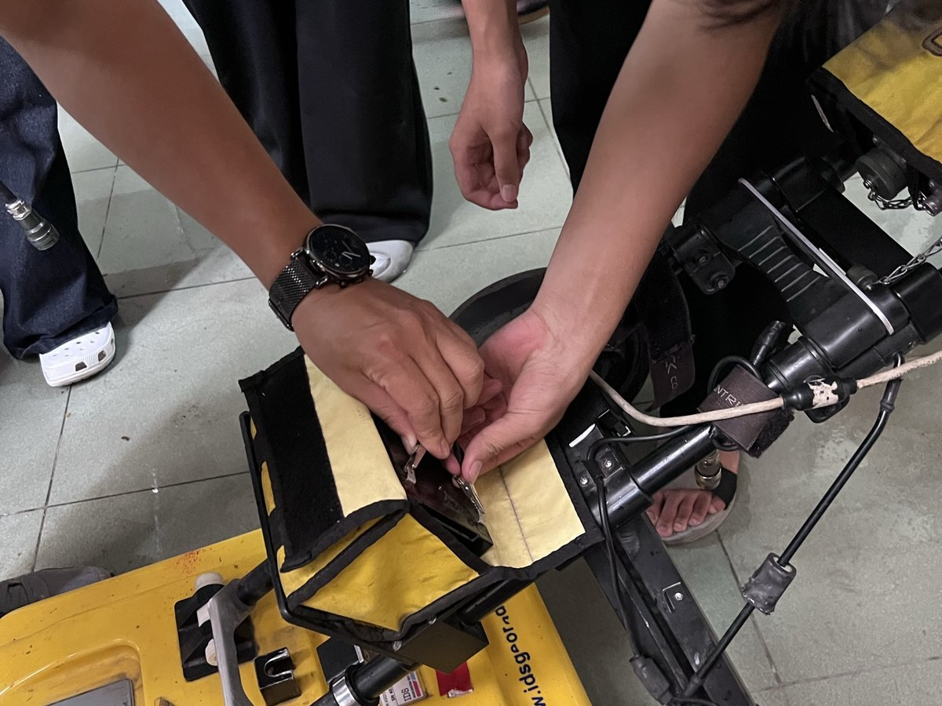
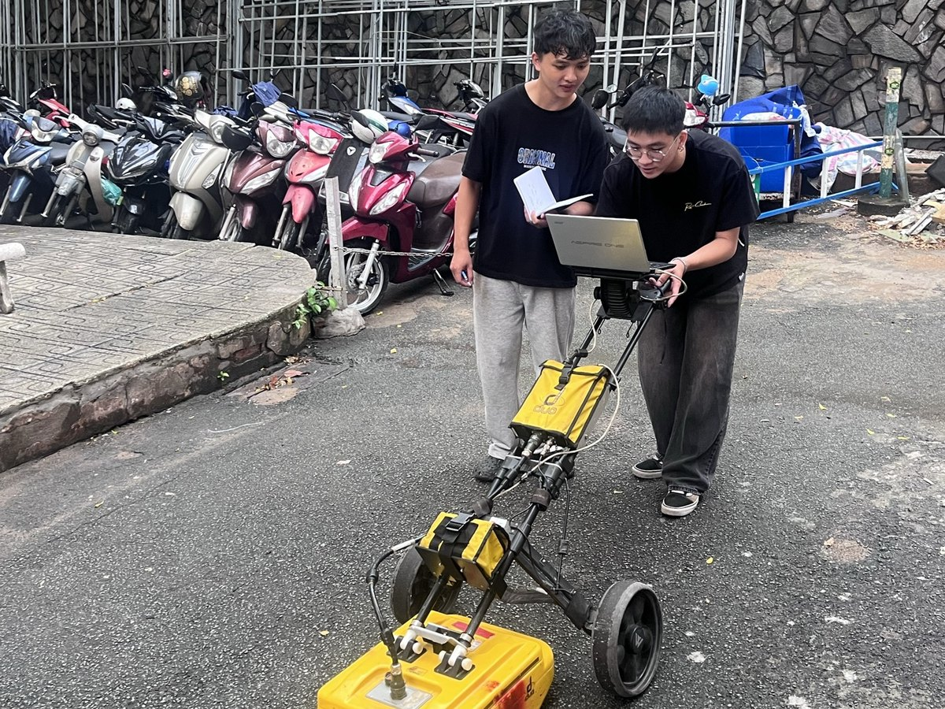
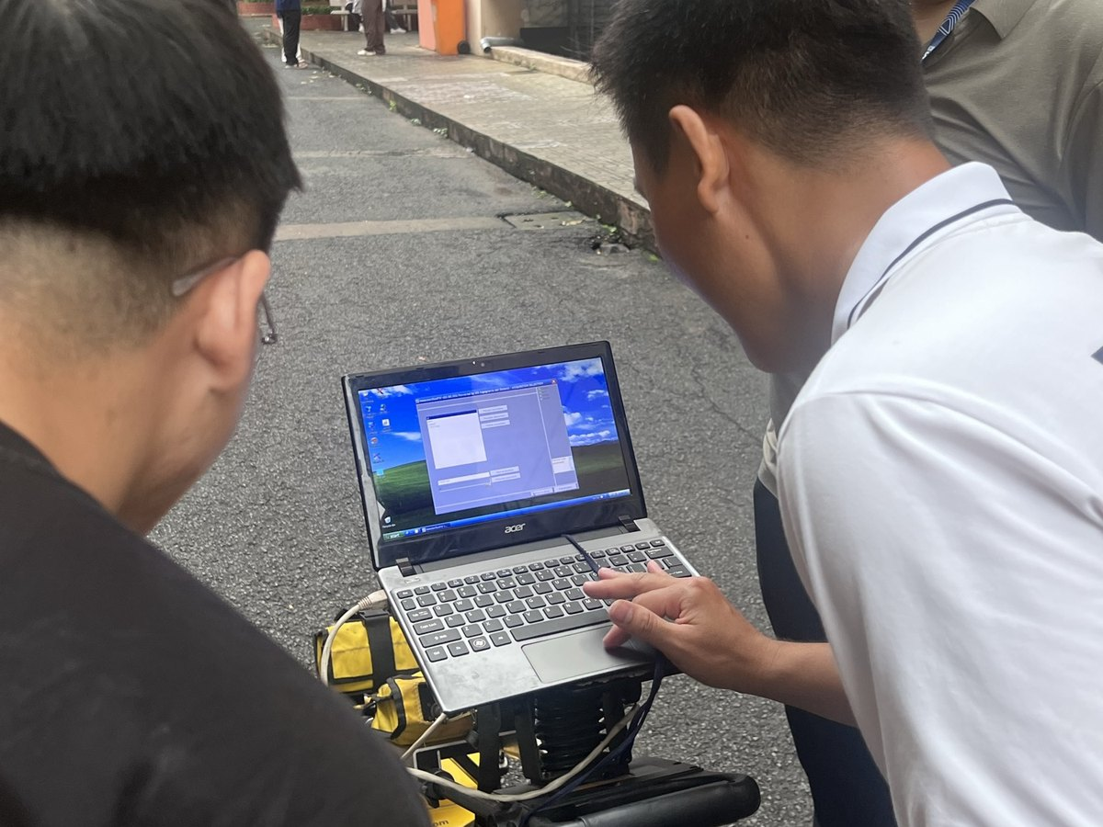
3.3 Field survey: a 10 m × 3.5 m grid of 9 lines
1 Introduction 2 Overview 3 Methods 4 Results 5 Conclusions
1 Mark the grid
2 Set up the radar
Parameter | Value
Radar | IDS Detector Duo
Antennas | 250 + 700 MHz, shielded
Trace interval | 2.78 cm
Lines | 4 C + 5 N, 1 repeat (N5)
Line layout | perpendicular to the target
Velocity (depth) | 0.12 | 0.10 m/ns
3 Scan each line
4 Check data on site
Why this layout: a target gives the clearest hyperbola when it is crossed at a right angle — C lines cross the cable, N lines cross the pipe.
C1–C4 along the road, 1 m apart → cable
N1–N5 across the road, ~0.8 m apart → pipe
Procedure after ASTM D6432-19 and PAS 128:2022. Velocity: 0.12 m/ns concrete, 0.10 m/ns soil (team 2-layer model).
Notes:
[4:35–5:25] This is how we measured, on the courtyard you saw.
We planned a grid, 10 metres by 3.5. A target gives the clearest hyperbola when we cross it at a right angle. The cable runs across the road, so four lines go along the road — C1 to C4, one metre apart. The water pipe runs along the road, so five lines cross it — N1 to N5.
[photos] We marked the lines, set up the IDS Detector Duo with its two antennas — 250 and 700 megahertz — pushed it along every line, and checked each radargram on the laptop before moving on.
[table] One trace every 2.78 cm, ten scans including a repeat of N5 to check repeatability.

Slide 9
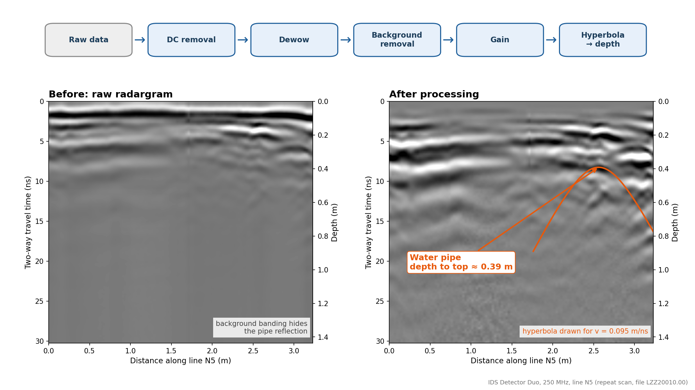
3.4 Data processing: from raw traces to depth
1 Introduction 2 Overview 3 Methods 4 Results 5 Conclusions
1
Move start time
time zero at the ground surface
2
DC removal + dewow
removes the slow drift of each trace
3
Background removal
deletes flat bands repeated on every trace
4
Gain
boosts weak, deeper echoes
5
Kirchhoff migration
collapses a hyperbola to its apex (v = 0.095 m/ns)
6
Time → depth
2-layer model: 0.12 m/ns concrete, 0.10 m/ns soil
Line N5 (repeat), 250 MHz: raw (left) and processed (right); the water-pipe hyperbola appears, depth to top ≈ 0.39 m.
Software: ReflexW (Sandmeier); figures and maps in Python. Migration methods: Özdemir et al. (2014).
Notes:
[5:25–6:05] Each processing step removes one problem. We move the start time to the ground surface; DC removal and dewow remove the slow drift; background removal deletes the bands that repeat on every trace; gain boosts the weak, deeper echoes.
[figure] Left: raw line N5 — the bands hide almost everything. Right: after processing, the water-pipe hyperbola is clear.
Migration with 0.095 m/ns collapses each hyperbola to its apex. For depths we use a two-layer model: 0.12 m/ns in the concrete, 0.10 in the soil.

Slide 10
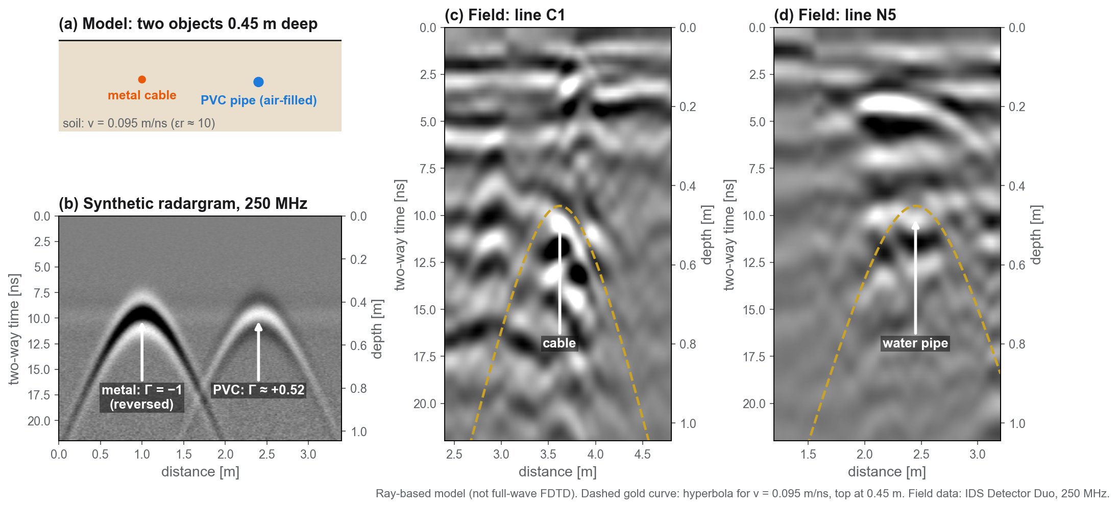
4.1 Model results: the model matches the field hyperbolas
1 Introduction 2 Overview 3 Methods 4 Results 5 Conclusions
Notes:
[6:05–6:40] Before trusting the field data, we built a simple model: soil with v = 0.095 m/ns, a metal cable and an air-filled PVC pipe, both 0.45 m deep, a 250 MHz pulse.
The model predicts a hyperbola with its apex at about 9.5 ns — and on the real lines C1 and N5 the measured hyperbolas follow the same curve, the dashed gold line.
It also shows the opposite polarity of metal and an air-filled pipe, from equation (3). This is a ray model; a gprMax input file is prepared for a full-wave simulation.

Slide 11
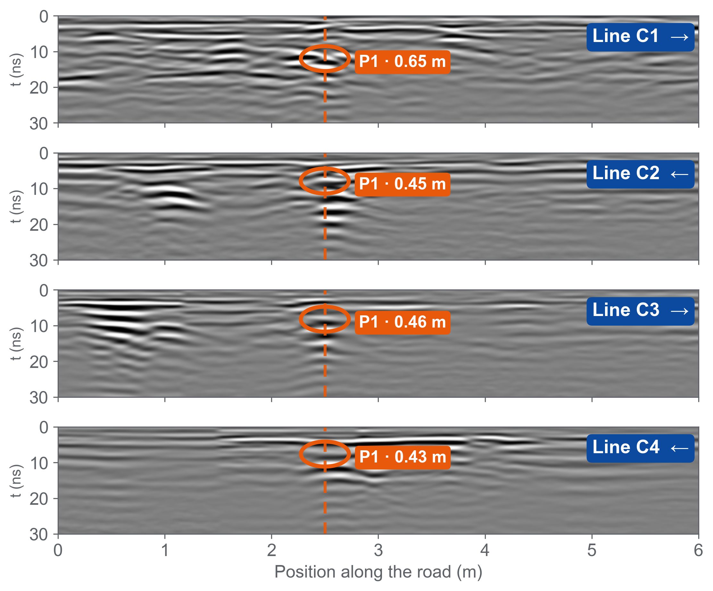
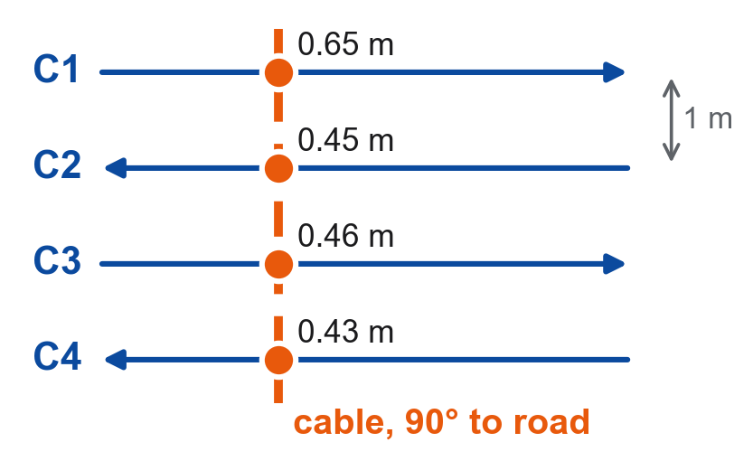
4.2 Field results: four aligned anomalies trace one power cable
1 Introduction 2 Overview 3 Methods 4 Results 5 Conclusions
Plan view
4 / 4
Same echo on every line
strong, ringing hyperbola → metal
90°
Straight across the road
C1, C3 at 2.50 m · field marks agree
≈ 0.45 m
Depth to the top
C2–C4: 0.43–0.46 m · C1: 0.65 m
250 MHz, lines C1–C4 (LZZ20001–20004; C3 = LZZ20003.11 flipped back), team picks. C2, C4 walked in reverse, placed from the cable marked on site.
Notes:
[6:40–7:20] One hyperbola alone could be anything — a stone, a pocket of fill. So we look for the same echo on neighbouring lines.
[left] Lines C1 to C4 run parallel, one metre apart, drawn on the same position axis. On every line we find the same anomaly, P1 — a strong hyperbola with a long ringing tail, typical of metal.
[dashed line] The four apexes sit in one column, at 2.5 m: the cable crosses the road at a right angle. That is also what we saw on site — the marks we made lined up straight across the road.
[cards] Depth to the top is about 0.45 m on C2 to C4, and 0.65 m on C1.
(If asked: C2 and C4 were walked in the opposite direction; we flipped them and placed their start so that P1 sits on the cable we marked. C1 and C3 agree at 2.50 m on their own.)

Slide 12
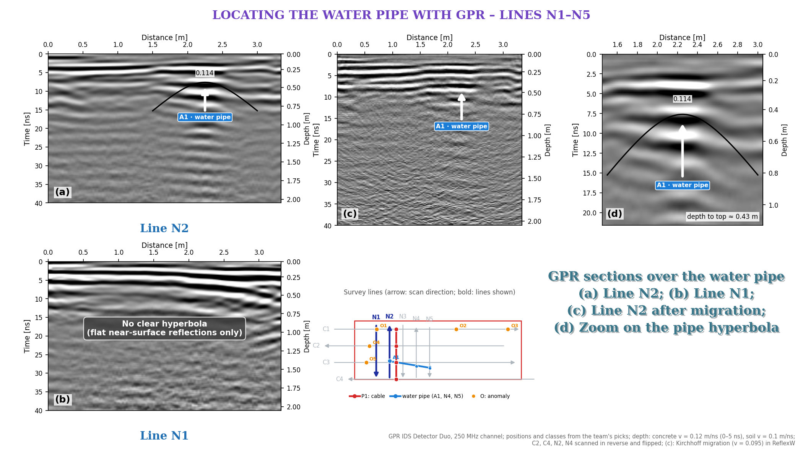
4.3 Field results: the water pipe on lines N1–N5
1 Introduction 2 Overview 3 Methods 4 Results 5 Conclusions
3 / 5
lines show the pipe hyperbola: N2, N4, N5
≈ 1 m
from the bench-side edge of the road (0.67–1.09 m)
0.43–0.59 m
depth to the top
N1: none
only flat pavement layers — we do not claim a pipe
250 MHz; (a) N2, (b) N1, (c) N2 after migration, (d) zoom on the pipe hyperbola. Depth: 0.12 m/ns concrete, 0.10 m/ns soil.
Notes:
[7:20–7:50] Same idea for the water pipe, on the lines across the road.
(a) N2: a clear hyperbola, A1; its top is about 0.43 m deep. We see the same pipe on N4 and N5 — about one metre from the bench-side edge of the road.
(b) N1: no clear hyperbola — only flat reflections from the pavement layers. We say so rather than guess.
(c) After migration this hyperbola does not focus well, so we do not claim a pipe size — (d) only zooms in on it.

Slide 13
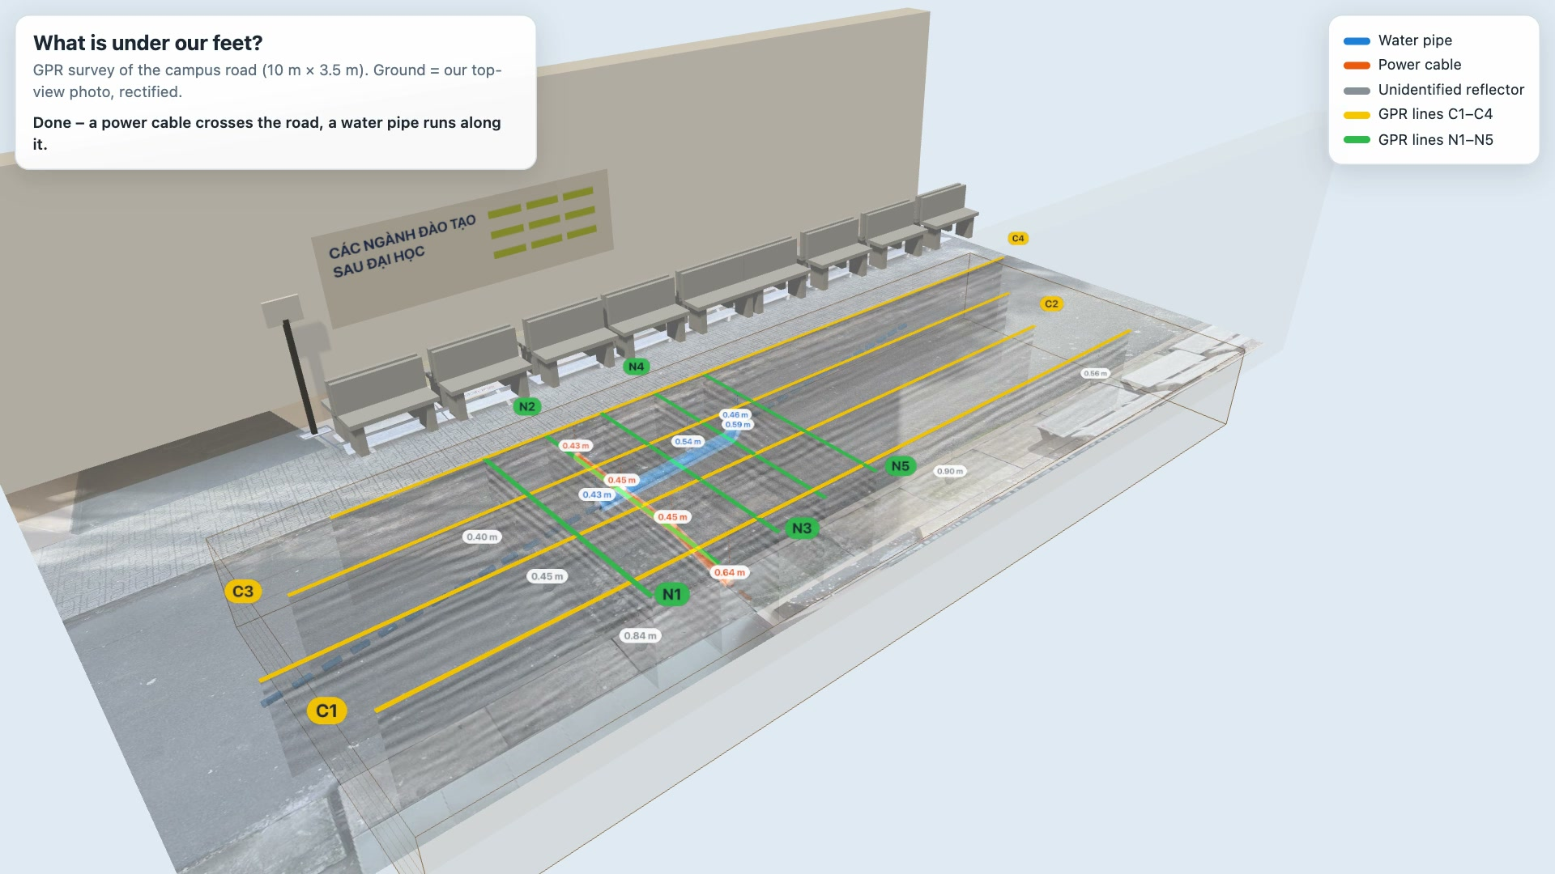
Notes:
[7:50–8:10] (4.4 – the video starts by itself, 19 s; the scanning part runs at 3× speed. Talk over it.)
This is our survey in 3D, built from the real data: the ground is our own top-view photo.
The radar cart scans each line — every C line, then every N line — and under each line its radargram appears.
At the end, the hyperbola apexes are joined: the orange cable straight across the road, the blue water pipe along it.
(Live version for questions: open 02_SoDoTuyen_BanDo/ket_qua/Canh3D_HienTruong.html in a browser and click the pipe or cable.)

Slide 14
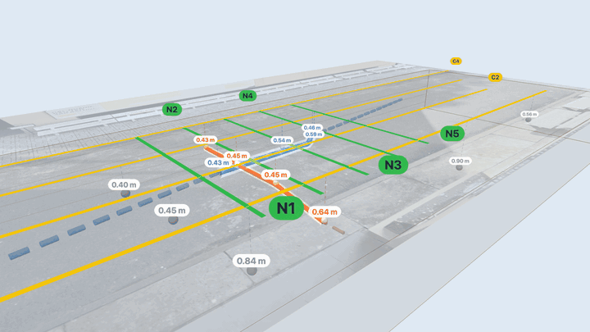
4.5 Results summary and evaluation
1 Introduction 2 Overview 3 Methods 4 Results 5 Conclusions
Target | Seen on | Path | Depth to top | Confidence
Power cable | C1–C4 (4/4) | across the road, 90° | 0.43–0.65 m | High
Water pipe | N2, N4, N5 (3/5) | along the road, ~1 m from the edge | 0.43–0.59 m | Medium
Other reflectors O1–O5 | 1 line each | – | 0.26–0.90 m | Low
Evaluation
360° view, ground made transparent · blue = water pipe · orange = power cable · labels = depth to top
Cable: the same ringing echo on 4 parallel lines, in line with the marks made on site.
Pipe: seen on 3 of 5 crossing lines; the path between lines is interpolated.
O1–O5 appear on one line only, so they are not interpreted.
Depth uncertainty: the 2-layer model and the migration velocity (0.095 m/ns) give depths ~20 % apart — about ±0.1 m at 0.5 m.
Notes:
[8:10–8:55] So, what is under our feet?
[table] A power cable crosses the road at a right angle, about 0.45 m to its top — seen on all four lines: high confidence.
A water pipe runs along the road, about a metre from the bench-side edge, 0.43 to 0.59 m deep — seen on three of five lines: medium confidence.
Five other reflectors appear on one line only — we do not claim what they are.
[bottom left] The main uncertainty is the wave speed: two velocity models give depths about 20 % apart.
In Kaohsiung, nobody could see the pipe. Here, we can.

Slide 15
5 Conclusions and recommendations
1 Introduction 2 Overview 3 Methods 4 Results 5 Conclusions
Conclusions
Limitations → recommendations
1
GPR located a power cable and a water pipe under asphalt — without digging.
Depth depends on the velocity: our 2-layer model vs 0.095 m/ns shifts depths by ~20 %.
Crossing the target at a right angle is what makes the hyperbola visible.
→ Calibrate with the RD7000 or one small test pit.
2
Line positions were paced, not surveyed: lines walked backwards had to be placed from our field marks.
3
700 MHz gives sharp images, 250 MHz sees deeper — using both is safer.
→ Fix line positions with GPS or a total station.
28 % of utility strikes in the US are traced to locating errors (CGA, 2019). Locating well is exactly what GPR is for.
Notes:
[8:55–9:40] Three conclusions.
One: with nine lines on a small grid, GPR found a cable and a water pipe under asphalt — no digging. The key was finding the same echo on neighbouring lines.
Two: geometry matters — crossing the target at a right angle is what makes the hyperbola appear.
Three: the two antennas complement each other — 700 MHz is sharper, 250 MHz goes deeper.
Two limits. Our depths depend on the wave speed — next time we calibrate with the RD7000 or one small test pit. And our line positions were set by hand — a GPS or a total station would make the map more accurate.
More than a quarter of utility strikes start with a locating mistake. Locating well is exactly what GPR is for.

Slide 16
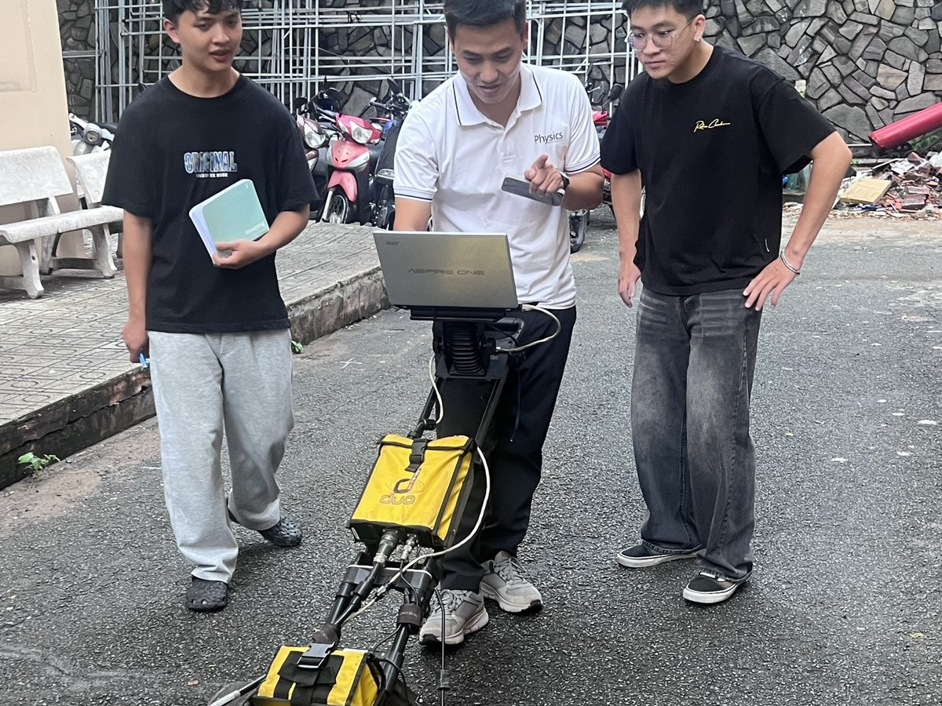
References
What is under our feet?
[1] Daniels, D. J. (2004). Ground Penetrating Radar, 2nd ed. IET.
[2] Jol, H. M. (2009). Ground Penetrating Radar: Theory and Applications. Elsevier.
[3] Metje, N. et al. (2007). Mapping the Underworld – state-of-the-art review. Tunn. Undergr. Space Technol. 22, 568–586.
[4] Royal, A. C. D. et al. (2011). Site assessment of multiple-sensor approaches for buried utility detection. Int. J. Geophys.
[5] Lai, W. W.-L., Dérobert, X., Annan, P. (2018). A review of GPR application in civil engineering. NDT & E Int. 96, 58–78.
[6] Nguyễn Thành Vấn et al. (2018). GPRTVN – processing GPR data software. Sci. Technol. Dev. J. – Nat. Sci. 2(5), 97–104.
[7] Đặng Hoàng Duy et al. (2020). Data analysis of 2D GPR profiles in 3D space. Sci. Technol. Dev. J. – Nat. Sci. 3(3), 169–179.
[8] Common Ground Alliance (2020). DIRT Report 2019. · ASTM D6432-19. · PAS 128:2022.
Now we know.
Thank you — Questions?
Our team
Quốc Long
Quốc Tài
Thành Trung
Đăng Khoa
Đăng Quang
Group [ ] · Supervisor: [ ]
Non-Destructive Testing Methods · HCMUS
Notes:
[9:40–10:00] At the start we asked: what is under our feet? Now we know — a cable crossing the road and a water pipe along it, about half a metre down.
Thank you for listening. We are happy to take your questions.
(Backup slides follow: plan-view map, depth slices, cable sections C1/C3, migration on line C1.)

Slide 17
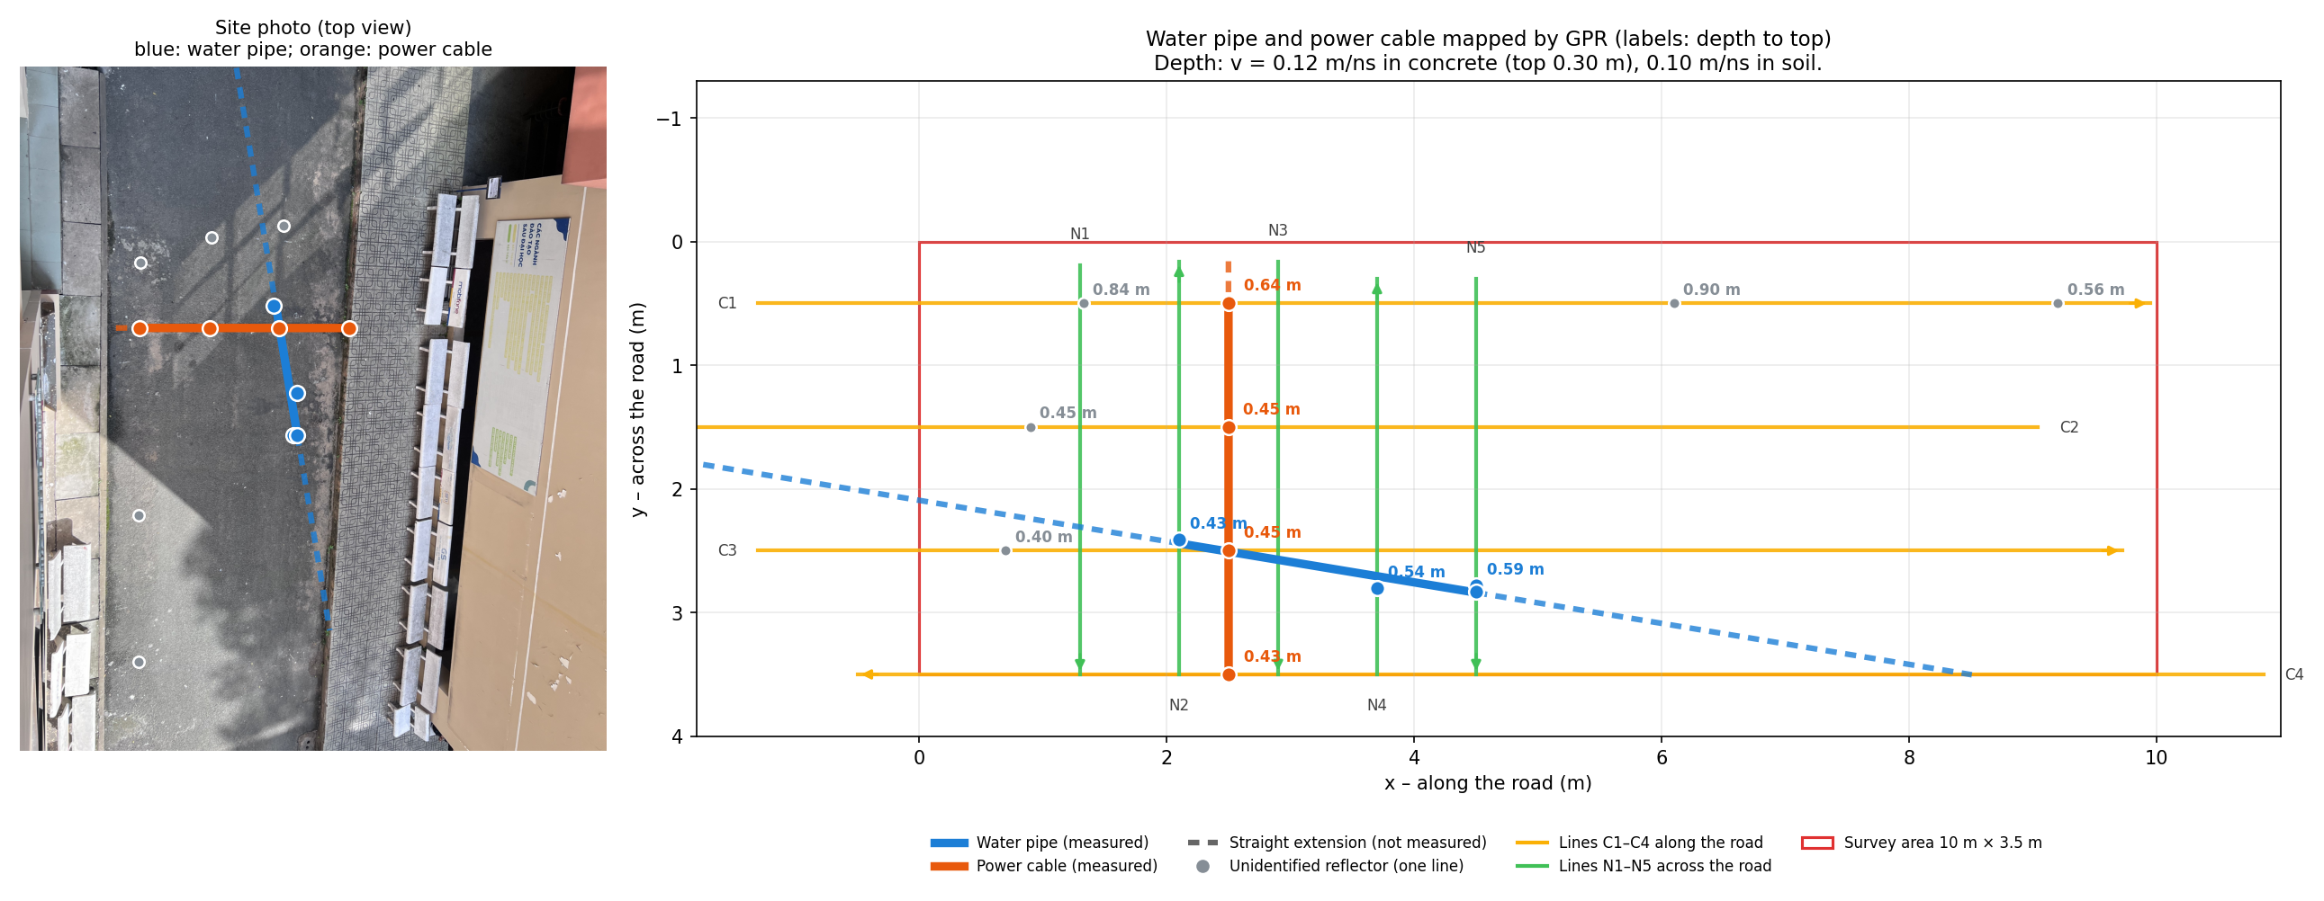
Backup · Plan view: every target with its depth
Notes:
Use if asked where exactly each point was measured, or about the dashed extensions.

Slide 18
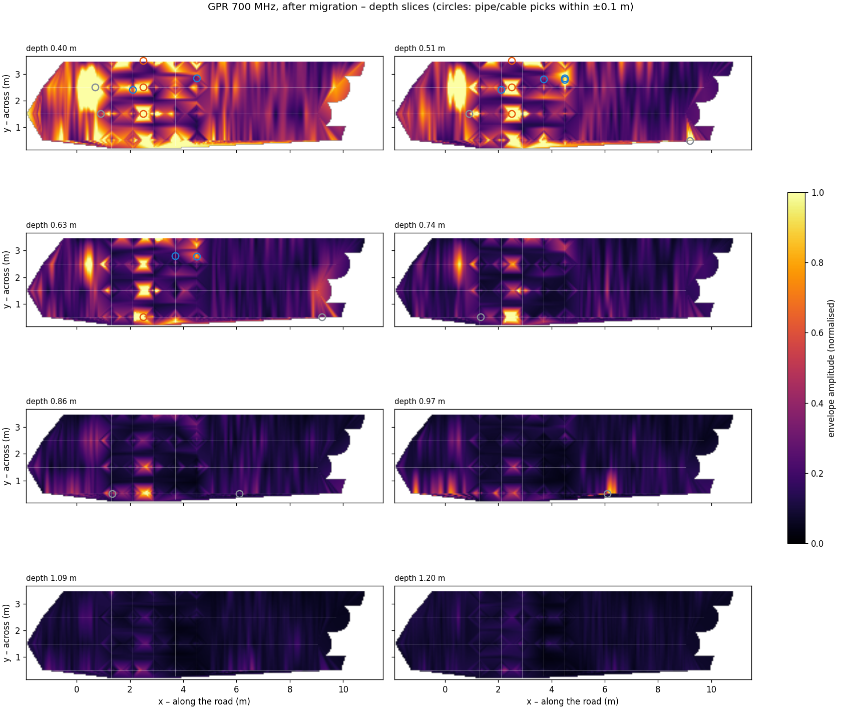
Backup · Depth slices (C-scan) of the 700 MHz data
Notes:
Use if asked at which depth the targets appear. Amplitude between lines is interpolated; cells far from any line are left blank.

Slide 19
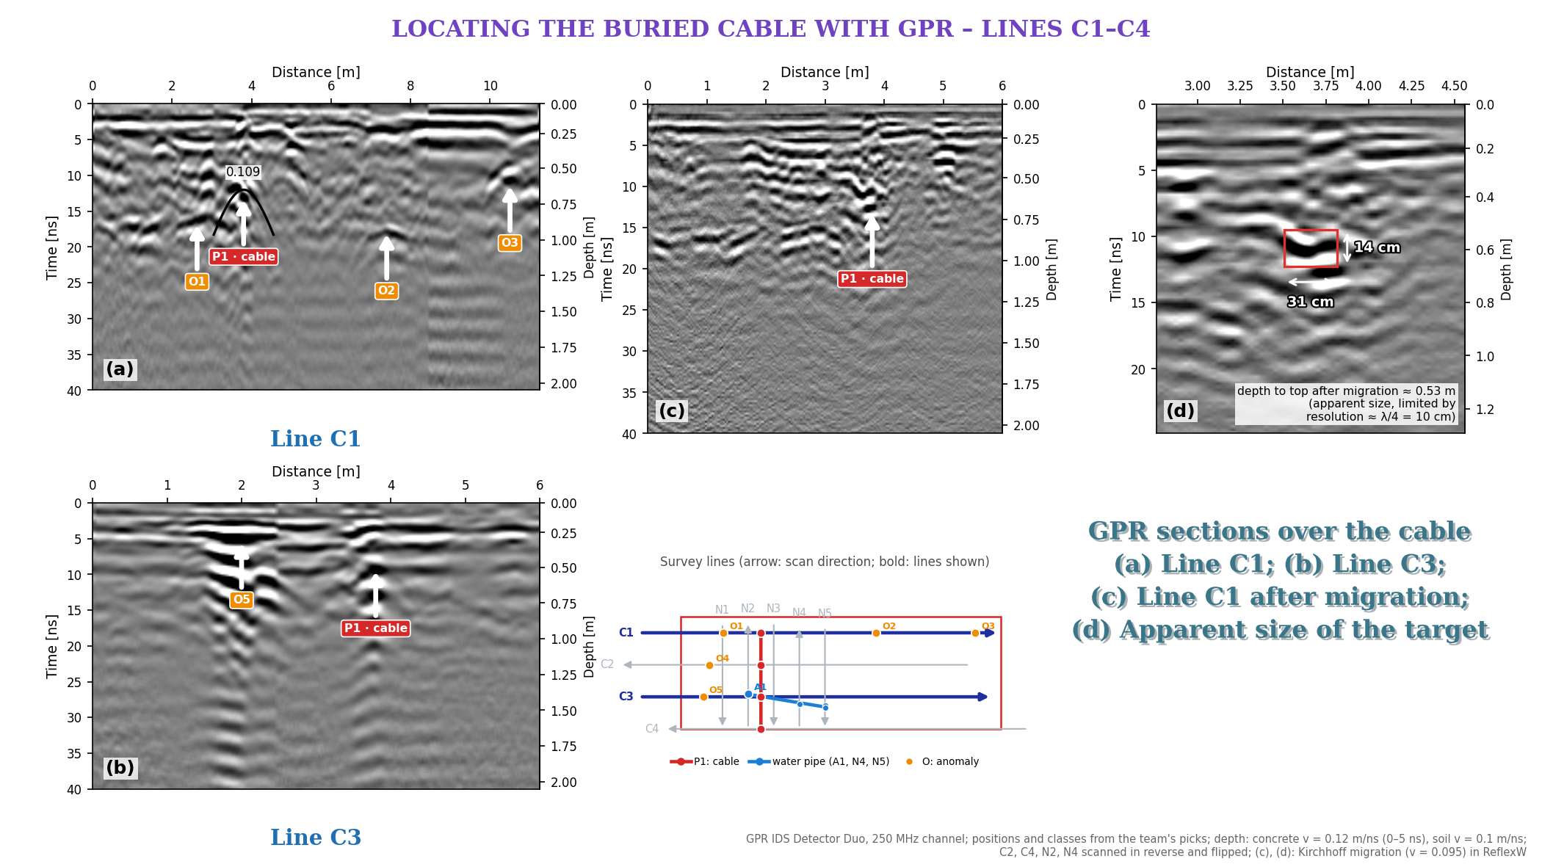
Backup · GPR sections over the cable: lines C1 and C3
Notes:
Use if asked to see the raw sections: (a) C1 and (b) C3 with P1 in red, other anomalies in orange; (c) C1 after Kirchhoff migration; (d) apparent size ~31 × 14 cm, limited by the ~10 cm resolution.

Slide 20
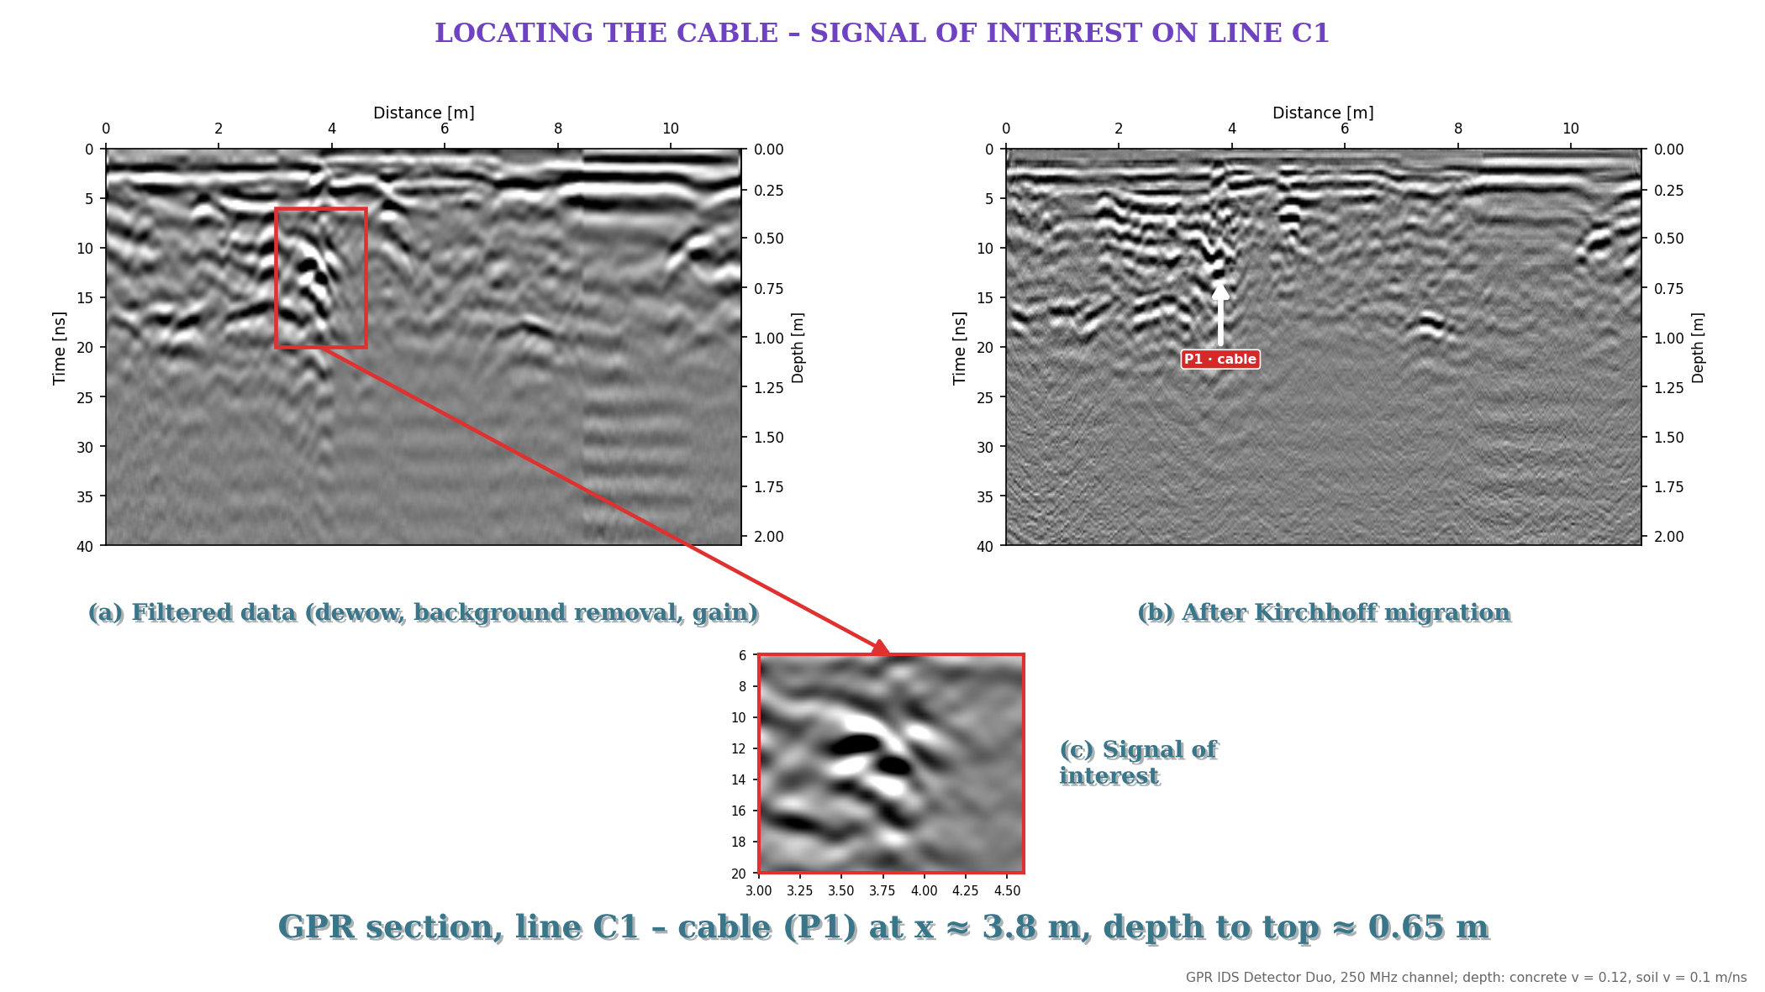
Backup · What migration does: line C1 before and after
Notes:
Use if asked what migration does: (a) filtered line C1 with the cable region boxed, (b) after Kirchhoff migration, (c) zoom on the signal of interest.

