Slide 1
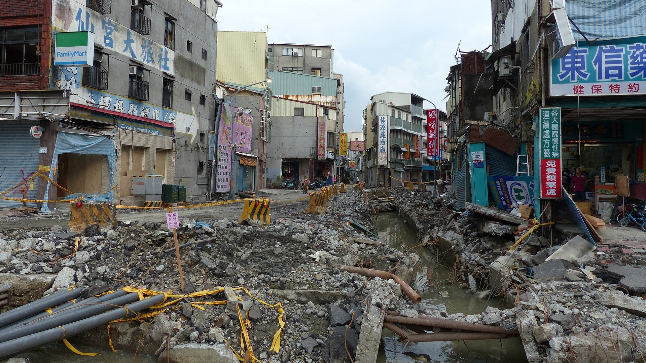

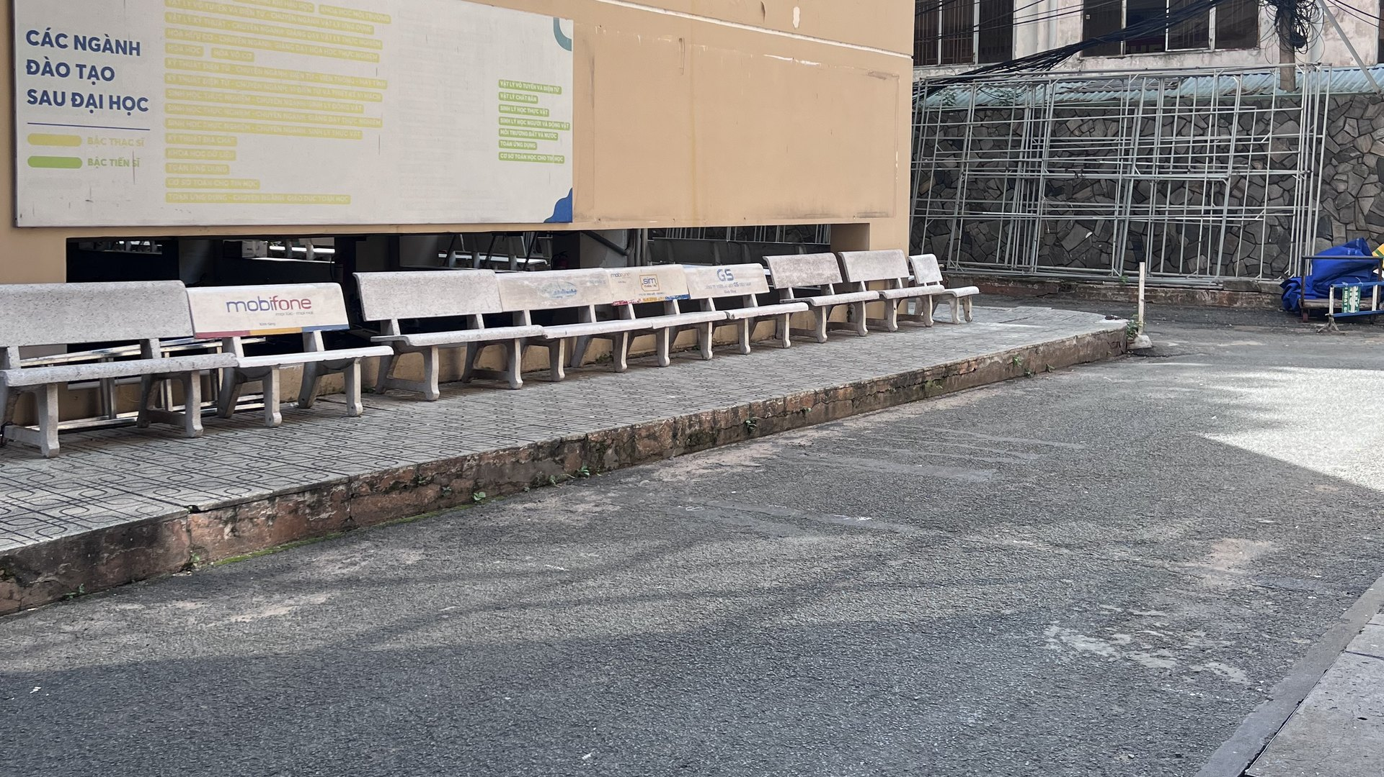


This courtyard · HCMUS campus
And this is not rare.
500,000+
$30B
32 dead
31 JULY 2014
buried utilities hit by digging each year (US)
in damage, every year
321 injured
Kaohsiung, Taiwan
What is under our feet?
“Dig up any street, and you hit a spider web.”
A leaking pipe under the street.
Nobody could see it.
— headline, Người Lao Động newspaper, Ho Chi Minh City (translated)
Ground Penetrating Radar for Underground Cables and Utilities
Group [name] · Supervisor: [name] · Non-Destructive Testing Methods · Faculty of Physics – HCMUS
Sources: Common Ground Alliance, DIRT Report 2019 · nld.com.vn
Sanduo 1st Rd, Kaohsiung, 11 Aug 2014 · Photo: 玄史生 / Wikimedia Commons · CC BY-SA 4.0
Notes:
[Black screen. Stand still, look at the audience, 2 seconds of silence.]
July 31st, 2014. Kaohsiung, Taiwan.
Late in the evening, people on the street begin to smell gas.
Firefighters arrive. They search for the leak — for almost three hours.
They cannot find it. [pause 1 s]
[CLICK 1] Just before midnight, the street explodes.
Thirty-two people dead. Three hundred and twenty-one injured.
The cause? A leaking pipe — buried right under their feet — that nobody could see.
[CLICK 2] And this is not rare. In the US alone, buried utilities are hit more than half a million times a year.
Here in Ho Chi Minh City, newspapers put it simply: dig up any street, and you hit a spider web.
[CLICK 3] Now look at this. Our own campus. We walk across it every day.
Under this asphalt there is a water pipe and a power cable — and no drawing of where they are.
If someone digs here tomorrow… where is it safe?
Today, we will answer that — without digging a single hole.
[Then one sentence: "We are group …, and this is GPR for underground utilities."]
CHECK BEFORE PRESENTING: confirm the timeline (~20:46 gas reports, explosions ~23:57) on Wikipedia "2014 Kaohsiung gas explosions".

