Slide 1
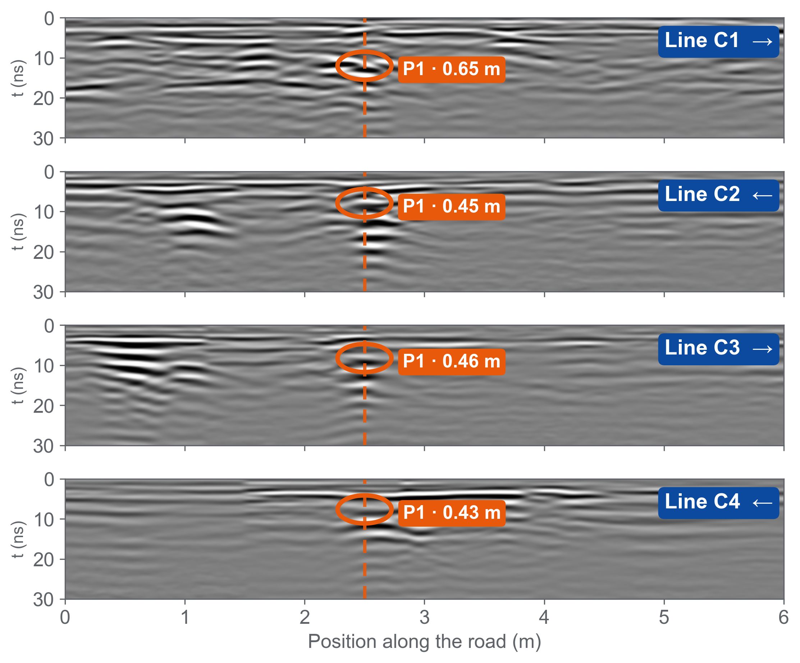
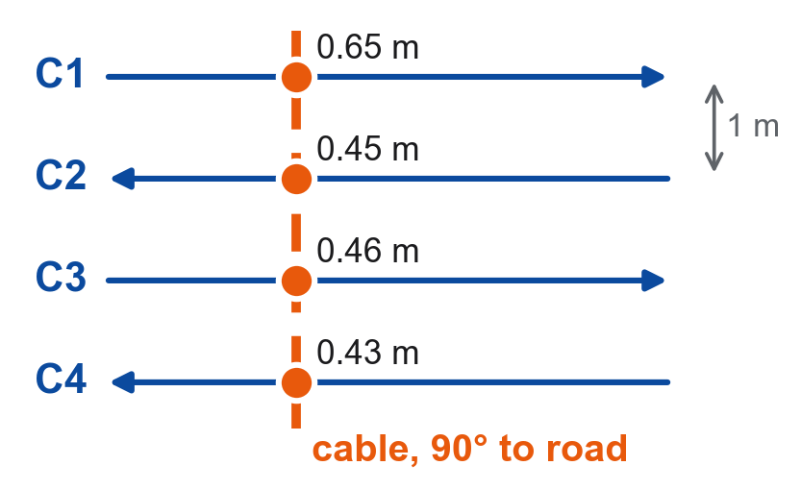
Four aligned anomalies trace one buried cable
Plan view
4 / 4
Same echo on every line
strong, ringing hyperbola → metal
90°
Straight across the road
C1, C3 at 2.50 m · field marks agree
≈ 0.45 m
Depth to the top
C2–C4: 0.43–0.46 m · C1: 0.65 m
250 MHz, lines C1–C4 (LZZ20001–20004; C3 = LZZ20003.11 flipped back), team picks. Depth: 0.12 m/ns concrete, 0.10 m/ns soil. C2, C4 walked in reverse, placed from the cable marked on site.
Notes:
[~40 s] One hyperbola alone could be anything — a stone, a pocket of fill. So we look for the same echo on neighbouring lines.
[left, top to bottom] Lines C1 to C4 run parallel, one metre apart, drawn on the same position axis. On every line we find the same anomaly, P1 — a strong hyperbola with a long ringing tail, typical of metal.
[dashed line] The four tops sit in one column, at 2.5 m: the cable crosses the road straight, at a right angle. That is also what we saw on site — each time we hit the anomaly we marked the ground, and the marks lined up straight across the road.
[cards] Depth to the top is about 0.45 m on C2 to C4, and a little deeper on C1, 0.65 m.
(If asked: C2 and C4 were walked in the opposite direction. We flipped them, as the team did in ReflexW, and placed their start so that P1 sits on the cable we marked. C1 and C3, walked forward, already agree at 2.50 m on their own.)

