Slide 1
GUI Data Manipulation and Persistence Using RDO, DTO, and ORM
A Layered Approach to Data Management
Presented by: [Alfred Glänzer]

Slide 2
Agenda
What is a Rich Data Object (RDO)?
What is a Data Transfer Object (DTO)?
The Role of ORM
Architecture Overview
Use Case Example
Benefits of This Approach
Summary and Q&A

Slide 3
What is an RDO?
A Rich Data Object is used in the presentation layer
Encapsulates business logic, validation rules, and UI-related behavior
Supports GUI binding and manipulation
Example: A ProductProfileRDO with display formatting, validation, etc.

Slide 4
What is a DTO?
A Data Transfer Object is used for data persistence and transport
Contains a flat data structure, no behavior
Typically maps directly to a database table
Example: A ProductProfileDTO with just the raw product data

Slide 5
Role of ORM
Object-Relational Mapping bridges objects and relational databases
Converts DTOs into database records and vice versa
Common tools: mORMot[2], dopf, tiopf
Separates business logic (RDO) from persistence concerns (DTO)

Slide 6
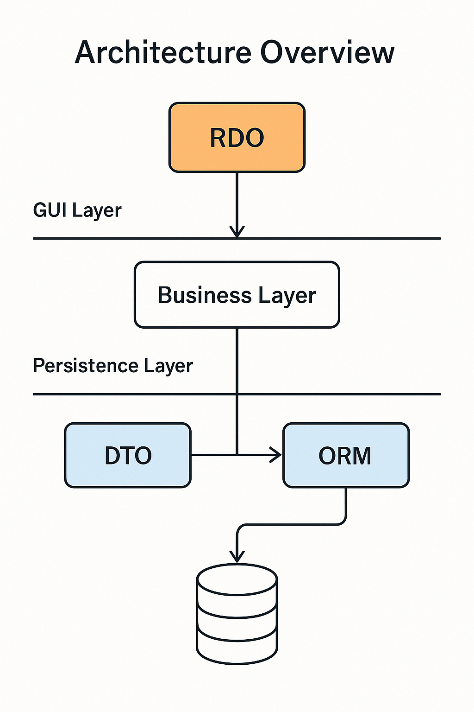
Architecture Overview
Layers:
- GUI Layer: RDOs manipulated by users
- Business Layer: Converts RDOs to/from DTOs
- Persistence Layer: persist DTOs by ORM to DB

Slide 7
Use Case Example
Scenario: Editing a User Profile
- GUI loads a ProductProfileDTO from DB (via ORM)
- Transforms it into ProductProfileRDO for GUI interaction
- User edits the RDO
- App transforms RDO back into DTO
- ORM saves DTO to DB

Slide 8
Benefits
Separation of concerns: GUI logic vs. persistence logic
Flexibility: RDOs can adapt to complex UI needs
Maintainability: DTOs remain stable and DB-friendly
Reusability: DTOs can be reused across services

Slide 9
Summary
RDOs: Rich, UI-centric, business logic-enabled
DTOs: Lightweight, persistence-focused
ORM: Automates object-to-database conversion
Enables a clean, scalable architecture

Slide 10
[Pros of] Using TCollection as RDO
1. Encapsulation of Complex Structures
TCollection holds TCollectionItem instances, making it ideal for representing complex data lists in GUIs (e.g., a list of user addresses).
2. Native Integration with GUI Components
Many visual components in Lazarus and Delphi bind well to TCollection, easing GUI development.
3. Custom Behavior per Item
You can subclass TCollectionItem to include validation, formatting, computed properties, or even change-tracking logic — aligning well with the RDO pattern.
4. Serialization and Persistence Friendly
TCollection supports streaming via TPersistent, easing transformations between GUI state and storage formats.

Slide 11
TCollection and RTTI
1. Automated Serialization / Deserialization
RTTI allows you to dynamically inspect the properties of TCollectionItem subclasses. This makes it possible to serialize RDOs to JSON, XML, or persist them through a custom ORM layer without hardcoding every property.
2. Dynamic GUI Binding
RTTI lets you build or update GUI elements (e.g., property editors, grids, forms) automatically based on the RDO's structure.
For instance, a property inspector could show editable fields for each TCollectionItem without manual UI definitions.
3. Cleaner Code Through Generic Utilities
With RTTI, you can write generic utility functions to:
Clone RDOs
Map between RDO and DTO
All without writing type-specific code for each TCollectionItem subclass.
4. Dynamic ORM Mapping
If you're using or building a custom ORM, RTTI can auto-map RDOs to DTOs or DB tables. Generate SQL or API payloads automatically. Extract field names, types, and annotations.

Slide 12
Conclusion
1. TCollection is powerful for GUI-bound RDOs in FPC and Lazarus / Delphi
2. RTTI makes RDOs more flexible, automatable, and metadata-driven
3. Add meta-data through attributes
https://wiki.lazarus.freepascal.org/Custom_Attributes
4. Ideal for dynamic forms, inspectors, and custom ORM solutions

Slide 13
Questions & Discussion
Thank you!
Any questions?

