Slide 1
AI Controlled Spaceship
CS 4795
Gavin Long

Slide 2
Topic
Goal
Method
Starting in orbit around Earth, reach the moon.
Try to reach the moon as soon as possible
Train a Feed-forward neural network to travel the distance from the earth to the moon.

Slide 3
Why I Chose This Topic
Why Controlling a Spaceship?
I am interested in AI controlled movement in a simulated environment
Why Space?
Space provides a good balance of complexity of movement and simplicity of controls
I already had a simulation about space movement to use as a base

Slide 4
My Implementation

Slide 5
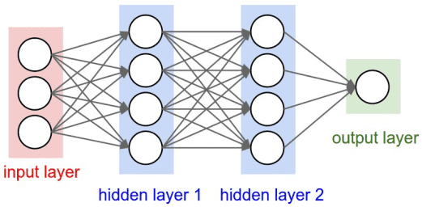
My AI
AI Layout
Feed-Forward Neural Network
Training Algorithm
Evolutionary Selection Algorithm
Agents are scored based on performance

Slide 6
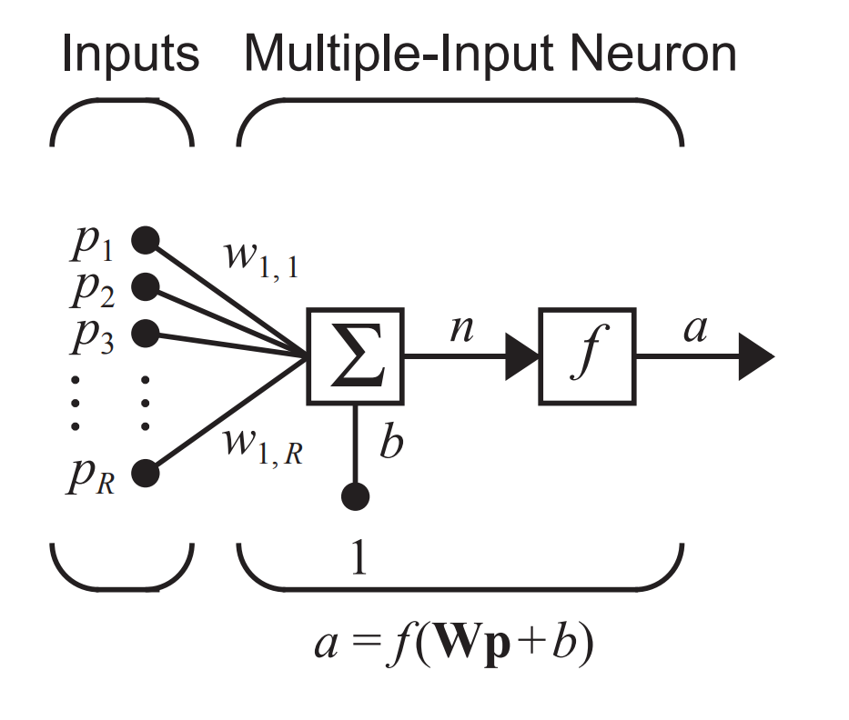
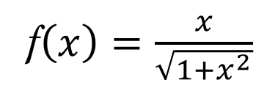
My Network Design
Each neuron is defined as a series of inputs, a weight for each input, a bias value and an activation function
The network is designed as multiple layers of stacked neurons where each neuron is connected to every neuron in the next layer
The size of my network remains constant throughout training
Activation Function
f$\left(x\right)=\frac{x}{\sqrt{1+x^{2}}}$

Slide 7
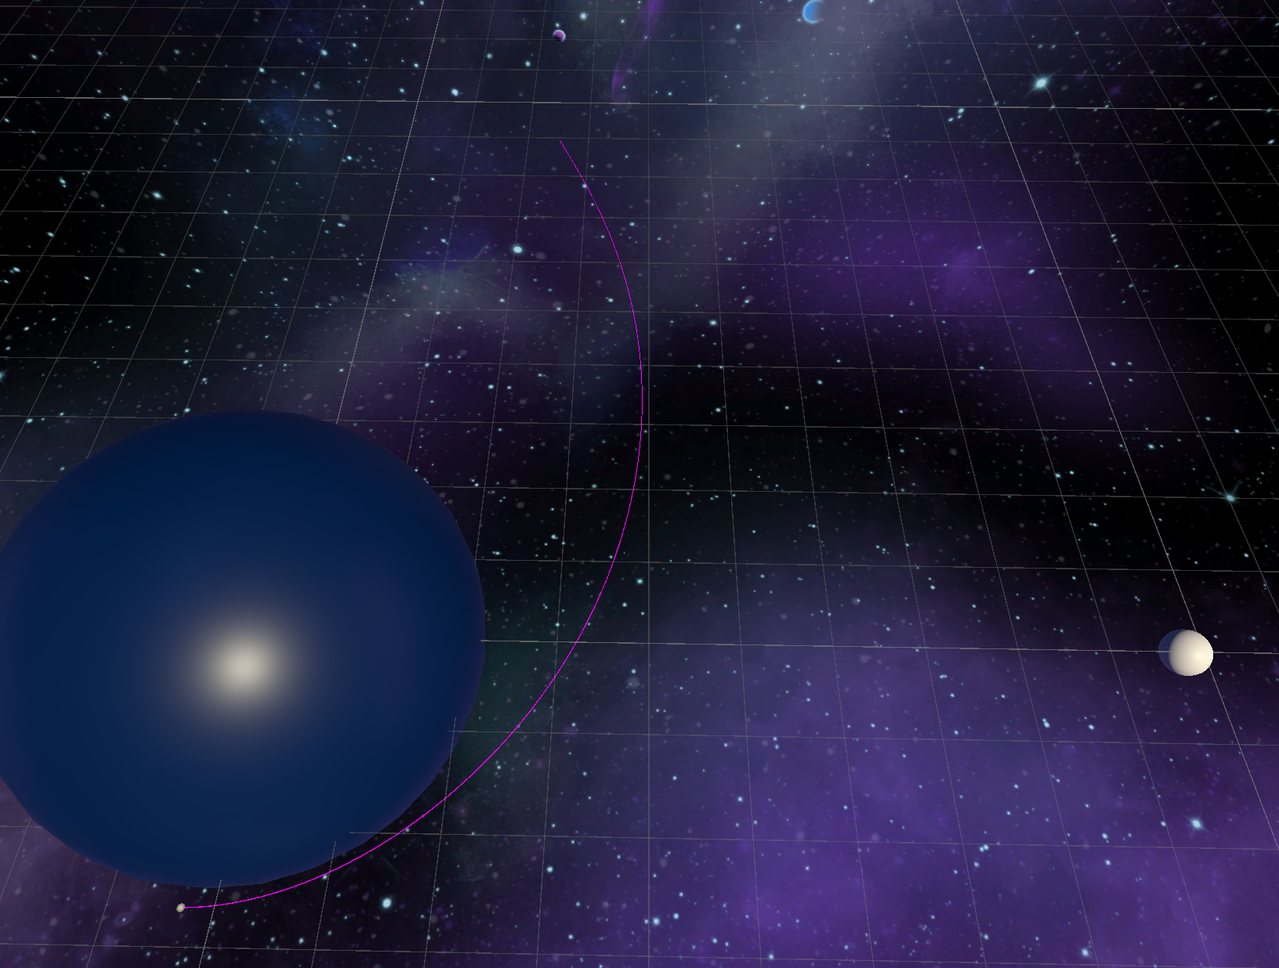
My Environment
A planet with a moon orbiting around its equator
Agent starts in Low Earth Orbit, 90 degrees behind the moon
The agent is tasked with getting from its starting point to within a proximity of the moon
Ideal
Route
Star
Planet
Moon
Ship

Slide 8
What’s Unique about my Agent
I decided to use Evolutionary selection and random mutation for training
Agents with the highest “fitness” are selected to be the basis of the next generation
Agent network values are randomly adjusted every generation

Slide 9
Results

Slide 10
Success Rate
After 1258 generations (105.18 hours) of training with a mutation rate of 5%
Average success rate of
~25%
After 372 more generations (31.02 hours) of training with a mutation rate of 0.1%
Average success rate of
51.6%

Slide 11
What Went Well
The AI has a quick initial learning curve, capable of understanding the task in only 20 or 30 generations
The AI is reasonably good at diversifying its strategy

Slide 12
What Went Wrong
Performance plateaus at a rather unimpressive fitness level, even after multiple changes to the scoring system
The code for the neural net is a nightmare to understand so its impossible to tell for sure that it fully works as intended
The AI was surprisingly good at hiding any flaws in its design

Slide 13
Performance
Network evaluation is very fast, capable of easily evaluating dozens of networks 50 times a second
Can run in a simulated environment running at 15 times speed

Slide 14
How I Could Improve my Implementation
Further improve the scoring algorithm
Provide the AI with active updates on its score
Adjust the mutation rate based on fitness
Add support for changing network layout between generation

Slide 15
References
[1] M. T. Hagan, H. B. Demuth, Mark Hudson Beale, Orlando De Jesús, and E. Al, Neural network design. S. L.: S. N, 2016.

Slide 16
Questions?
End

