Slide 1
glsl-simulator
https://github.com/burg/glsl-simulator
Sophia Wang & Brian Burg

Slide 2
Why we need a glsl simulator?
glsl shaders are
- widely used in WebGL-based online gaming
- but hard to debug

Slide 3
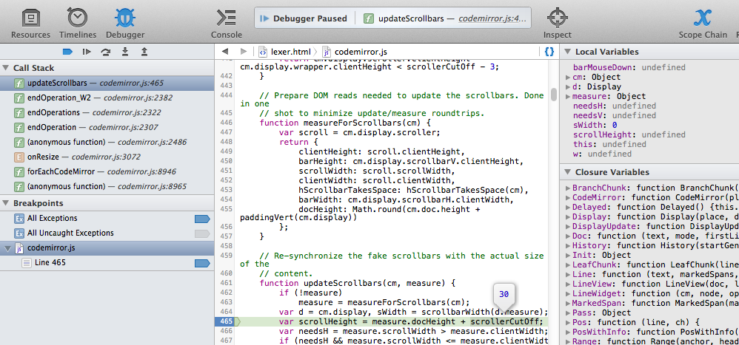
WebKit Web Inspector
Notes:
Breakpoints, call stack, runtime values, local variables,

Slide 4
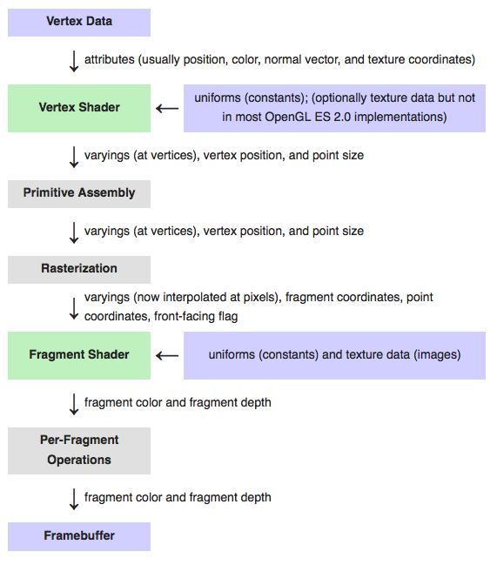

Slide 5
Our approach: convert glsl shader language to JavaScript
Pros: easy to step through
Cons: slow; run on CPU instead of GPU

Slide 6
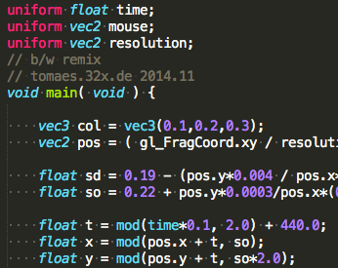
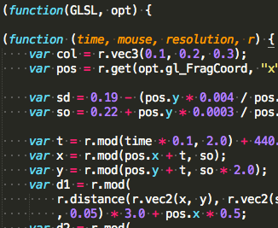

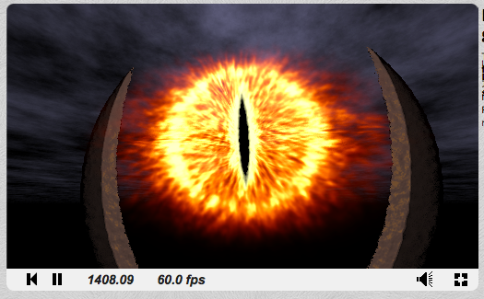

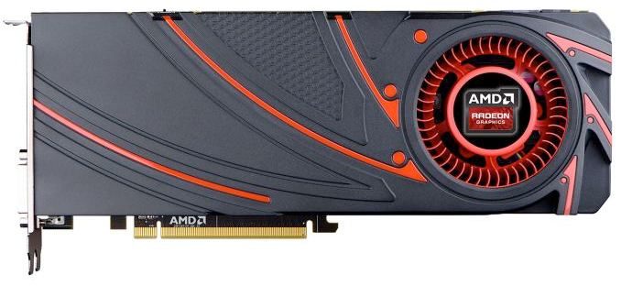
GLSL
JavaScript

Slide 7
Code Translation
GLSL
JavaScript

Slide 8
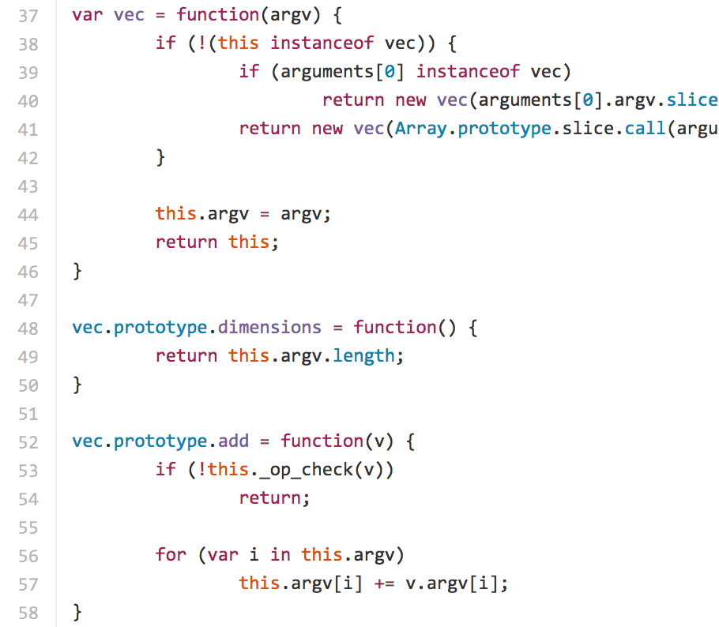
Runtime
Call
JavaScript

Slide 9
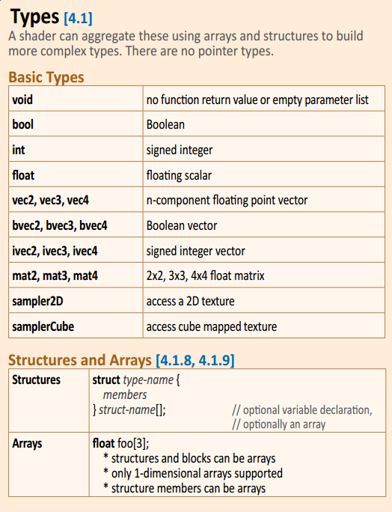
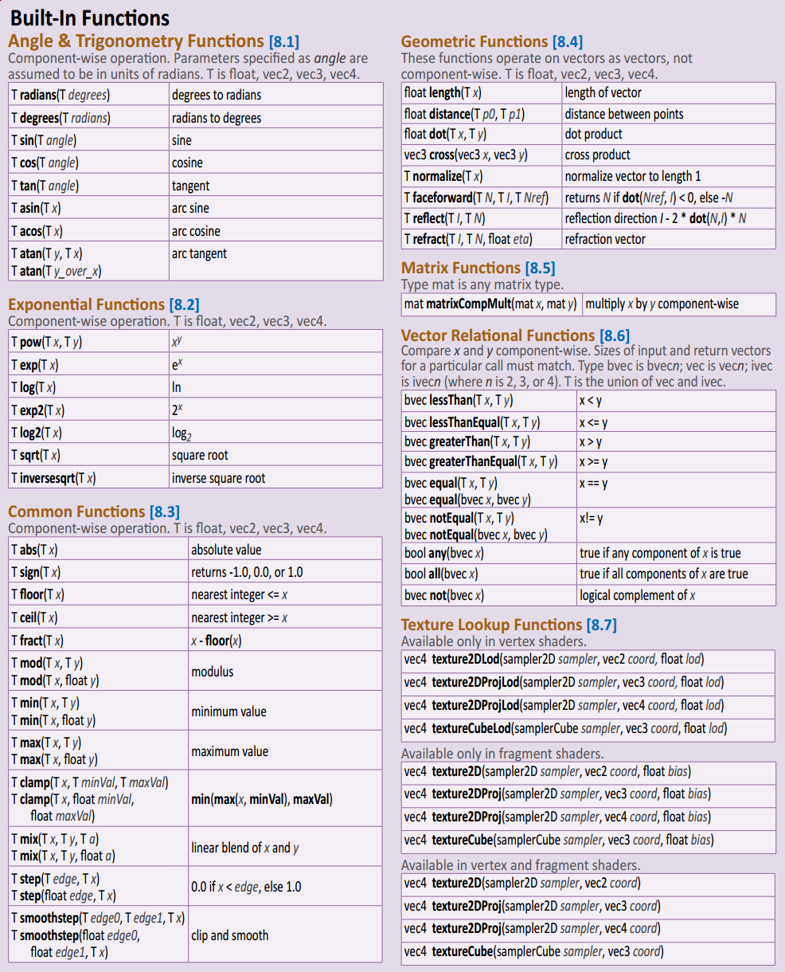
Runtime
Built-in Types
Built-in Functions

Slide 10
github
https://github.com/burg/glsl-simulator

