Slide 1

INTRODUCTION TO
lenium
Automation Testing

Slide 2
What is Selenium Testing?
Selenium is open source testing tool for web applications. Any web application can be testing on web browsers with this automation testing tool.
Selenium Testing tool can test only web application, it is not useful for mobile or desktop applications.
Test scripts can be written in Java, Python, C#, PHP, Ruby, Perl & .Net
Tests can be carried out in Windows, Mac or Linux
Tests can be carried out using Mozilla Firefox, Internet Explorer, Google Chrome, Safari or Opera
It can be integrated with tools like TestNG & JUnit for managing test cases and generating reports

Slide 3
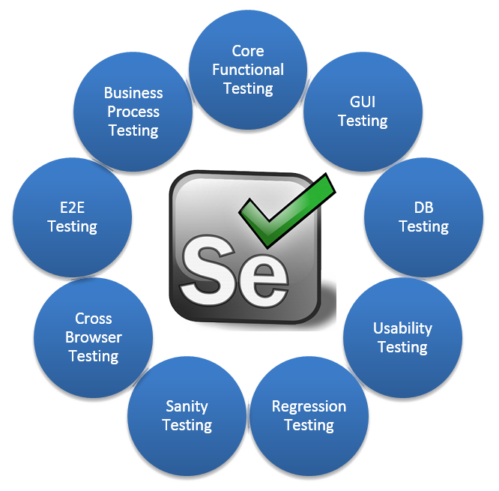
Why Selenium Software Testing?
The current industry trends is going toward the automation testing.
Many big companies moving their process of testing
in selenium.
Open Source, No cost require
Language support
Supports operating systems
Tests across devices & browsers

Slide 4
Selenium Testing Tools
Below are some Selenium Testing Tools,
Selenium RC (Now depreciated)
Selenium IDE
Selenium Grid
Selenium WebDriver
Selenium RC : Remote Controller
This is a server which is written in Java that accept commands (for browser) via HTTP. This let user to write own test cases from above mention common languages and run with it.
Selenium RC has been officially deprecated with selenium web driver

Slide 5
Selenium IDE : Integrated Development Environment
Selenium IDE is an easy-use tool for any person and which is designed to work with browsers. It is a browser plugin with graphical user interface. This GUI will allow user to record test actions and replay. However the recorded test scripts can be converted in to any languages supported by selenium.
Selenium Grid
This also a server which use to test web instances running on remote machines. Actually here this act as hub and all tests should contact this hub to get access for browsing. This is mostly used to run parallel tests across different machines and browsers simultaneously which measure execution time.
Selenium 2.0 (WebDriver)
WebDriver or selenium 2.0 is the most widely used tool of selenium family. This API fit with the same role played by Selenium RC. In simple way can be express WebDriver in following format,
Selenium 1.0 (IDE) + RC = Selenium 2.0

Slide 6
Selenium Advantages and Drawbacks
Advantages
Cross-browser compatibility
Language support
Rich set of features
Integration with testing frameworks
Extensibility
Drawbacks
Steep learning curve
Lack of built-in reporting
Slow execution
Limited support for non-web-based applications

Slide 7
Thank You

