Slide 1

PREDICTING DIABETES WITH MACHINE LEARNING Using NHANES data for healthcare insights

Slide 2
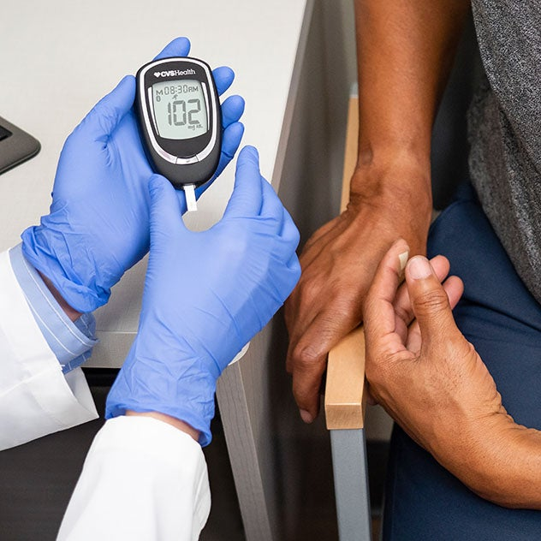
ISM 6251 Project Presentation Our Team
Long Nguyen
Tasnim Shairy
Brian Kimotho

Slide 3
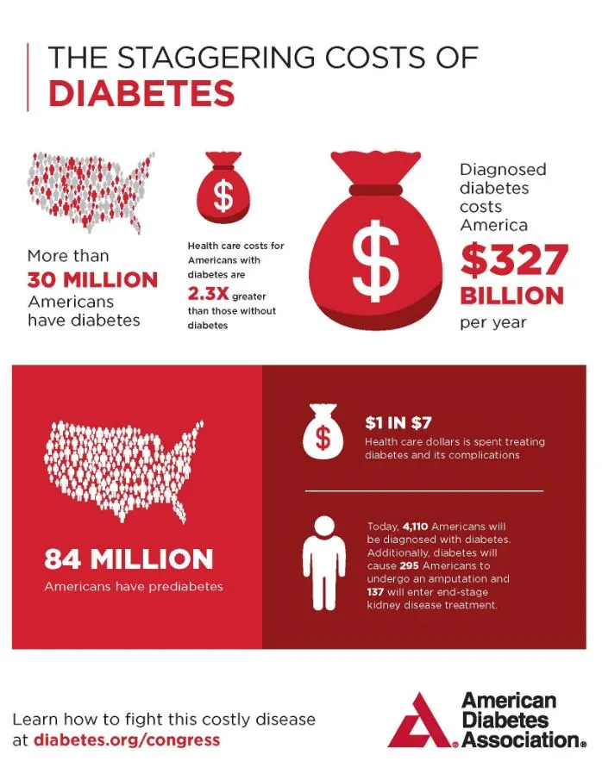
THE DIABETES DILEMMA : A GROWING HEALTHCARE CRISIS
Disease Prevalence:
37.3M Americans have diabetes (11.3% of population)
96M American adults have prediabetes (38% of population)
Economic Burden:
Total annual cost of diagnosed diabetes: $327 billion
$237 billion in direct medical costs
$90 billion in reduced productivity
Average medical expenditure: $16,752 per person annually
The GLP-1 Medication Crisis:
Supply shortages affecting 50% of US pharmacies
Novo Nordisk revenue up 29% in 2023
Global GLP-1 market expected to reach $150 billion by 2030
Out-of-pocket costs: $1,000+/month
Key Insight: 1 in 4 healthcare dollars is spent on diabetes care

Slide 4
BUSINESS PROBLEM & MOTIVATION
Why Early Detection Matters:
8.5 million Americans undiagnosed (23% of diabetic population)
Early diagnosis can reduce lifetime medical costs by 60%
Prevention programs can reduce type 2 diabetes risk by 58%
Current Challenges:
Limited healthcare resources and specialist access
Growing patient wait times
Rising medication costs and shortages
Need for efficient screening methods

Slide 5
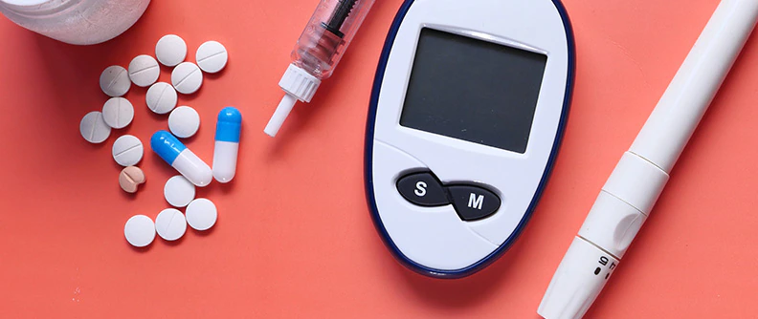
PREVIOUS APPROACHES
Traditional medical diagnosis through specific tests
Manual risk assessment based on individual factors
Limited use of machine learning in clinical settings
Gap in utilizing comprehensive health data for prediction

Slide 6

BUSINESS ANALYTICS OPPORTUNITY
How Our Model Helps:
Resource Optimization:
Prioritize high-risk patients for medication access
Better allocation of limited healthcare resources
Reduce unnecessary testing costs
Supply Chain Management:
Forecast regional medication demand
Better inventory management for pharmacies
Help prevent drug shortages
Cost Reduction:
Early intervention reduces long-term costs
More efficient screening process
Better insurance risk assessment

Slide 7
NHANES Dataset Overview (2013-2014)
Dataset:
2,277 patient records
Target: Diabetes Status (No/Yes/Borderline)
Distribution: 89% Non-diabetic, 8% Diabetic, 3% Borderline
Key Health Features:
Clinical: Blood glucose, BMI, Insulin levels
Demographics: Age, Gender
Lab Results: Oral glucose test
Lifestyle: Physical Activity
Primary Challenge:
Significant class imbalance (11% diabetic/borderline cases)
Critical for medical diagnosis accuracy

Slide 8


NATIONAL HEALTH AND NUTRITION HEALTH SURVEY 2013-2014 (NHANES) AGE PREDICTION SUBSET
The National Health and Nutrition Examination Survey (NHANES), administered by the Centers for Disease Control and Prevention (CDC), collects extensive health and nutritional information from a diverse U.S. population.
The dataset used for this project is a subset of the CDC database.
The dataset uses multiple healthcare information to predict one’s age group (senior/adult). However, we would like to use diabetic status as our target variable.

Slide 9
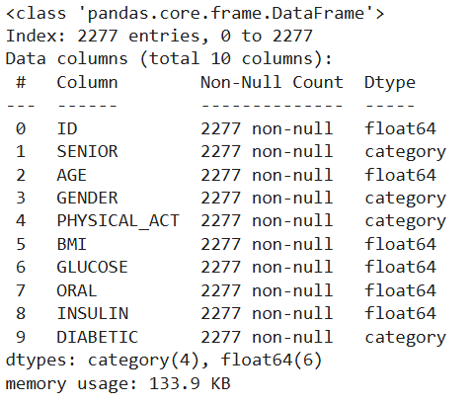
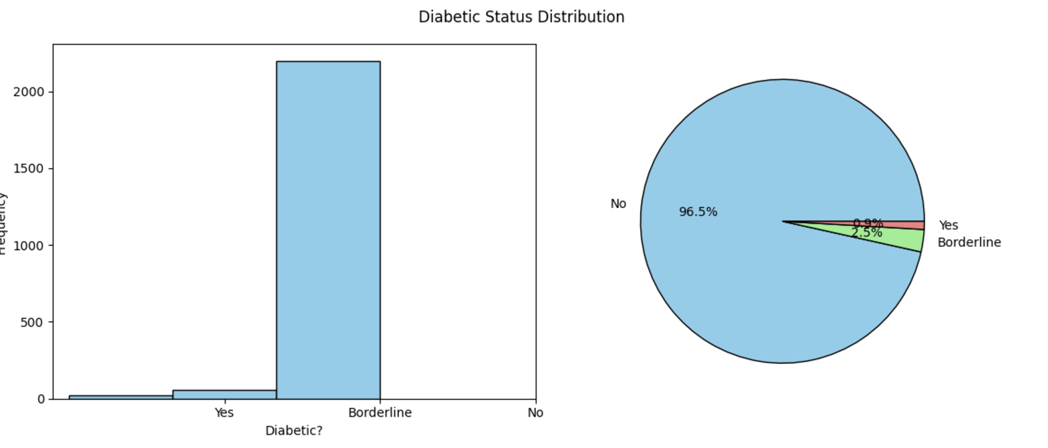
EXPLORATORY DATA ANALYSIS
The major concern is the imbalance in the target classes. Only 0.9% of the respondents are diabetic.
To address this issue:
stratify=y during train_test_split
class_weight=‘balanced’ during model building
average=‘macro’ during evaluating
However, we still do not expect high accuracy from our models due to imbalance data. Other resampling techniques would be needed to improve the data.

Slide 10
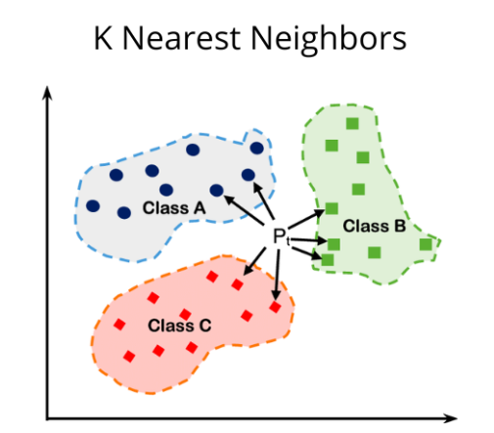
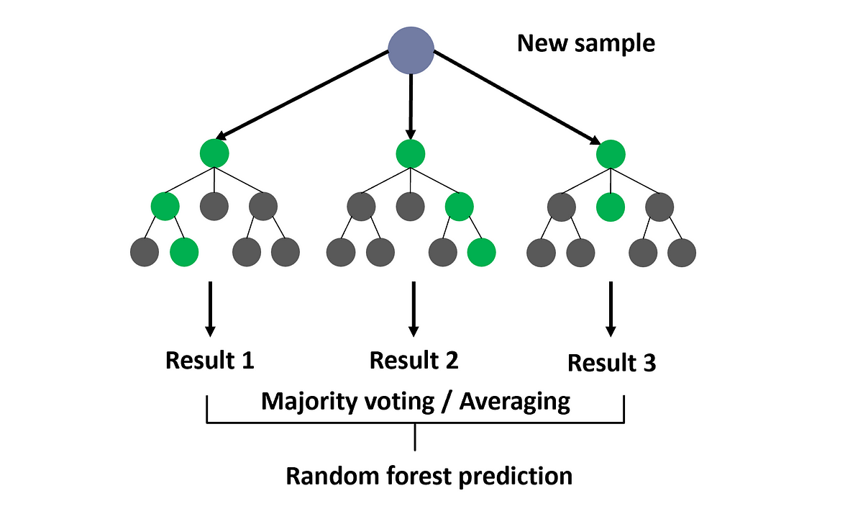
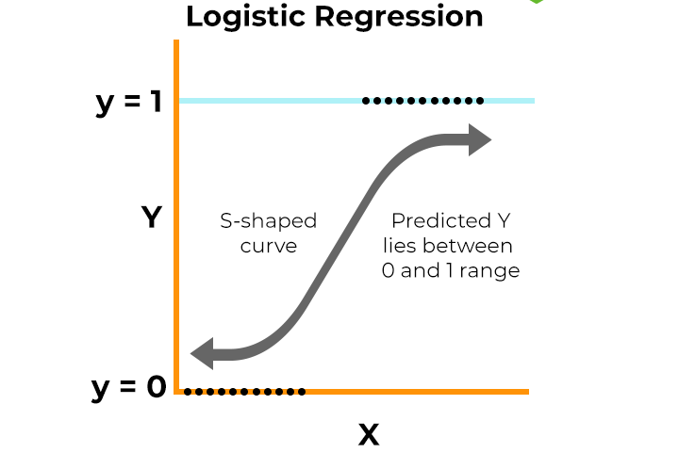
MACHINE LEARNING MODELS

Slide 11
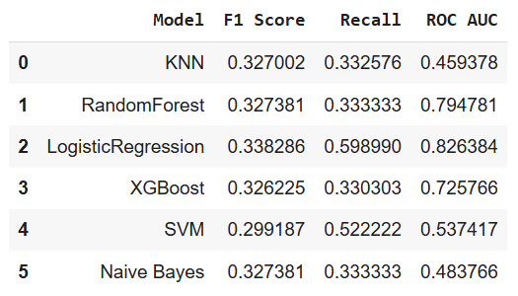
MODEL PERFORMANCE SUMMARY
The following machine learning models are selected:
K Nearest Neighbors
Ensembles: Random Forest & XGBoost
Logistic Regression: we use OneVsRestClassifier to handle the multiclass data.
Support Vector Machine
Naive Bayes
To evaluate their performance, we will focus on Recall, F1 score, and ROC AUC.
Overall, Logistic Regression yielded the best performance.

Slide 12
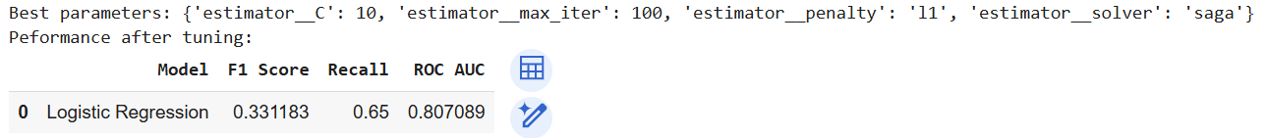
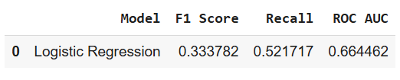
HYPERPARAMETER TUNING
Performance with unseen data (test set):

Slide 13
CONCLUSION
Our analysis demonstrates that Logistic Regression is the most effective model for predicting diabetes, achieving: F1-Score: 0.33 Recall: 0.52 ROC AUC: 0.66 with unseen data.
The model addresses the significant class imbalance in the dataset and reliably identifies diabetic patients, reducing the risk of false negatives.
Focused on recall, F1-score, and ROC AUC as performance metrics due to the highly imbalanced data.
Early detection enabled by this model can reduce long-term medical costs, improve resource allocation, and optimize patient outcomes.

Slide 14
RECOMMENDATIONS
The model should only serve as a preliminary screening method to identify high-risk individuals, complementing traditional diagnostic approaches for a comprehensive evaluation.
Deploy the model in clinical settings to flag high-risk patients efficiently, reducing reliance on costly and time-consuming tests.
Additional resampling techniques (e.g., oversampling or undersampling) should be considered to further improve model performance and address the highly imbalance nature.
The model can be refined further by incorporating additional patient data e.g genetic information, lifestyle factors.

Slide 15

THANK YOU

