Slide 1
PROJECT REPORT PRESENTATION IMPACT OF RACIAL DIVERSITY ON PERFORMANCE AND EARLY CHILDHOOD DEVELOPMENT Long Nguyen | ISM 6642: Advanced Data Science

Slide 2

ABOUT THE PROJECT
Objective
Across domains, DEI in the US education system remains a critical controversy. Thus, this project aims to study the significance of DEI in academia.
Policy makers and institutions can gain a comprehensive understanding of the subject matter to support decision-making.
This study seeks to address disparities and biases regarding DEI in education in today’s society.

Slide 3

ABOUT THE PROJECT
Data
Data from the Early Childhood Longitudinal Studies (ECLS) Program by the US Dept. Of Education and The National Center for Educational Statistics (NCES).
The program examined child development, school readiness, and early school experiences through various factors: family, school, community.
Kindergarten class 2010-11 cohort: 18,174 participating children between Fall 2010 and Spring 2016 semesters.

Slide 4
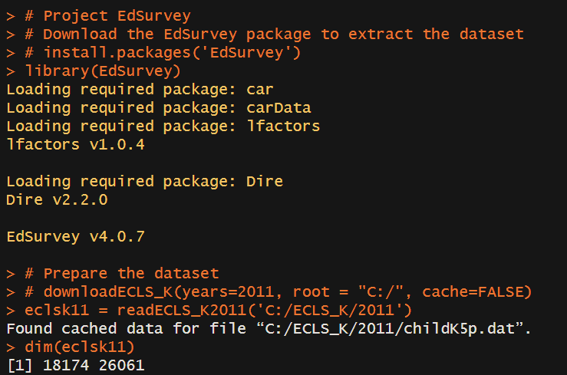
PROGRAMMING SETUP (R)
Utilize the EdSurvey package in R to import the dataset.
18,174 rows x 26,061 columns
Each row represents one child and contains the data across multiple time points.

Slide 5
DATA PREPROCESSING
Variables Selection
childid: Children ID numbers.
s1_id, s2_id, …: School ID numbers.
x2krceth, x4rceth, …: Percentage of non-white children at the school. No racial data was collected for the first, third, and fifth semesters.
x1rthet, x2rthet, x1mthet, …: IRT-based scores to measure children performance in reading (rthet), math (mthet), and science (sthet) across the semesters

Slide 6
DATA PREPROCESSING (cont.)
The Race rceth Variables
Reformat x2- and x4rceth as discreet variables.
Add x3- and x5rceth using s3_id and s5_id.
Add x1rceth = 1 since the first semester is the baseline.
Treatment group: children who had spent more than 4 semesters at racially diverse schools (-rceth >= 2)
De-flattening the Dataset
Convert the wide flattened format into a long time-series format.
Each row now represents a single child’s data at a particular semester.

Slide 7
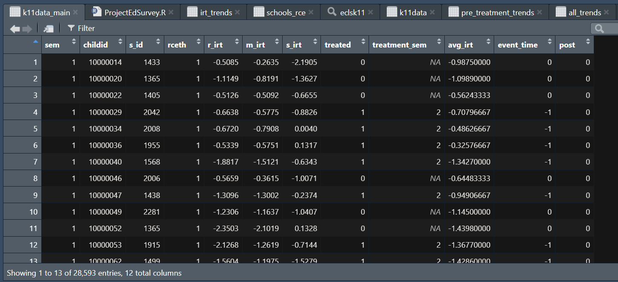
FINAL DATA FRAME

Slide 8
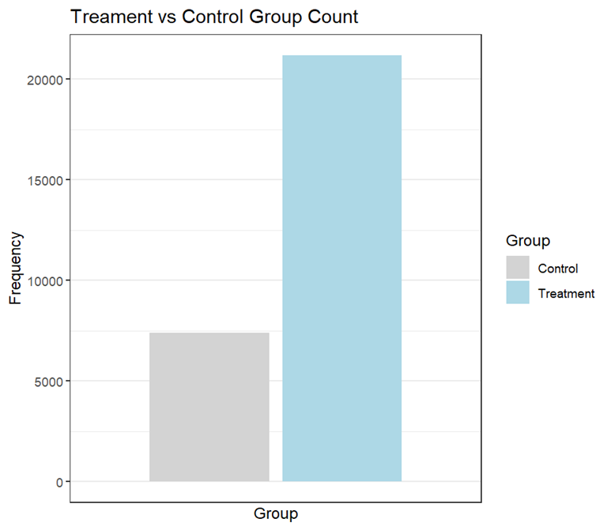
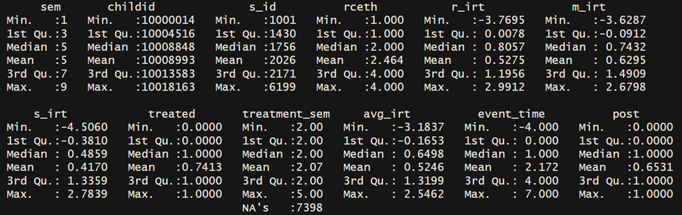
TREATMENT VS CONTROL GROUPS
Descriptive Statistics

Slide 9
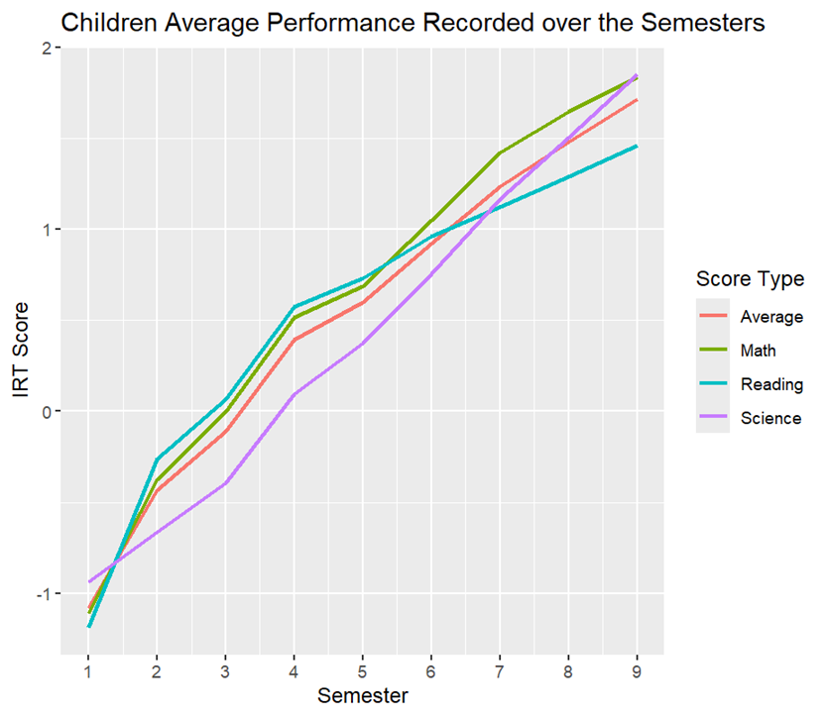
AVERAGE IRT SCORES

Slide 10
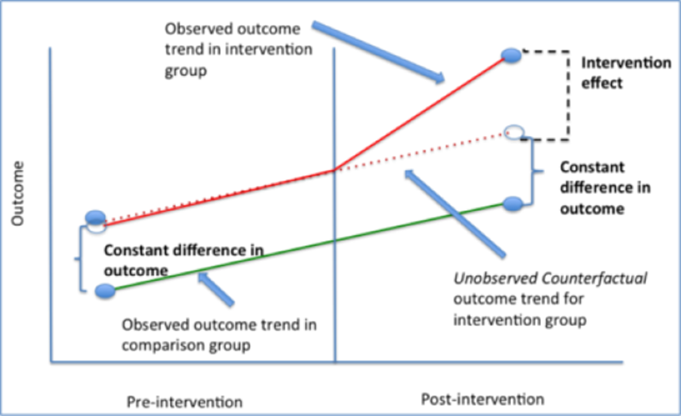
DIFFERENCE-IN-DIFFERENCES ANALYSIS (DID)
The DID analysis is a quasi-experimental design that helps assess the causal effect of an intervention by comparing the changes in outcomes between treatment group and control group.
DID effect is usually implemented as an interaction term between time and binary treated variables in a regression model:
Y= β0 + β1×[Time]+ β2×[Treated]+ β3×[Time×Treated]+ β4×[Covariates]+ε

Slide 11
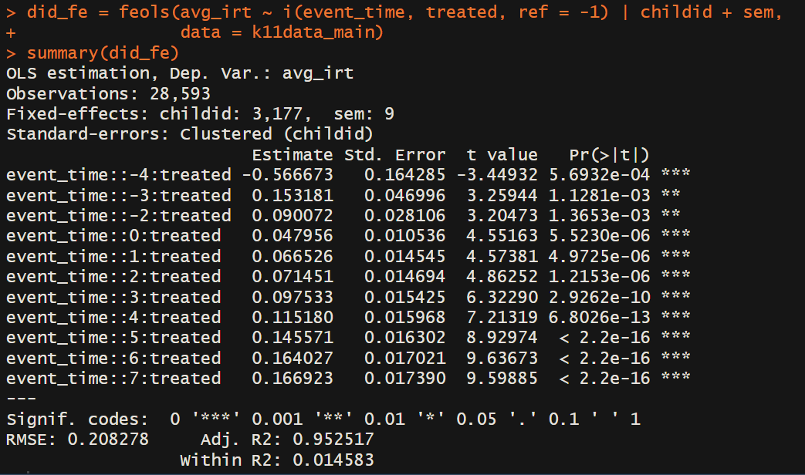
DID / FIXED EFFECTS MODEL OUTPUT

Slide 12
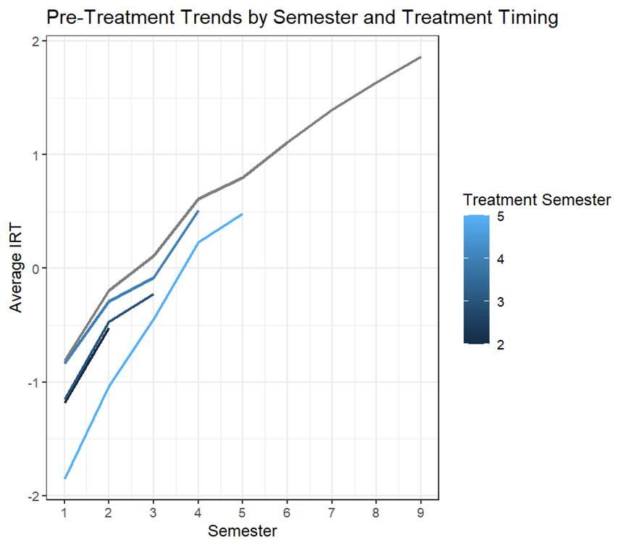
PARALLEL TRENDS ASSUMPTION
Treatment group is separated into subsets based on their treatment start date.
Patterns seem fairly parallel.
Some divergence in sem 2-3 but not significant.

Slide 13
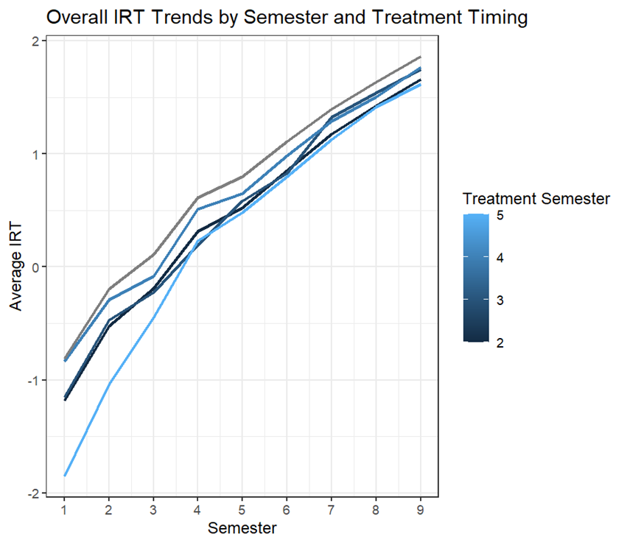
CONCLUSIONS
Positive and increasing effect of going to a diverse school at a younger age on performance.
Policy makers and school administrators should implement DEI policies and programs.
DEI requires long-term effort and commitment to start seeing actual returning values

Slide 14
LIMITATIONS
Target Variable: rceth – Diversity Indicator
Proportion of non-white students might still be dominated by only one specific racial group.
How much diversity is enough to be considered “diverse”?
Other aspects: gender, socioeconomic status, disabilities.
Violation of Parallel Trends Assumption
Needs further testing.

Slide 15
Thanks!
ANY QUESTIONS?

