Slide 1

Study VTK Together
一起学习VTK
水灵
QQ: 348774226
MSN: shuiling119@hotmail.com
All Rights Reserved by 水灵

Slide 2
一起学习VTK-第2讲
VTK的基本框架结构
组成VTK的两种对象模型(Object Model)
  图形模型
  可视化模型
构建一个最简单的VTK程序
  在VTK里要绘制或者渲染一个场景，需用如下基本对象：
  vtkRenderWindow
  vtkRenderer
  vtkLight
  vtkCamera
  vtkActor
  vtkProperty
  vtkMapper
Company Logo
All Rights Reserved by 水灵

Slide 3
一起学习VTK-第2讲
  图形模型和可视化模型
  图形对象：Rendering
  可视化对象: 生成几何图形
数据流，管道的执行流程:
Data source Visualization Graphics
Company Logo
All Rights Reserved by 水灵

Slide 4
The Graphics Model
Render
Visualization model Graphics model
Source Filter Mapper Actor
Direction of data flow

Slide 5

The Graphics Model
Actor
Light
camera
screen

Slide 6
The Graphics Model
vtkCamera
vtkActor
vtkProperty
vtkMapper
vtkLight
vtkRenderWindow
vtkRenderer
vtkRenderWindowInteractor

Slide 7
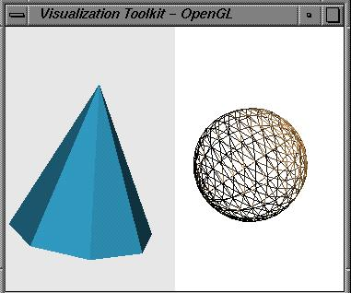
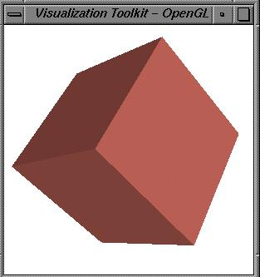
1 vtkRenderWindow
vtkCamera
2 vtkRenderer
vtkLight
vtkActor
( property, geometry(mapper), transformation, etc)

Slide 8
一起学习VTK-第3讲(预告)
VTK Observer/command设计模式
VTK 对象工厂设计模式
Company Logo
All Rights Reserved by 水灵

