Slide 1

Study VTK Together
一起学习VTK
水灵
QQ: 348774226
MSN: shuiling119@hotmail.com
All Rights Reserved by 水灵

Slide 2
一起学习VTK-第4讲
主要内容：
vtkCamera
vtkLight
Company Logo
All Rights Reserved by 水灵

Slide 3
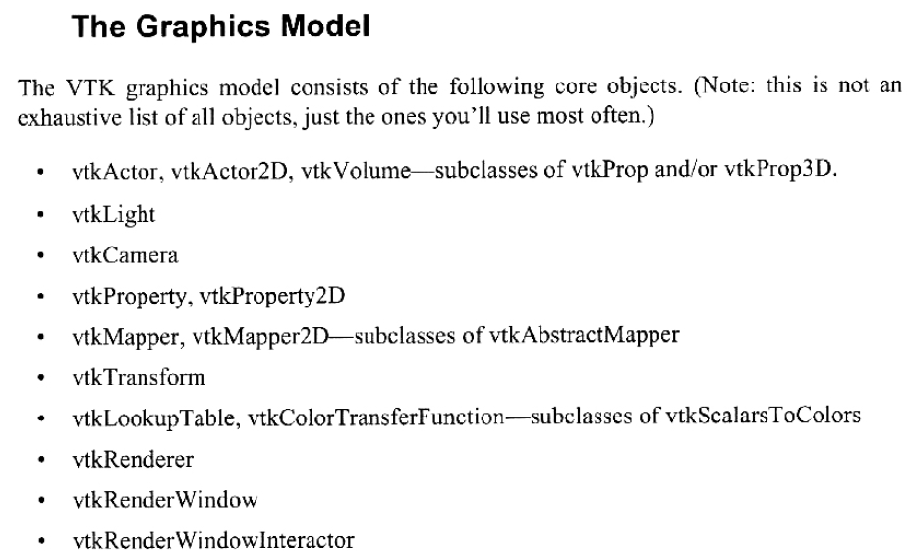
一起学习VTK-第4讲
先看一下《VTK User’s Guide》(VTK4.0版)-P20
Company Logo
All Rights Reserved by 水灵

Slide 4
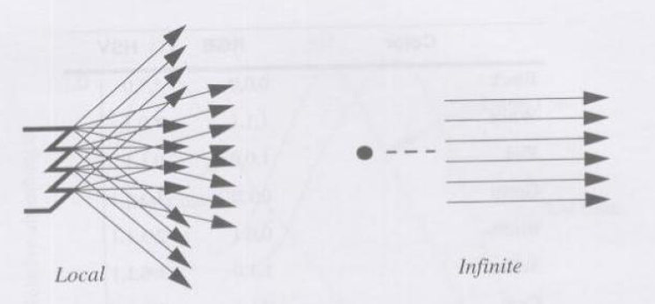
一起学习VTK-第4讲
vtkLight
光源种类：
位置光源 平行光源(无限光源)
Company Logo
All Rights Reserved by 水灵

Slide 5
一起学习VTK-第4讲
vtkLight
vtkLight *light = vtkLight::New();
light->SetColor(?,?,?);
light->SetAmbientColor(?,?,?);
light->SetDiffuseColor(?,?,?);
light->SetSpecularColor(?,?,?);
…
renderer->AddLight(light);
Company Logo
All Rights Reserved by 水灵

Slide 6
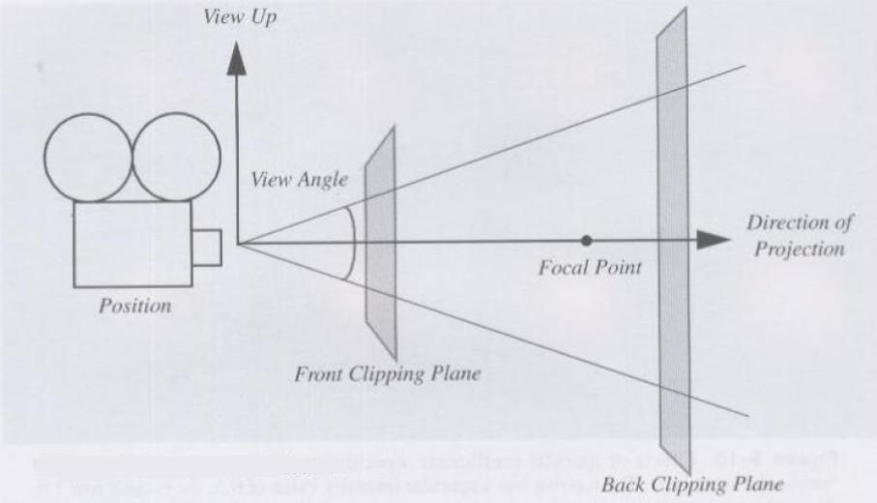
一起学习VTK-第4讲
vtkCamera
Company Logo
All Rights Reserved by 水灵

Slide 7
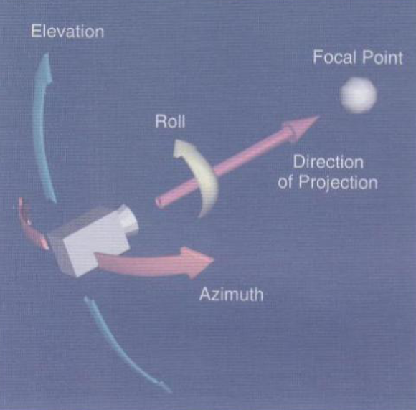
一起学习VTK-第4讲
vtkCamera
照相机绕着 Focal Point 的运动
Company Logo
All Rights Reserved by 水灵

Slide 8
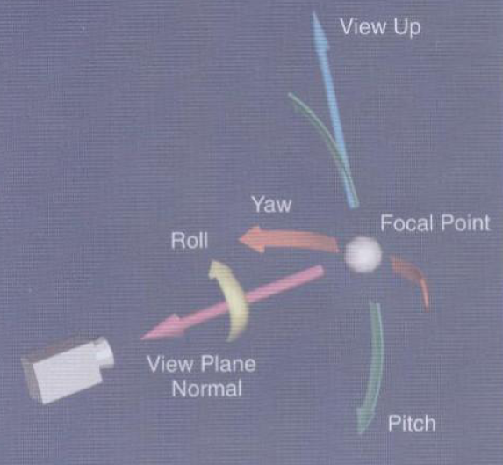
一起学习VTK-第4讲
照相机绕着 camera Position 的运动
vtkCamera
Company Logo
All Rights Reserved by 水灵

Slide 9
一起学习VTK-第4讲
vtkCamera
camera()->SetFocalPoint(0,0,0);
camera()->SetPosition(0,0,1);
camera()->SetViewUp(0,1,0);
renderer->SetActiveCamera();
Or:
renderer->GetActiveCamera() -> SetFocalPoint(0,0,0);
renderer->GetActiveCamera() -> SetPosition(0,0,1);
renderer->GetActiveCamera() -> SetViewUp(0,1,0);
renderer->ResetCamera();
Company Logo
All Rights Reserved by 水灵

Slide 10
一起学习VTK-第5讲(预告)
主要内容：
Vtk Coordinate System
Coordinate System Transform
Company Logo
All Rights Reserved by 水灵

