Slide 1


Study VTK Together
一起学习VTK
水灵
QQ: 348774226
MSN: shuiling119@hotmail.com
All Rights Reserved by 水灵

Slide 2
一起学习VTK-第7讲
主要内容：
1. The Visualization Model
2. vtkDataObject and vtkDataSet
3. Visualization Data
All Rights Reserved by 水灵

Slide 3
一起学习VTK-第7讲
The Visualization Model
Graphics pipeline
Graphical Data
Pictures
Data Flow
Visualization pipeline
Visualization Pipeline is responsible for constructing
Geometric representation that is then rendered by the
Graphic pipeline.
Visualization Data
All Rights Reserved by 水灵

Slide 4
一起学习VTK-第7讲
Visualization data
可视化数据(Visualization data)的特征：
1. visualization data is discrete.
--->Interpolation: linear, quadratic, cubic, spline or other interpolation functions.
2. visualization data's structure may be regular or irregular(alternatively, structured or unstructured).
--->regular data can save computer memory; irregular data gives us more freedom in representing data and can represent data that has no regular patterns.
3. visualization data has a topological dimension.
--->The dimension of the data is important because it implies appropriate methods for visualization and data representation.
All Rights Reserved by 水灵

Slide 5
一起学习VTK-第7讲
The Visualization Model
Data Flow
Two basic types of objects involved this:
vtkDataObject and vtkProcessObject
vtkDataObject:
Data objects represent the data that is processed by the visualization pipeline. It is the general representation of visualization data.
vtkDataObjects are used to represent arbitrary repositories of data via the vtkFieldData instance variable. These data must be eventually mapped into a concrete subclass of vtkDataSet before they can actually be displayed.
All Rights Reserved by 水灵

Slide 6
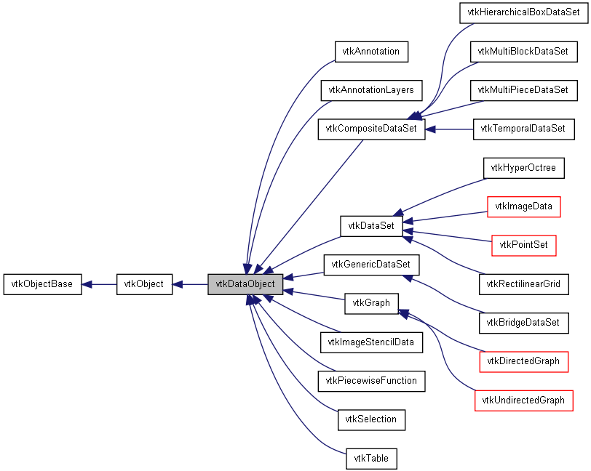
一起学习VTK-第7讲
All Rights Reserved by 水灵

Slide 7
一起学习VTK-第7讲
vtkDataObject and vtkDataSet
VTK一般把数据表示成场数据，数据集是带有拓扑和几何结构的数据对象。除了空间结构，数据集还附带有属性数据。属性数据包括：标量,矢量,张量,法向,纹理坐标,以及场数据。
数据属性(标量,矢量,张量,法向,纹理坐标,以及场数据)
拓扑结构
cells
数据集
组织结构
几何结构
points
All Rights Reserved by 水灵

Slide 8
一起学习VTK-第7讲
  关于Cell
从数学的角度来看，用Ci表示一个cell，那么cell就是一系列点的集合： Ci={p1, p2, ..., pn}. pi∈P, P是一系列n维的点(n在这里取等3)。
cell的类型决定了点的排列顺序或者说是cell的拓扑结构。定义cell的点的数目n叫做cell的大小(size)。当点pi ∈ Ci时，我们就说cell Ci使用了点pi。
这样可以定义一个“使用点”集合，用U(pi)表示：
U(pi)={Ci: pi ∈ Ci}
cell可以是基元(primary,就是基本元素，不可再分的一种结构，这只是我个人的一种翻译)或者是组合。像vertex, line这些就是primary, 而triangle strip就是primary的一种组合结构(composite).
总的来说，cell分为线性和非线性两种。
All Rights Reserved by 水灵

Slide 9
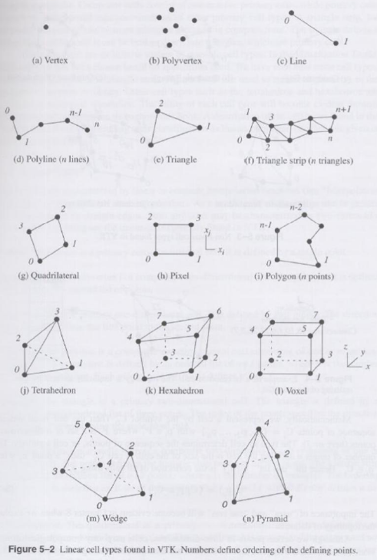
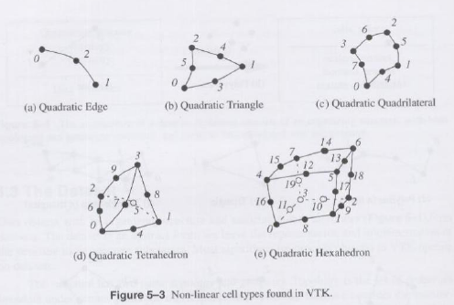
一起学习VTK-第7讲
VTK中的拓扑单元类
All Rights Reserved by 水灵

Slide 10
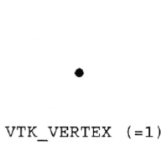
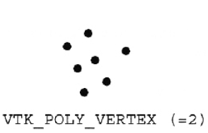
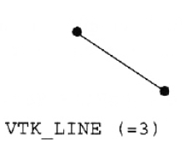
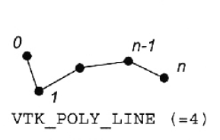
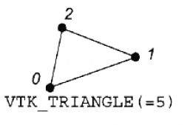
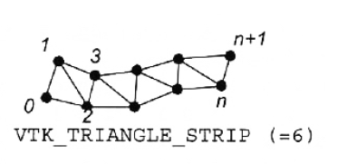
一起学习VTK-第7讲
VTK中的拓扑单元类
All Rights Reserved by 水灵

Slide 11
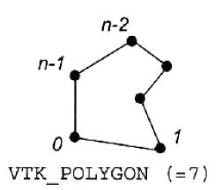
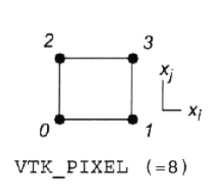
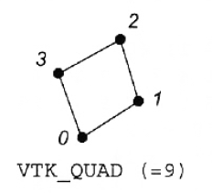
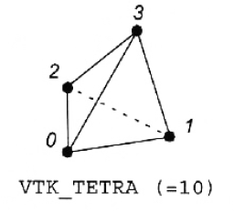
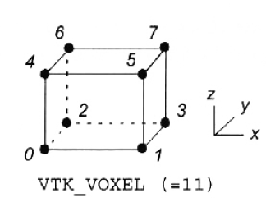
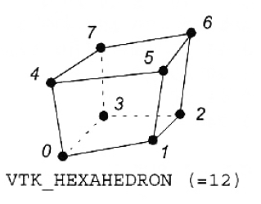
一起学习VTK-第7讲
VTK中的拓扑单元类
All Rights Reserved by 水灵

Slide 12
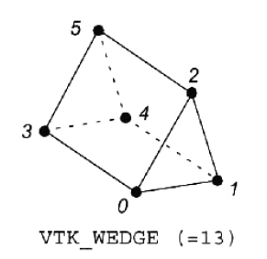
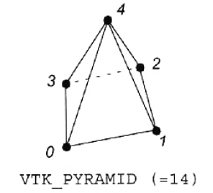
一起学习VTK-第7讲
VTK中的拓扑单元类
All Rights Reserved by 水灵

Slide 13
一起学习VTK-第7讲
Linear cells:
Vertex --- 0维基元
Polyvertex --- 0维vertex的组合
Line --- 1维基元
Polyline --- 1维Line的组合
Triangle --- 2维基元，注意是逆时针定义点的顺序，右手螺旋准则
Triangle Strip --- 2维Triangle的组合
Quadrilateral --- 2维基元，逆时针定义点的顺序，是凸多边形，边不相 交，点在同一个平面上。右手准则定义法向量。
Pixel --- 2维基元，由四个点定义，每条边都与邻边垂直，而且与x-y-z坐标系统坐标轴垂直。法向量与坐标系统中的某一坐标轴平行。注意四个点的顺序与Quadrilateral四个点的顺序不一样！注意这里的pixel是作 为一个cell的基本类型，要与图像的pixel概念的区别。
All Rights Reserved by 水灵

Slide 14
一起学习VTK-第7讲
Linear cells:
Polygon --- 2维基元，注意是逆时针定义点的顺序，右手螺旋准 则，可以是非凸的，但边不能相交。
Tetrahedron --- 3维基元
Hexahedron --- 3维基元
Voxel --- 3维基元
Wedge --- 3维基元
Pyramid --- 3维基元
All Rights Reserved by 水灵

Slide 15
一起学习VTK-第7讲
Nonlinear cells:
主要应用于数值分析领域，它提供了更加精确的插值方法以及更好的曲线模型。与线性类型的一个显著区别是对它们的绘制方法和被多数的可视化算法所处理的方法不同。
线性的cells绘制时先转换为线性基元，再直接被图形库所处理；而非线性cells是不能直接被图形库所支持的(除了B-splines或NURBS)。通常对于非线性cells的绘制是先把它们分解(Tessellate or Decompose)为线性的cells，再进行绘制或渲染。
非线性类型的cell有：Quadratic Edge; Quadratic Triangle; Quadratic Quadrilateral; Quadratic Tetrahedron; Quadratic Hexahedron
All Rights Reserved by 水灵

Slide 16
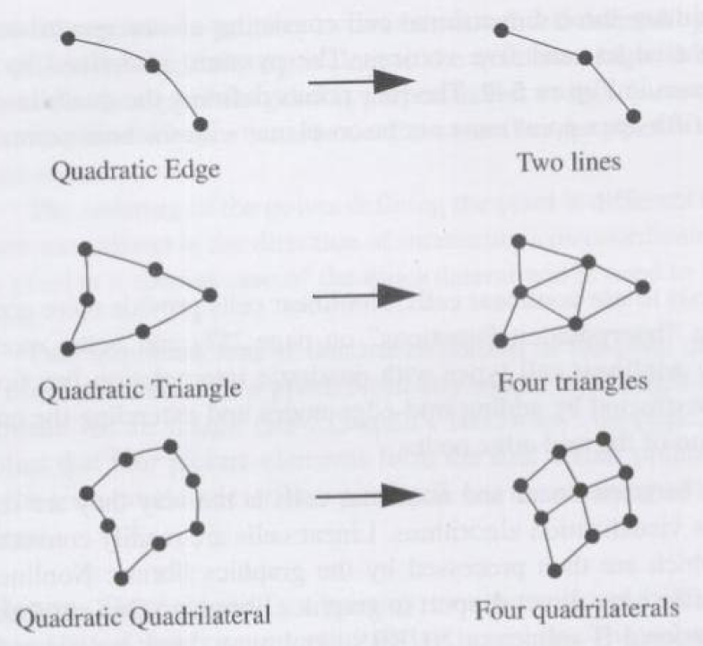
一起学习VTK-第7讲
All Rights Reserved by 水灵

Slide 17
一起学习VTK-第7讲
VTK中的拓扑单元类
vtkCell
vtkCell3D
vtkConvexPointSet
vtkHexahedron
vtkPyramid
vtkTetra
vtkVoxel
vtkWedge
vtkEmptyCell
vtkGenericCell
vtkLine
vtkPixel
vtkPolygon
vtkPolyLine
vtkPolyVertex
vtkQuad
vtkTriangle
vtkTriangleStrip
vtkVertex
vtkNonLinearCell
vtkExplicitCell
vtkQuadraticEdge
vtkQuadraticHexahedron
vtkQuadraticQuad
vtkQuadraticTetra
vtkQuadraticTriangle
All Rights Reserved by 水灵

Slide 18
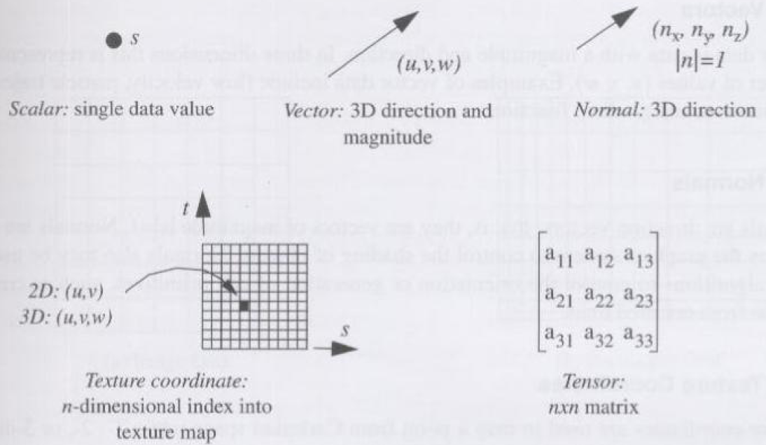
一起学习VTK-第7讲
Attribute Data 属性数据
属性数据是与数据集结构相关联的信息。数据集结构包括几何和拓扑，大多数情况下，属性数据是与数据的点或Cells相关联的，但有时也可能与某一条边或一个面相关联。关于属性数据的典型例子有某一个点上的温度或速度；一个cell的质量；流入或流出一个cell表面的热通量等。
All Rights Reserved by 水灵

Slide 19
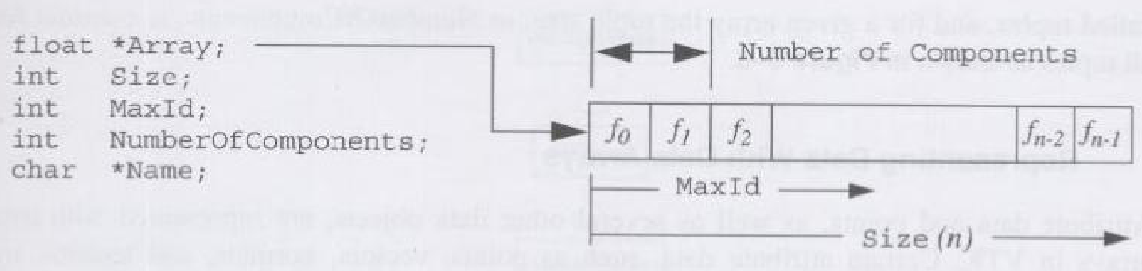
一起学习VTK-第7讲
VTK中的数组类
在VTK里，数据是存放在Contiguous data array，我们把这个叫做data arrays。用类：vtkDataArray来表示。
Tuple Abstraction
All Rights Reserved by 水灵

Slide 20
一起学习VTK-第7讲
VTK中的数组类
vtkDataArray
vtkBitArray
vtkCharArray
vtkDoubleArray
vtkFloatArray
vtkIdTypeArray
vtkIntArray
vtkLongArray
vtkShortArray
vtkUnsignedCharArray
vtkUnsignedIntArray
vtkUnsignedLongArray
vtkUnsignedShortArray
vtkVoidArray
All Rights Reserved by 水灵

Slide 21
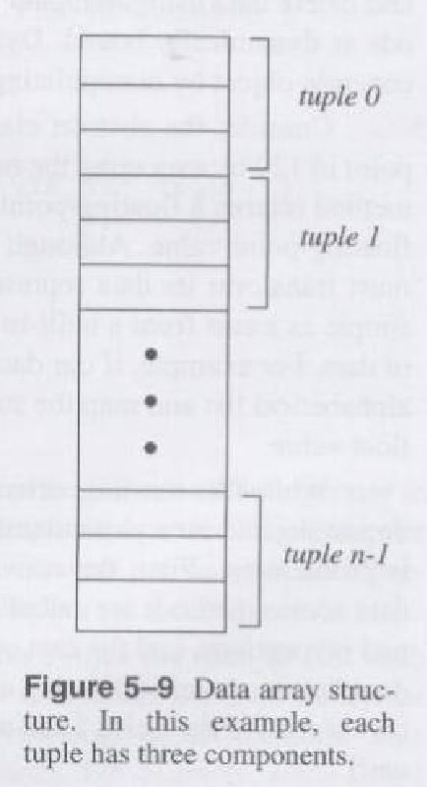
一起学习VTK-第7讲
The Tuple Abstraction
Tuple Size = 3
All Rights Reserved by 水灵

Slide 22
一起学习VTK-第7讲
vtkDataSet
vtkDataSet:
abstract class to specify dataset behavior.
vtkDataSet is an abstract class that specifies an interface for dataset objects. vtkDataSet also provides methods to provide informations about the data, such as center, bounding box, and representative length.
A dataset consists of one or more cells. Cells are the fundamental building blocks of visualization systems. Cells are defined by specifying a type in combination with an ordered list of points. The ordered list, often referred to as the connectivity list, combined with the type specification, implicitly defines the topology of the cell. The x-y-z point coordinates define the cell geometry.
(See next example)
All Rights Reserved by 水灵

Slide 23
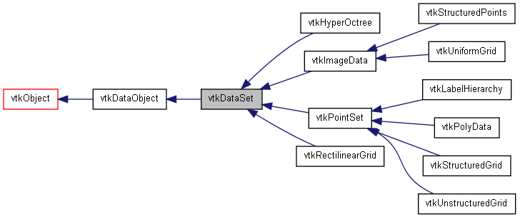
一起学习VTK-第7讲
Inheritance diagram for vtkDataSet
vtkDataSet
All Rights Reserved by 水灵

Slide 24
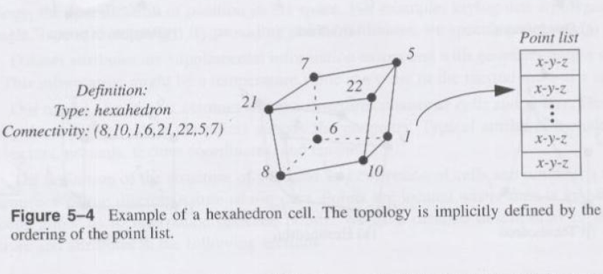
一起学习VTK-第7讲
One Example of a cell
All Rights Reserved by 水灵

Slide 25
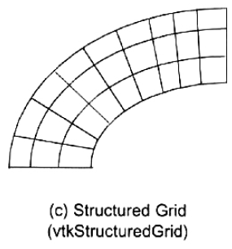
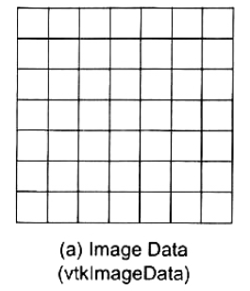
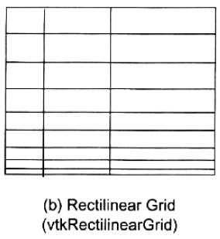
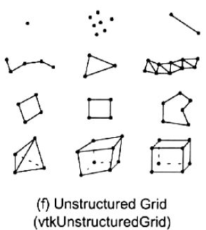
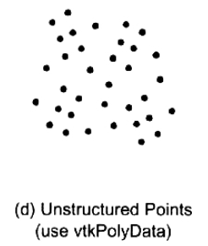
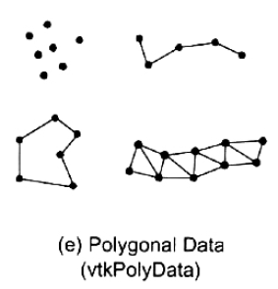
一起学习VTK-第7讲
Five datasets find is VTK
All Rights Reserved by 水灵

Slide 26
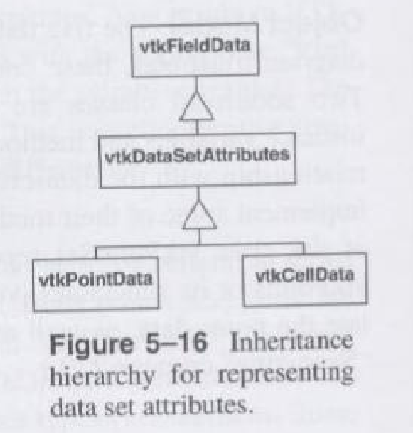
一起学习VTK-第7讲
Data Attributes的表达
All Rights Reserved by 水灵

Slide 27
一起学习VTK-第7讲
Example:
Create a Polygonal Dataset
Create an Image Data Dataset
Create Step:
The geometry and topology of the dataset must be defined.
The point and/or cell attribute data is created and associated with the dataset.
All Rights Reserved by 水灵

Slide 28
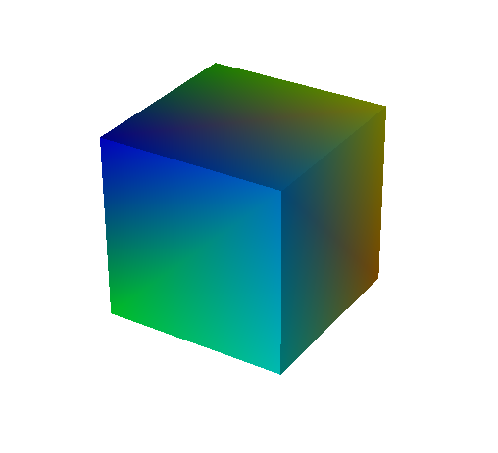
一起学习VTK-第7讲
z
Create a Polygonal Dataset
int i;
static float x[8][3]={{0,0,0}, {1,0,0}, {1,1,0}, {0,1,0},
{0,0,1}, {1,0,1}, {1,1,1}, {0,1,1}};
static vtkIdType pts[6][4]={{0,1,2,3}, {4,5,6,7}, {0,1,5,4},
{1,2,6,5}, {2,3,7,6}, {3,0,4,7}};
vtkPolyData *cube = vtkPolyData::New();
vtkPoints *points = vtkPoints::New();
vtkCellArray *polys = vtkCellArray::New();
vtkFloatArray *scalars = vtkFloatArray::New();
for (i=0; i<8; i++) points->InsertPoint(i,x[i]);
for (i=0; i<6; i++) polys->InsertNextCell(4,pts[i]);
for (i=0; i<8; i++) scalars->InsertTuple1(i,i);
cube->SetPoints(points);
points->Delete();
cube->SetPolys(polys);
polys->Delete();
cube->GetPointData()->SetScalars(scalars);
scalars->Delete();
vtkPolyDataMapper *cubeMapper = vtkPolyDataMapper::New();
cubeMapper->SetInput(cube);
cubeMapper->SetScalarRange(0,7);
vtkActor *cubeActor = vtkActor::New();
cubeActor->SetMapper(cubeMapper);
7
6
4
5
y
2
0
1
x
All Rights Reserved by 水灵

Slide 29
一起学习VTK-第7讲
#include "vtkRenderer.h"
#include "vtkRenderWindow.h"
#include "vtkRenderWindowInteractor.h"
#include "vtkImageData.h"
#include "vtkFloatArray.h"
#include "vtkContourFilter.h"
#include "vtkPolyDataMapper.h"
#include "vtkActor.h"
#include "vtkPointData.h"
int main ()
{
int i, j, k, kOffset, jOffset, offset;
float x, y, z, s, sp;
vtkRenderer *renderer = vtkRenderer::New();
vtkRenderWindow *renWin = vtkRenderWindow::New();
renWin->AddRenderer(renderer);
vtkRenderWindowInteractor *iren = vtkRenderWindowInteractor::New();
iren->SetRenderWindow(renWin);
vtkImageData *vol = vtkImageData::New();
vol->SetDimensions(26,26,26);
vol->SetOrigin(-0.5,-0.5,-0.5);
sp = 1.0/25.0;
vol->SetSpacing(sp, sp, sp);
All Rights Reserved by 水灵

Slide 30
一起学习VTK-第7讲
vtkFloatArray *scalars = vtkFloatArray::New();
for (k=0; k<26; k++)
{
z = -0.5 + k*sp;
kOffset = k * 26 * 26;
for (j=0; j<26; j++)
{
y = -0.5 + j*sp;
jOffset = j * 26;
for (i=0; i<26; i++)
{
x = -0.5 + i*sp;
s = x*x + y*y + z*z - (0.4*0.4);
offset = i + jOffset + kOffset;
scalars->InsertTuple1(offset,s);
}
}
}
All Rights Reserved by 水灵

Slide 31
一起学习VTK-第7讲
vol->GetPointData()->SetScalars(scalars);
scalars->Delete();
vtkContourFilter *contour = vtkContourFilter::New();
contour->SetInput(vol);
contour->SetValue(0,0.0);
vtkPolyDataMapper *volMapper = vtkPolyDataMapper::New();
volMapper->SetInput(contour->GetOutput());
volMapper->ScalarVisibilityOff();
vtkActor *volActor = vtkActor::New();
volActor->SetMapper(volMapper);
renderer->AddActor(volActor);
renderer->SetBackground(1,1,1);
renWin->SetSize(450,450);
// interact with data
renWin->Render();
iren->Start();
// Clean up
renderer->Delete();
renWin->Delete();
iren->Delete();
vol->Delete();
scalars->Delete();
contour->Delete();
volMapper->Delete();
volActor->Delete();
return 0;
}
All Rights Reserved by 水灵

Slide 32
一起学习VTK-第7讲
致谢：
贾富仓 博士，研究员
中科院深圳先进技术研究院
All Rights Reserved by 水灵

