Slide 1
Web portal to visualize and retrieve pan-cancer methylome data
Internship summary report
Long Tian
Supervisor: Dr. Zhifu Sun
08/07/2018
Notes:
Good morning, thank you all for being here. My name is Long, I’m the informatics specialist intern supervised by Dr. Zhifu Sun.
Today, I’m going to present my internship project, which is a web portal to visualize and retrieve pan-cancer methylome data.

Slide 2
Acknowledgement
Dr. Zhifu Sun
Mayo Clinic

Slide 3
Outline
Introduction & Rationale
Objectives
Methods
Results
Future plans
Notes:
I’m going to start with a brief introduction and rationale, followed by the objectives of this project, and the methods I used. Then I will present the result I have so far, and talk about the future plans for this project.

Slide 4
Introduction & Rationale
Exploring DNA methylation contributes to early cancer detection, tumor progression monitoring and potential drug discovery
Large genomic data – half a million to a few million CpGs
Large sample size – patient cohort ranges from hundred to tens of thousand
The Cancer Genome Atlas (TCGA) is one of the resources that hosts methylome data for ~10k patients on 450k CpG sites
Notes:
DNA methylation causes mutations in genome, and it was discovered that DNA methylation is associated with different types of cancer. So exploring DNA methylation can contribute to early cancer detection, tumor progression monitoring and facilitate potential biomarker and drug discovery.
However, DNA methylation data are large, consisting of half a million to a few million CpG sites, and large sample sizes, the patient number ranges from hundred to tens of thousand.
There are a few public databases hosting DNA methylation data, the cancer genome atlas is one of them. And the public data from TCGA is where this project starts with, with up to 10 thousand patients and 450k CpG sites.
They are hard to be accessed for individual researchers or small labs without high performance computing power, and even for labs with such equipment, it is still difficult to visualize data at this scale. Just imaging how hard it could be to load a 50 GB table into memory.

Slide 5
Objectives
Build a Web server to host data
Create a Web interface to query data by CpG ID, gene, and genomic region
View CpGs in gene context with a user-friendly way
Visualize CpG methylation distribution within and across tumor types (normal and tumor samples)
Perform differential methylation analysis between tumor and normal samples for each tumor type
Enable the downloading of selected sub-dataset
Notes:
So my project is about building a Web server to host these large data.
And create a web interface to query data by CpG IDs, genes, and genomic region.
After CpG sites are queried, this interface is able to visualize these CpGs in gene context with a user-friendly way
CpG methylation distribution is also calculated and displayed within and across tumor types
Performing differential methylation analysis between tumor and normal samples for each tumor type is also a helpful function for this interface that gives the user a good intuition
Last but not least, this interface also enables the downloading of selected sub-dataset, so that the user can avoid downloading the full and large dataset.

Slide 6
Methods
Web server
Microsoft Azure Virtual Machine
LAMP stack
Linux (Ubuntu 17.04) + Apache2 + MySQL + PHP
Database
MySQL
Metadata of samples (patients): tumor type, status, etc.
Metadata of CpG sites: genomic location, gene, etc.
Physical files on disk
DNA methylation data file for each CpG site

Slide 7
Method (Cont’d)
Query data

Slide 8
Method (Cont’d)
Dynamically visualize the distribution of DNA methylation data
Use igv.js to provide a genome viewer with customized CpG site information added
Use JavaScript and JQuery to “listen” and respond to the events (mouse clicking)
Use plotly.js, a D3.js-based JavaScript charting library to visualize the distribution of DNA methylation data
Statistical analysis of DNA methylation data
T-test on each tumor type
Save results into tables and read upon CpG selection

Slide 9
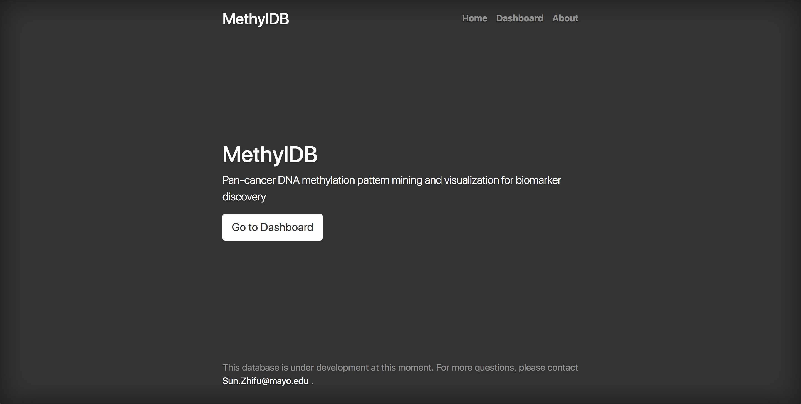
Results

Slide 10
Future plans
Make it available to connect to different datasets
Further analytical functions
Associate CpGs with clinical results, e.g. survival analysis
Discover most differentially expressed markers in tumor types
Publication

Slide 11
Quesitions?

