Slide 1

Your career planning begins with a good resume
Jessica Krause, Career Counselor, UTSA Career Center
Larry Clark, Lecturer, UTSA Computer Science
Notes:
Transition: “How is planning for your trip similar to career planning?”
“Planning is involved…You have to prepare….You should know at least the direction you’re going…You may need help along the way…You have to take trips in incremental pieces.”

Slide 2

Resumes should be clear, concise, and relevant

Slide 3
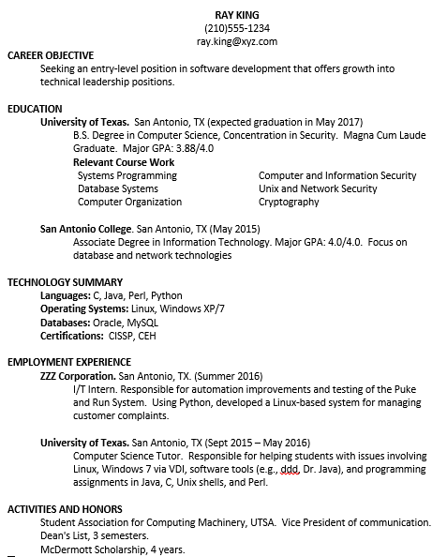
Version #1 – Example of a good 1 page resume
Objective is optional. For a career fair, it should be general. For a specific job, it should be specific.
List GPA if 3.0 or greater. If not listed, employers will assume it is < 3.0. If your major GPA is better than overall GPA, show it.
Either list relevant course work or important projects (see next example).
List previous earned degrees.
Only list technologies if you are comfortable using them.
Experience should be listed in reverse chronological order with a description of job duties or outcomes from that experience.
List activities and honors along with time frames.

Slide 4
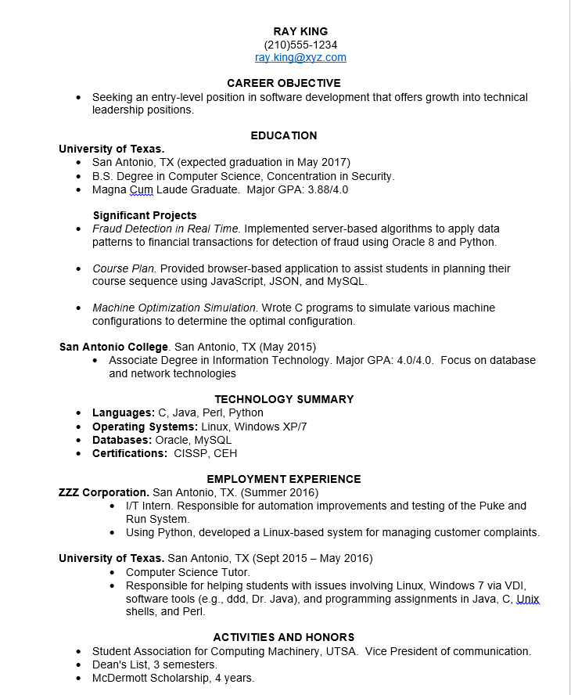
Version #2 – Example of a good 1 page resume
Bullet format
Includes projects under education vs. relevant courses. This helps show what you actually did.

Slide 5
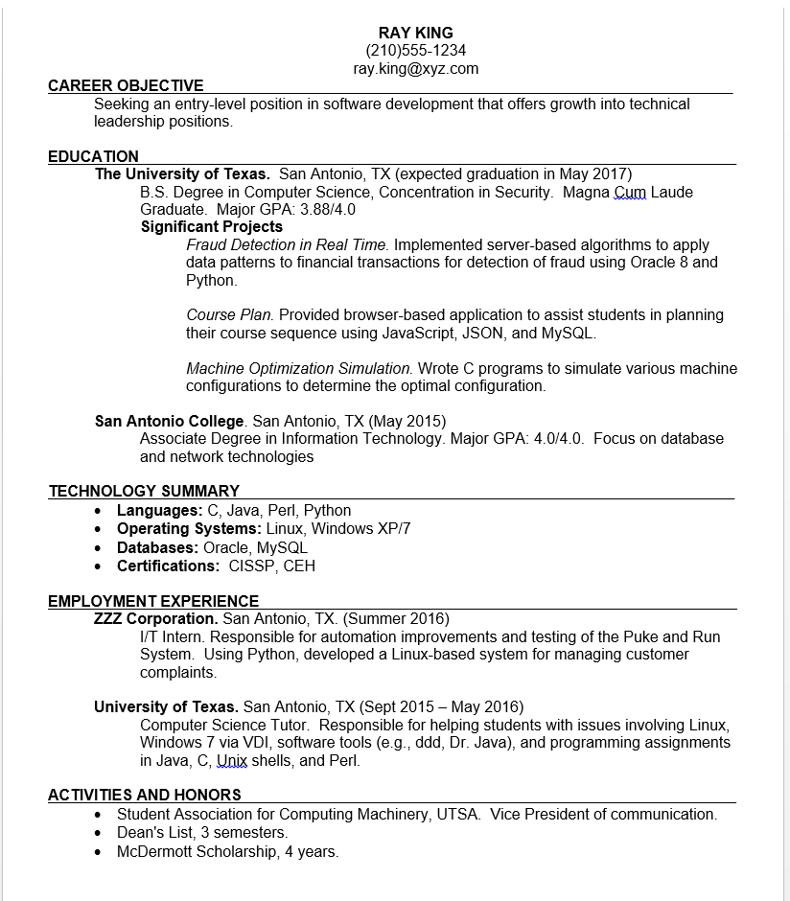
Version #3 Example of a good 1 page resume
Lines separate the categories
Notice the projects and experiences start out with action verbs to describe the experiences or outcomes.

Slide 6
Unfortunately, we have seen resumes like this one.
Multiple spelling errors (e.g., improvments, Infromation, Advicing).
LEE KING
(210)555-1234
lee.king@xyz.com
EDUCATION
University of Texas at San Antonio. B.S. Degree in Computer Science, Concentration in Security.
San Antonio College. Associate Degree in Information Technology.
EMPLOYMENT EXPERIENCE
University of Texas. Computer Science Tutor. San Antonio, TX Sept 2015 – May 2016
Helped students with issues involving Linux, Windows 7 via VDI, software tools (e.g., ddd, Dr. Java), and programming assignments in Java, C, Unix shells, and Perl.
Advicing students and answering questions
ZZZ Corporation. I/T Intern. San Antonio, TX. Summer 2016
Responsible for automation improvments and testing of the Puke and Run System.
Using Python, developed a Linux-based system for managing customer complaints.
McDonalds Inc. Shift Manager. San Antonio, TX. January 2007-Aug 2015
Listen to customer and employee complaints without killing anyone.
ACTIVITIES AND HONORS
Student Association for Computing Machinery, UTSA. Vice President of communication.
Dean's List, 3 semesters.
McDermott Scholarship, 4 years.
Additional Infromation
Computer Skills: Microsoft Office (Powerpoint, Excel, Word), C, C++
Interests: Hiking, Biking
Skills: Skilled an through in analyzing problems and situations, while finding effective and creative solutions. Superior problem solving skills, ability to work well under pressure to meet deadlines.
Work eligibility: Very flexible
GPA should be included if 3.0 or greater.
Category headings are difficult to distinguish from the subordinate information. White space is inconsistent.
“Additional Information” is not capitalized like the other category headings.
Experience should be listed in reverse chronological order with a description of job duties or outcomes from that experience. ZZZ Corporation should precede the other experiences.
Experience in the past should use past tense verbs.
It is good to show you have experience with customers and managing people as in the McDonalds experience; however, avoid phrases like “without killing anyone”
Computer Science students shouldn’t list Microsoft Office skills.
Showing “interests” is inappropriate.
“Skills” subordinate information is too wordy.

Slide 7
Examples of Career Objectives
Career Objective is optional . For a career fair, it should be general; however, for a specific job, it should be specific.
CAREER OBJECTIVE #1
Seeking an entry-level position in software development that offers growth into technical leadership positions.
CAREER OBJECTIVE #2
Since I genuinely love programming, I seek a software development job which allows me to continue learning new technology.
CAREER OBJECTIVE #3
To provide my technical skills in an organization dedicated to helping their customers.
CAREER OBJECTIVE #4
Seeking a challenging position as a software engineer where I can show my analytical and design strengths, allowing me to grow into a technical architect position.
CAREER OBJECTIVE #5
Seeking the position of software developer at XYZ Company allowing me to grow into a technical leadership role. The rapid adoption of new technologies at XYZ Company matches my desire to learn and apply those technologies.
CAREER OBJECTIVE #6
Seeking a cyber security analyst position in the financial services industry allowing me to demonstrate my proven technical and leadership skills.
Examples 1 through 4 are not company specific.
Example 5 is company specific. It shows why you are interested in the specific company.
Example 6 is industry-specific.

Slide 8
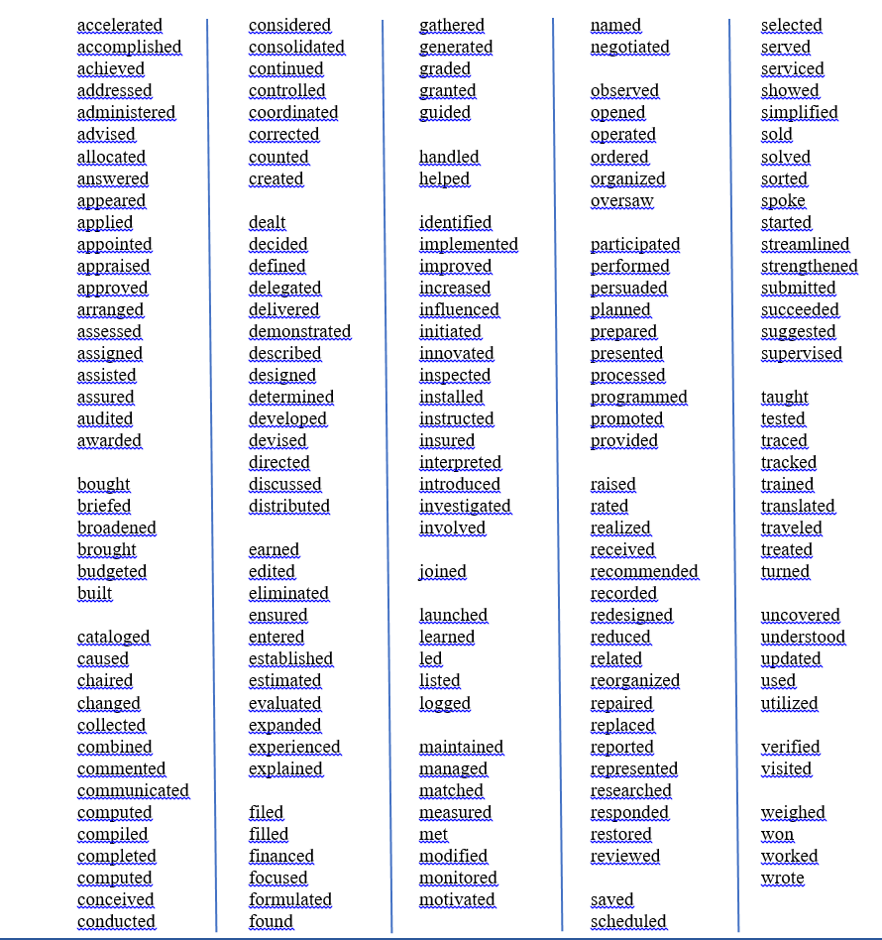
Action Verbs – Used at the beginning of a phrase to explain an experience or project.

