Slide 1

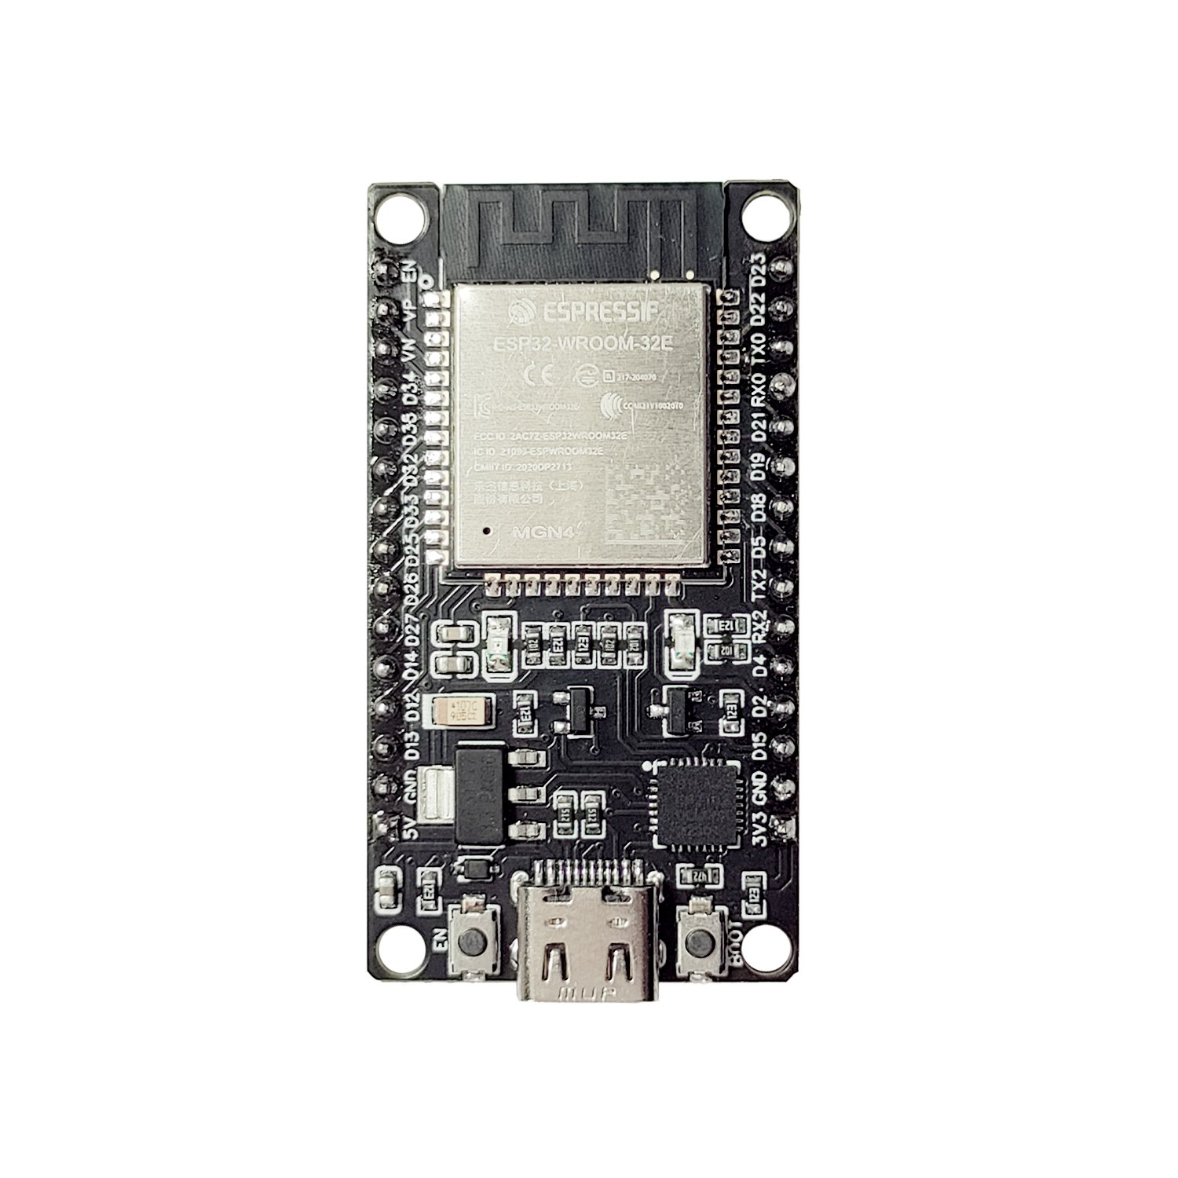


WSN
Node 2
Node 1
Node 3
ESP NOW
WebDash Board
Data
GateWay
Back-End – Google Firebase
Realtime Database
Firebase Hosting

Slide 2
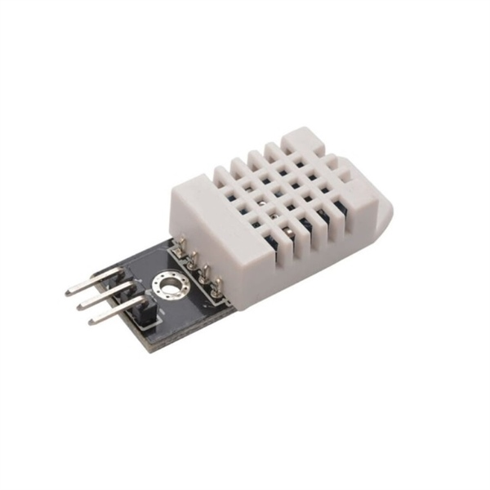
Node 1
Back-End – Google Firebase
Realtime Database
Firebase Hosting

