Slide 1
JEE Main WTM 29 Analysis
Student: B VISHAL CHANDRAKANTH Student ID: 257402707 Class: 12 Report Date: June 27, 2026

Slide 2
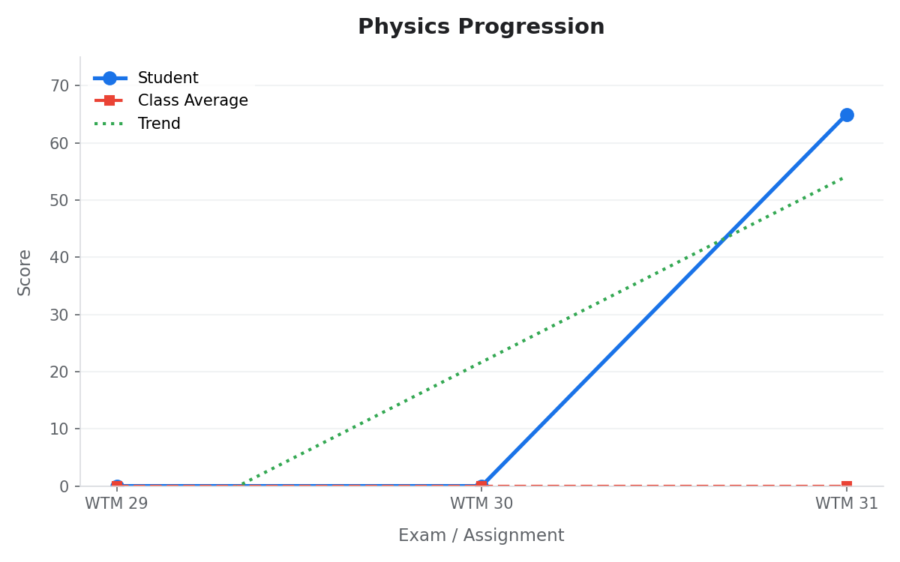
Physics Analysis
Key Data Points:
• Average Score: 21.67
• Max Score: 65.0 (on WTM 31)
• Min Score: 0.0 (on WTM 29)
• Trend Direction: Improving (+65.00 points from start)
• Class Comparison: Student is 65.00 points above the class average in the latest exam.

Slide 3
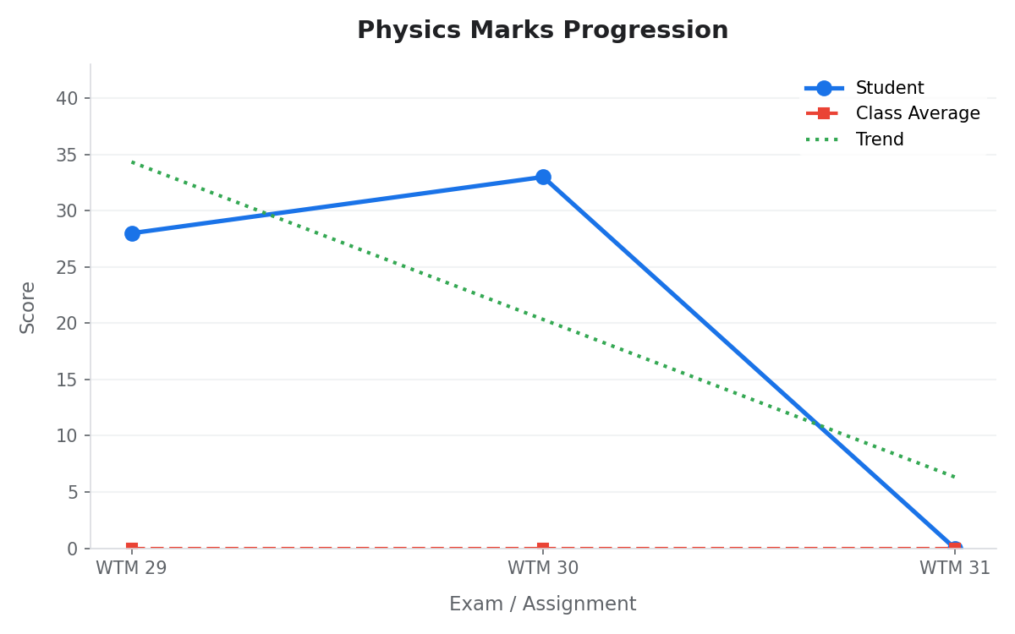
Physics Marks Analysis
Key Data Points:
• Average Score: 20.33
• Max Score: 33.0 (on WTM 30)
• Min Score: 0.0 (on WTM 31)
• Trend Direction: Declining (-28.00 points from start)
• Class Comparison: Student is equal to the class average in the latest exam.

Slide 4
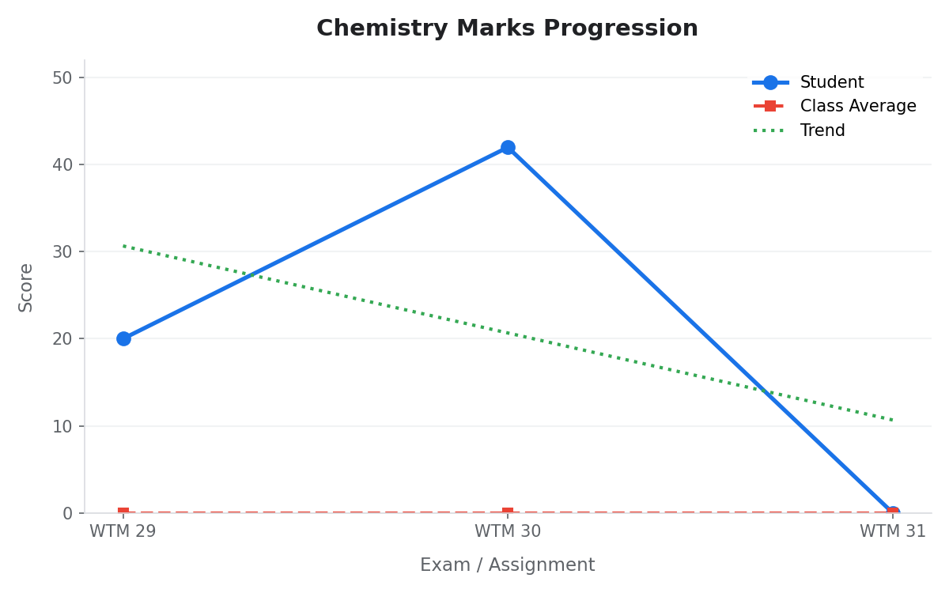
Chemistry Marks Analysis
Key Data Points:
• Average Score: 20.67
• Max Score: 42.0 (on WTM 30)
• Min Score: 0.0 (on WTM 31)
• Trend Direction: Declining (-20.00 points from start)
• Class Comparison: Student is equal to the class average in the latest exam.

Slide 5
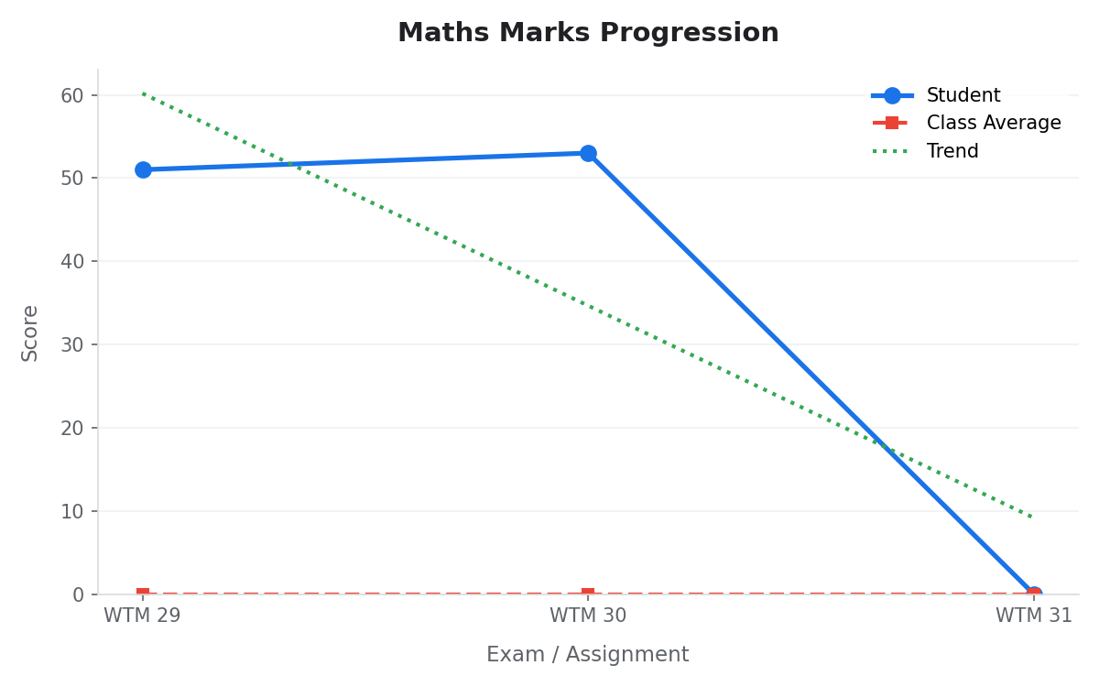
Maths Marks Analysis
Key Data Points:
• Average Score: 34.67
• Max Score: 53.0 (on WTM 30)
• Min Score: 0.0 (on WTM 31)
• Trend Direction: Declining (-51.00 points from start)
• Class Comparison: Student is equal to the class average in the latest exam.

Slide 6
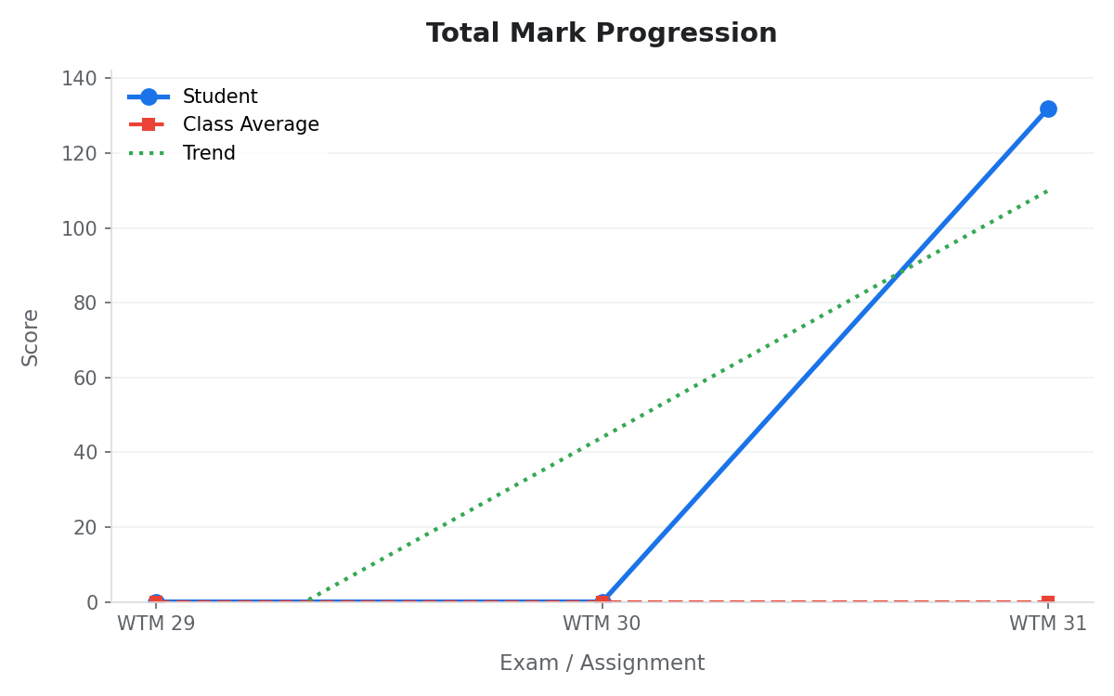
Total Mark Analysis
Key Data Points:
• Average Score: 44.00
• Max Score: 132.0 (on WTM 31)
• Min Score: 0.0 (on WTM 29)
• Trend Direction: Improving (+132.00 points from start)
• Class Comparison: Student is 132.00 points above the class average in the latest exam.

Slide 7
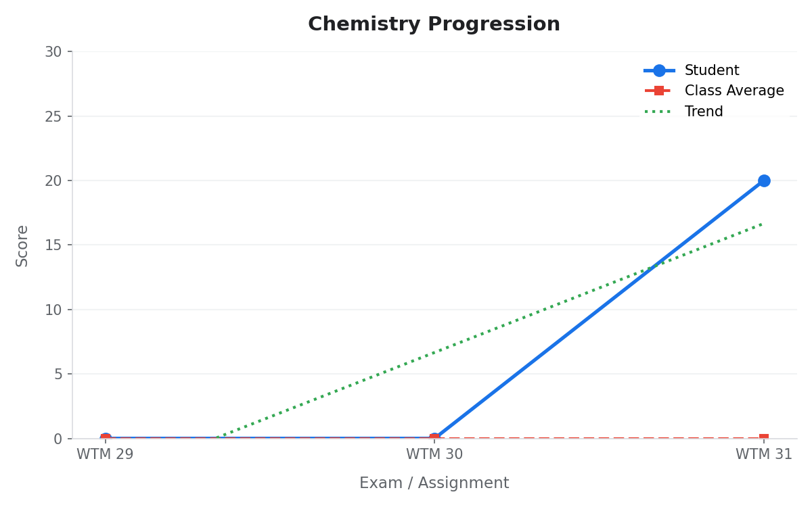
Chemistry Analysis
Key Data Points:
• Average Score: 6.67
• Max Score: 20.0 (on WTM 31)
• Min Score: 0.0 (on WTM 29)
• Trend Direction: Improving (+20.00 points from start)
• Class Comparison: Student is 20.00 points above the class average in the latest exam.

Slide 8
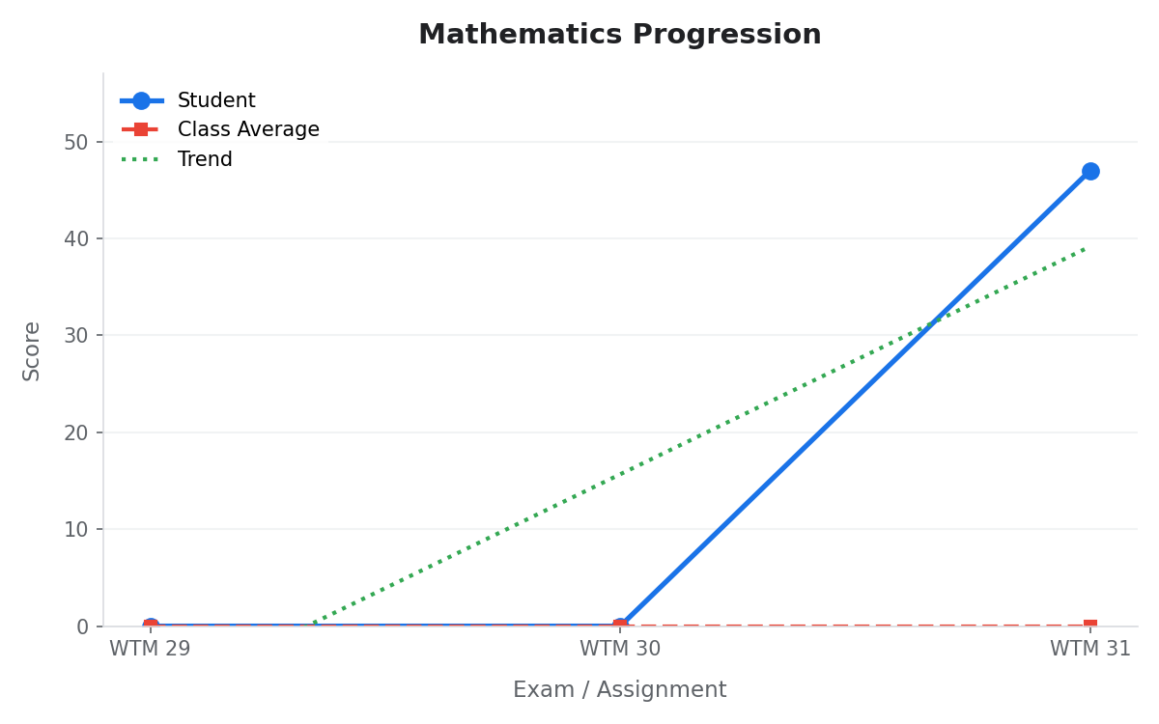
Mathematics Analysis
Key Data Points:
• Average Score: 15.67
• Max Score: 47.0 (on WTM 31)
• Min Score: 0.0 (on WTM 29)
• Trend Direction: Improving (+47.00 points from start)
• Class Comparison: Student is 47.00 points above the class average in the latest exam.

Slide 9
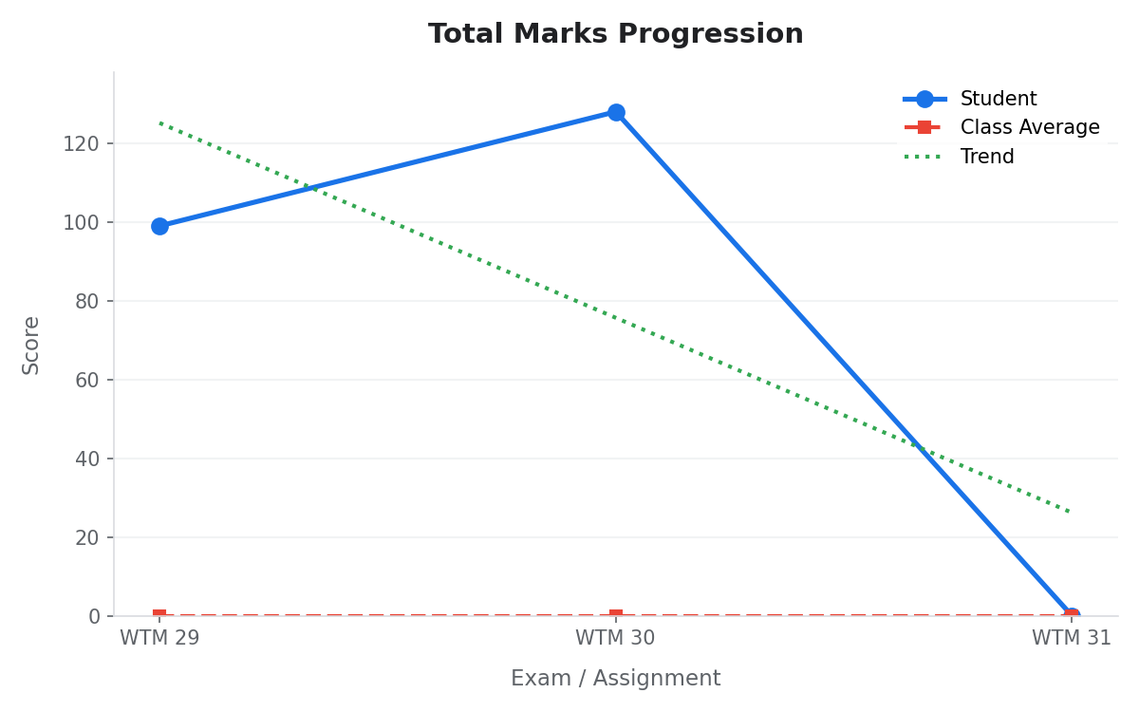
Total Marks Analysis
Key Data Points:
• Average Score: 75.67
• Max Score: 128.0 (on WTM 30)
• Min Score: 0.0 (on WTM 31)
• Trend Direction: Declining (-99.00 points from start)
• Class Comparison: Student is equal to the class average in the latest exam.

Slide 10
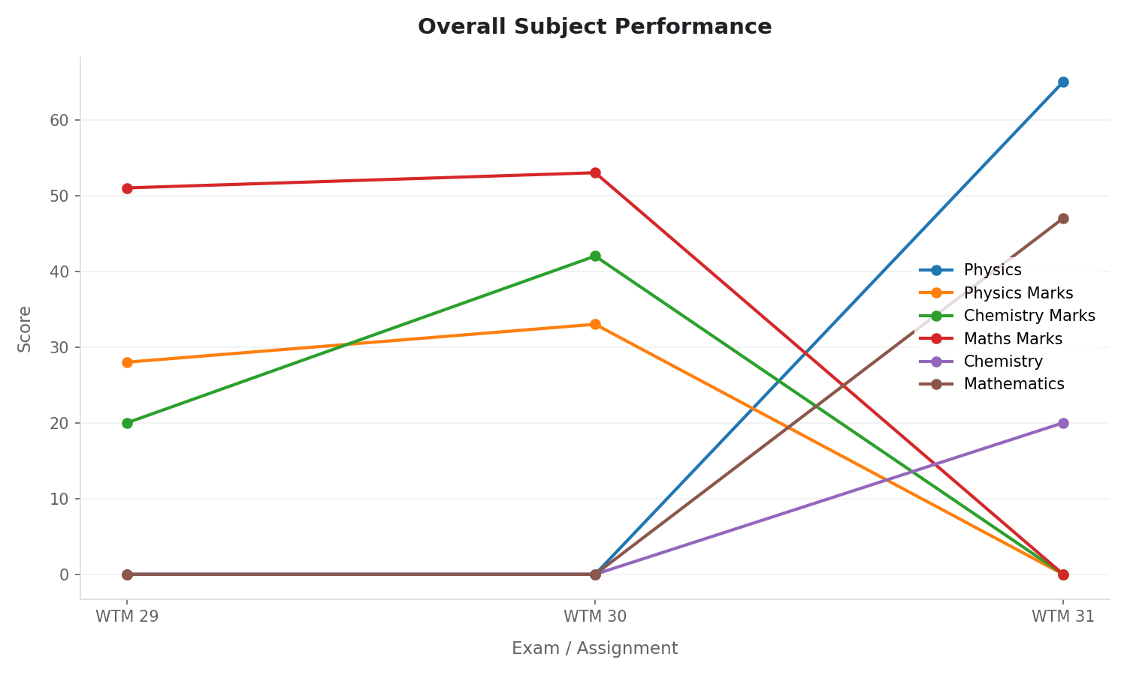
Overall Performance Summary
Key Takeaways:
Action Items:
1. Maintain performance in topics showing upward progression. 2. Review test materials in subjects showing declining lines. 3. Discuss class average discrepancies to ensure parity with peer groups.

