Slide 1
PARTNERSHIP PROPOSAL · FOR FITASY
StrideSense
Make every Stride understand how its wearer moves.
👟 Removable pod
🩺 Rehab
🏃 Performance
✅ Proven today
Xiaoyu Zhang · 2026

Slide 2
① THE PRODUCT
A pop-in pod that makes the shoe sense
👟
🔌
📱
Stride + pod cavity
Removable 6-axis pod
Phone app
✓ Custom fit
✓ Single-material recyclable
✓ Single-shoe
Removable by design — sensing added, recyclability untouched.
StrideSense · 2/9

Slide 3
② WHAT IT'S FOR
Two markets, one sensor
🩺 REHAB · anchor
🏃 PERFORMANCE · expansion
🚶 Gait: speed · cadence · stride
👟 Running: cadence · contact time
📉 Fall-risk (variability)
ONE
pod
💥 Impact · loading
🦶 Clearance · ROM
↔ Left–right asymmetry
🔁 Recovery: return-to-walk
🗺 Distance · trajectory
One pod → trajectory + clinical gait. A category of one — no rival owns both.
StrideSense · 3/9

Slide 4
② WHY IT MATTERS TO FITASY
From a one-time sale to a platform
👟 💲
📱 🔁
One-time shoe sale
Recurring health platform
💵
📈
🏥
🛡
Recurring revenue
Retention · LTV
B2B channels
Software moat
Illustrative: $[X]/mo tier · +$[Y] Smart-Stride SKU · ~[N]× LTV — we carry firmware/support.
StrideSense · 4/9

Slide 5
③ HOW IT'S USED
Wear · walk · see
👟
🚶
📶
📊
🤝
1. Wear
2. Walk / run
3. BLE → phone
4. Dashboard
5. Share
No calibration. The shareable report opens the B2B door.
StrideSense · 5/9

Slide 6
④ SPECS & EXPECTED
Honest ranges — green / amber / grey
· 6-axis ×2
· 16-bit
· ±16 g
· ±2000 dps
· 100–500 Hz
· ZUPT
RELIABLE
Cadence
<2%
Speed
ICC .83–.94
Clearance
~8–9 mm
Foot pitch
0.6–4°
Trajectory
0.5–2%
SPEED-DEP
Stride length
±7–13 cm
Run GCT
15–30 ms
TREND-ONLY
Gait CV
ICC ~0–.67
L–R symmetry
low
Trend-only metrics = screening signals, never precision medical claims. Confirmed on real pod in Phase 2.
StrideSense · 6/9

Slide 7
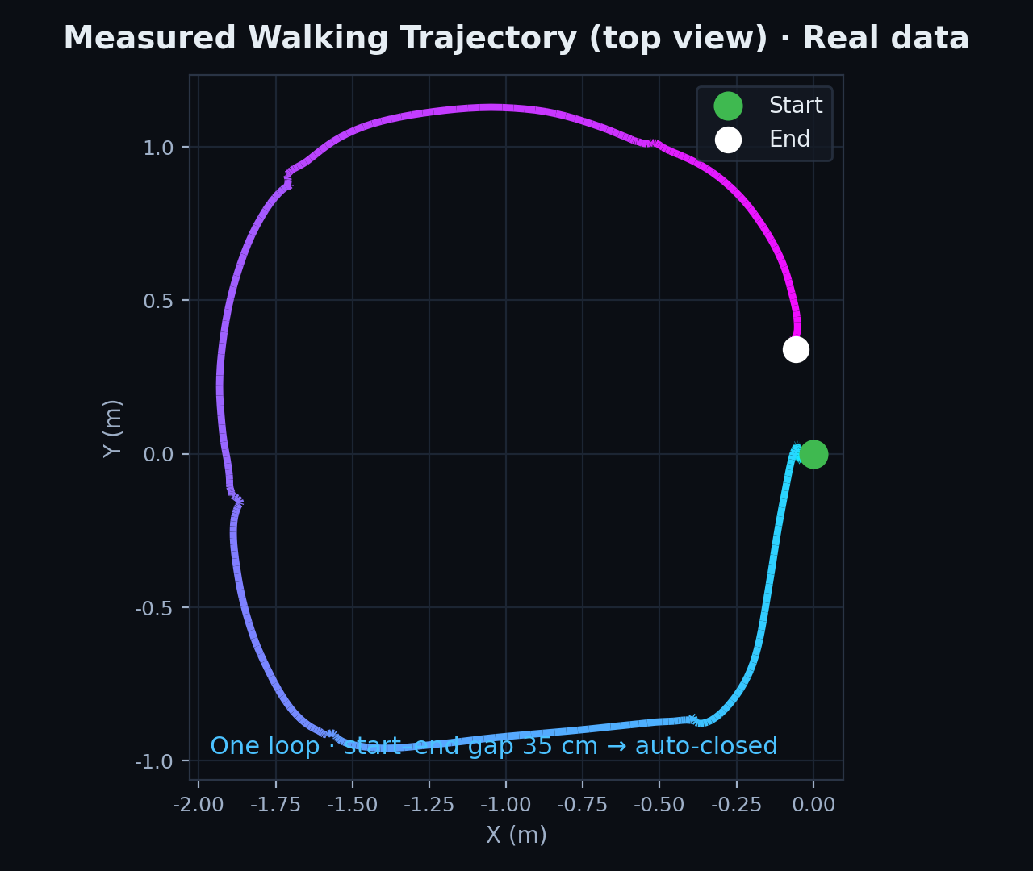
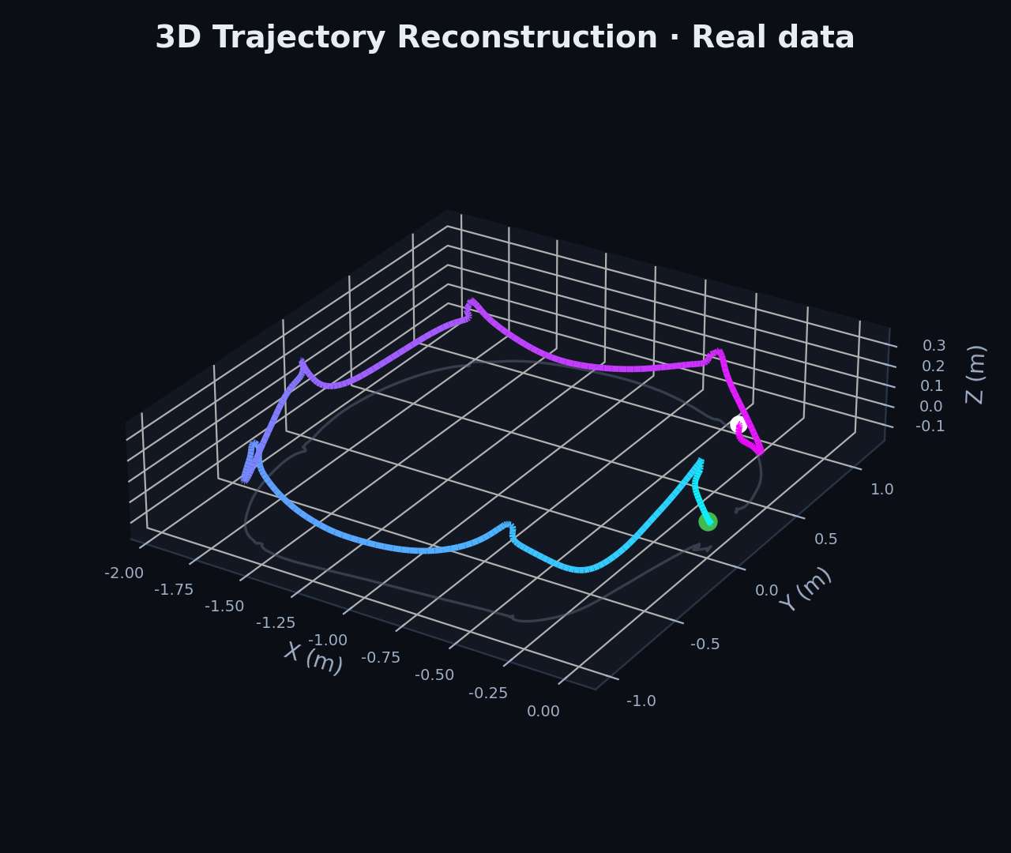
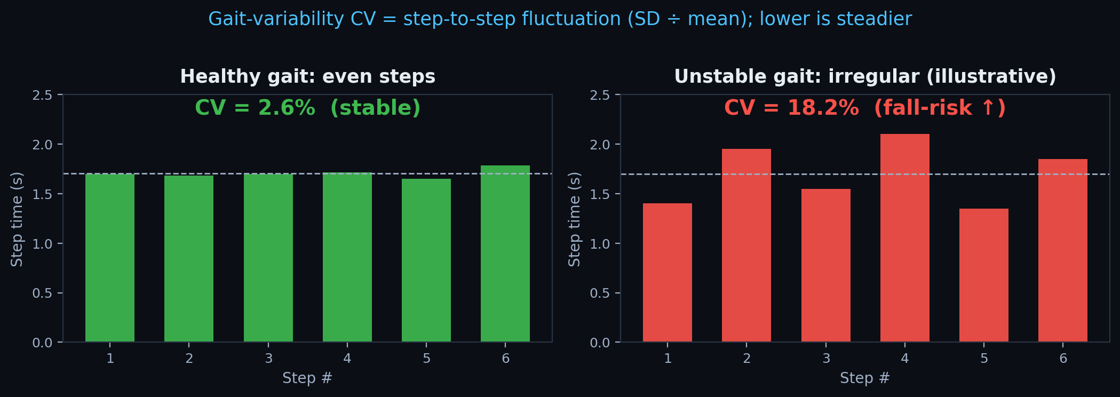
⑤ CURRENT DEMO
Real foot data — the loop closes itself
~94%
loop closure
6-axis
only — no GPS/cam
ZUPT
drift resets each step
Phone = clean 6-axis proxy · same IMU + algorithm as the pod → transfer risk is integration, not algorithm.
StrideSense · 7/9

Slide 8
⑥ PLAN & TIMELINE
Pilot-first · phase-gated
Phase 0
Phase 1
Phase 2
Phase 3
Phase 4
2026 Q2
2026 H2
2027 H1
2027 H2
2028
Algorithm proven
Pod + cavity prototype
Rehab + sport pilot
9-axis · clinical-grade
Launch + subscription
✓ DONE
BUILD
PILOT
SCALE
LAUNCH
Fund one step at a time. Wellness-first launch — no medical clearance needed.
StrideSense · 8/9

Slide 9
THE ASK
Low risk to your core, high upside
Fitasy owns
We own
🤝
Shoe · brand · channel · customer
Sensing · algorithms · app · IP
🔧
Co-design the
pod cavity
👟
Provide
pilot units
🔒
Exclusivity +
co-owned data
Next step: scope the cavity + pilot. Bounded to test, high optionality to scale.
StrideSense · 9/9

