Slide 1
Phone Demo · Specs & Accuracy Comparison
StrideSense
Foot-mounted 6-axis IMU · phone demo proven (feasibility)
⚠️ Pain: L-R asymmetry · impact overload · unstable landing — invisible to the eye; training by feel = injury + plateau
Now: one iPhone reconstructs trajectory & gait → Next: commercial 6-axis IMU embedded in Fitasy shoes
📱 Live Demo
📊 Accuracy & Capability
🚀 Future Apps
Xiaoyu Zhang · 2026
StrideSense · 1/6
Notes:
SPEAKER NOTES · Cover (~45s)
• Hook: "Athletes train by feel — but the foot is where the truth is, and the eye can't see it."
• Point to the ⚠ box: left-right asymmetry, impact overload, unstable landing → invisible → injury + plateau.
• What we built: today, ONE iPhone strapped to the foot already reconstructs trajectory + full gait. No app, no special hardware.
• Where it goes: a commercial 6-axis IMU pod embedded in YOUR Fitasy shoes — that is the proposal.
• Agenda: three things — live demo, accuracy & capability, future apps.
→ NEXT: "Let me show you it actually works."

Slide 2
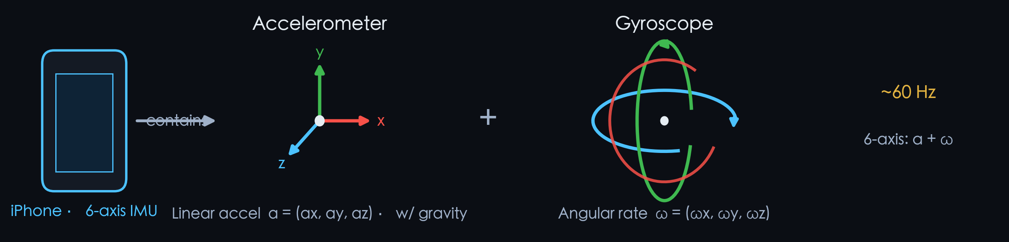
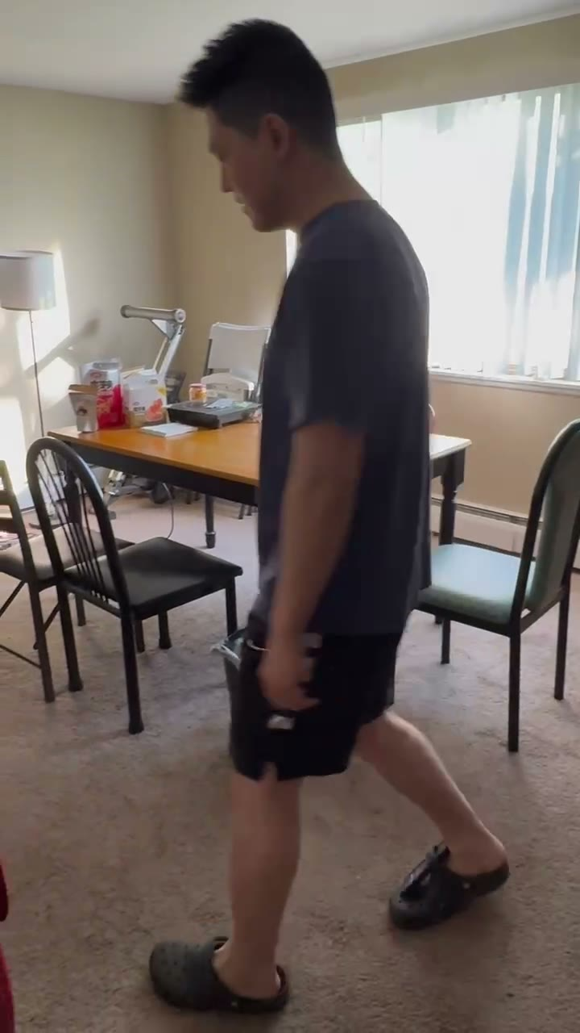
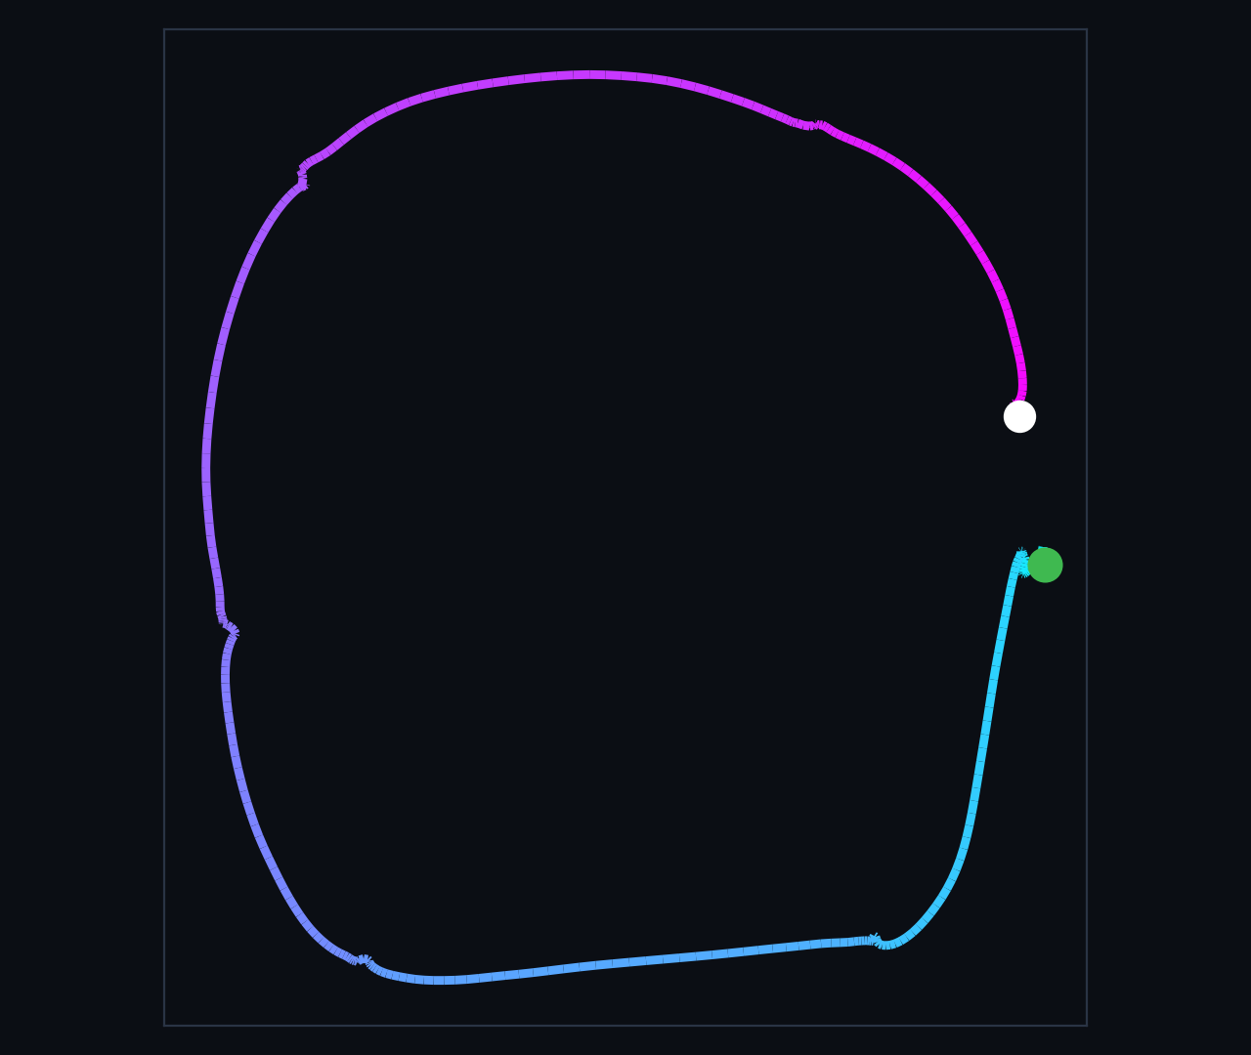
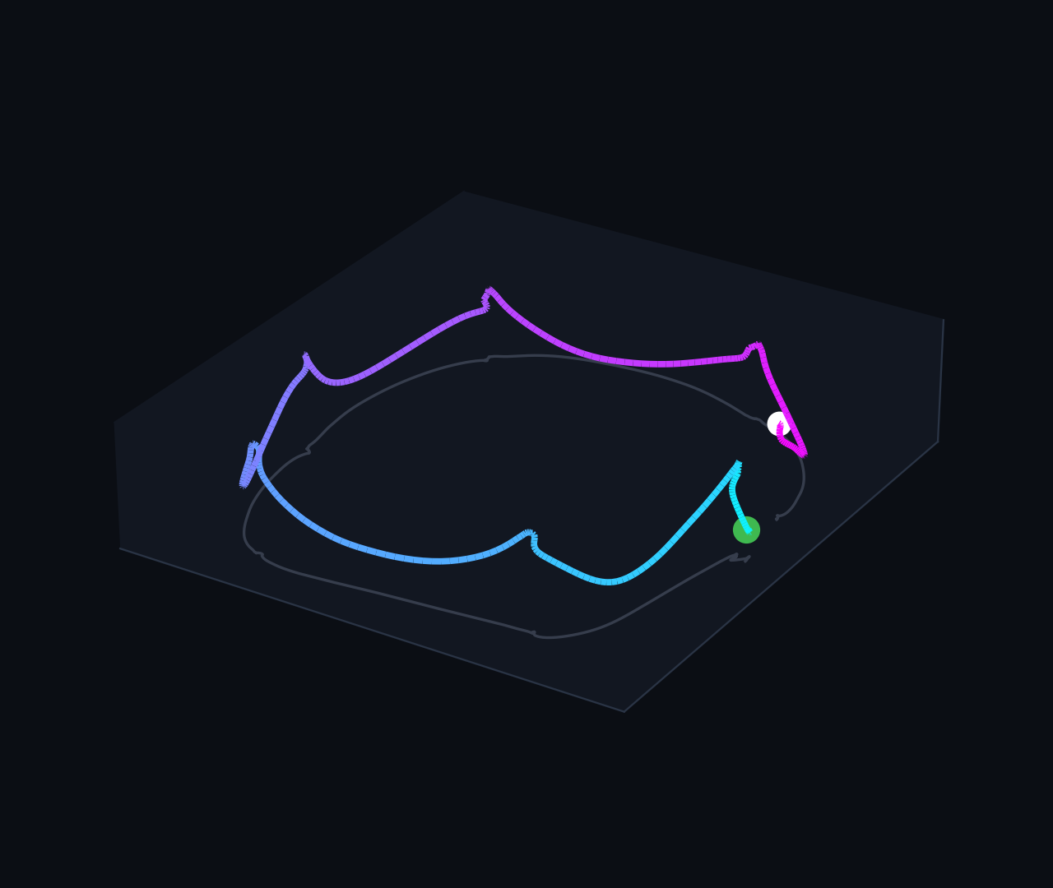
① Current Demo · Device & Results
Phone 6-axis IMU records real walking → reconstructs 2D / 3D trajectory
📹 Real recording
2D trajectory · ●start→○end
3D trajectory
One phone (accel + gyro) already reconstructs a full single-foot gait trajectory — an in-shoe commercial pod only makes it steadier & more complete.
Scope: single walk ~8.6s · 6 steps · 60Hz · open path (not a loop) · step-time CV≈1.7%; shows feasibility & trajectory reconstruction, not validated vs motion-capture ground truth.
StrideSense · 2/6
Notes:
SPEAKER NOTES · Demo (~1.5 min, + live demo)
• Real data, not a mockup: an iPhone's built-in 6-axis IMU (accelerometer + gyroscope) recording a real walk.
• Left = the sensor; middle = the actual recording; right = reconstructed 2D ground path + 3D trajectory.
• Why it does not drift: every footfall is momentarily still → we zero the velocity each step (ZUPT) → no runaway drift.
• KEY LINE (say it): one phone already reconstructs a full single-foot gait trajectory; an in-shoe pod only makes it steadier & more complete.
• Be honest: one ~8.6s walk, 6 steps, 60Hz, open path — proves feasibility + reconstruction, NOT yet validated vs motion-capture.
• [LIVE DEMO — optional, ~2 min]: open the phone page, Calibrate → Walk mode → walk a few steps → show the live ground path + gait panel. Keep it short.
→ NEXT: "It works — but is it accurate enough to be useful?"

Slide 3
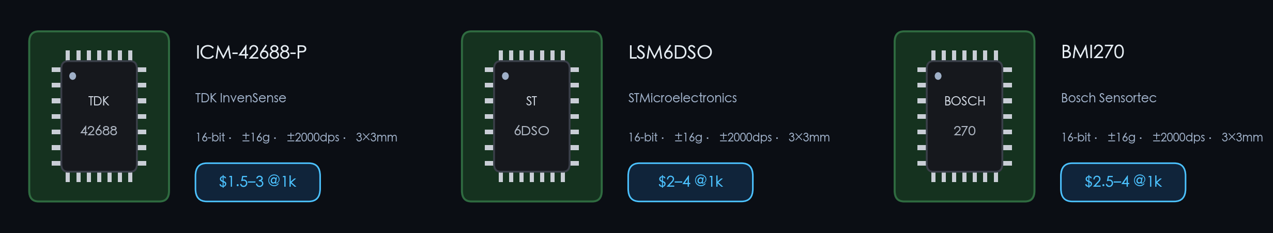
② Phone Demo vs Commercial 6-axis IMU · Accuracy & Capability
Is each feature accurate enough to serve as an absolute metric?
📱 Phone Demo · iPhone built-in 6-axis (Bosch)
Commercial 6-axis IMU pod (real parts)
16-bit · ±16g
±2000 dps
ODR ≥1 kHz
rigid in-shoe · hard timebase
~60 Hz · 16-bit · fixed range · soft-strapped · weak sync
↔ Same class of 6-axis & same algorithm — just lower rate, softer mount
11 features →
✓ 7 · absolute metrics
~ 4 · relative
Feature
Phone demo accuracy
Commercial pod accuracy
Capability (metric?)
Cadence
±2–3 spm
±1–2 spm
Absolute
Stride time
±20–40 ms
±5–15 ms
Absolute
Gait CV
±1–1.5%
±0.5–1%
Absolute
Ground contact GCT
±30–60 ms
±5–15 ms
Absolute
Stance / Swing
±5–8%
±2–3%
Absolute
Stride length
±8–15%
±2–5%
Absolute
Gait speed
±10–20%
±3–8%
Relative
Symmetry LSI
needs both feet
±2–4% (both feet)
Absolute
Toe clearance MTC
±3–6 cm
±1–3 cm
Relative
Foot angle
±5–10°
±1–3° (contact)
Relative
2D / 3D trajectory
high drift
higher rate + rigid
Relative
■ Absolute = usable directly as a metric ■ Relative = needs one calibration, but the change is precise. Foot signals a watch can't measure.
Source: phone column = on-device measured, ± are estimates (single trial, uncalibrated); commercial column = datasheet / literature upper bounds, benchmarked to Vicon, Plantiga.
StrideSense · 3/6
Notes:
SPEAKER NOTES · Accuracy & Capability (~1.5 min)
• Two columns: left = the phone demo (iPhone 6-axis), right = a commercial 6-axis pod (real parts).
• Same sensor class, same algorithm — the pod just adds higher rate, rigid mount, hard timebase.
• HEADLINE (point to the bar): of 11 gait features, 7 are good enough to use as ABSOLUTE metrics; 4 are RELATIVE — one calibration, but the change is precise.
• Don't read the table line by line. Message: cadence, stride time, gait CV, ground-contact, stance/swing, stride length — all absolute. These are foot signals a watch cannot measure.
• Honesty (source row): phone ± are estimates from a single uncalibrated trial; commercial column = datasheet / literature upper bounds, benchmarked to Vicon & Plantiga.
→ NEXT: "So what do these features actually unlock?"

Slide 4
③ Future · What a Commercial 6-axis IMU Enables
One in-shoe pod covers both Athletic Performance + Sport Rehab
Athletic Performance · running efficiency / training load
🏃
🗺
🏋
Running form & efficiency
Path & range of motion
Training load management
Detected features
Cadence · GCT · flight ratio · foot angle · symmetry
Detected features
2D/3D trajectory · speed · turn analysis
Detected features
Cumulative impact · steps · GCT · load asymmetry
Sport Rehab · return-to-sport (ACL · ankle · overuse)
⚖️
📉
🦶
Return-to-sport · symmetry LSI
Fatigue · landing stability
Trip / clearance risk alert
Detected features
L-R & stride symmetry · single-leg load · stability
Detected features
Gait CV · landing impact · cycle variability
Detected features
Toe clearance MTC · variability · foot angle
Swap the report template to cover both scenarios; each app = a set of quantifiable foot features.
StrideSense · 4/6
Notes:
SPEAKER NOTES · Future Apps (~1 min)
• One pod, two scenarios — both matter to your customers.
• Athletic Performance: running form & efficiency, path / range of motion, training-load management.
• Sport Rehab — this is RETURN-TO-SPORT, not medical: symmetry / RTS readiness, fatigue & landing stability, trip / clearance risk.
• Each "app" is just a different report template over the same quantifiable foot features.
→ NEXT: "Which raises the obvious question — can this actually fit inside a shoe?"

Slide 5
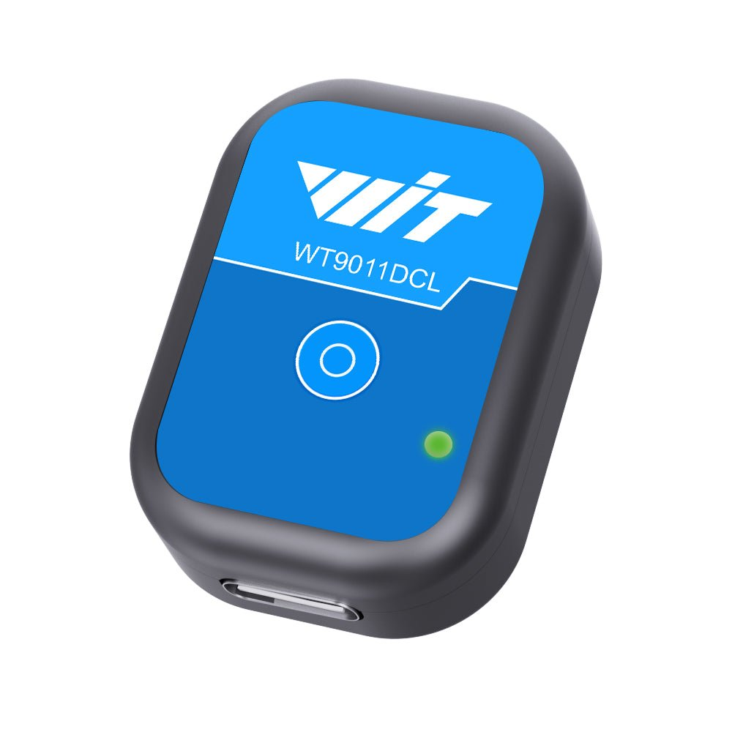
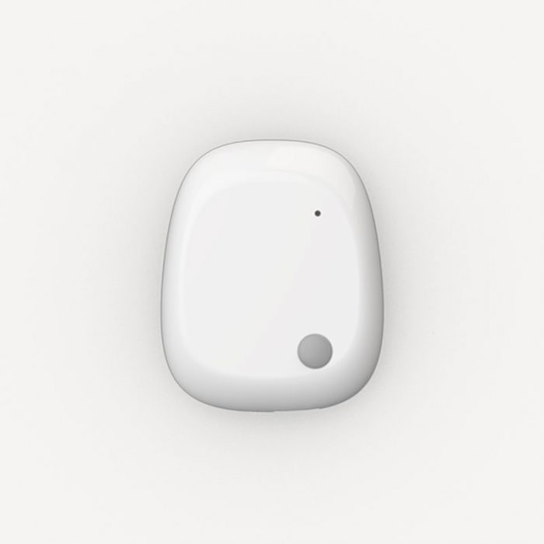
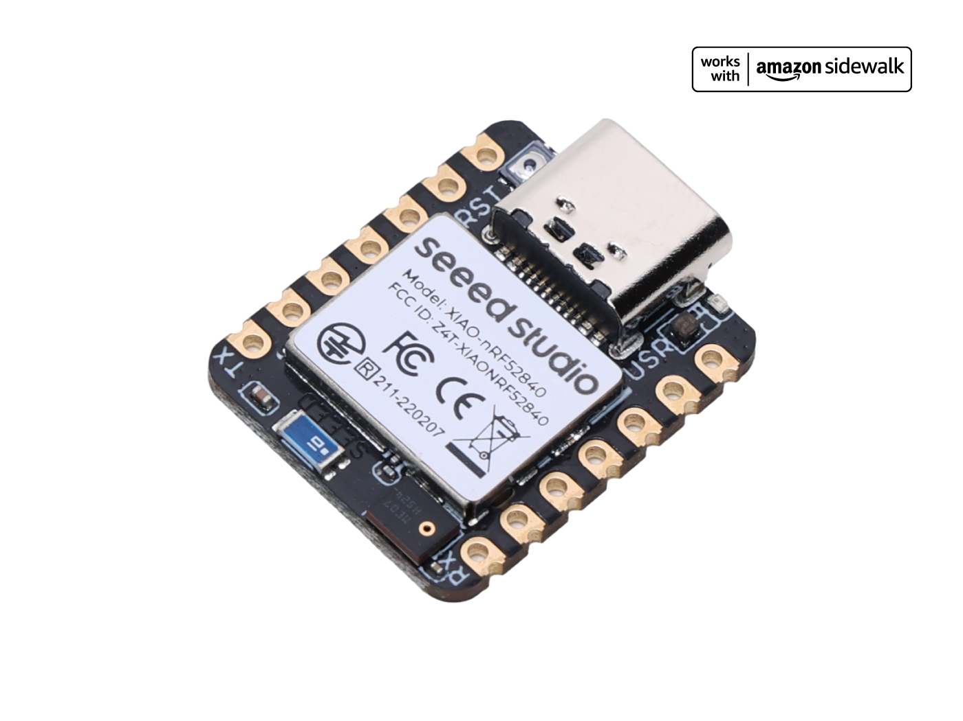
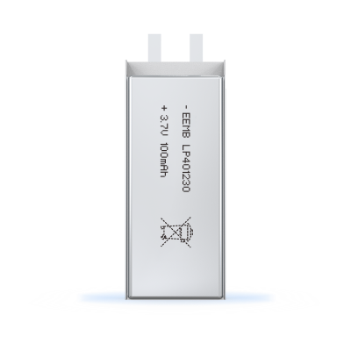
④ Hardware · Two Routes to In-Shoe
Complete modules are all ≥10mm — two viable in-shoe routes, no circuit design
A · Fast route — off-the-shelf module + custom pocket
B · Thin route — tiny board + ultra-thin battery ~5mm
Complete module (BLE+battery) → custom Fitasy midsole pocket, removable
Tiny board (BLE+6-axis) + ultra-thin LiPo → ~5mm stack, any insole
WitMotion WT9011DCL
mbientlab MMS
Seeed XIAO nRF52840 Sense
Ultra-thin LiPo pouch
~12mm · $16–30
10mm · $130
21×18×3.5mm · $16
~1mm / 50mAh · $3
✓ No circuit design · off-the-shelf · pilot in 1–2 wks
= ~5mm pod stack · 6-axis + BLE5.4 · built-in charging
✗ Thick ~10–12mm → fits a custom midsole pocket, removable
✓ ~5mm, thinnest & unnoticeable, fits any thin insole
→ Exactly the 'buy + package' idea; custom shoe is the key
✗ Needs a battery connected (light assembly, no circuit design)
Plan: route A (fast) for the real-shoe pilot first → route B (thin) for productization; both off-the-shelf, no circuit design.
StrideSense · 5/6
Notes:
SPEAKER NOTES · Hardware · Two Routes (~1.5 min)
• Honest reality first: complete off-the-shelf modules (battery + Bluetooth built in) are all ≥10mm — you can't lay one flat in a thin insole.
• Two routes, NEITHER needs us to design a circuit:
• Route A (fast): a complete module (WitMotion ~$16–30, or mbientlab) → a custom Fitasy 3D-printed midsole pocket, removable. This IS the "buy + package" idea — your custom shoe is the enabler. Pilot in 1–2 weeks.
• Route B (thin): a tiny board (Seeed XIAO, 3.5mm) + ultra-thin LiPo → a ~5mm stack that fits any insole, unnoticeable. Needs a battery connected = light assembly, still no circuit design.
• Plan: Route A for the pilot now → Route B for productization.
→ NEXT: "So here is what I'm actually proposing."

Slide 6
⑤ Next · From Phone Demo to In-Shoe Product
Three steps: real-shoe pilot → validate accuracy & stability → thin-pod product
Phone demo proves '6-axis can reconstruct gait'; commercial pod accuracy = the next target to realize in-shoe, not yet achieved.
🛒
🎯
👟
① Off-the-shelf · pilot
② Validate accuracy & stability
③ Thin pod · product
Complete module (BLE+battery) in
Fitasy custom midsole pocket · removable
Confirm measurement accuracy
& everyday reliability
Build a ~5mm thin pod
seamlessly embedded in Fitasy shoes
🚀 Proposal: start with an off-the-shelf module + custom midsole pocket; run one joint real-shoe pilot on a Fitasy model with agreed, verifiable milestones.
Business model & pricing are in the full business deck.
StrideSense · 6/6
Notes:
SPEAKER NOTES · Next & The Ask (~1 min)
• Three steps: ① off-the-shelf module in a Fitasy custom midsole pocket → ② validate measurement accuracy & everyday reliability → ③ a ~5mm thin pod seamlessly embedded in your shoes.
• THE ASK (CTA box): start with an off-the-shelf module + custom pocket, and run ONE joint real-shoe pilot on a Fitasy model, with agreed, verifiable milestones. Low cost, low risk, fast.
• Business model & pricing live in the separate business deck — happy to walk through it after.
• Close: "The phone demo already proved the algorithm. The only thing left is to put it in your shoe — and that is a pilot, not a research project."
[TOTAL ≈ 7 min talk + ~2 min live demo = 9–10 min]

