Slide 1

MULTIPLAYER SIDE-SCROLLING SHOOTER GAME – UNITY ENGINE
Internship project by:
Nguyễn Ngọc Khanh – BI12-205

Slide 2
Introduction

Slide 3
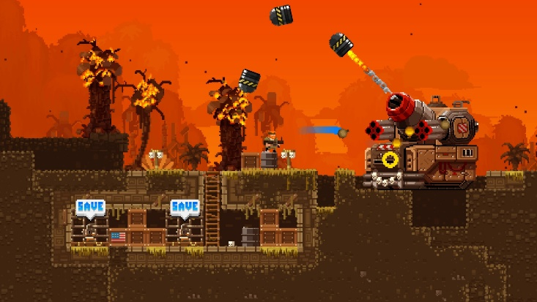
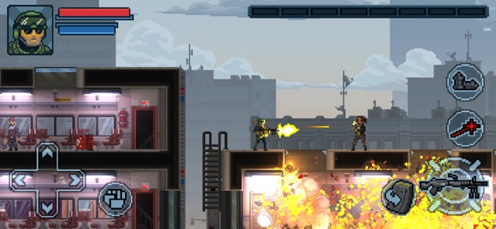
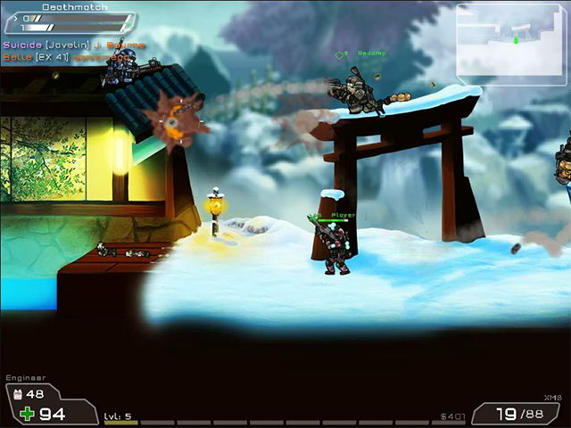
Definition
Side-scrolling shooter :
+ Side-view camera angle
+ 2D graphic style, 2D dimensional controller
+ Gameplay revolves around ranged firearm weapons
+ Simple in graphic and programming
Real-time online multiplayer :
+ Allow players in a wide region to interact with each other in real-time using different devices
+ Randomize opponents
+ Reward and progressing system

Slide 4
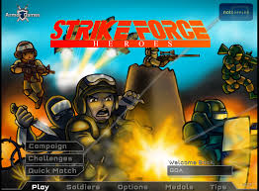
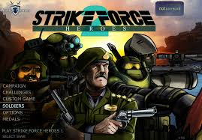

Motivation
Side-scrolling games: simple in graphics and program engineering => favored by indie developers/amateur developers
Online multiplayer: more challenging gameplay, application of networking architecture and database
Tribute to Strike Force Heroes – A popular flash game back in 2013

Slide 5
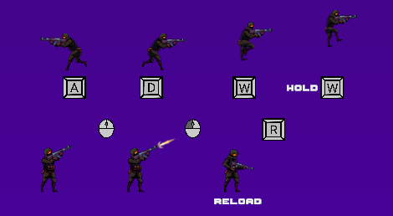
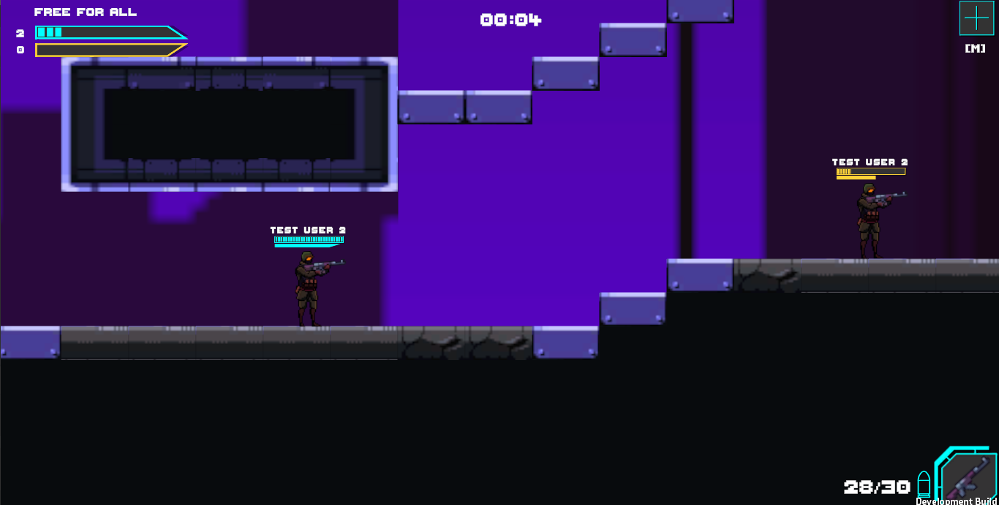
Featured content
Controller:
Timer
Maximum score = 12
Enemies (Kill)
You (Stay alive)

Slide 6
Objectives
The main goal of this project is to develop a real-time multiplayer in the format of a side-scrolling shooter game:
- Create a base 2D shooter game in Unity that handles the gameplay, mechanism and game logics that let players to control.
- Create a networking system that allows players to actually interact with each other using game mechanism in real time.
- Create a progressing system that allow players to unlock more content using the rewarded currency after each match to keep them engaging with the game.
- Create a database and host it online to stores player’s progress in the game.

Slide 7
Material and methods

Slide 8




Technologies application
Unity Game Engine: Provides optimal tools and solutions to make a complete game.
Photon 2 Engine: A real-time multiplayer framework that provides the tools and services necessary for developing multiplayer games and applications.
Database: store various game information like account information, token-based authentication and data about player’s progression in the game. SQL and PHP are utilized in order to ensures connection between Unity and database

Slide 9
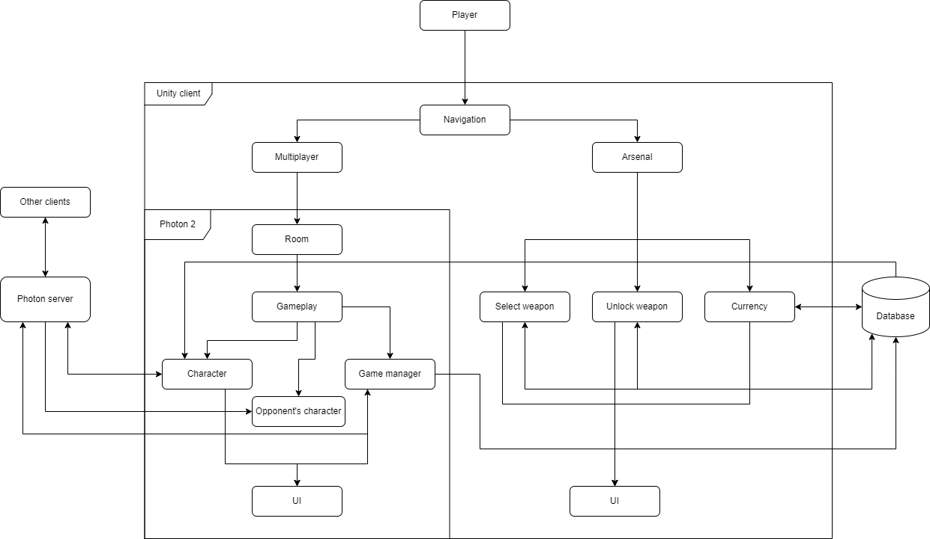
Framework
Demonstrate how major components of a system interact with each other

Slide 10
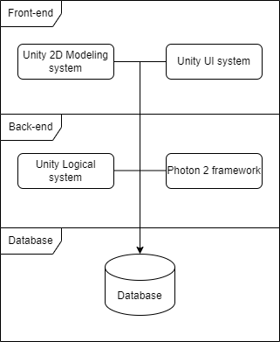
Layer architecture
Generalize structure of the application
Unity UI system: User interface (buttons, input fields, timers, health display, …)
Unity 2D modelling system: 2D objects that player can interact/control (Character, geometrical environment, weapons, …)
Unity logical system: Control behavior of Game Objects
Photon 2 framework: Extension that ensures the connection between Unity client and Photon server.
Database: Stores and organize data used in the game

Slide 11
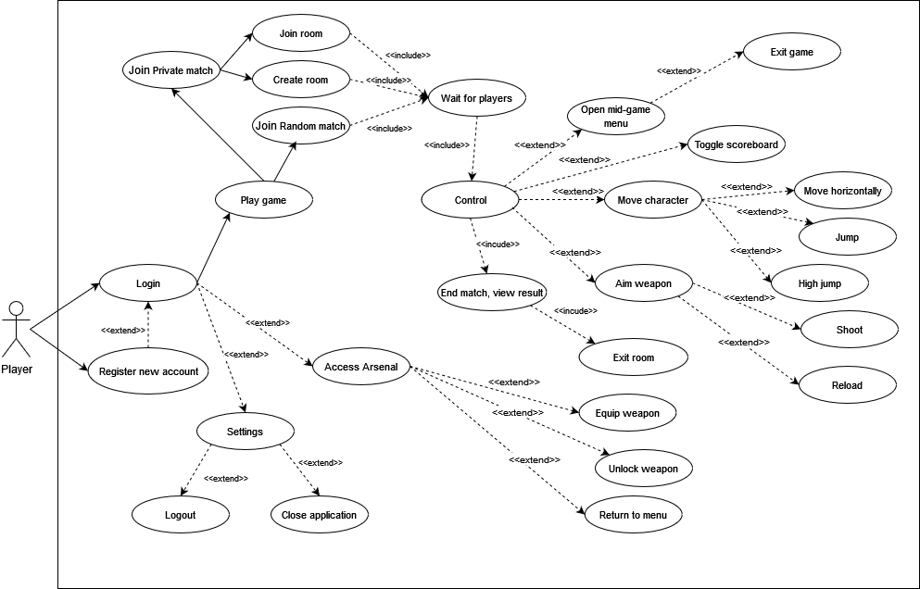
System analysis and design
Use case diagram:
Character controller:
This shows every way player can control character and interact with in-game UI
Join room:
Player can choose to join random room to play against strangers or private room to play with friends
Setting:
Players have options to log out of the account or exit the application completely
Access arsenal:
Player can select/unlock weapons
Register/Login:
Login is mandatory to access the game
If player don’t have an account, they has an option to create one

Slide 12
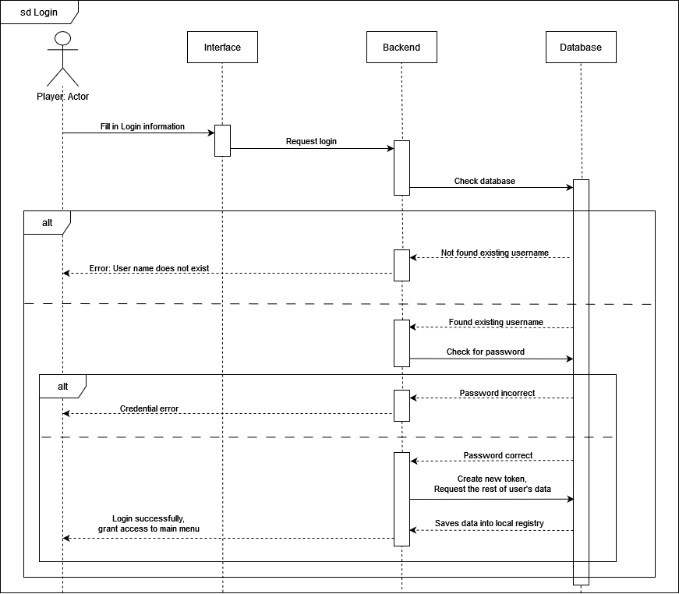
Sequence diagrams:
Login:
User requests login, system simply check the database. If the account info does not valid, report what’s wrong to player, else grant access to game

Slide 13
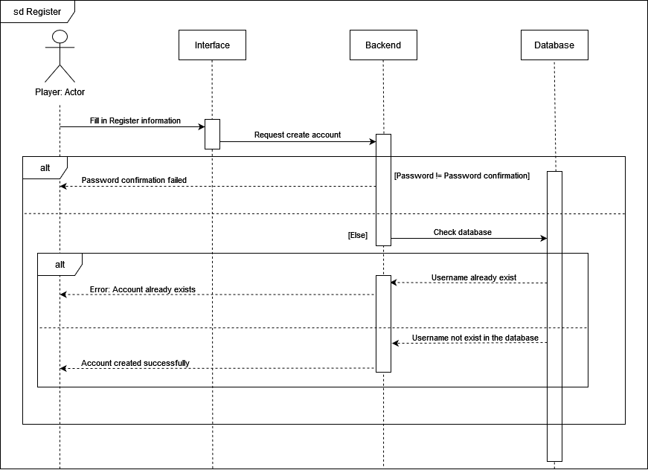
Register:
Validate player’s request to create account, then check database to see if there’s already an account with identical username. If there’s problem system will let player
know

Slide 14
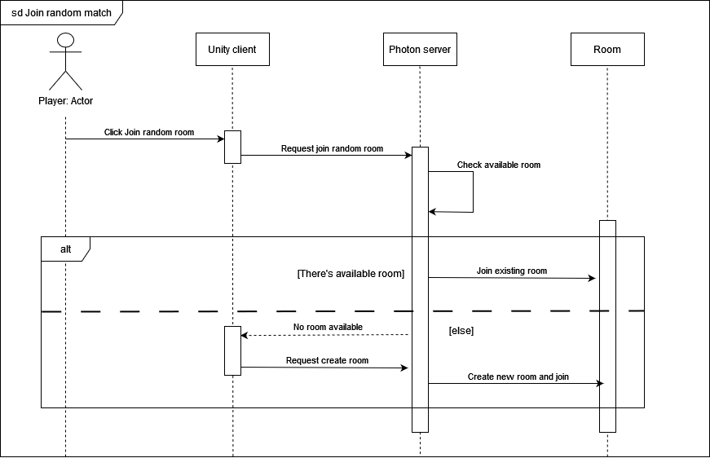
Join random match:
Find an existing room for player to join. If there is no room available, automatically create one
“Room” is just a concept created by Photon to group player together into a match. Players are still using Unity client

Slide 15
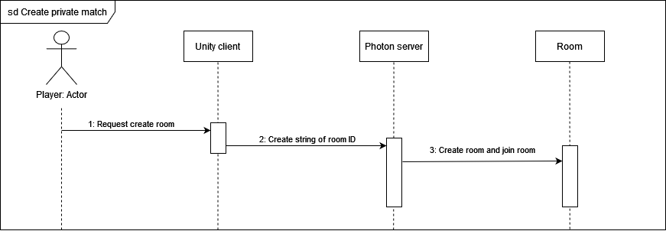
Create private room
Simply request to create room, the system will grant player a private room with visible ID. Room created can only be joined by players who know the ID

Slide 16
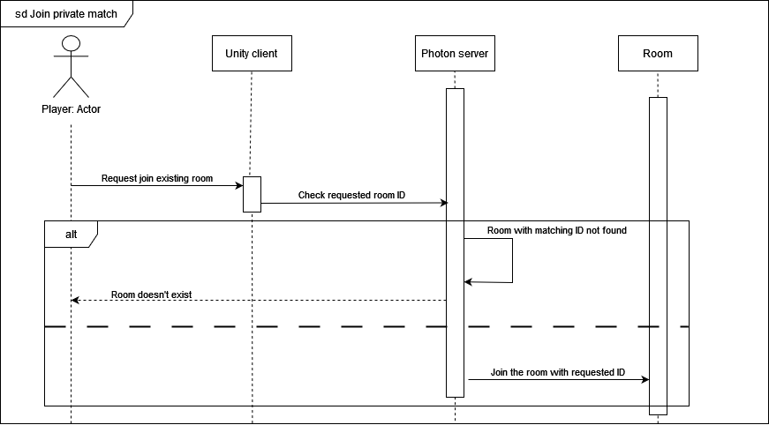
Join private match:
After a player created a private room, another must know the ID if they with to join it. Request joining room with wrong ID will return notice message

Slide 17
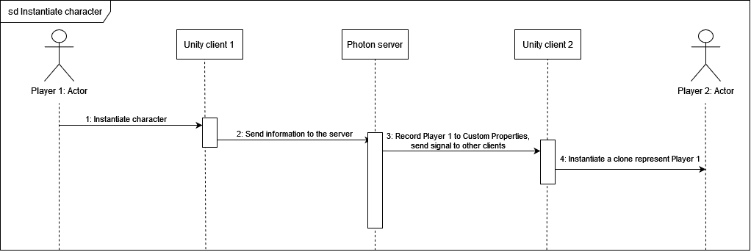
Instantiate character:
Players does not directly interact with each other using the character they are controlling. Instead Photon creates a clone that represent the player in every other Unity clients

Slide 18
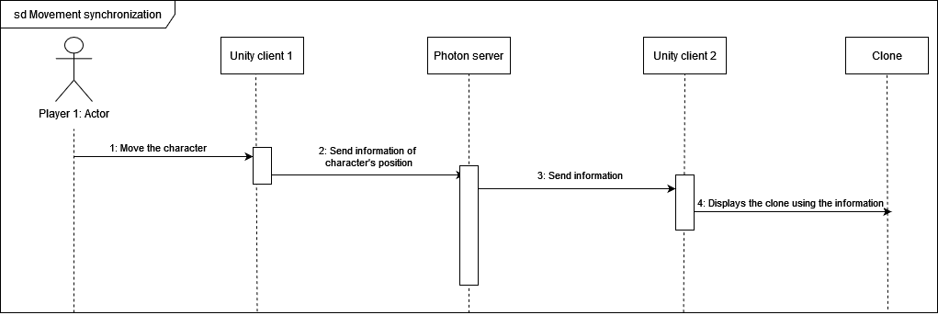
Character movement synchronization :
The “clone” represent players in the foreign clients must imitates exactly how the player control the character in the local client. Hence, requires synchronization between clients.
The “Photonview” component and the method “OnPhotonSerializeView” included in Photon 2 framework assist a lot on this task

Slide 19
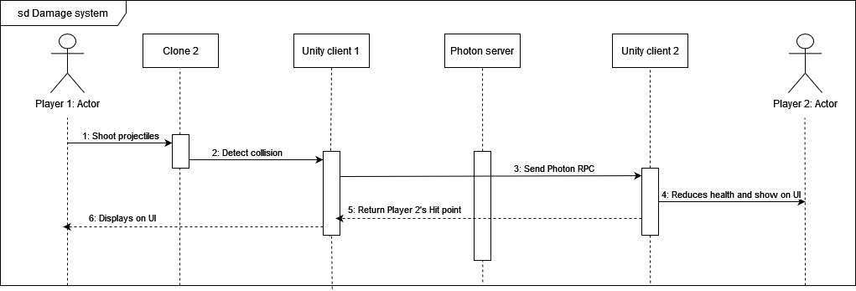
Damage and Health system
In order to make the damage and health system works across the Photon Network, a feature in Photon 2 framework called Photon RPC (Photon Remote Procedure Call) is used to execute methods on other player’s client

Slide 20
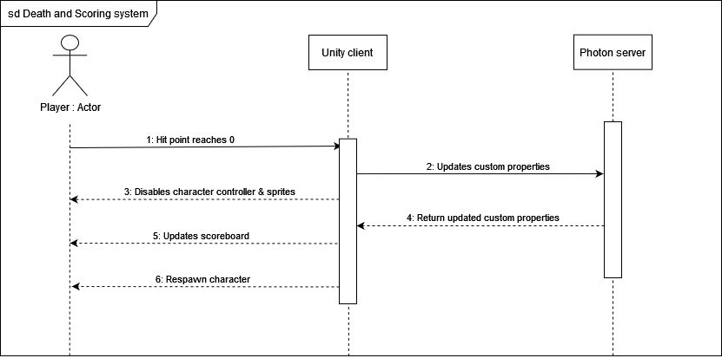
Death and scoring system
For every death or kill that the a player have committed in the game are all recorded in “Custom properties” which is a feature from Photon server to temporarily record player’s stats within a match

Slide 21
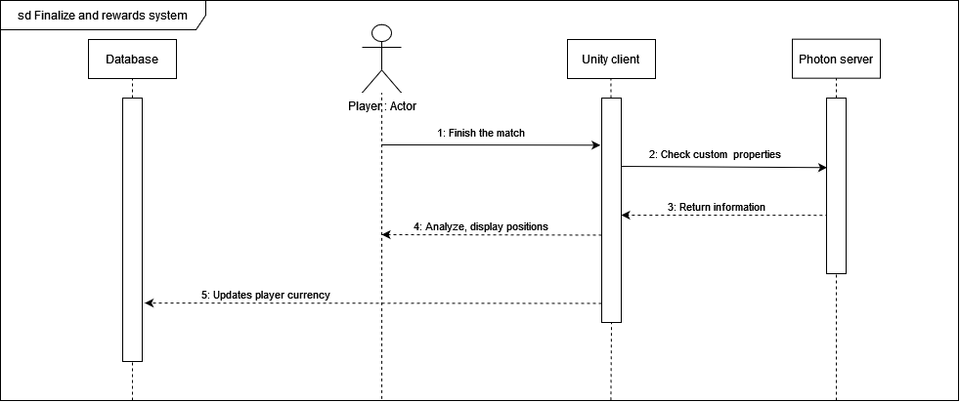
Finalize and Rewards
System will analyze custom properties , calculate positions and provide reasonable reward (currency) to player, transfer it directly to the database

Slide 22
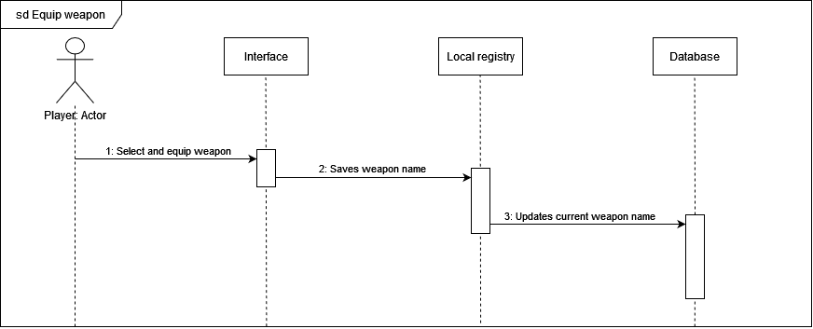
Equip weapon
The game will instantiate player with weapon name written on the local registry. Database in this case just to remember player’s recently equipped weapon if they quit the application

Slide 23
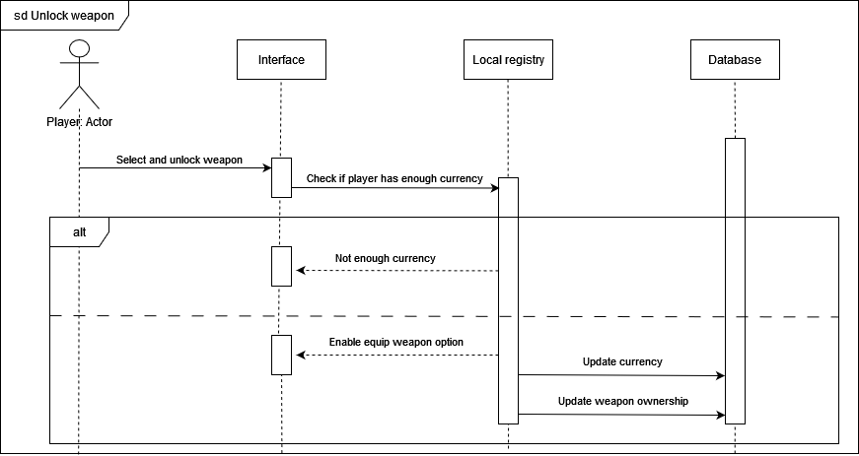
Unlock weapon
Player can request to unlock weapon on the interface. System will check database if there is enough currency. If not, notify player.

Slide 24
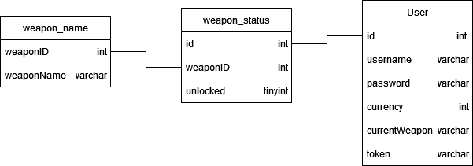
Database design
User: This table represent a player who can log into the game, It saves player’s data and progression throughout the game while also handle authentication system.
weapon_name: cannot be alternate through game client, gives every weapon in the game its unique ID
weapon_status: from the weaponID in the weapon_name and id from User table, this table holds information of whether a player has unlocked weapons or not

Slide 25
Results and discussions

Slide 26
Accomplishment
After 5 months of development I have made a Multiplayer side-scrolling shooter game with the following features:
- A real-time multiplayer game that has the characteristic of the side-scrolling shooter genres.
- Successful application of Photon 2 framework into the game to maintain communication between Unity client and Photon server.
- A matchmaking system that allow player to choose to play random match or private match with friends.
- A scoring and rewarding system for the game, to give player a sense of accomplishment for winning the game.
- Weapon system for player to customize and unlock weapon.
- A database system to save player’s information and progress and host it online

Slide 27
Potential improvements
Despite having accomplished many things in this project, it’s still an unfinished works with many flaws and incompleteness that require more time and effort for improvement such as:
Lack diversity in main game mechanic to make the gameplay more interesting
Lack of variety in the weapon changing section.
Potential bugs and visual errors.
Unappealing UI and Graphic.
Need more code optimization.
Need more quality of life improvements in user interface.
Database not secure enough.
Game jitter
And even many more unseen issues within the project

Slide 28
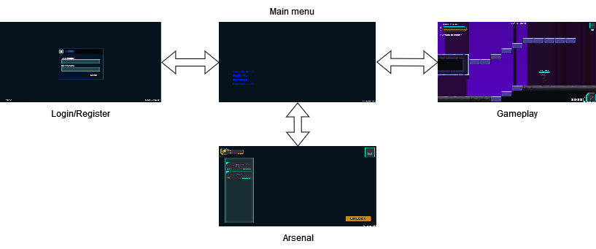
Game scenes

Slide 29
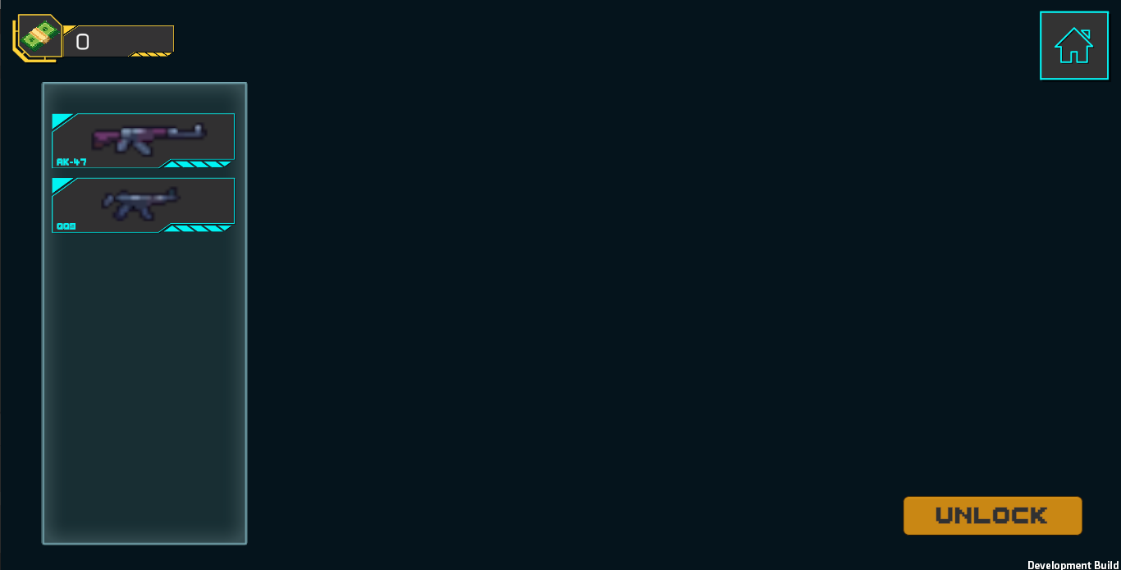
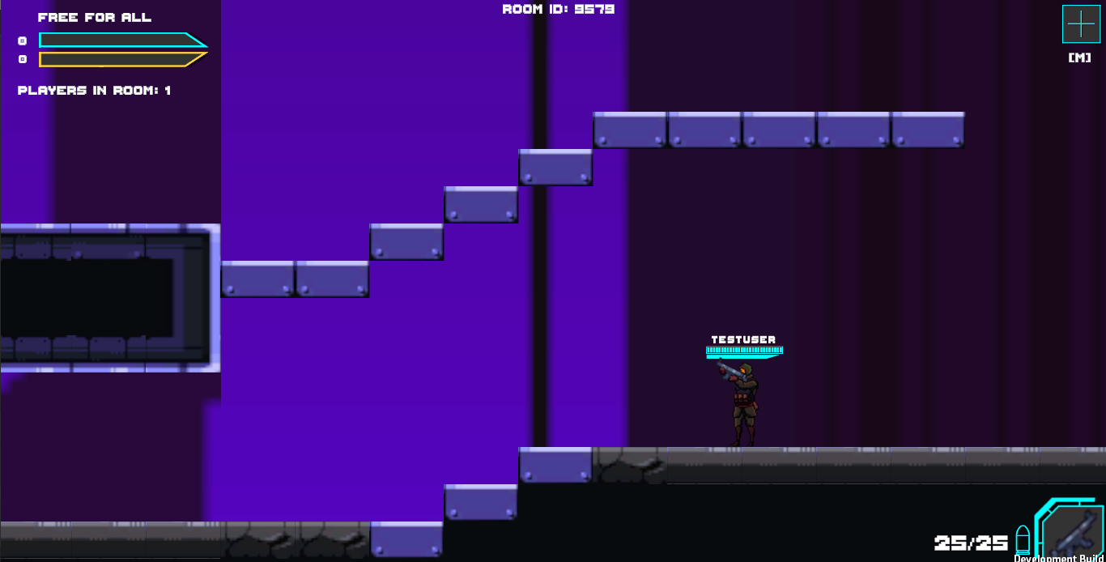
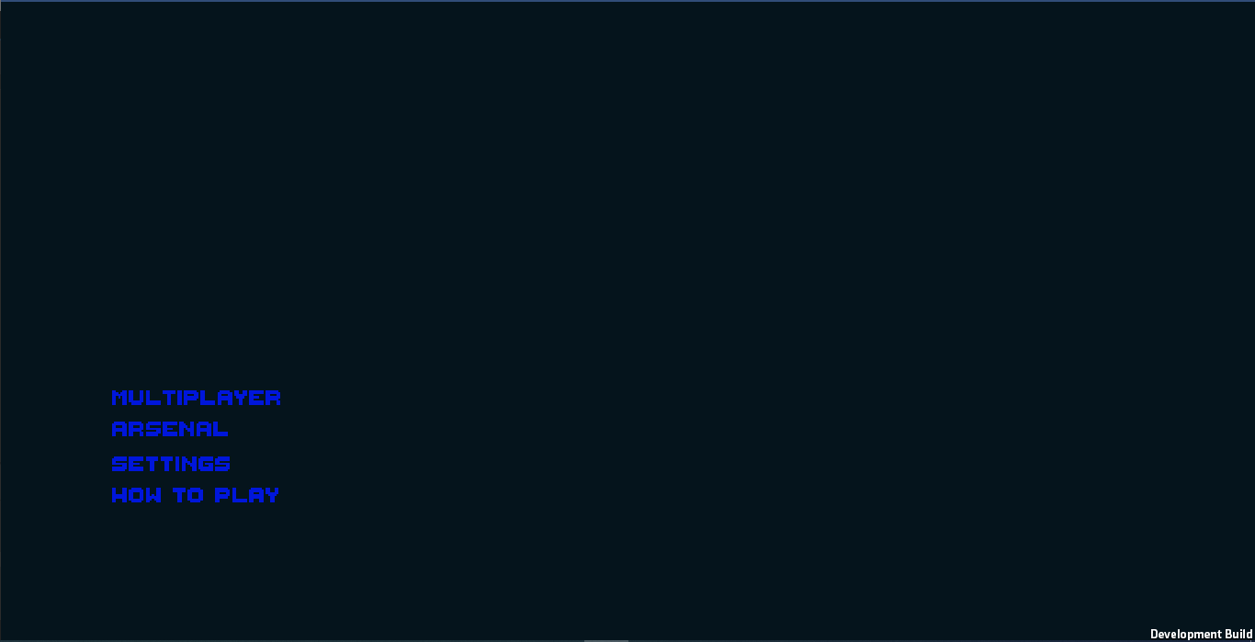
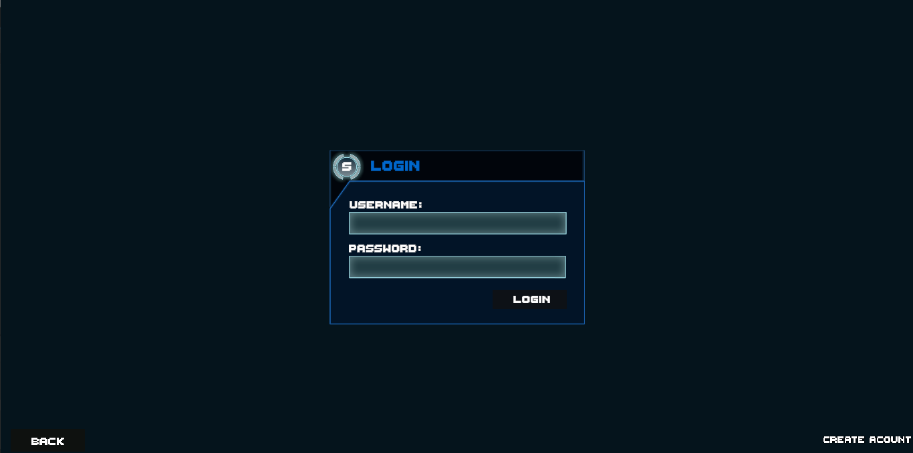
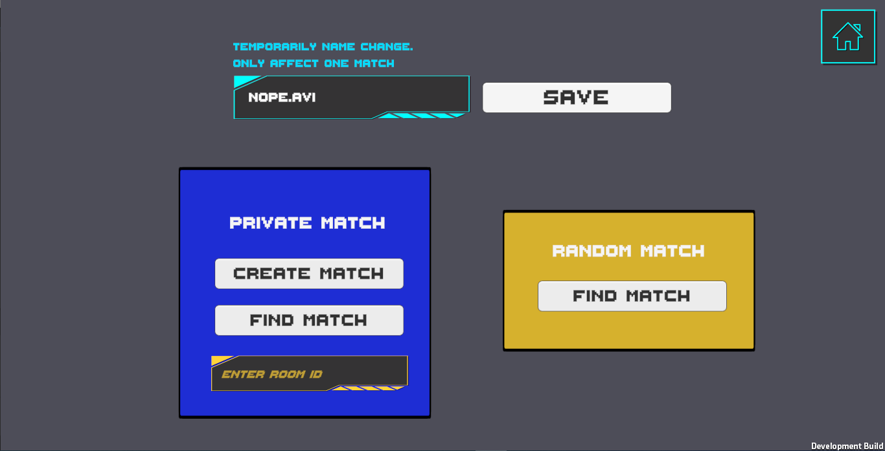
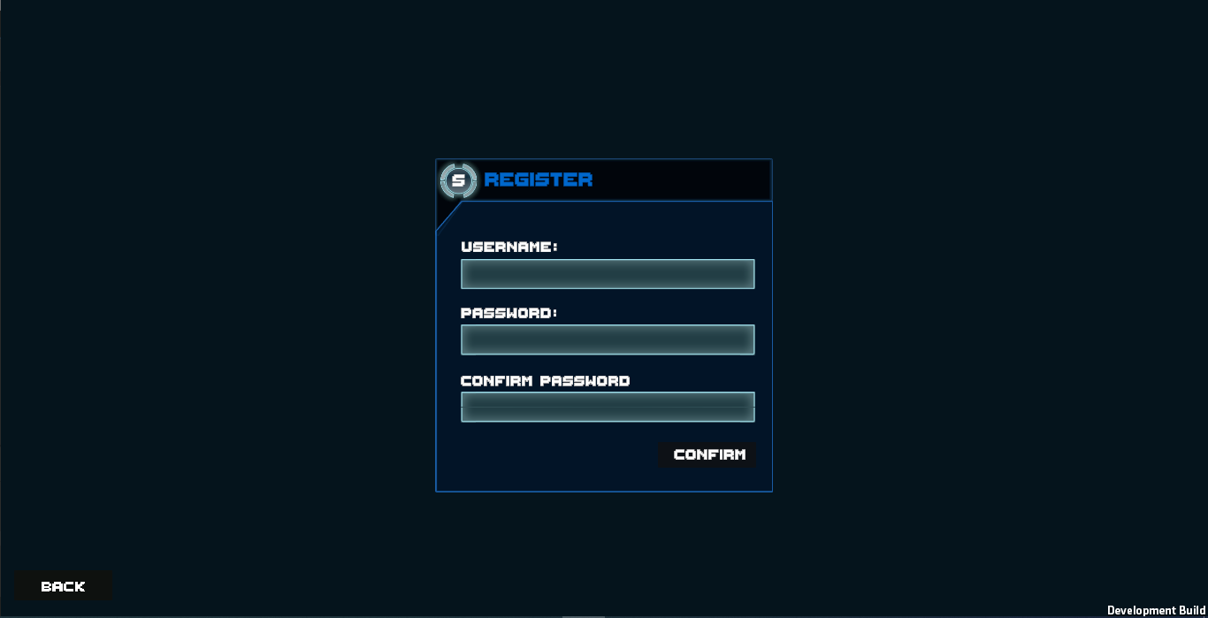
Gallery
Login interface
Start game Interface
Main menu Interface
Gameplay Interface
Weapon selection Interface
Register interface

Slide 30
Thank you for following !

