Slide 1


Slide 2

WHY MEDAUDIT
Medical model review has a fragile evidence gap
Prediction export
Metrics pass through notebooks and spreadsheets
Language models can sound certain without evidence
Clinical language can outrun validation
MedAudit makes deterministic evidence the source of truth.

Slide 3
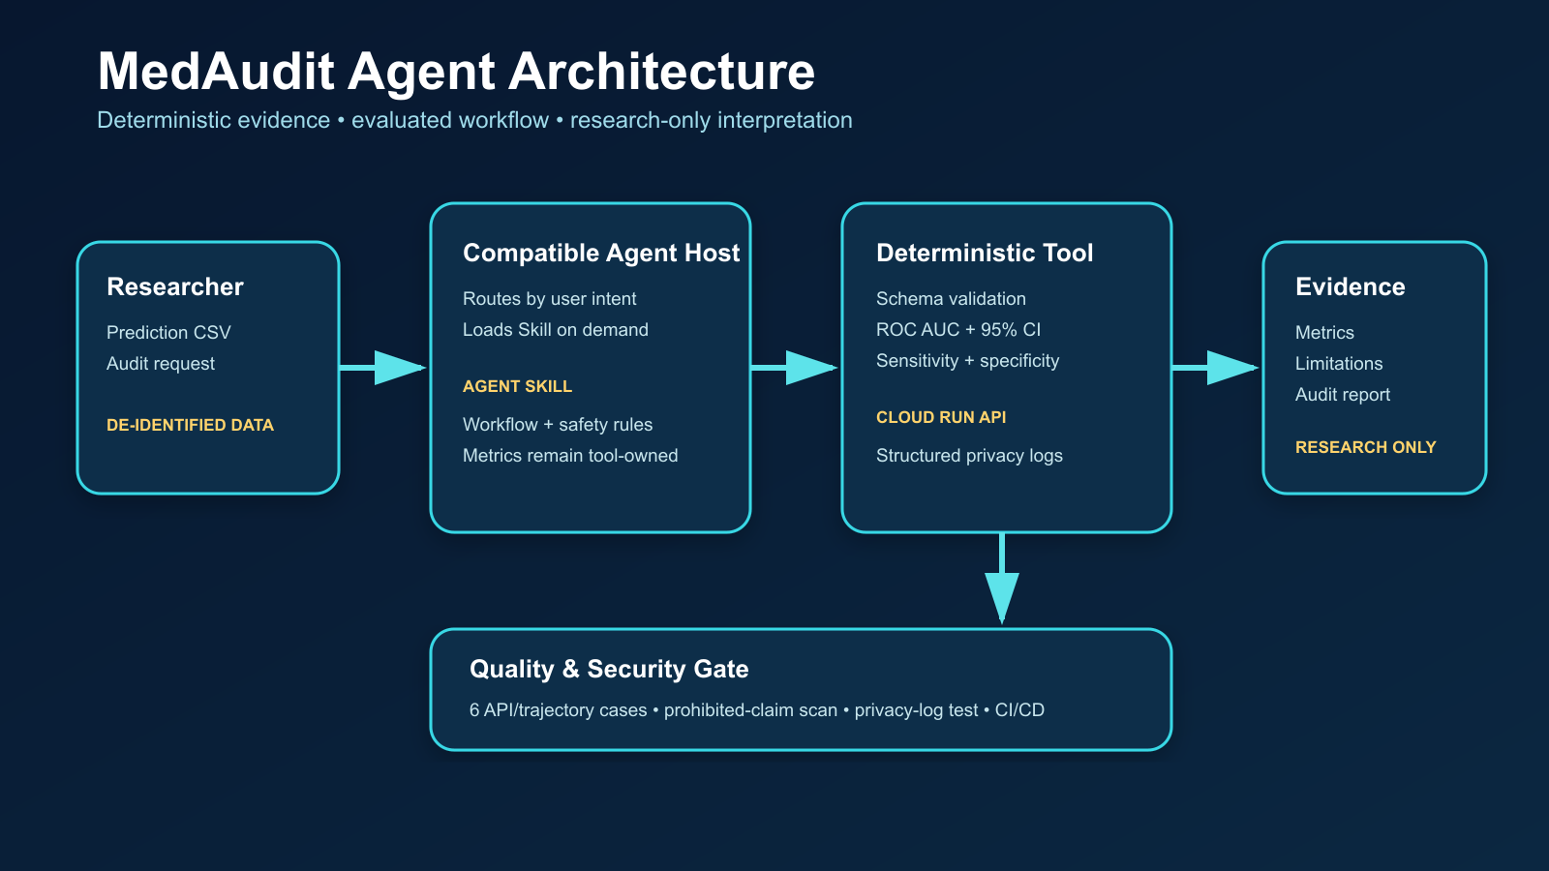

Slide 4
LIVE RESULT • 624 TEST PREDICTIONS
The tool returns reproducible evidence
0.9260
0.9059–0.9461
0.9795
0.6752
ROC AUC
95% CI
Sensitivity
Specificity
Threshold 0.50 • Positive rate 0.6250
Research evidence — not clinical validation

Slide 5
QUALITY AND SECURITY
Reliable agents must fail safely
6 / 6
API and trajectory cases passed
0
Prohibited medical claims detected
0
Sentinel identifiers found in logs
100%
Requests routed through the audit tool

Slide 6
AGENTIC ENGINEERING
Four course concepts are visible in the build
01
02
03
04
Agent Skill
Security
Deployability
Antigravity
Progressive disclosure
Tool-owned metrics
Input guardrails
Privacy-safe logs
Docker + Cloud Build
Cloud Run v1.0.0
AGENTS.md + .Codex
Reproducible eval commands

Slide 7
MEDAUDIT V1.0.0
A small system with evidence behind every claim
PUBLIC DEMO
medaudit-statistics-tool-770349538120.us-east1.run.app
OPEN SOURCE
github.com/Longer430/medaudit-pneumoniamnist
Research workflow support only • External validation remains required

