Slide 1
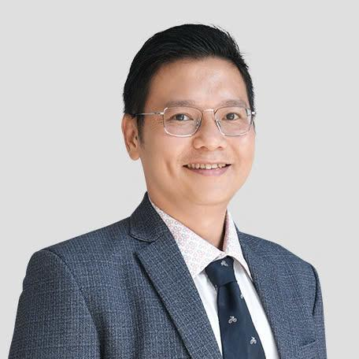
Introduction to Machine Learning
Nov 01 2025
Phuc-Loi Luu, PhD
Email: luu.p.loi@googlemail.com
Zalo: 0901802182

Slide 2
Content
What are data?
What do we attend this course for?
What are we going to learn?
How are we going to learn?

Slide 3
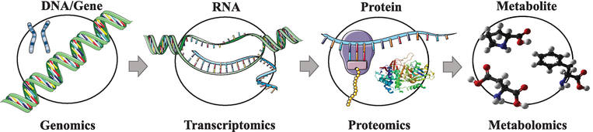
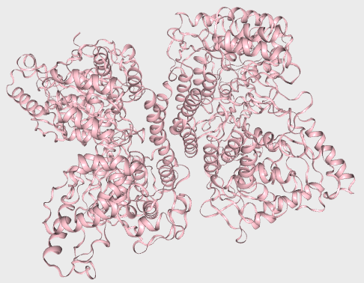
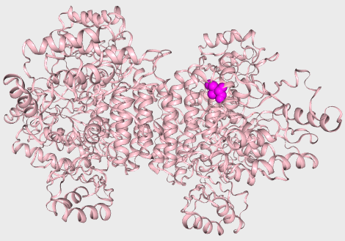
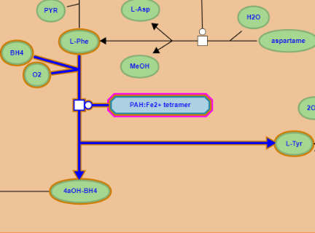
Central Dogma
PAH gene
Ref …ATCGAT…
P1 …AACGAT…
NM_000277.3(PAH):c.971T>A
PAH mRNA
Ref …AUCGAU…
P1 …AACGAU…
NM_000277.3(PAH):c.971T>A
PAH protein
Ref …Ile-Asp…
P1 …Asn-Asp…
NM_000277.3(PAH):p.Ile324Asn
PAH
Ref Phe → Tyr
PAH
P1 Phe → Tyr
10.5772/intechopen.71769

Slide 4
Genomic Data
Genomics (SNP microarray, CNV microarray and long or short read DNA-seq/WGS)
Transcriptomics (microarray, bulk RNA-seq, single-cell RNA-seq and spatial transcriptomics)
Proteomics (protein microarrays and mass spectrometry)
Metabolomics (mass spectrometry and Nuclear Magnetic Resonance Spectroscopy)
Epigenomics
Methylomics (methylation microarray, WGBS, EM-seq and long-read sequencing)
Metagenomics (long or short read DNA-seq)

Slide 5
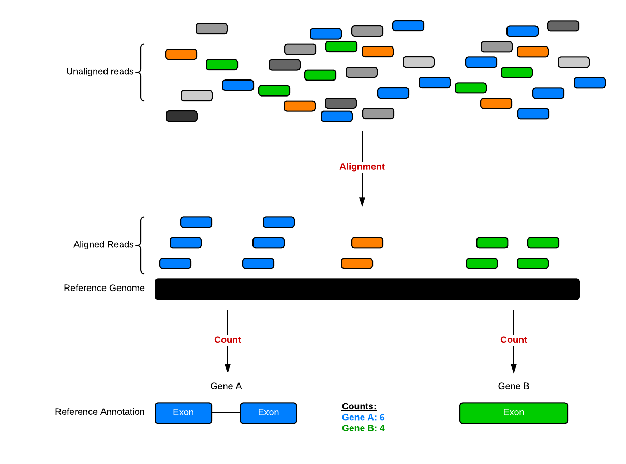
How to generate genomic data: RNA-seq

Slide 6
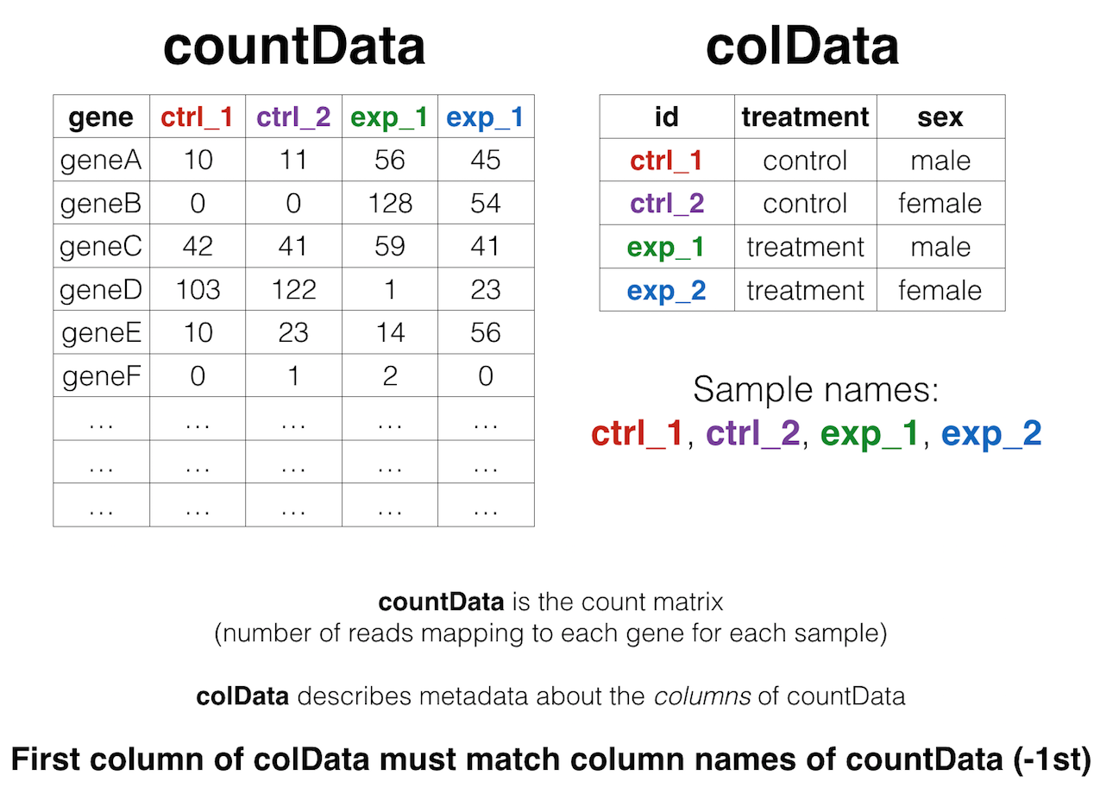
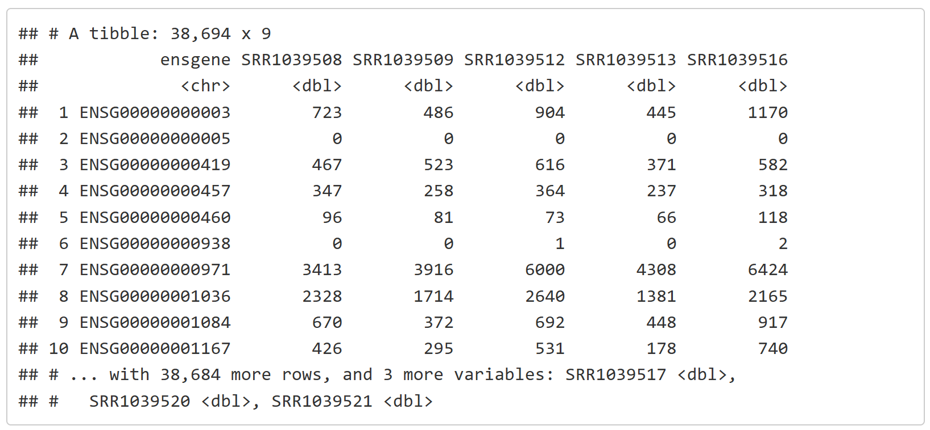
RNA-seq count table
https://bioconnector.github.io/workshops/r-rnaseq-airway.html

Slide 7
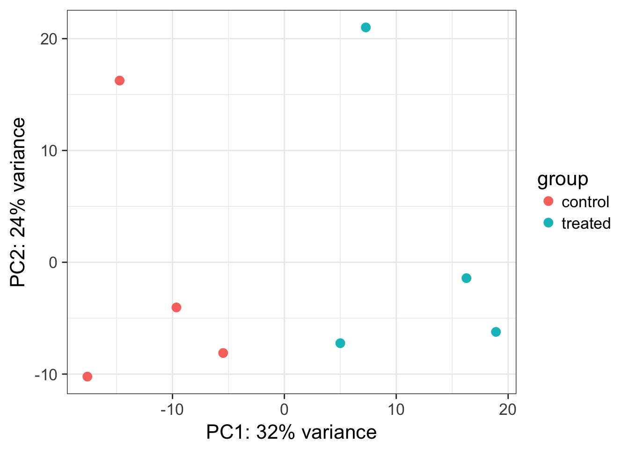
RNA-seq Downstream Analysis
https://bioconnector.github.io/workshops/r-rnaseq-airway.html

Slide 8
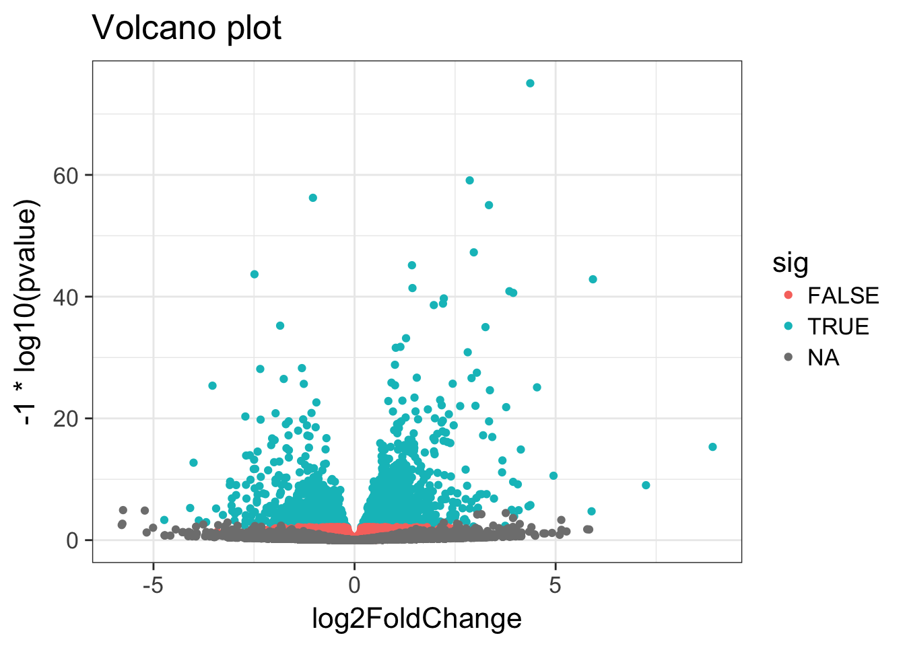
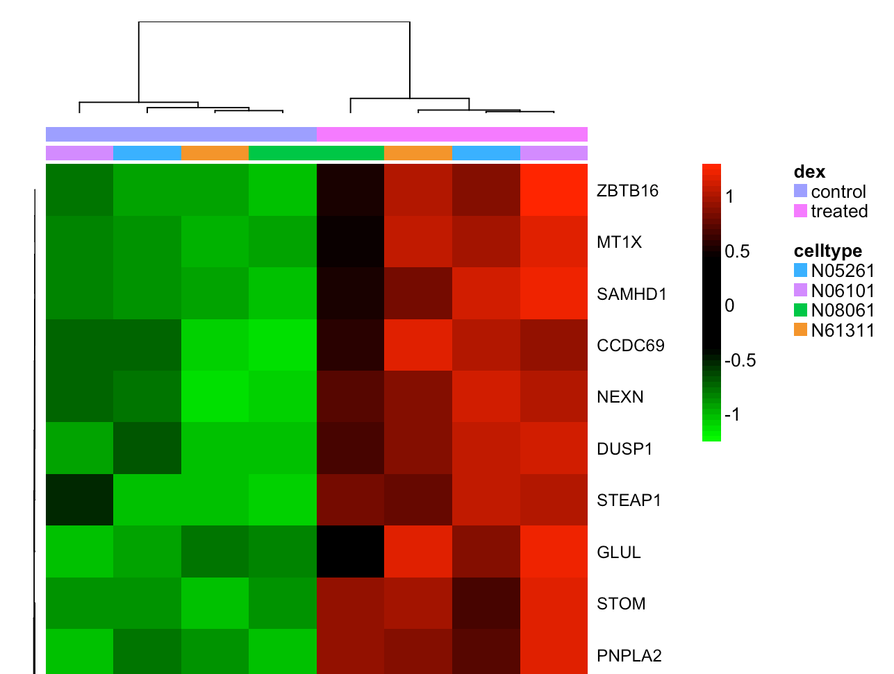
RNA-seq Downstream Analysis
https://bioconnector.github.io/workshops/r-rnaseq-airway.html

Slide 9
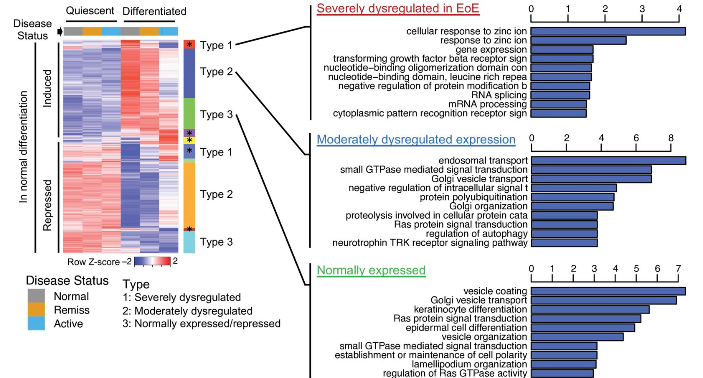
RNA-seq Downstream Analysis
https://insight.jci.org/articles/view/159093/figure/5

Slide 10
Medical Data
Text (Patient Medical Record or Health Record)
Image (Hematoxylin Eosin (HE), Immunohistochemistry (IHC) CT nd MRI)
Video (Medical Ultrasonography and Endoscopy)
Signal (Electrocardiogram (ECG) and Electroencephalogram (EEG))

Slide 11
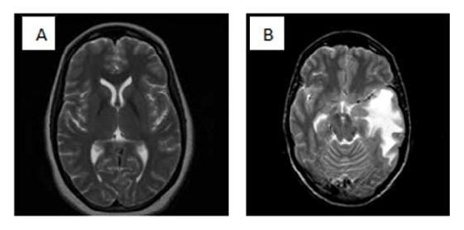
MRI
(A)-Normal brain (B)-Tumor Brain
DOI:10.1109/ASONAM.2012.142

Slide 12
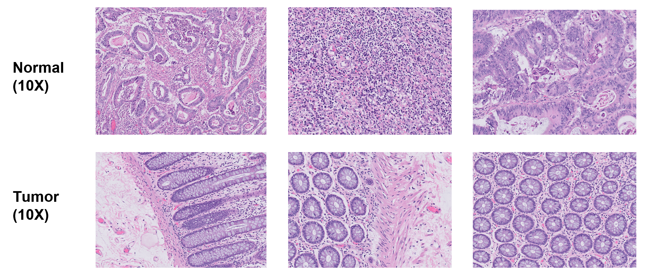
Hematoxylin Eosin

Slide 13
Medical Ultrasonography
https://commons.wikimedia.org/wiki/File:Ultrasound_Scan_ND_0105143736_1439320.gif

Slide 14
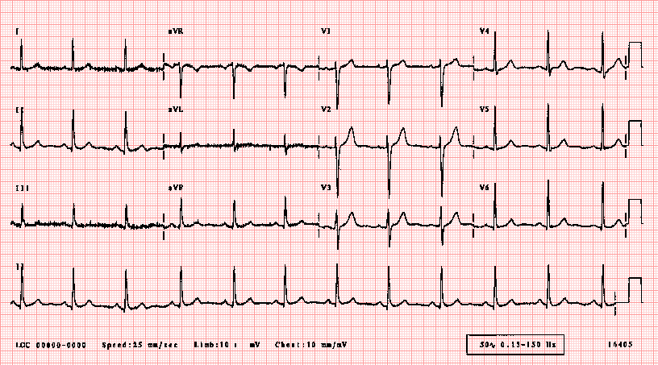
ECG
https://ecglibrary.com/norm.php

Slide 15
Thank you!

