Slide 1
Longlevens Library Code Club Show & Tell 2019

Slide 2
2019 Coding Challenge

Slide 3
2019 Coding Challenge
from sense_hat import SenseHat
sense = SenseHat()
sense.set_rotation(270)
red = (255,0,0)
sense.show_message("Whats the temperature?", scroll_speed= 0.05,text_colour=red)
b=0,0,0
w=255,255,255
temp = round (sense.get_temperature(), 1)
sense.show_message("It is " +str(temp)+" degrees",scroll_speed= 0.05)
h= (255,255,0)
hot = [b,b,h,h,b,h,h,b,
b,b,h,h,b,h,h,b,
b,b,h,h,b,h,h,b,
b,b,h,h,h,h,h,b,
b,b,h,h,h,h,h,b,
b,b,h,h,b,h,h,b,
b,b,h,h,b,h,h,b,
b,b,b,b,b,b,b,b]
w=(255,255,255)
cold = [b,b,b,b,b,b,b,b,
b,w,w,w,w,w,w,b,
b,w,w,w,w,w,w,b,
b,w,w,b,b,b,b,b,
b,w,w,b,b,b,b,b,
b,w,w,w,w,w,w,b,
b,w,w,w,w,w,w,b,
b,b,b,b,b,b,b,b]
temp = sense.get_temperature()
if temp >= 20:
sense.set_pixels(hot)
else:
sense.set_pixels(cold)
Less than 1000 characters in length
Runs with a 64 pixel display – only able to show 1 character at once
Only used for one minute
But...
Travelled nearly 600 miles while it was running
That’s a speed of 17,100 mph / 27,600 km/h
Almost certainly travelled in excess of 1,000,000 miles, that’s more than the distance to the moon and back 4 times.
Flew at an altitude of 250 miles.

Slide 4
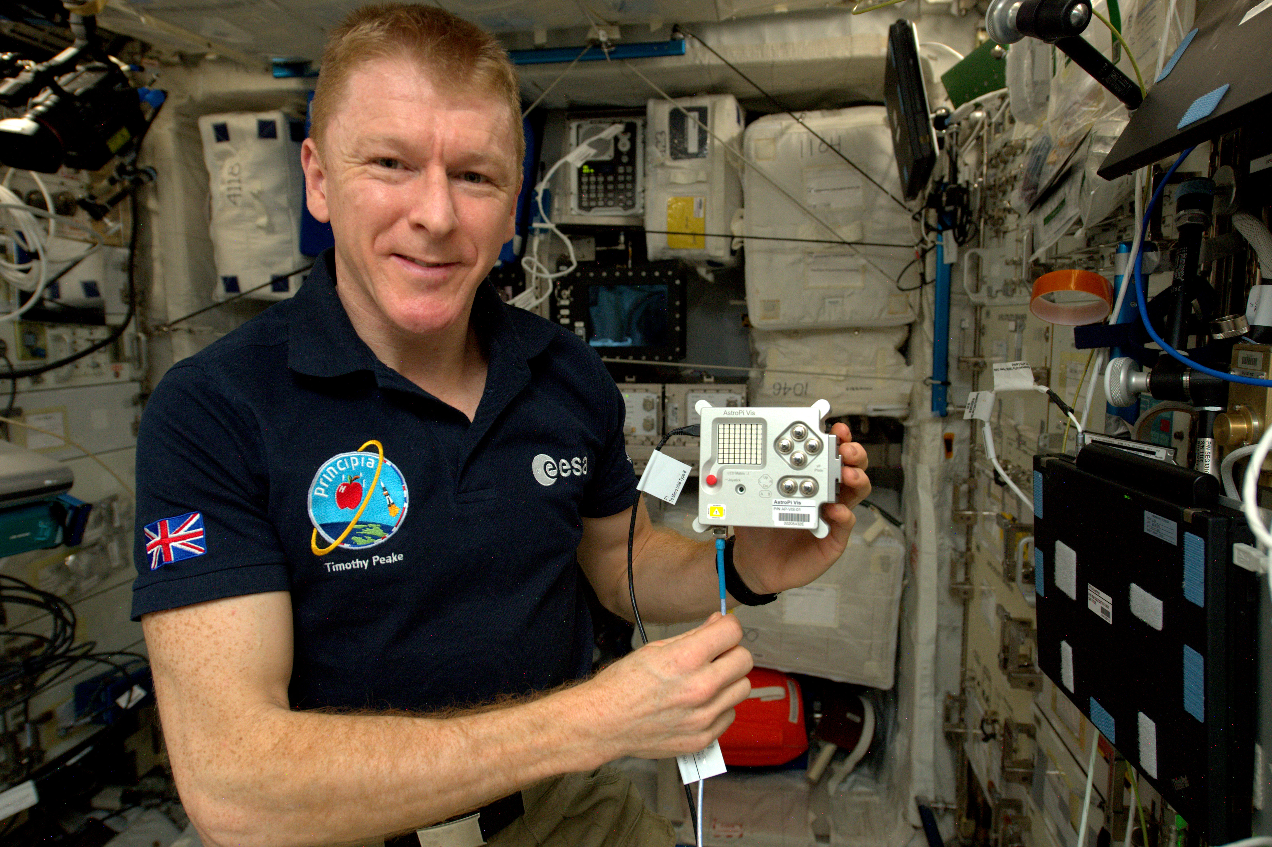
2019 Coding Challenge
Astronaut Tim Peake using an Astro Pi aboard the International Space Station. Image Credit: ESA (European Space Agency)

Slide 5
2019 Coding Challenge
Reuben & Aisha

Slide 6
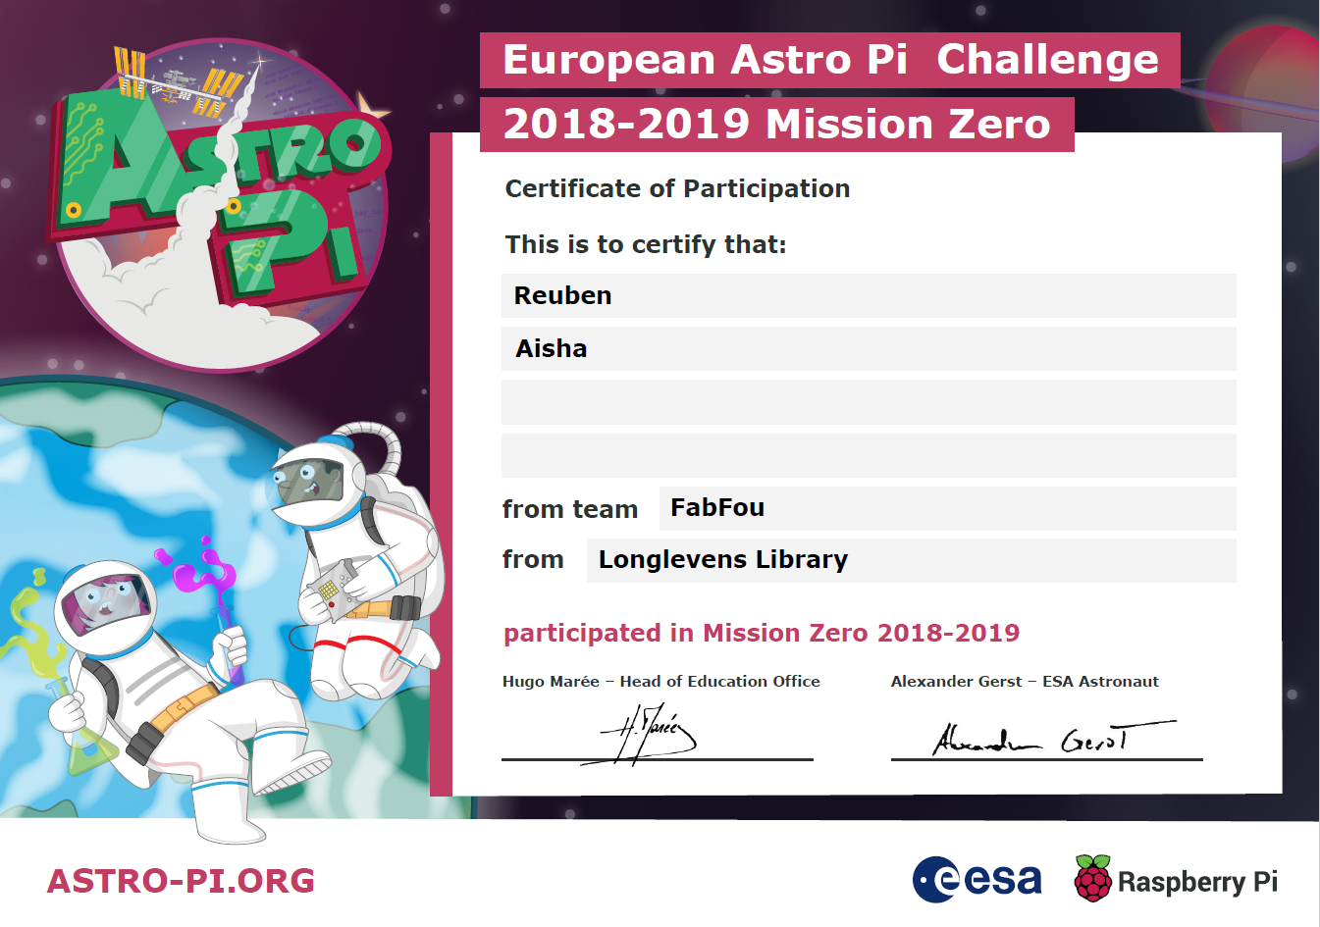
2019 Astro-Pi Coding Challenge

Slide 7
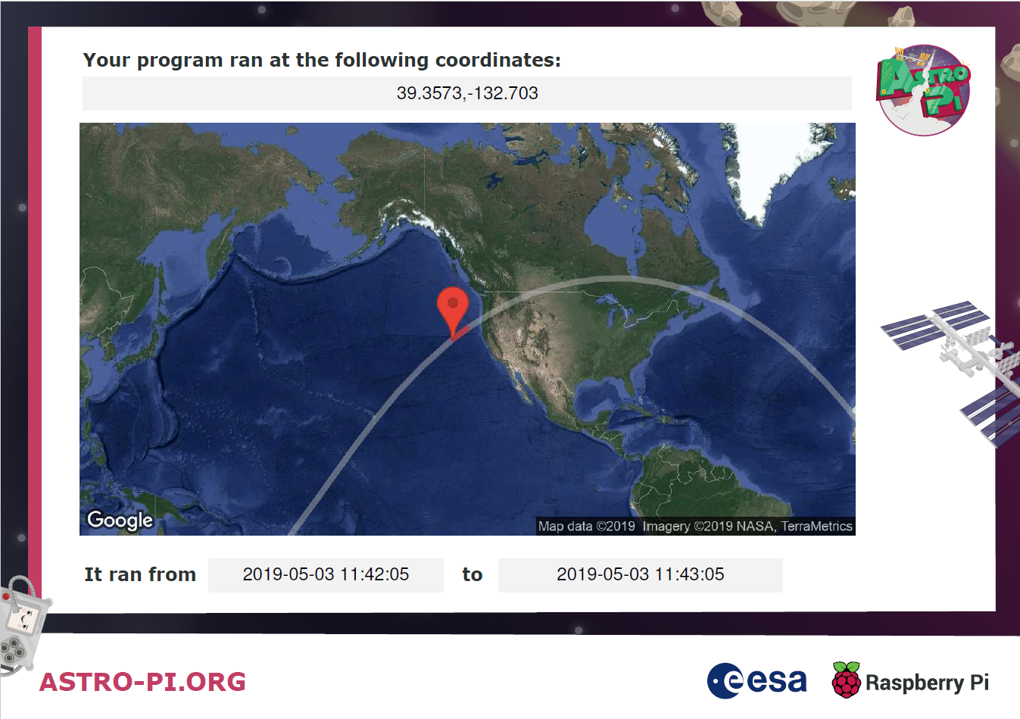
2019 Astro-Pi Coding Challenge
Plus a BBC Gloucestershire radio interview with Jo Durrant

Slide 8
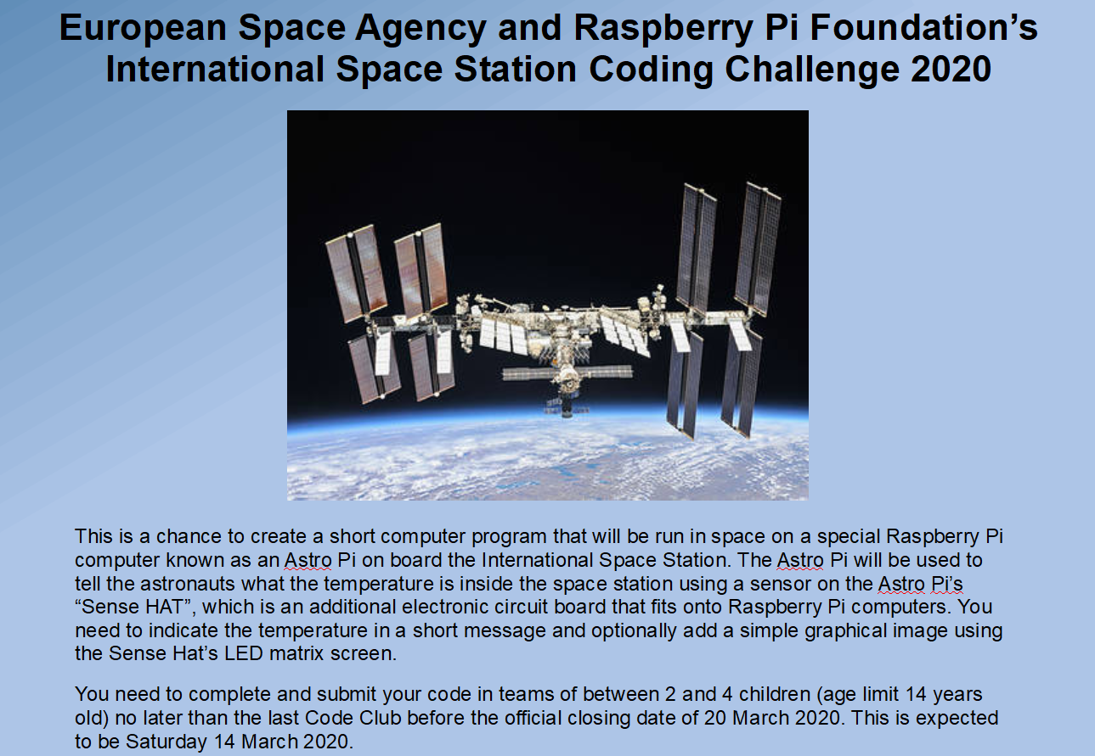
2020 Astro-Pi Coding Challenge

