Slide 1
PixMix Video Inpainting
Implementation of TVCG’14 paper
Presented by: Zhang Xianyao, Zhang Yu & Tong Yuqiang

Slide 2
Outline
The task: (video/image) inpainting
Object removal
The method: Pix-Mix for object removal
Object selection
Object tracking
Inpainting
The result: plausible and fast

Slide 3
Outline
The task: (video/image) inpainting
Object removal
The method: Pix-Mix for object removal
Object selection
Object tracking
Inpainting
The result: plausible and fast

Slide 4
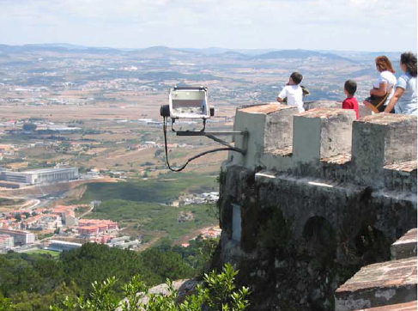
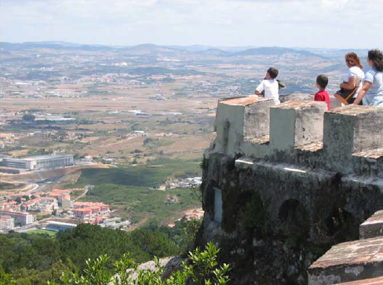
Inpainting/Object Removal

Slide 5
Outline
The task: (video/image) inpainting
Object removal
The method: Pix-Mix for object removal
Object selection
Object tracking
Inpainting
The result: plausible and fast

Slide 6
Inpainting Pipeline
1st frame
1st frame

Slide 7



Object Selection
User gives approx. contour
All in background
Serves as fingerprints
Object = Pxs not like fingerprints
How to define similarity?
Simple rule: by color difference
Clustering is important

Slide 8
Object Selection - GUI
Object selection
Line constraint
Unused area

Slide 9
Object Tracking

Slide 10

Inpainting
Pixel mapping method
$f\left(p\right)=q$
Compare to patch-based method
Minimize energy function
$\min_{f}{\sum_{p∈T}{cost_{α}(p)}}$
$cost_{α}\left(p,f\right)=α_{s}cost_{spatial}\left(p,f\right)+α_{a}cost_{appear}\left(p,f\right)+α_{c}cost_{constr}(p,f)$

Slide 11
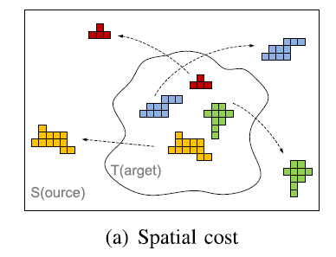
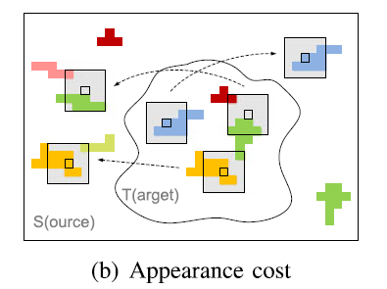


Inpainting
Spatial cost
Appearance cost

Slide 12
Outline
The task: (video/image) inpainting
Object removal
The method: Pix-Mix for object removal
Object selection
Object tracking
Inpainting
The result: plausible and fast

Slide 13
Title and Content Layout with Chart

Slide 14
Two Content Layout with Table
First bullet point here
Second bullet point here
Third bullet point here
Class | Group A | Group B
Class 1 | 82 | 95
Class 2 | 76 | 88
Class 3 | 84 | 90

Slide 15
Two Content Layout with SmartArt
Group A
Task 1
Task 2
Group B
Task 1
Task 2
Group C
Task 1
First bullet point here
Second bullet point here
Third bullet point here

Slide 16
Add a Slide Title - 1

Slide 17
Add a Slide Title - 2

Slide 18
Add a Slide Title - 3

Slide 20
Add a Slide Title - 4

Slide 21
Add a Slide Title - 5

