Slide 1
PixMix Video Inpainting
Implementation of TVCG’14 paper
Presented by: Zhang Xianyao, Zhang Yu & Tong Yuqiang

Slide 2
Outline
The task: (video/image) inpainting
Object removal
The method: Pix-Mix for object removal
Object selection (Tong Yuqiang)
Object tracking (Zhang Yu)
Inpainting (Zhang Xianyao)
The result: plausible and fast

Slide 3
Outline
The task: (video/image) inpainting
Object removal
The method: Pix-Mix for object removal
Object selection (Tong Yuqiang)
Object tracking (Zhang Yu)
Inpainting (Zhang Xianyao)
The result: plausible and fast

Slide 4
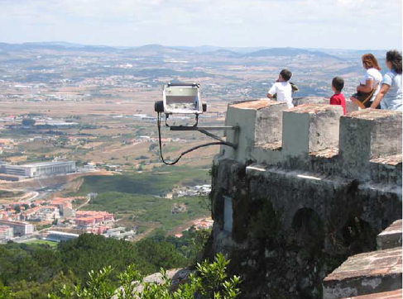
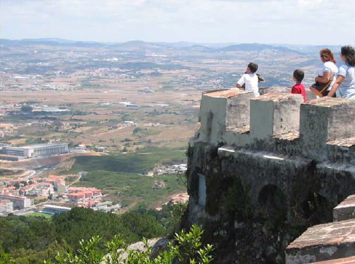
Inpainting/Object Removal

Slide 5
Outline
The task: (video/image) inpainting
Object removal
The method: Pix-Mix for object removal
Object selection (Tong Yuqiang)
Object tracking (Zhang Yu)
Inpainting (Zhang Xianyao)
The result: plausible and fast

Slide 6
Video Inpainting Pipeline
First frame
Successive frames (i-1 and i)
Frame 1
Result 1
Result i-1
Result
i
Fill
Fill
Constr.
1
f(p)
1
f(p)
i-1
f(p)
i
GUI
Track
Object i
Object 1
Object i-1

Slide 7



Object Selection
User gives approx. contour
All in background
Serves as fingerprints
Object = Pxs not like fingerprints
How to define similarity?
Simple rule: by color difference
Clustering is important

Slide 8
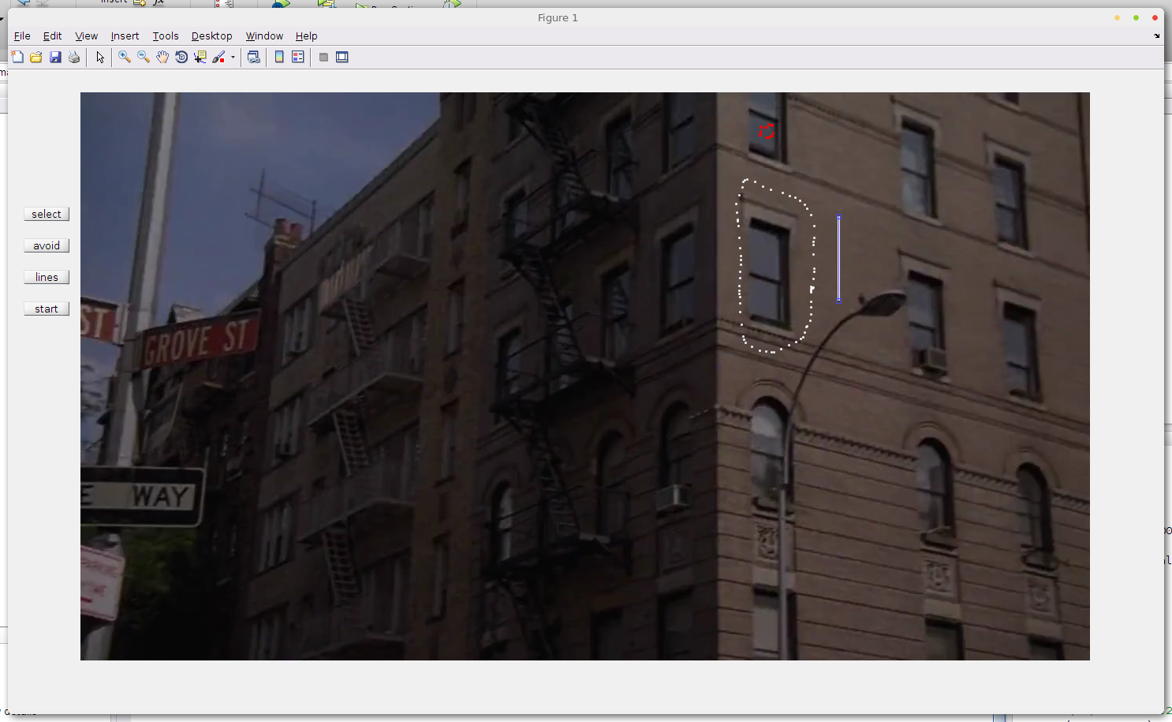
Object Selection - GUI
Object selection
Line constraint
Unused area

Slide 9
Object Tracking

Slide 10
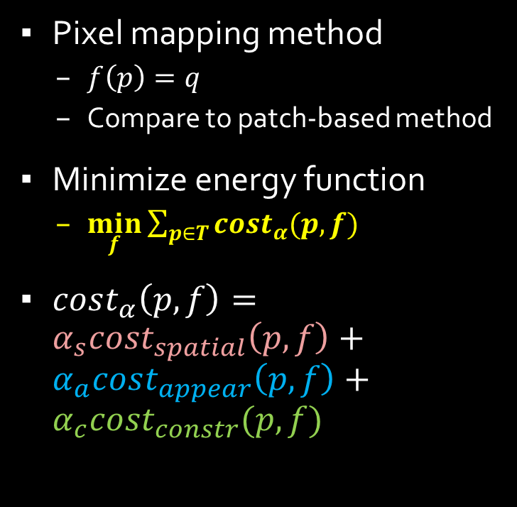
Inpainting - Overview
Pixel mapping method
$f\left(p\right)=q$
Compare to patch-based method
Minimize energy function
$\min_{f}{\sum_{p∈T}{cost_{α}(p,f)}}$
$cost_{α}\left(p,f\right)=α_{s}cost_{spatial}\left(p,f\right)+α_{a}cost_{appear}\left(p,f\right)+α_{c}cost_{constr}(p,f)$
Multi-resolution

Slide 11
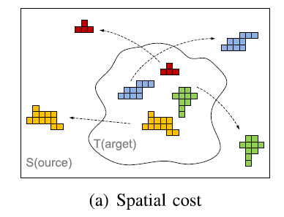
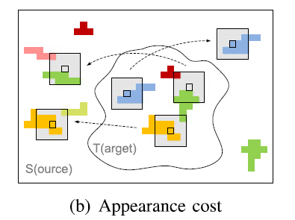


Inpainting – Cost Terms
Spatial cost
Appearance cost

Slide 12
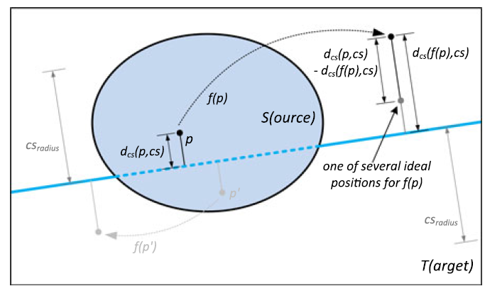
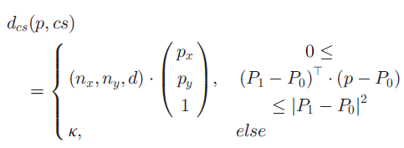

Inpainting – Cost Terms
Line constraint
Preserves important edge
Detected + user selected lines

Slide 13
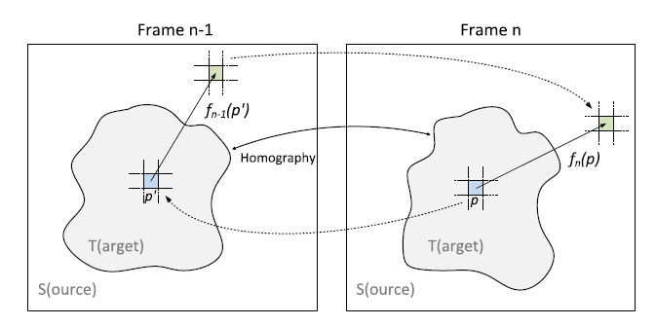


Inpainting – Mapping Forwarding
$H$ is the homography between two contours
$f^{n−1}(p)$ is the mapping for frame $n−1$
$\hat{f^{n}}(p)$ is the initial guess for frame $n$

Slide 14

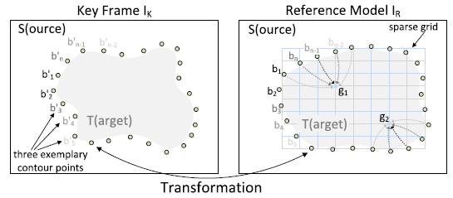


Inpainting – Reference Model
Image reference model
First guess of frame $n$
Transformed from frame $n−1$
Lightness adjustment
Estimate color difference on contour
Calculate a grid
Simple interpolation from grid
Additional appearance term
Use $I_{R}$ to guide inpainting of $I_{n}$

Slide 15
Implementation Notes
MATLAB and MEX file
GitHub for collaboration
Add a picture!!
Notes:
1. MEX is 100~1000 times faster than M file for loops
But prone to mysterious errors…
2. Vectorization is 100~1000 times faster than loops
3. MATLAB is fantastic if the algorithm is already implemented

Slide 16
Outline
The task: (video/image) inpainting
Object removal
The method: Pix-Mix for object removal
Object selection (Tong Yuqiang)
Object tracking (Zhang Yu)
Inpainting (Zhang Xianyao)
The result: plausible and fast

Slide 17
Thank you!!

Slide 18
Title and Content Layout with Chart

Slide 19
Two Content Layout with Table
First bullet point here
Second bullet point here
Third bullet point here
Class | Group A | Group B
Class 1 | 82 | 95
Class 2 | 76 | 88
Class 3 | 84 | 90

Slide 20
Two Content Layout with SmartArt
Group A
Task 1
Task 2
Group B
Task 1
Task 2
Group C
Task 1
First bullet point here
Second bullet point here
Third bullet point here

Slide 21
Add a Slide Title - 1

Slide 22
Add a Slide Title - 2

Slide 23
Add a Slide Title - 3

Slide 25
Add a Slide Title - 4

Slide 26
Add a Slide Title - 5

