Slide 1










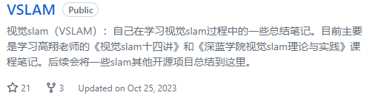



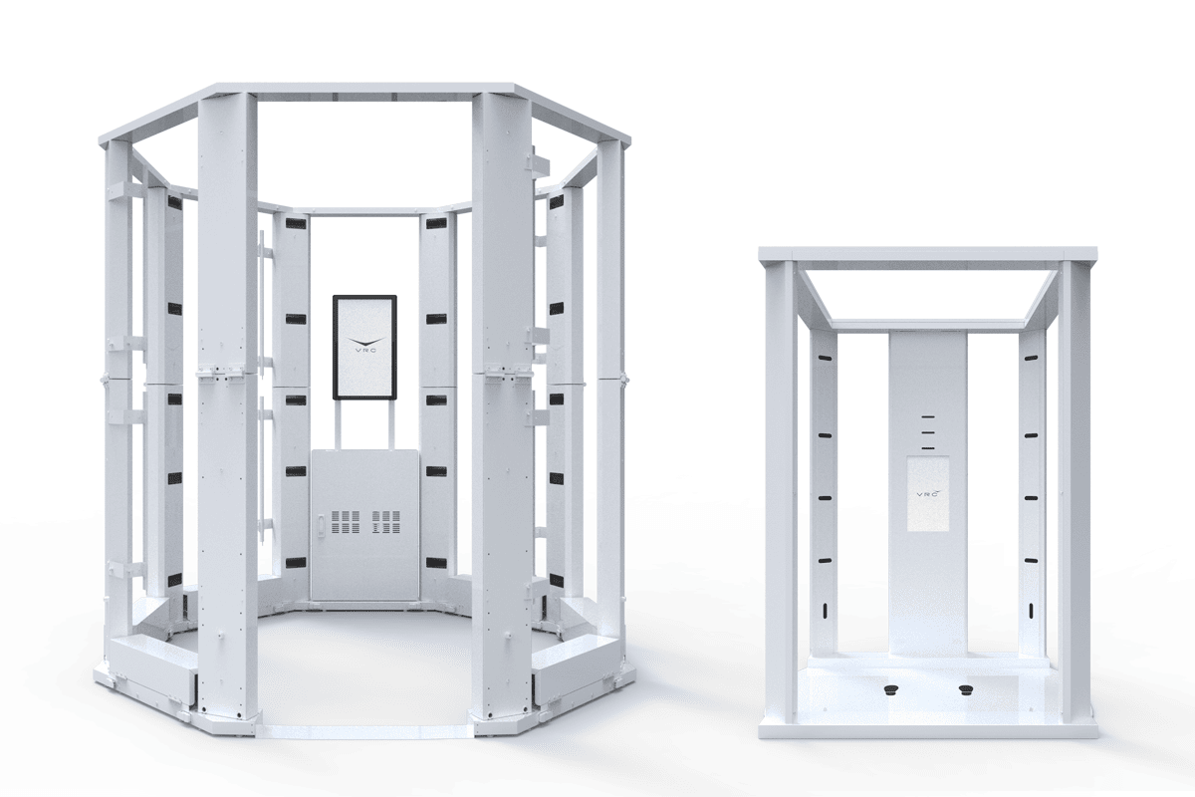

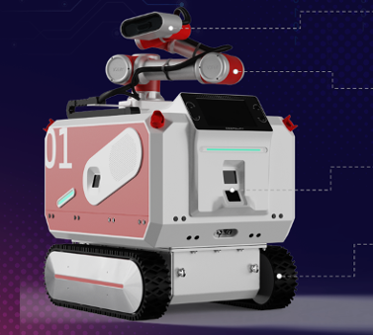
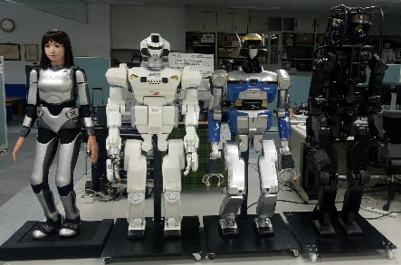


4/27
CNRS-AIST JRL(Joint Robotics Laboratory), IRL
2018.8--
2019
2020
2021
Machine learning
Deep Learning
2D computer vision
2D Object Detection
2D Image Segmentation
3D computer vision
Open3D: Point cloud
Visual SLAM(c++)
Faculty：
School of Electronics
and Control Engineering
Department：
Automation
2022
2024.4
2023
Algorithm internship program
(2022.8-2023.3)
VRC Inc.
Human Body Reconstruction Algorithm
Algorithm internship program
(2021.11-2022.4)
Beijing Deep Glint Technology Co.,Ltd
2D Image anomaly detection
Graduation thesis(2022.7)
M1: VSLAM+DL

