Slide 1
Python Programming for Remote Sensing and GIS
Gregory Brunner

Slide 2
Welcome!
I’m Greg Brunner
Scientists/developer for Esri
Programming with Python for 5+ years
Email:
Office hours: Before class or upon request

Slide 3
Course Overview
This course will introduce students to python programming. Through completing this course, students will be able to use Python to perform common GIS and remote sensing analysis tasks, automate workflows, and develop custom Python tools. Topics will include describing data, manipulating data, automating spatial analysis tasks, creating Python scripts and tools, and using Python for imagery analysis.

Slide 4
Course Objectives
Learn Python and understand how to use it to solve problems in GIS and Remote Sensing
Encourage the use of Python through relevant examples and assignments
Get graduate level students implementing it in their own research projects.
This will be one of the most valuable skills you learn and develop

Slide 5
Syllabus

Slide 6
Labs
Exercises to guide you in learning Python
Please submit last week’s exercises with your homework at the beginning of each class.
Your feedback is appreciated

Slide 7
Homework
The objective with homework is to keep you thinking and learning about Python even outside of days in lab.
Homework is due at the beginning of each lab.

Slide 8
Projects
Not intending an exams at this point.
Projects will ensure your developing an understanding of how to use Python to solve GIS and Remote Sensing Problems
Project 1: I will give you a problem to solve.
Project 2: You define a problem and solution using Python and then present it back to the class on the last day of class.

Slide 9
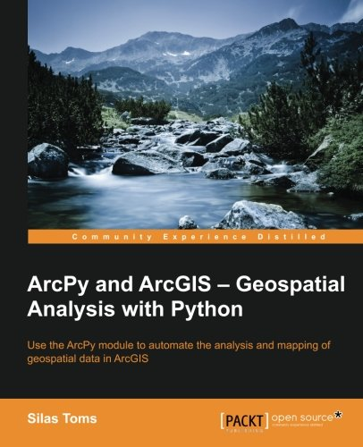
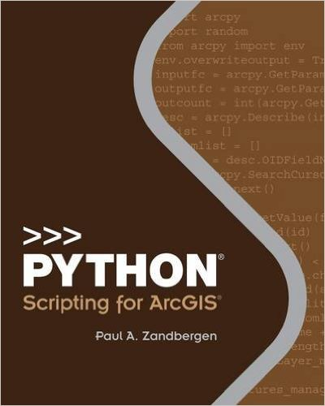
Textbook(s)
Required:
Toms, Silas. Arcpy and ArcGIS – Geospatial Analysis with Python. (https://www.amazon.com/ArcPy-ArcGIS-Geospatial-Analysis-Python/dp/1783988665)
Recommended:
Zandbergen, Paul A. Python Scripting for ArcGIS. (https://www.amazon.com/gp/product/1589483715/)
Don’t get both. Get either!

Slide 10
Labs and Homework
Github.com/gbrunner

Slide 11
Any Questions?

Slide 12
Intro to Python
Gregory Brunner

Slide 13
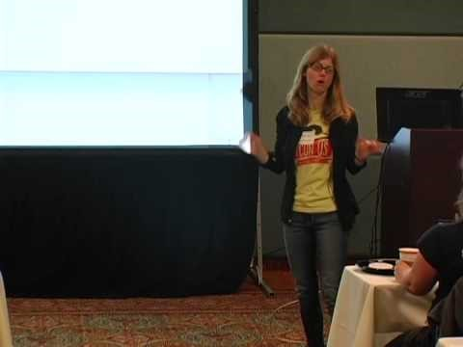
Why Python? (Jessica McKellar)

Slide 14
Quoting Jessica
Python is a versatile language: you can analyze data, build websites (*), maintain servers, make art or music.
Employers love Python: people will want to hire you.
Python is a great teaching language … a lot of educational institutions are switching to Python, e.g., MIT
It reads very much like English (it has low syntactic overhead)
It is very easy to get useful work done quickly in Python
You can do data analysis and graphing with Matplotlib (even 3D animations)

Slide 15
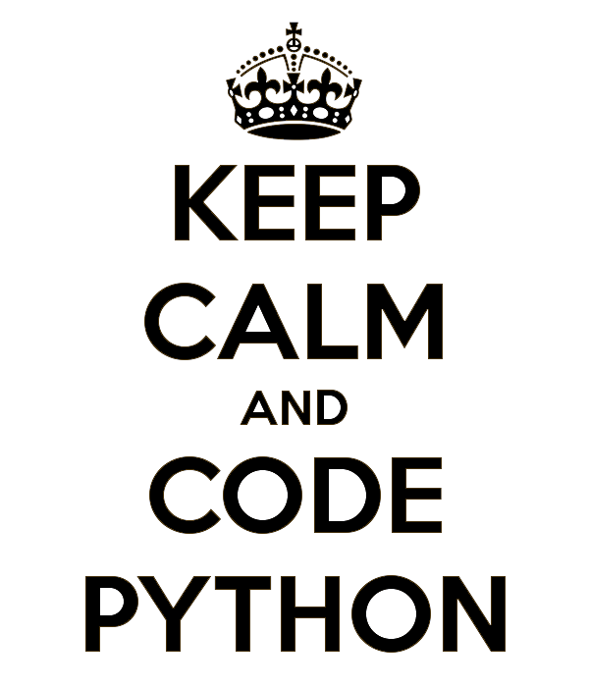
Why do I love Python?

Slide 16
Maps!

Slide 17
Sports!

Slide 18
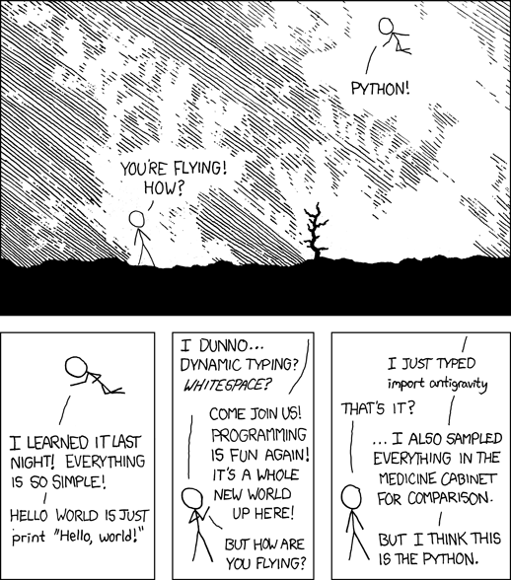
It’s so easy!

Slide 19
Let’s Get Started!

