Slide 1
Python Basics
Gregory Brunner

Slide 2
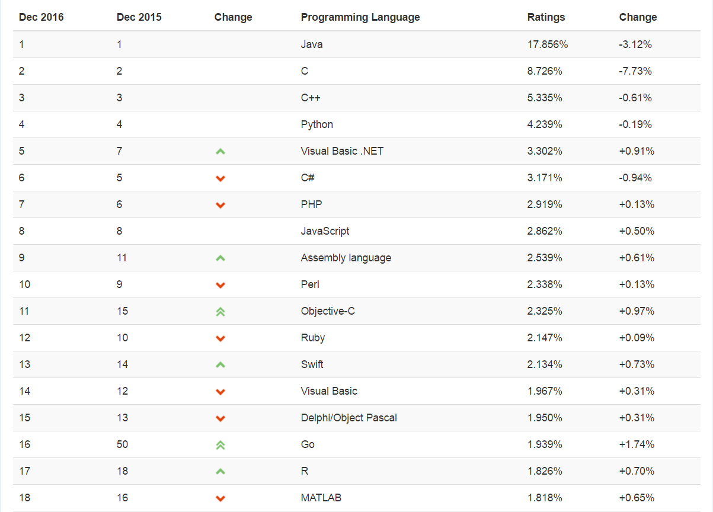
Python
Created in 1989 by Guido van Rossum
Named after Monty Python
Evolved into a major programming language
http://www.tiobe.com/tiobe-index/

Slide 3
Advantages to Python
Simple syntax: easy to read and write
Allows for rapid testing and development
Open Source

Slide 4
An Interpreted Language
Code is compiled when it is executed
.py file – Python code
.pyc file – Compiled Python code

Slide 5
“Built-In” Libraries
Python come with a lot of great capabilities
String manipuylations, math, http calls, and more
If it isn’t “built-in”, there is probably an import
Numpy
Requests
Urllib2
scipy

Slide 6
A “Glue” Language
Using Python to control other languages
Great at allowing programmers to quickly pull together a lot of apabilities
In reality, Python is more than a “glue” language.
Python is behind the scenes in websites, geoprocessing tools, and much more

Slide 7
IDE – Integrated Development Environment
Where you can write, test, debug, and run code

Slide 8
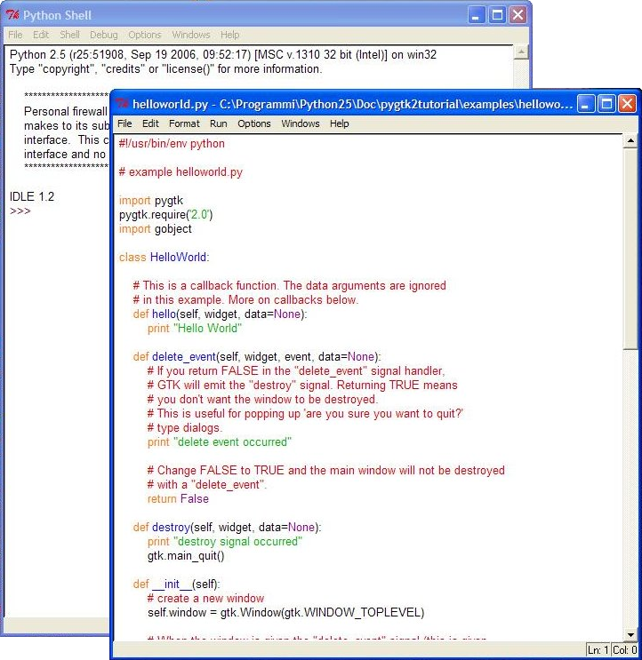
IDLE – Default IDE

Slide 9
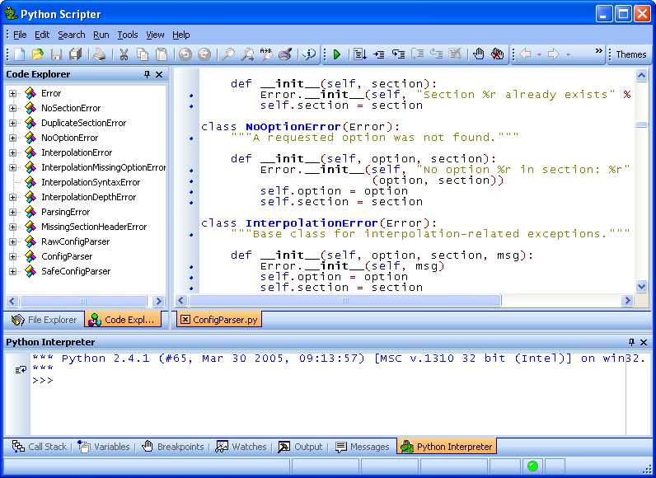
Pyscripter
More popular than IDL
Has code completion
Has debugging
https://sourceforge.net/projects/pyscripter/

Slide 10
Others
PyCharm
Eclipse
Visual Studio
Wing IDE
Spyder
Top 10 Python IDEs: http://noeticforce.com/best-python-ide-for-programmers-windows-and-mac

Slide 11
Getting Help

Slide 12
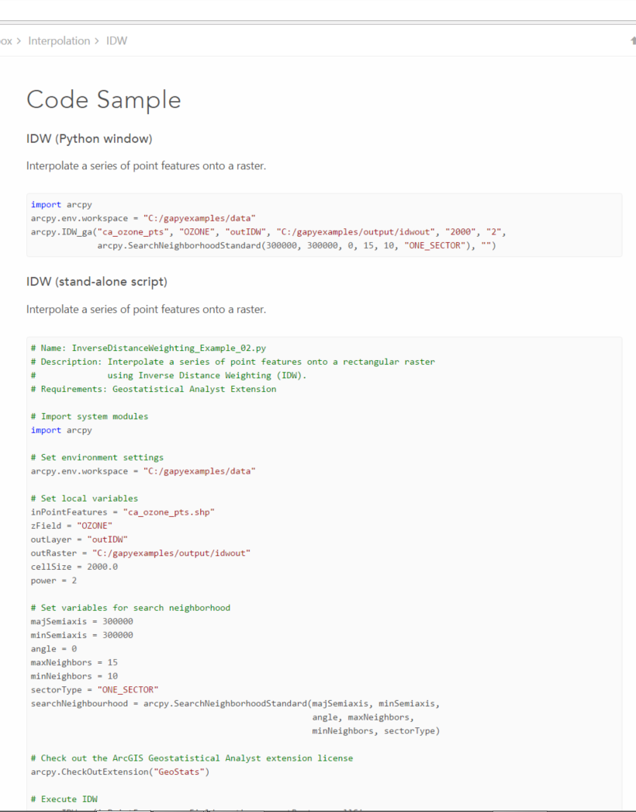
Arcgis.com

Slide 13
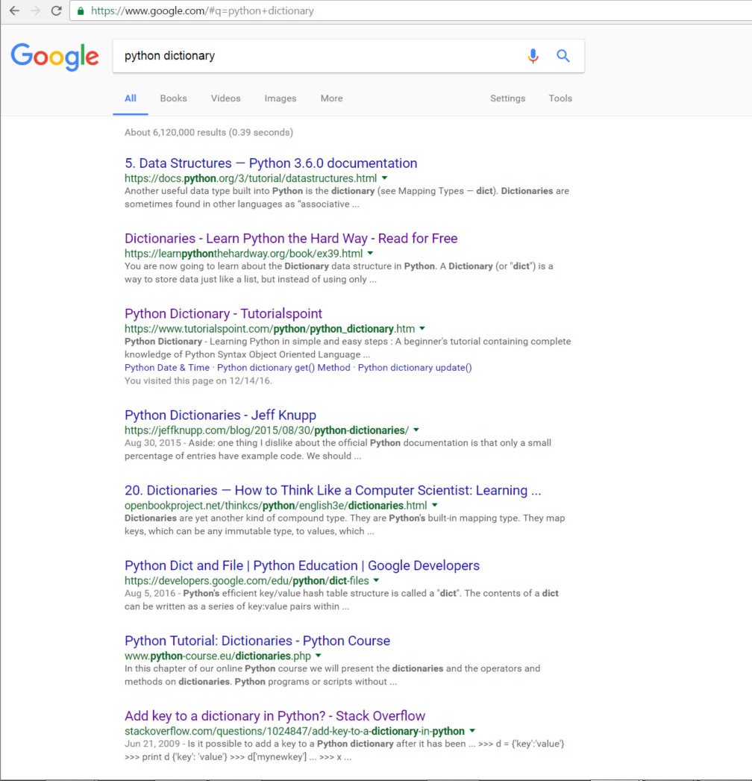
Google!
For example, Google “Python dictionary”

Slide 14
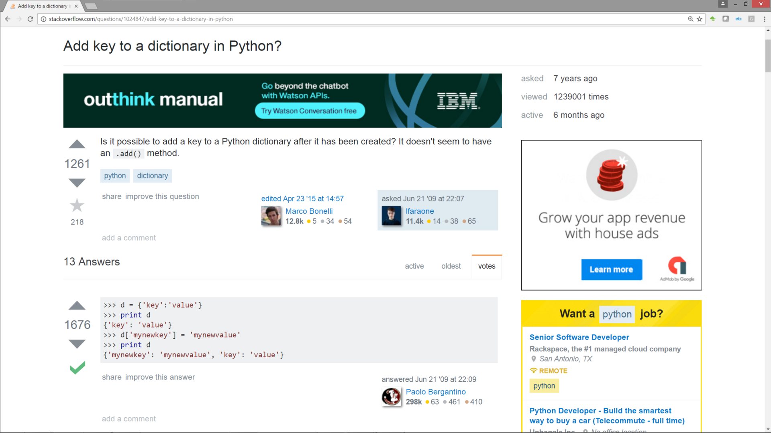
Stack Overflow

Slide 15
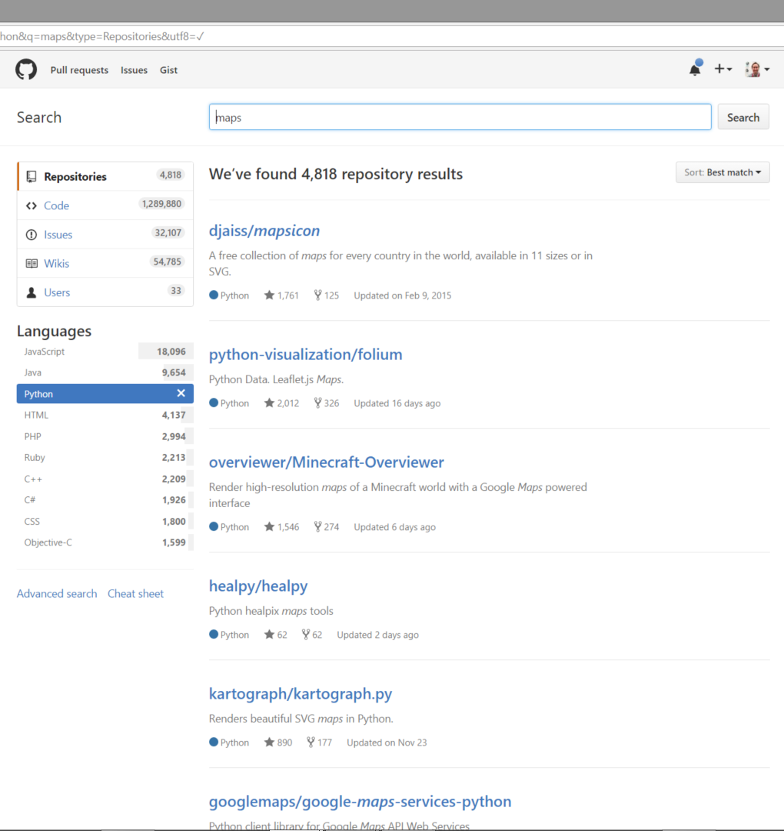
GitHub

Slide 16
Open Your IDE; Let’s Get Started!

