Slide 1
Week 8
Gregory Brunner

Slide 2
This Week
Practical Coding Advice
Functions
Debugging
Using the IDE
Using Try-Except

Slide 3
Practical Coding Advice

Slide 4
Use “print” statements!
Print out things like:
Variables
Files and paths
When a process finishes
The amount of time a process takes
Similarly, use arcpy.AddMessage() to add print statements to tools

Slide 5
Let your compiler yell at you!
http://www.pgbovine.net/c-programming-tips.htm#compiler-warnings
When a program fails, you want it to fail loudly
Don’t use try-except statements until your code works. Try-except statements can mask the real issues.

Slide 6
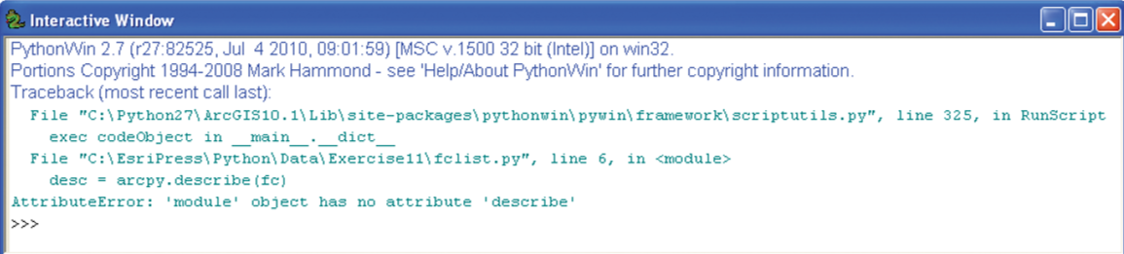
Learn to read compiler error messages
First thing to notice: what line of code the tool failed on.
From there, think about what the most likely source of error is

Slide 7
Functions

Slide 9
Debugging

Slide 10
Common Python Code Errors
Spelling mistakes
Forgetting to import modules
Case sensitivity
Paths
Forgetting colons (:) on if-else statements and loops
Incorrect or inconsistent indentation

Slide 11
Debugging Tips and Tricks
Remember, ArcGIS puts a lock on files that are in use
When working with large files, test code on a small sample of data
Use “print” statements ☺

Slide 12
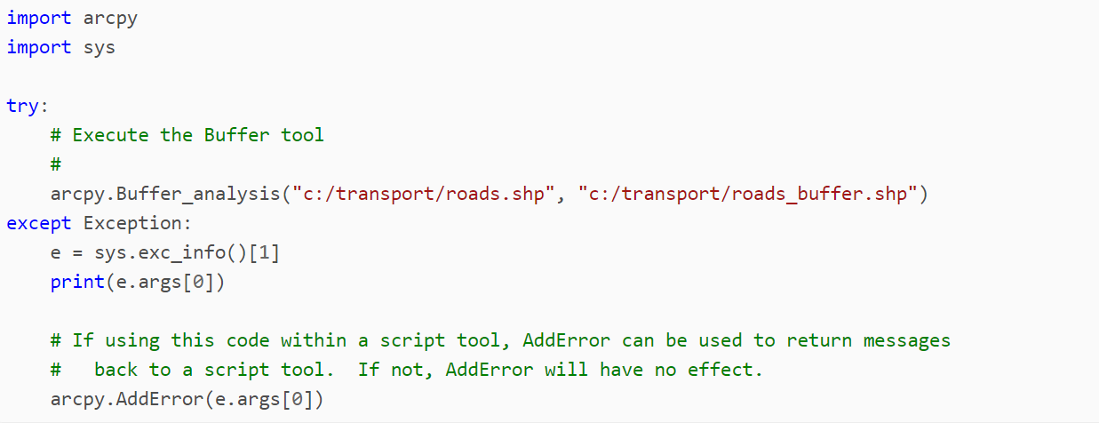
Exceptions
Try-except – Way to gracefully handle errors
http://pro.arcgis.com/en/pro-app/arcpy/get-started/error-handling-with-python.htm
If interested in learning, look at the Debugging Exercise!

Slide 13
Example – How I Use Try-Except

