Slide 1
ArcPy Geometry Objects and JSON
Gregory Brunner

Slide 2
Schedule
This week (Week 7)
Project 1 Due
ArcPy Geometries and JSON
Next Week - March 7
Script Tools
Python Toolboxes
Final Project Proposal Due
Homework
Spring Break – March 14

Slide 3
ArcPy Geometry Objects
We can perform spatial operations directly on geometries on a feature class
Buffer
DistanceTo
Clip
Contains

Slide 4
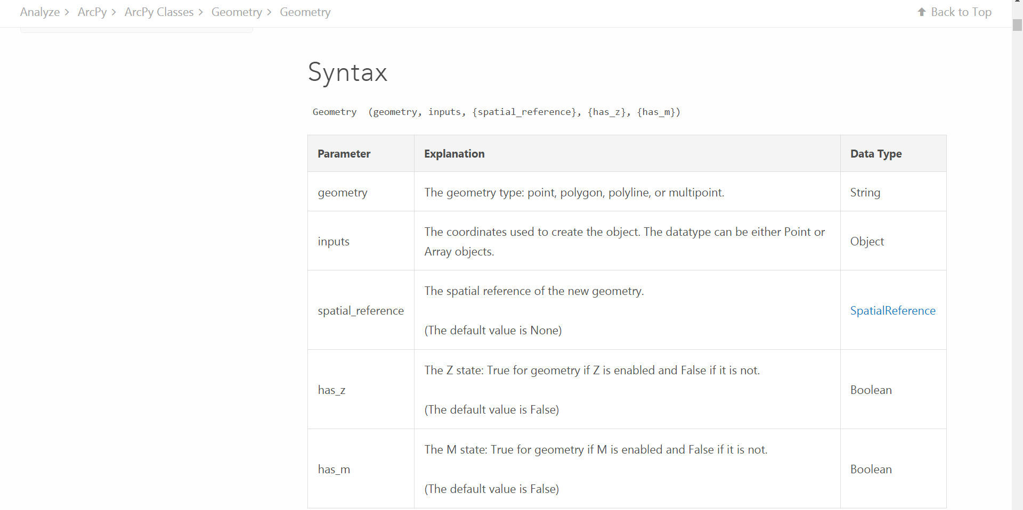
Geometry Class
http://desktop.arcgis.com/en/arcmap/10.3/analyze/arcpy-classes/geometry.htm

Slide 5
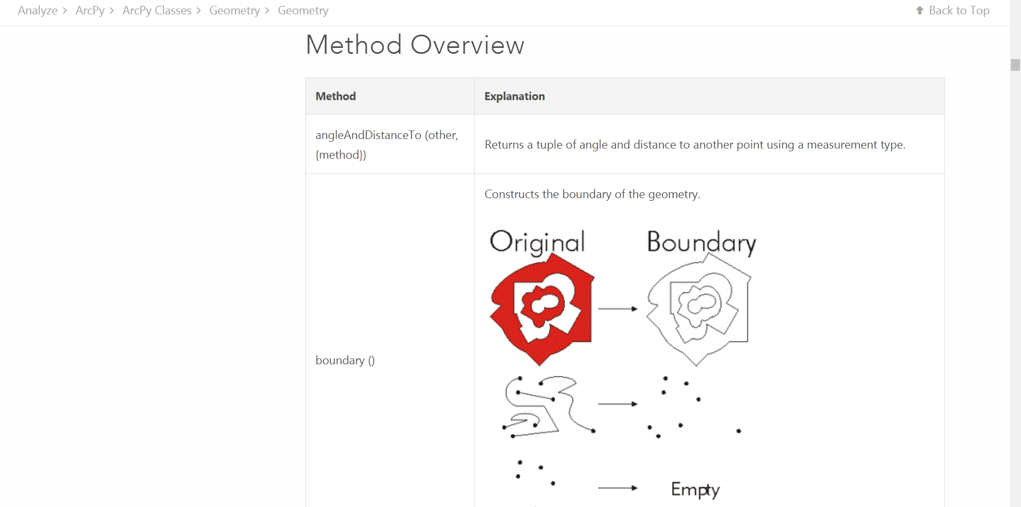
Geometry Methods
http://desktop.arcgis.com/en/arcmap/10.3/analyze/arcpy-classes/geometry.htm#M1_GUID-BC466D06-360C-42BD-B198-DA4139B45F49

Slide 6
ArcPy Geometry Demo

Slide 7
JSON

Slide 8
JSON – JavaScript Object Notation
Format for sending a receiving data between server and browser
Common format for transacting data on web
A format, not a standard
The format that data is in when it’s pushed to your browser

Slide 9
Examples
NBA.com
Yahoo Sports
UNHCR - http://data.unhcr.org/wiki/index.php/Get-stats-mediterranean-monthly-arrivals-by-country.html

Slide 10
JSON Demo

Slide 11
This week (Week 7)
Toms Chapter 6, pages 95 – 105.
Stop at dataDic[stopid] = shape.buffer…
Watch out for syntax errors in this chapter
>> indicates run at command line
Exercise 2 – JSON tutorial in Week 7 Folder
Submit the Homework question at the end of the exercise into the Week 7 Homework folder.

